Slide 1
Computer Vision – TP9 Active Contours
Miguel Tavares Coimbra
Acknowledgement: Slides adapted from Kristen Grauman

Slide 2
Outline
Introduction to Active Contours
Energy functions
Energy minimization

Slide 3
Topic: Introduction to Active Contours
Introduction to Active Contours
Energy functions
Energy minimization

Slide 4
Active Contours
Given: initial contour (model) near desired object

Slide 5
Active Contours
Goal: evolve the contour to fit exact object boundary
How?
Reward solutions next to high image gradients
Punish solutions that deform shape too much
Iteratively find the ‘best’ solution to these requirements

Slide 6
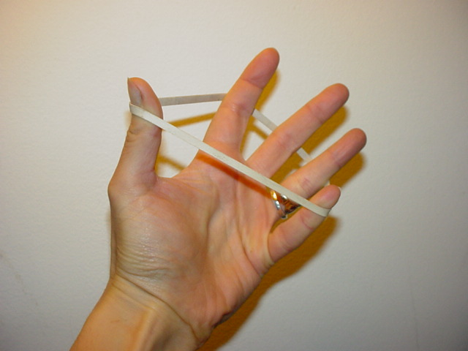
Intuition - Elastic Band
Contour evolves to a low-energy solution, but is hindered by obstacles
Better intuition: Gravity
Contour is ‘attracted’ to specific image features
Contour resists to any deformation of its shape

Slide 7
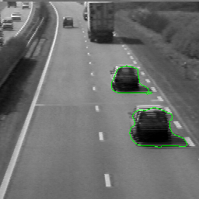
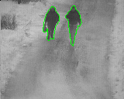
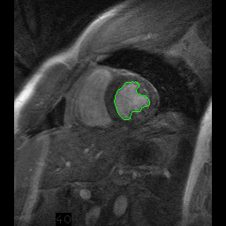
Strong motivation – Moving deformable objects

Slide 8
Things we need to consider
Representation of the contours
Defining the energy functions
External
Internal
Minimizing the energy function

Slide 9
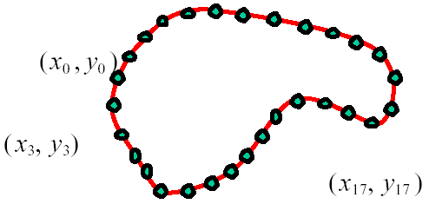
Representation
We’ll consider a discrete representation of the contour, consisting of a list of 2d point positions (“vertices”)
At each iteration, we’ll have the option to move each vertex to another nearby location (“state”)
for

Slide 10
Topic: Energy functions
Introduction to Active Contours
Energy functions
Energy minimization

Slide 11
Energy function
The total energy (cost) of the current snake is defined as:
External energy: encourage contour to fit on places where specific image structures exist
Internal energy: encourage prior shape preferences
A good fit between the current deformable contour and the target shape in the image will yield a low value for this cost function
$$E_{total}=E_{external}+E_{internal}$$

Slide 12
External image energy
Magnitude of gradient
- (Magnitude of gradient)

Slide 13
External image energy
Gradient images and
External energy at a point on the curve is:
External energy for the whole curve:

Slide 14
Internal energy
For a continuous curve, a common internal energy term is the “bending energy”
At some point v(s) on the curve, this is:
Tension,
Elasticity
Stiffness,
Curvature

Slide 15
Internal energy
For our discrete representation:
Internal energy for the whole curve:

Slide 16
Example: compare curvature
(2,5)
(2,2)
(3,1)
(1,1)
(3,1)
(1,1)
$$\left(3−2\left(2\right)+1\right)2+\left(1−2\left(5\right)+1\right)2$$
$$\left(3−2\left(2\right)+1\right)2+\left(1−2\left(2\right)+1\right)2$$
$$=\left(−8\right)2=64$$
$$=\left(−2\right)2=4$$

Slide 17
Penalizing elasticity
Current elastic energy definition uses a discrete estimate of the derivative:
This rewards very small shapes!
Instead -> Reward an ‘average distance d between pairs of points’

Slide 18
Total energy

Slide 19
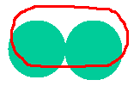
Energy weights
e.g., weight controls the penalty for internal elasticity
large
medium
small

Slide 20
Topic: Energy minimization
Introduction to Active Contours
Energy functions
Energy minimization

Slide 21
Recap: deformable contour
A simple elastic snake is defined by:
A set of n points,
An internal energy term (tension, bending, plus optional shape prior)
An external energy term (gradient-based)
To use this to segment an object:
Initialize in the vicinity of the object
Modify the points to minimize the total energy

Slide 22
Energy minimization: greedy
For each point, search window around it and move to where energy function is minimal
Typical window size, e.g., 5 x 5 pixels
Stop when predefined number of points have not changed in last iteration, or after max number of iterations
Note:
Convergence not guaranteed
Need decent initialization

Slide 23
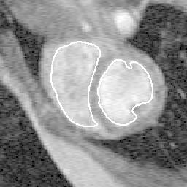
Tracking via deformable contours
Use final contour/model extracted at frame t as an initial solution for frame t+1
Evolve initial contour to fit exact object boundary at frame t+1
Repeat, initializing with most recent frame
Tracking Heart Ventricles
(multiple frames)

Slide 24
Deformable contours: pros and cons
Pros:
Useful to track and fit non-rigid shapes
Contour remains connected
Possible to fill in “subjective” contours
Flexibility in how energy function is defined, weighted.
Cons:
Must have decent initialization near true boundary, may get stuck in local minimum
Parameters of energy function must be set well based on prior information

Slide 25
Resources
Szeliski, “Computer Vision: Algorithms and Applications”, Springer, 2011
Chapter 5 – “Segmentation”

