Slide 1
Computer Vision – TP8
Statistical Classifiers
Miguel Coimbra, Francesco Renna

Slide 2
Outline
Statistical Classifiers
Support Vector Machines
Neural Networks

Slide 3
Topic: Statistical Classifiers
Statistical Classifiers
Support Vector Machines
Neural Networks

Slide 4
Statistical PR
I use statistics to make a decision
  I can make decisions even when I don’t have full a priori knowledge of the whole process
  I can make mistakes
How did I recognize this pattern?
  I learn from previous observations where I know the classification result
  I classify a new observation

Slide 5
Features
Feature F_{i}
Feature F_{i} with N values.
Feature vector F with M features.
Naming conventions:
  Elements of a feature vector are called coefficients
  Features may have one or more coefficients
  Feature vectors may have one or more features

Slide 6
Classifiers
A Classifier C maps a class into the feature space
Various types of classifiers
  Nearest-Neighbours
  Support Vector Machines
  Neural Networks
  Etc...

Slide 7
Distance to Mean
I can represent a class by its mean feature vector
To classify a new object, I choose the class with the closest mean feature vector
Different distance measures!
Euclidean Distance

Slide 8
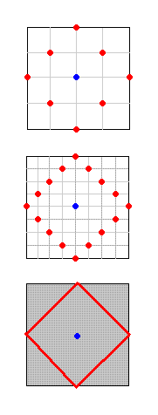
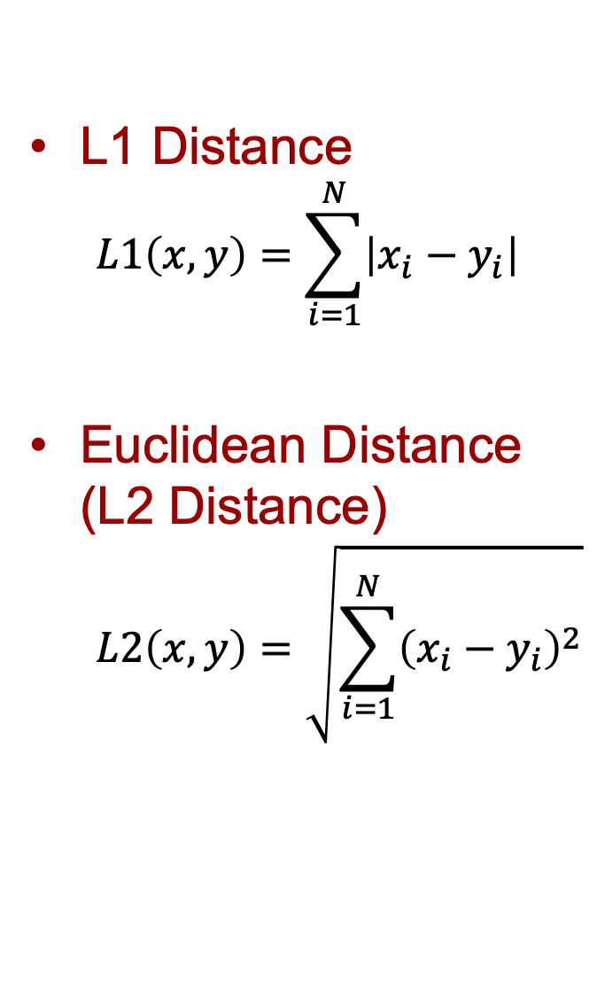
Possible Distance Measures
L1 Distance
  $$L1\left(x,y\right)=\sum_{i=1}^{N}{\left|x_{i}−y_{i}\right|}$$
Euclidean Distance (L2 Distance)
  $$L2\left(x,y\right)=\sqrt{\sum_{i=1}^{N}{{\left(x_{i}−y_{i}\right)}^{2}}}$$
L1 or Taxicab Distance

Slide 9
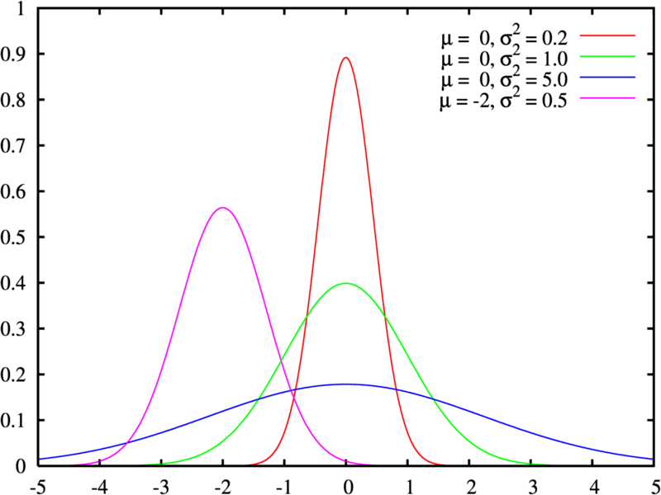
Gaussian Distribution
Defined by two parameters:
  Mean: μ
  Variance: σ²
Great approximation to the distribution of many phenomena.
  Central Limit Theorem

Slide 10



Multivariate Distribution
For N dimensions:
Mean feature vector:
Covariance Matrix:

Slide 11
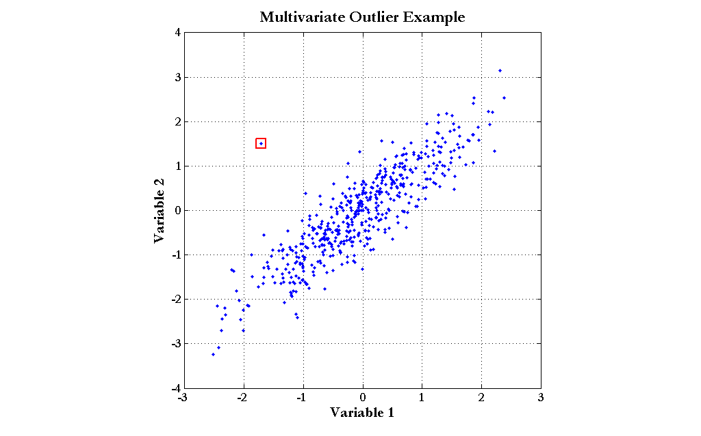
Mahalanobis Distance
Based on the covariance of coefficients
Superior to the Euclidean distance

Slide 12
Generalization
Classifiers are optimized to reduce training errors
  (supervised learning): we have access to a set of training data for which we know the correct class/answer
What if test data is different from training data?

Slide 13
Underfitting and Overfitting
Is the model too simple for the data?
  Underfitting: cannot capture data behavior
Is the model too complex for the data?
  Overfitting: fit perfectly training data, but will not generalize well on unseen data

Slide 14
Bias and variance
Bias
  Average error in predicting correct value
Variance
  Variability of model prediction
High bias
Low bias, low variance
High variance

Slide 15
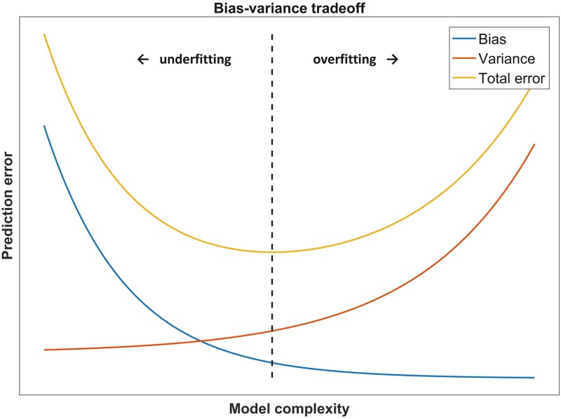
Bias-variance tradeoff
total err = bias² + variance + irreducible err

Slide 16
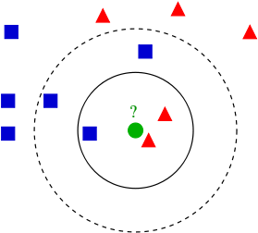
K-Nearest Neighbours
Algorithm
  Choose the closest K neighbours to a new observation
  Classify the new object based on the class of these K objects
Characteristics
  Assumes no model
  Does not scale very well...

Slide 17
Topic: Support Vector Machines
Statistical Classifiers
Support Vector Machines
Neural Networks

Slide 18
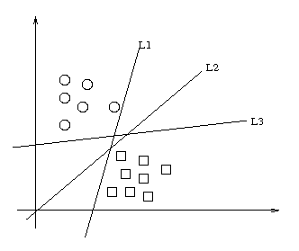
Maximum-margin hyperplane
There are many planes that can separate our classes in feature space
Only one maximizes the separation margin
Of course that classes need to be separable in the first place...

Slide 19
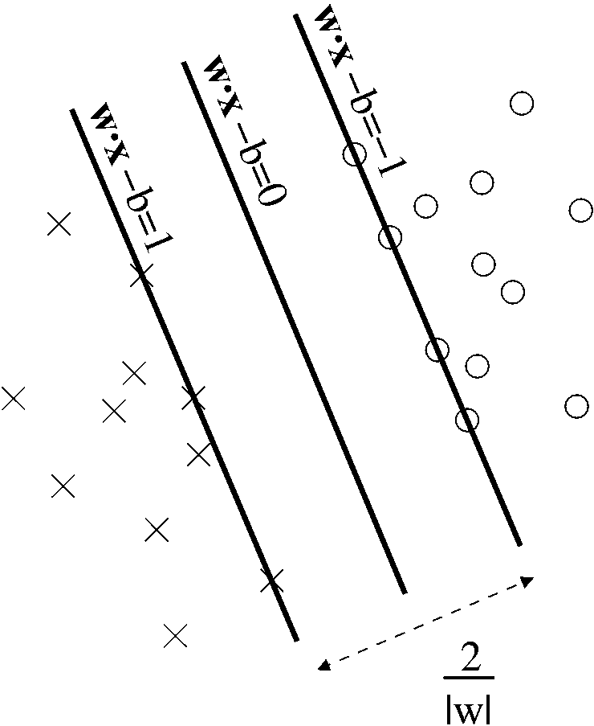
Support vectors
The maximum-margin hyperplane is limited by some vectors
These are called support vectors
Other vectors are irrelevant for my decision

Slide 20
Decision
I map a new observation into my feature space
Decision hyperplane:
Decision function:
A vector is either above or below the hyperplane

Slide 21
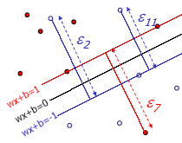
Slack variables
Most feature spaces cannot be segmented so easily by a hyperplane
Solution:
  Use slack variables
  ‘Wrong’ points ‘pull’ the margin in their direction
  Classification errors!

Slide 22

But this doesn’t work in most situations...
Still, how do I find a Maximum-margin hyperplane for some situations?
Most real situations face this problem...

Slide 23
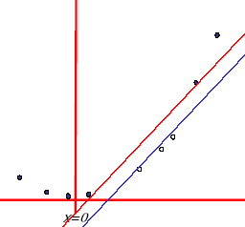
Solution: Send it to hyperspace!
Take the previous case: f(x) = x
Create a new higher-dimensional function: g(x) = (x, x²)
A kernel function is responsible for this transformation
https://www.youtube.com/watch?v=3liCbRZPrZA

Slide 24
Typical kernel functions
Linear
Polynomial
Radial-Base Functions
Sigmoid

Slide 25
Classification
Training stage:
  Obtain kernel parameters
  Obtain maximum-margin hyperplane
Given a new observation:
  Transform it using the kernel
  Compare it to the hyperspace

Slide 26
Topic: Neural Networks
Statistical Classifiers
Support Vector Machines
Neural Networks

Slide 27
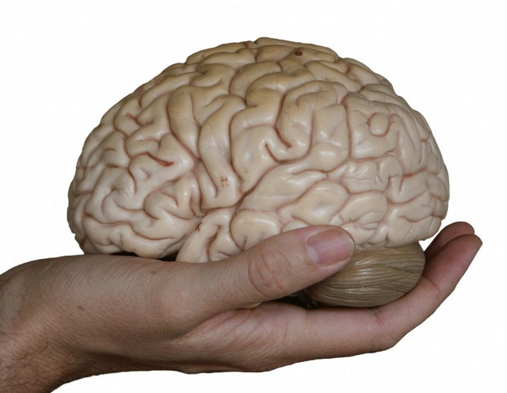
If you can’t beat it.... Copy it!
http://managementcraft.typepad.com/photos/uncategorized/brain.jpg

Slide 28
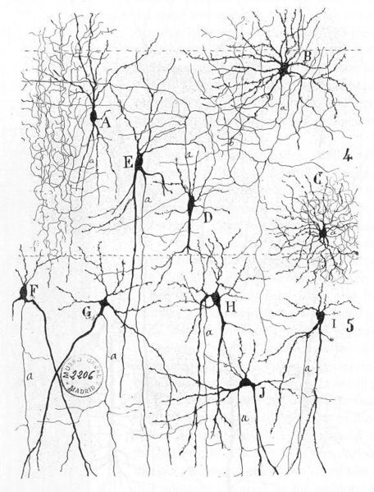
Biological Neural Networks
Neuroscience:
  Population of physically inter-connected neurons
Includes:
  Biological Neurons
  Connecting Synapses
The human brain:
  100 billion neurons
  100 trillion synapses

Slide 29
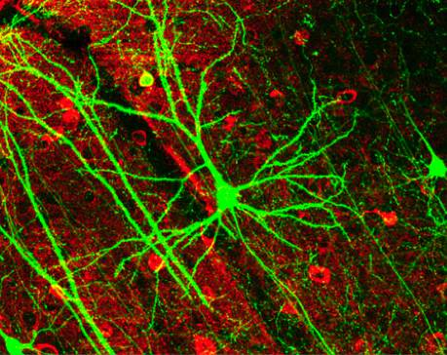
Biological Neuron
Neurons:
  Have K inputs (dendrites)
  Have 1 output (axon)
  If the sum of the input signals surpasses a threshold, sends an action potential to the axon
Synapses
  Transmit electrical signals between neurons

Slide 30
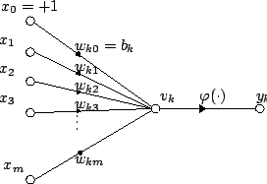

Artificial Neuron
Also called the McCulloch-Pitts neuron
Passes a weighted sum of inputs, to an activation function, which produces an output value
McCulloch, W. and Pitts, W. (1943). A logical calculus of the ideas immanent in nervous activity. Bulletin of Mathematical Biophysics, 7:115 - 133.

Slide 31
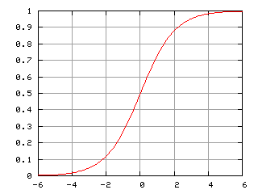
Sample activation functions
Rectified Linear Unit (ReLU)
Sigmoid function

Slide 32
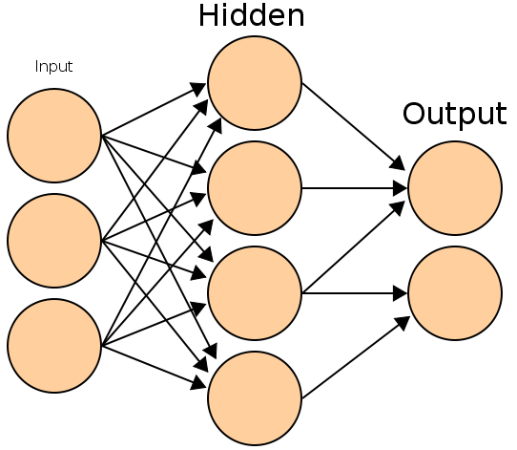
Artificial Neural Network
Commonly refered as Neural Network
Basic principles:
  One neuron can perform a simple decision
  Many connected neurons can make more complex decisions

Slide 33
Characteristics of a NN
Network configuration
  How are the neurons inter-connected?
  We typically use layers of neurons (input, output, hidden)
Individual Neuron parameters
  Weights associated with inputs
  Activation function
  Decision thresholds
How do we find these values?

Slide 34
Learning paradigms
We can define the network configuration
How do we define neuron weights and decision thresholds?
  Learning step
  We train the NN to classify what we want
Different learning paradigms
  Supervised learning
  Unsupervised learning
  Reinforcement learning
Appropriate for Pattern Recognition.

Slide 35
Learning
We want to obtain an optimal solution given a set of observations
A cost function measures how close our solution is to the optimal solution
Objective of our learning step:
  Minimize the cost function
Backpropagation Algorithm

Slide 36
In formulas
Network output:
Training set:
Optimization: find such that
It is solved with (variants of) the gradient descent, where gradients are computed via the backpropagation algorithm
input
label

Slide 37
Losses
They quantify the distance between the output of the network and the true label, i.e., the correct answer
Classification problems:
  The output (obtained usually with softmax) is a probability distribution
  Loss-function: cross-entropy. It is defined in terms of the Kullback-Leibler distance between probability distributions
Regression problems:
  The output is a scalar or a vector of continuous values (real or complex)
  Loss-function: mean-squared error. It is the distance associated with the L2-norm

Slide 38
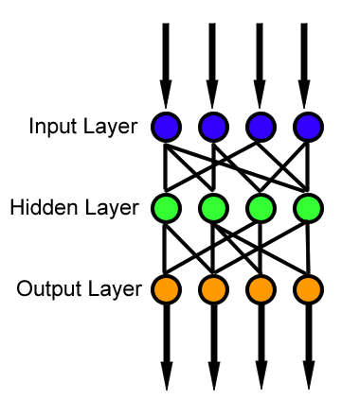
Feedforward neural network
Simplest type of NN
Has no cycles
Input layer
  Need as many neurons as coefficients of my feature vector
Hidden layers
Output layer
  Classification results

Slide 39
Resources
Andrew Moore, “Statistical Data Mining Tutorials”, http://www.cs.cmu.edu/~awm/tutorials.html
C.J. Burges, “A tutorial on support vector machines for pattern recognition”, in Knowledge Discovery Data Mining, vol.2, no.2, 1998, pp.1-43.

