Slide 1
SIntS 13/14
Course Projects
Mestrado em Informática Médica
Miguel Tavares Coimbra

Slide 2
Details on course projects
Group project:
  Group size: 3-4 students
Main component:
  Written report – 100%
Support component:
  Public presentation – Can improve the evaluation of the written report on specific sections

Slide 3
Scenario for this work
You have a small company that does HCI design and implementation.
I have a big company that needs an HCI task and has money to ‘buy it’.
Your course project is to provide a solid proposal that will make me buy the HCI solution from your company.
  How is this proposal?

Slide 4
Proposal - Report
You need to convince me to invest in your solution.
First: Write a report where you have studied the problem and propose a solution:
  What is the objective of the work, the available technology, and who are the end-users?
  Given this, what are my ‘killer ideas’?

Slide 5
Proposal – Prototype
I am hard to convince!
Second: Produce a prototype that convinces me that your ‘killer ideas’ will work!
  It is not a finished product
  Needs to demonstrate that the HCI is adequate
  We will use Balsamiq

Slide 6
Summing up – Project Details
Sell me your solution
  Report – Pdf File
  Prototype
    Balsamiq
Questions?

Slide 7
Project topics
I will give you some possible topics for your course project
You can suggest your own topics, but I need to validate them
Characteristics of a topic:
  Has well defined target users, objectives and available technology
  Can be prototyped using JAVA, Balsamiq or other available technologies

Slide 8
Topic 1: e-Learning for medicine
What if medicine students can learn and train how to use medical devices at home?
  Auscultation, ECG, Ultrasound, EEG?
What about other professionals?
  Sports medicine? Nurses? Others?
Build a effective interactive system that can be used in an e-learning environment:
  Learn the mechanical gesture of the exam;
  Learn the perception and interpretation of the exam;
As transparently as possible!

Slide 9
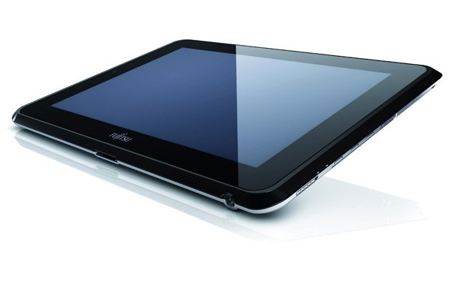
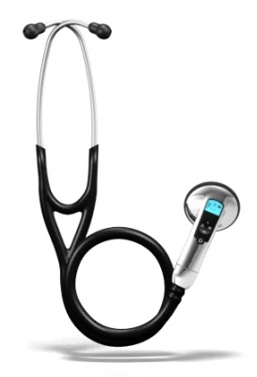
Auscultation

Slide 10
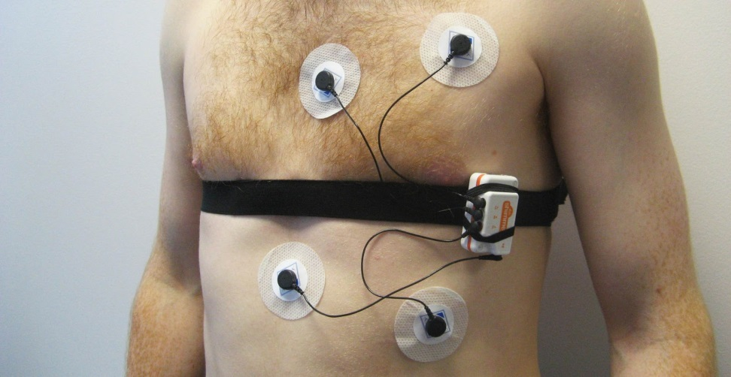
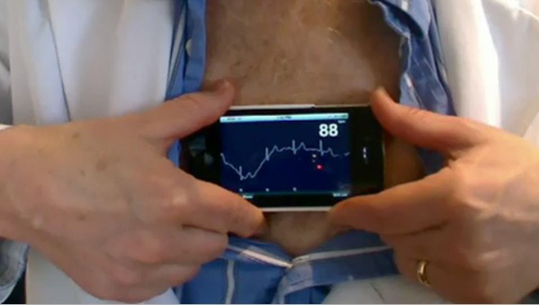
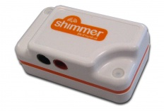
ECG, Ultrassound, EEG

Slide 11
Details
Objective:
  Build an interactive system for e-learning and training of medical exams that require devices
Target user:
  Medicine students, sports medicine, nurses, others
Available technology:
  Web, cheap devices

Slide 12
Topic 2: Telemedicine at home
Can we monitor people in their homes if a medical professional visits them using an interactive system?
Build an effective interactive system that can be used by a medical professional to:
  Gather, record, transmit relevant vital signs;
  Enables remote contact with a medical specialist.

Slide 13
Telemedicine

Slide 14
Details
Objective:
  Build an interactive system for collecting vital signs from patients in their homes, enabling remote contact with specialists
Target user:
  Nurses
Available technology:
  Tablet

Slide 15
Topic 3: Listen
Sounds in the Neurosurgical Operating Room
  Noisy environment
  Demand for constant attention
Build an interactive system to:
  Visualize and collect heart sounds
    Doppler
  View important information retrieved from the signals
  Screen for embolism and alert to critical events

Slide 16
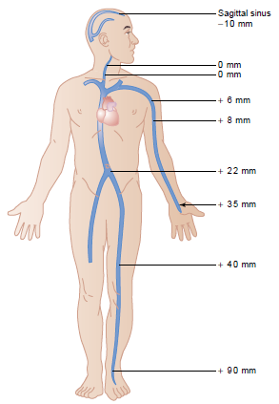

Sounds in the OR
LISTEN
Heart Auscultation
Arterial Pressure
Doppler Sound
Embolism
Alarms
OR Noisy Environment
Doppler
Auscultation

Slide 17
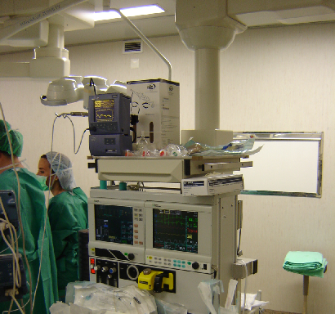

Details
Objective:
  Build an interactive system to visualize data and provide alarms based on heart sounds
Target user:
  Anesthesiologists
Available technology:
  PC

Slide 18
Summing up – Project Topics
Various different proposed topics.
No problem if several groups choose the same topic.
If you don’t like them feel free to propose one!
  Problem? Technology? Target users?
  Each new topic needs my validation!

Slide 19
Discussion
Create groups TODAY! (compulsory).
Choose / Propose a topic next week.
Questions?

