Slide 1
SM 14/15 – T8 Computer Graphics and Animation
LCC, MIERSI
Miguel Tavares Coimbra

Slide 2
(Some) Pieces of the Puzzle
Image creators (3D -> 2D)
Camera (T4)
Computer Graphics (Today)
Image manipulators (2D -> 2D)
Image Processing (T4)
Image displays (2D -> ?)
2D Screen
3D Virtual Reality (T7)

Slide 3
How do we get 2D images of a real 3D world?

Slide 4
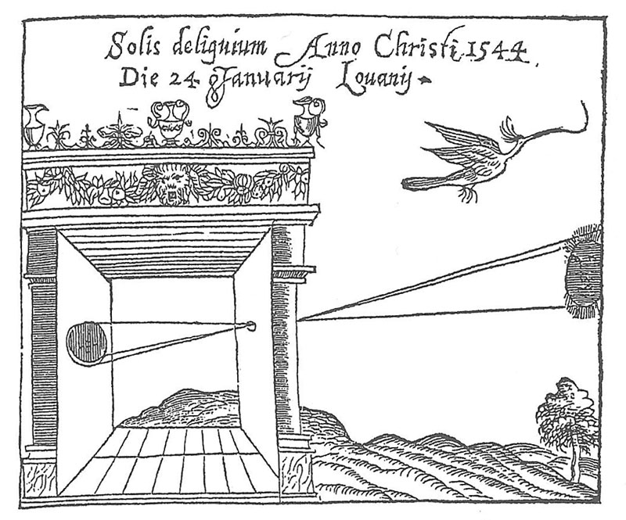
Camera Obscura, Gemma Frisius, 1544

Slide 5
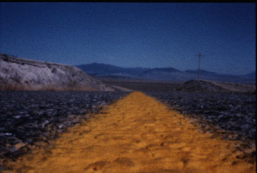

Slide 6
How do we get 2D images of a real synthetic 3D world?

Slide 7
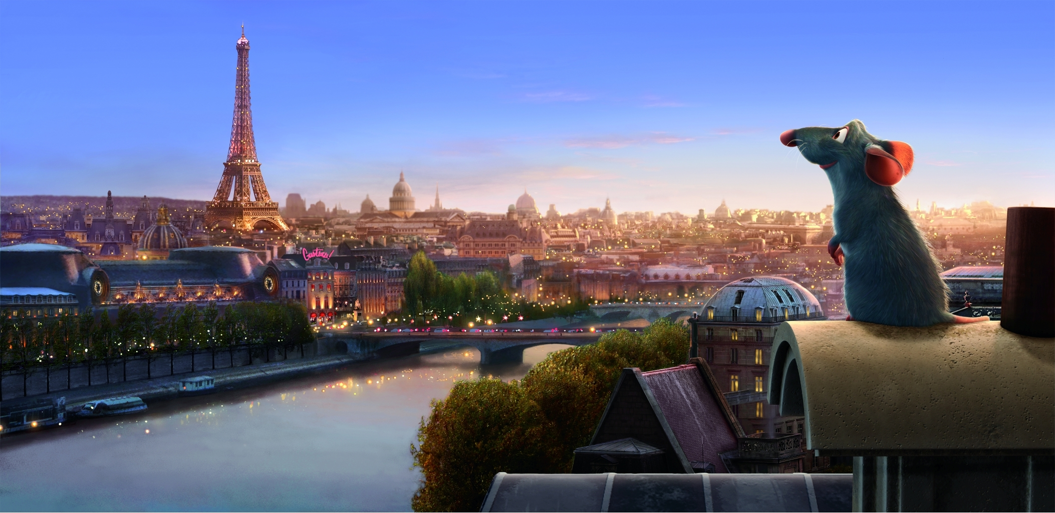
transformation + shading + texture + blending
© pixar

Slide 8
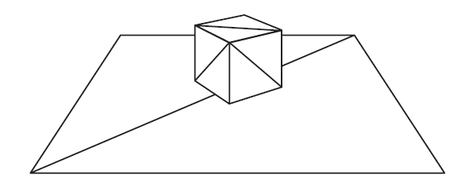
Projected 3D World
wireframe

Slide 9
Rasterization
filling with colors

Slide 10
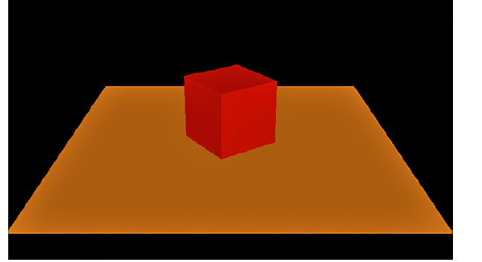
Shading
Varing the color values across the surface (between vertices). Create the effect of light shining on a red cube

Slide 11
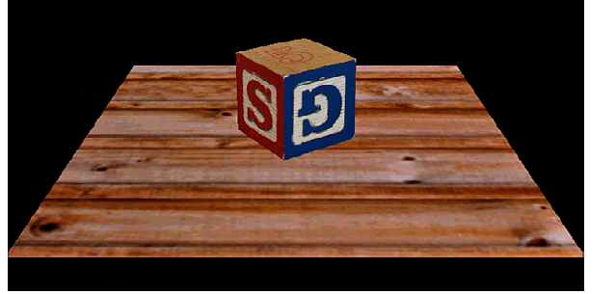
Texture Mapping
A picture that we map to the surface of a triangle or polygon. A texture can simulate an effect that could take thousands of triangles

Slide 12
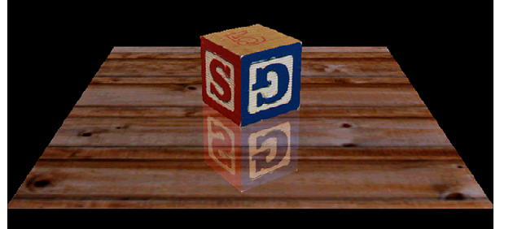
Blending
Allows mixing different colors together. e.g. create reflections

Slide 13
Basic steps for creating a 2D image out of a 3D world
Create the 3D world
Vertexes and triangles in a 3D space
Project it to a 2D ‘camera’
Use perspective to transform coordinates into a 2D space
Paint each pixel of the 2D image
Rasterization, shading, texturing
Will break this into smaller things later on
Enjoy the super cool image you have created

Slide 14
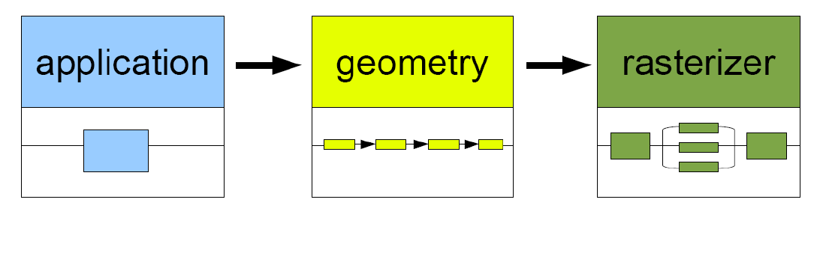
Pipeline
. collision detection
. animation global acceleration
. physics simulation
process on CPU or GPU
. transformation
. projection
Computes:
. what is to be drawn
. how should be drawn
. where should be drawn
process on GPU
. draws images generated by
geometry stage
process on GPU

Slide 15
Geometry

Slide 17
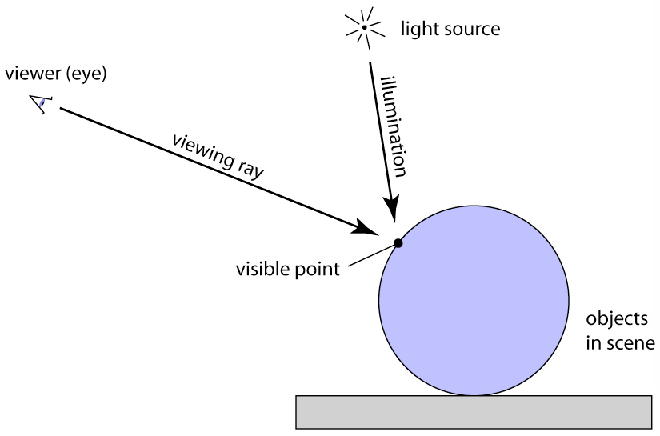
One possibility: Ray tracing
for each pixel {
compute viewing ray
intersect ray with scene
compute illumination at visible point
put result into image
}
Adapted from Steve Marschner, Cornell University

Slide 18
Another one: Projection
Adapted from Steve Marschner, Cornell University

Slide 19
Ray tracing vs. Projection
Viewing in ray tracing
start with image point
compute ray that projects to that point
do this using geometry
Viewing by projection
start with 3D point
compute image point that it projects to
do this using transforms
Inverse processes
ray gen. computes the preimage of projection
Adapted from Steve Marschner, Cornell University

Slide 20
Representing Geometric Objects
Geometric objects are represented using vertices
A vertex is a collection of generic attributes
positional coordinates
colors
texture coordinates
any other data associated with that point in space
Position stored in 4 dimensional homogeneous coordinates
Vertex data must be stored in vertex buffer objects (VBOs)
VBOs must be stored in vertex array objects (VAOs)
Slide by Ed Angel, Siggraph 2012
Notes:
In OpenGL, as in other graphics libraries, objects in the scene are composed of geometric primitives, which themselves are described by vertices. A vertex in modern OpenGL is a collection of data values associated with a location in space. Those data values might include colors, reflection information for lighting, or additional coordinates for use in texture mapping. Locations can be specified on 2, 3 or 4 dimensions but are stored in 4 dimensional homogeneous coordinates.
Vertices must be organized in OpenGL server-side objects called vertex buffer objects (also known asVBOs), which need to contain all of the vertex information for all of the primitives that you want to draw at one time. VBOs can store vertex information in almost any format (i.e., an array-of-structures (AoS) each containing a single vertex’s information, or a structure-of-arrays (SoA) where all of the same “type” of data for a vertex is stored in a contiguous array, and the structure stores arrays for each attribute that a vertex can have). The data within a VBO needs to be contiguous in memory, but doesn’t need to be tightly packed (i.e., data elements may be separated by any number of bytes, as long as the number of bytes between attributes is consistent).
VBOs are further required to be stored in vertex array objects (known as VAOs). Since it may be the case that numerous VBOs are associated with a single object, VAOs simplify the management of the collection of VBOs.

Slide 21
Pipeline of transformations
Adapted from Steve Marschner, Cornell University

Slide 23
Projections

Slide 24
Classical projections
Adapted from Steve Marschner, Cornell University

Slide 25
Parallel Projection
Adapted from Steve Marschner, Cornell University

Slide 26
Multiview orthographic
Adapted from Steve Marschner, Cornell University

Slide 27
View volume: Orthographic
Adapted from Steve Marschner, Cornell University

Slide 28
View volume: Perspective
Adapted from Steve Marschner, Cornell University

Slide 29
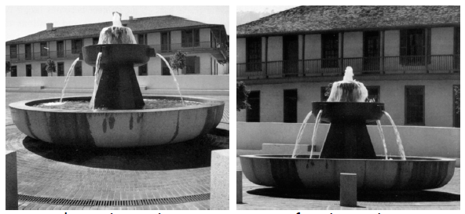
Field of view
Angle between the rays corresponding to opposite edges of a perspective image
Determines ‘strength’ of perspective effects
Adapted from Steve Marschner, Cornell University

Slide 30
Adapted from Steve Marschner, Cornell University

Slide 31
Adapted from Steve Marschner, Cornell University

Slide 32
Orthographic projection
Adapted from Steve Marschner, Cornell University

Slide 33
What about the view volume?
Adapted from Steve Marschner, Cornell University

Slide 34
What about the z direction?
Two clipping planes further constrain the view volume
Near plane: parallel to view plane; things between it and the viewpoint will not be rendered
Far plane: also parallel; things behind it will not be rendered
Adapted from Steve Marschner, Cornell University

Slide 35
Orthographic transformation chain
Adapted from Steve Marschner, Cornell University

Slide 36
View volume: Perspective (clipped)
Adapted from Steve Marschner, Cornell University

Slide 37
Perspective transformation chain
Adapted from Steve Marschner, Cornell University

Slide 38
Summary: Projection
Different types of projection
Orthographic
Perspective
Integrate nicely into the transformation chain
Other elements:
Viewing transform
Viewport transform

Slide 39
Rasterization

Slide 40
Basic steps for creating a 2D image out of a 3D world
Create the 3D world
Vertexes and triangles in a 3D space
Project it to a 2D ‘camera’
Use perspective to transform coordinates into a 2D space
Paint each pixel of the 2D image
Rasterization, shading, texturing
Will break this into smaller things later on
Enjoy the super cool image you have created

Slide 41
Rasterization
rasterization:
wireframe
filling with colors

Slide 42
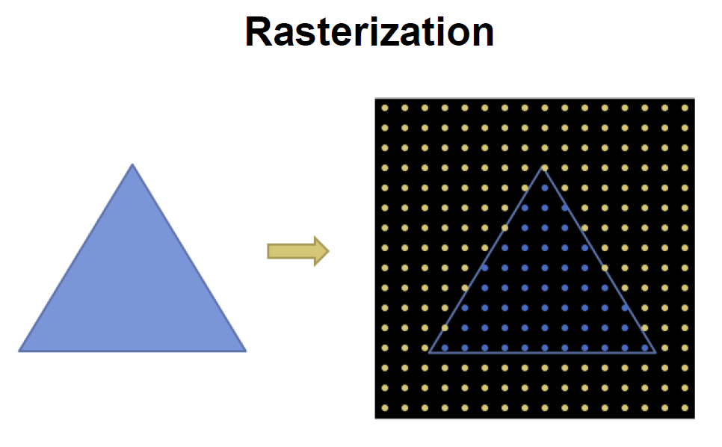
Slide by Ron Fedkiw, Stanford University

Slide 43
Primitives
Only three!
Points
Line segments
Triangles
How do I rasterize them?
Points are simple
Lines?
Triangles?

Slide 44
Rasterizing lines
Lines are defined by two points
Projected into my 2D screen from my 3D world
Consider it a rectangle
So that it occupies a non-zero area
Adapted from Steve Marschner, Cornell University

Slide 45
Bresenham lines (midpoint alg.)
Idea:
Define line width parallel to pixel grid
What does this mean?
Turn on the single nearest pixel in each column
Adapted from Steve Marschner, Cornell University

Slide 46
Interpolation along lines
We don’t want to simply know which pixels are on the line
Boolean
Vertexes hold attributes
Ex: Color
We want these to vary smoothly along the line
Linear interpolation
Adapted from Steve Marschner, Cornell University

Slide 47
Rasterizing triangles
Pixel belongs to the triangle if its center is inside the triangle
Need two things:
Which pixels belong to the triangle?
How do we interpolate values from 3 vertexes?
Adapted from Ron Fedkiw, Stanford University

Slide 48
Using directed lines
Point is inside the triangle if it is on the left of three directed lines
They could be on the right too…
How do we build a simple test for this?
Adapted from Ron Fedkiw, Stanford University

Slide 49
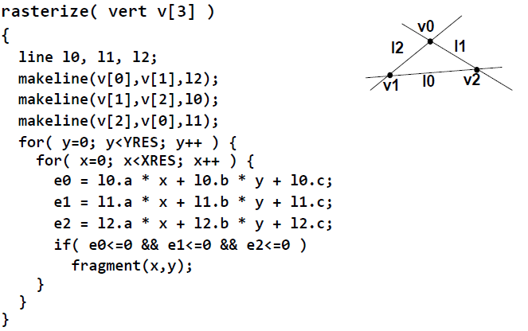
Point inside triangle test
Adapted from Ron Fedkiw, Stanford University

Slide 50
Illumination

Slide 51
Basic steps for creating a 2D image out of a 3D world
Create the 3D world
Vertexes and triangles in a 3D space
Project it to a 2D ‘camera’
Use perspective to transform coordinates into a 2D space
Paint each pixel of the 2D image
Rasterization, shading, texturing
Will break this into smaller things later on
Enjoy the super cool image you have created

Slide 52
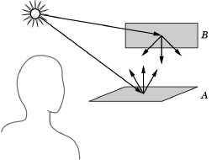
Illumination: main concepts
light sources emit light . color spectrum . position and direction
surfaces reflect light . reflectance . geometry . transmission . absortion
specular diffuse transparency

Slide 53
Illumination: main concepts
Illumination determined by the interaction of the light source + the surface

Slide 54
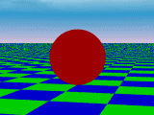
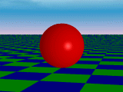
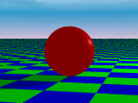
Illumination: types of lights
ambient
directional
point
Indirect
illumination
sun
light bulb

Slide 55
How does light interact with a surface?

Slide 56
Three types of interactions
Slide by Ron Fedkiw, Stanford University

Slide 57
Slide by Ron Fedkiw, Stanford University

Slide 58
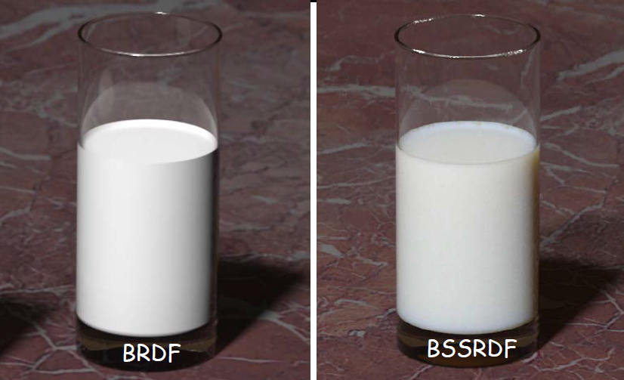
Paint vs. Milk
Slide by Ron Fedkiw, Stanford University

Slide 59
The lighting equation
Slide by Ron Fedkiw, Stanford University

Slide 60
How to colour a pixel?
Slide by Ron Fedkiw, Stanford University

Slide 61
Irradiance
Slide by Ron Fedkiw, Stanford University

Slide 62
some basics you MUST know
Types of Lights
1. Ambient
2. Diffuse
3. Specular
4. Emissive: color of a surface adds intensity to the object, but is unaffected by any light sources. Does not introduce any additional light into the overall scene.
day 1:
Images: http://xoax.net/comp/sci/graphics3D/BasLocIll.php

Slide 63
Ambient Light

Slide 64
ambient light
. light that doesn't come from any direction
. objects are evenly lit on all surfaces in all directions

Slide 65
ambient light
. has a source, but rays of light bounce around the scene and become directionless
ambient light source
R G B
.5 intensity .5 intensity .5 intensity
material "ambient" color (.5, 1, .5)

Slide 66
ambient light
. has a source, but rays of light bounce around the scene and become directionless
ambient light source
how do you calculate the ambient color component of an object?
R G B
.5 intensity .5 intensity .5 intensity
material "ambient" color (.5, 1, .5)

Slide 67
ambient light
. has a source, but rays of light bounce around the scene and become directionless
ambient light source
color vector (R,G,B) = (.25, .5, .25)
R G B
.5 intensity .5 intensity .5 intensity
.5*.5=.25 .5*1=.5 .5*.5=.25
material "ambient" color (.5, 1, .5)

Slide 68
Diffuse illumination

Slide 69
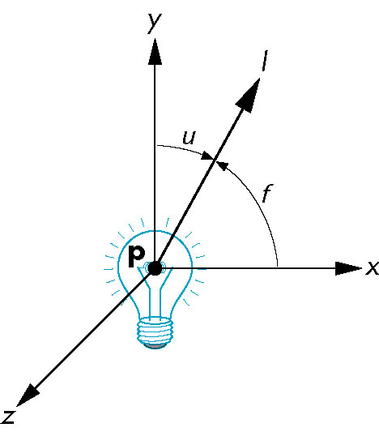
how can we create a light model?
I(x,y,z,θ,φ,λ)
. (x,y,z): light source
. (θ,φ): emition direction
. λ : light intensity

Slide 70
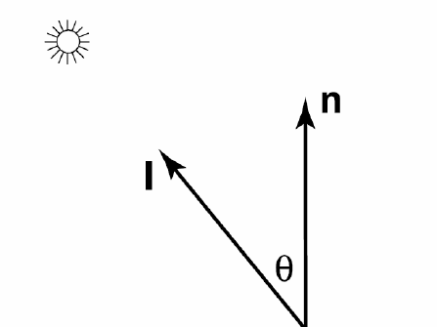
how can we create a light model?
measuring irradiance at a plane perpendicular to l tells us how bright the light is in general
i
p

Slide 71
how can we create a light model?
meassures the density of the rays
n
θ
d
d/cosθ
Irradiance is proportional to the density of the rays
Inversely proportional to the distance d between the rays
Since irradiance is inversely proportional to the distance d it is proportional to cos θ

Slide 72
Lambert's law
I = k I cos(θ ) = k I n·l
diffuse
d
light
d
light
I : light source intensity
k : surface reflectance coefficient in [0,1]
θ: light/normal angle
light

Slide 73
Illumination: components
phong
ambient + diffuse + specular = phong
reflection
other: blinn-phong, lambert, gouraud,...

Slide 74
Shading

Slide 75
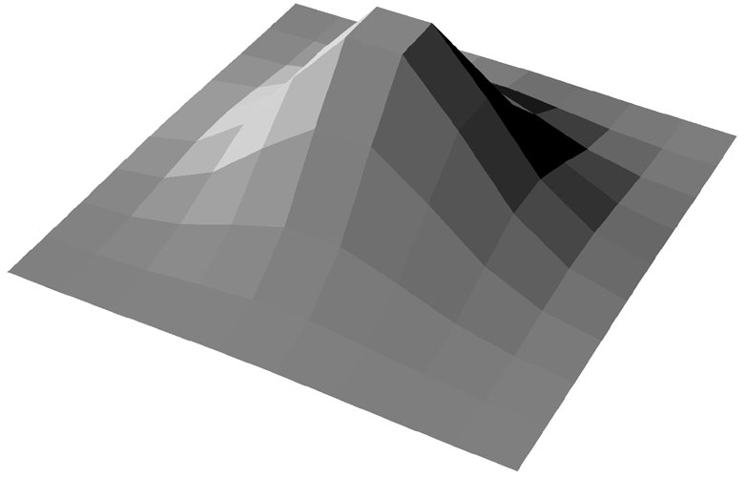
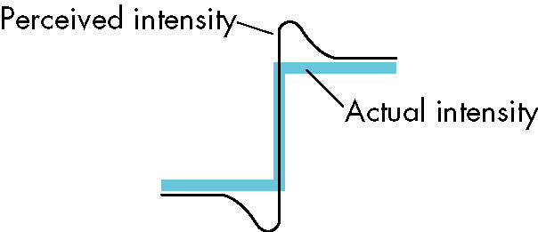
flat shading (ambient)

Slide 76
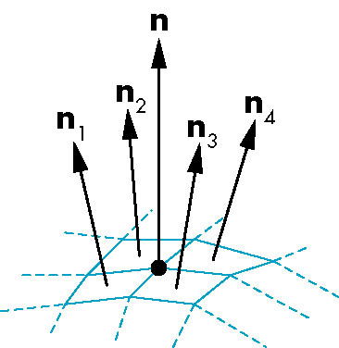
gouraud (smooth) shading
In OpenGL: glShadeModel(GL_SMOOTH)

Slide 77
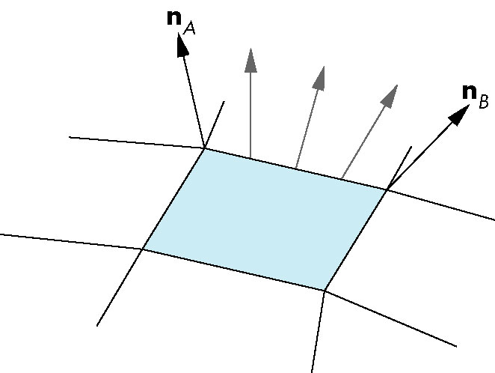
phong (smooth) shading
1. calculate the normals on the side of the polygons by interpolating the vertex normals

Slide 78
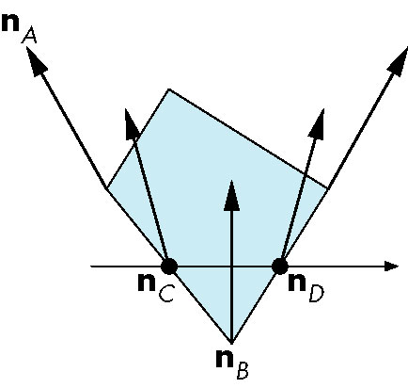
phong (smooth) shading
1. calculate the normals on the side of the polygons by interpolating the vertex normals
2. calculate the normals inside the polygon

Slide 79
Slide by Ron Fedkiw, Stanford University

Slide 80
In a nutshell
Calculate each primary color separately
Start with global ambient light
Add reflections from each light source
Clamp to [0, 1]

Slide 81
Summary: Illumination
Three main types of light:
Ambient, Diffuse, Specular
Illumination on a surface depends on the irradiance angle with the normal
Lambert shading model
How can we calculate these normals?
Flat shading, Gouraud shading, Phong shading

Slide 82
Texture

Slide 85
Particle Systems

Slide 86
introduction
Particles systems what for?
solution to modeling amorphous, dynamic and fluid objects like clouds, smoke, water, explosions and fire.

Slide 87
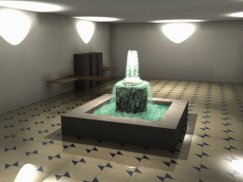
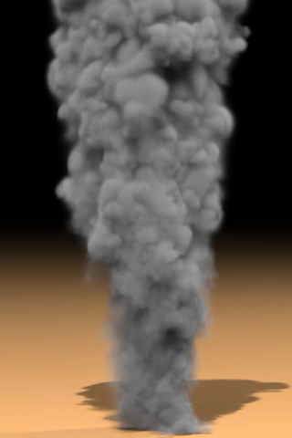
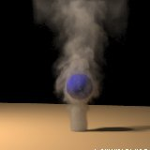
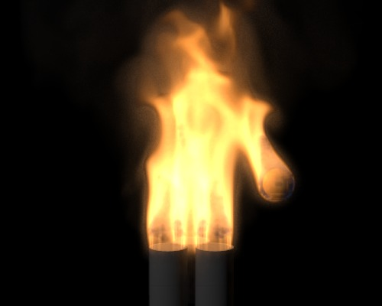
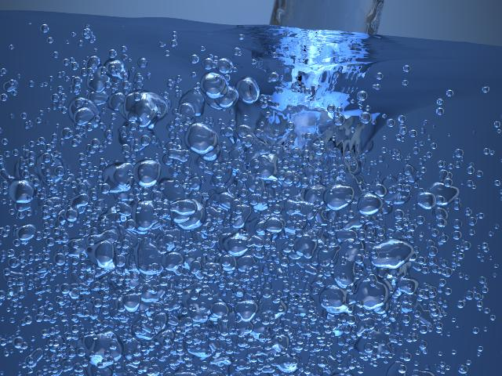
How can we do it?
Ron Fedkiw
Jeong-Mo Hong

Slide 88
Pipeline
. collision detection
. animation global acceleration
. physics simulation
process on CPU or GPU
. transformation
. projection
Computes:
. what is to be drawn
. how should be drawn
. where should be drawn
process on GPU
. draws images generated by
geometry stage
process on GPU

Slide 89
representing objects with particles
An object is represented as clouds of primitive particles that define its volume rather than by polygons or patches that define its boundary
A particle system is dynamic, particles changing form and moving with the passage of time.
Object is not deterministic, its shape and form are not completely specified

Slide 90
Basic Model of Particle Systems
1) New particles are generated into the system
2) Each new particle is assigned its individual attributes
3) Any particle that has existed past its prescribed lifetime is extinguished
4) The remaining particles are moved and transformed according to their dynamic attributes
5) An image of the particles is rendered in the frame buffer, often using special purpose algorithms.

Slide 91
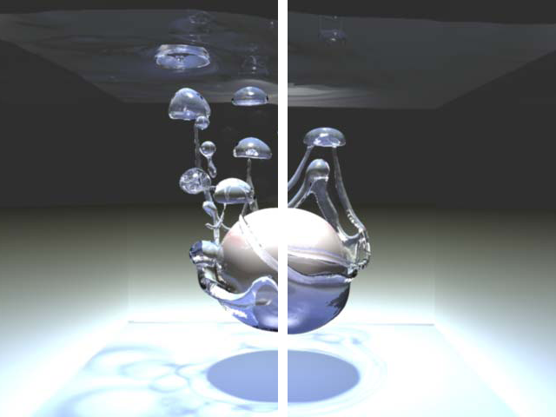
Particle rendering
Particles can obscure other objects behind them, can be transparent, and can cast shadows on other objects. The objects may be polygons, curved surfaces, or other particles.

Slide 92
Physics

Slide 93
Why do we need physics?
How do objects move?
How much energy do they have?
How do they stop by themselves?
How do they float?
How do they fly?
And that only involves movement… (Heat? Electricity? Wind? Light? Sound?)

Slide 94
Pipeline
. collision detection
. animation global acceleration
. physics simulation
process on CPU or GPU
. transformation
. projection
Computes:
. what is to be drawn
. how should be drawn
. where should be drawn
process on GPU
. draws images generated by
geometry stage
process on GPU

Slide 95
Motion

Slide 96
The basic law
$$\vec{F}=m.\vec{a}$$
Newton’s second law
Force (N) equals mass (kg) times acceleration (ms⁻²)
Means that accelerating an object requires an external force
Also means that if we know this force, mass, and initial conditions we can predict object motion

Slide 97
Position and velocity
If we know acceleration
We can integrate it over time to obtain velocity
And integrate it again to obtain position
We can predict motion!
$$\vec{v}=\int_{t}{\vec{a}.dt}$$
$$\vec{v}=\vec{v_{0}}+\vec{a}.t$$
$$\vec{x}=\int_{t}{\vec{v}.dt}$$
$$\vec{x}=\vec{x_{0}}+\vec{v_{0}}.t+1/2\vec{a}.t^{2}$$

Slide 98
Vectors
Note that position, acceleration and velocity are vectors
Scalars are simpler…
Use scalar versions of the equations for each dimension
x, y, z
Separability makes things much simpler!

Slide 99
Example
Break down the vector equation into its components x and y
Use them independently
Great for calculating gravity effects of projectiles
$$\vec{v}=\vec{v_{0}}+\vec{a}.t$$
y
$$\vec{v_{0}}$$
$$α$$
x
$$v_{0x}=\left|\vec{v_{0}}\right|.\cos{α}$$
$$v_{0y}=\left|\vec{v_{0}}\right|.\sin{α}$$
$$v_{x}(t)=v_{0x}+a_{x}(t).t$$
$$v_{y}(t)=v_{0y}+a_{y}(t).t$$

Slide 100
Projectile motion
No force affects horizontal axis
a_{x} = 0
Gravity affects vertical axis
a_{y} = g = -9,8 ms⁻²
So:
$$x\left(t\right)=x_{0}+v_{0x}.t$$
$$y\left(t\right)=y_{0}+v_{0y}.t−1/29,8.t^{2}$$
Image adapted from www.wikipedia.org

Slide 101
Engines
How do I simulate an engine propelling an object?
I can use force if I know mass
I can use acceleration directly
More difficult than gravity
Direction of acceleration is usually associated with the direction of velocity
Direction and magnitude of acceleration may be influenced externally: brakes, steering wheel, etc.
Can easily combine with gravity

Slide 102
Gravitational force
Any two objects with mass attract each other
Newton’s law of universal gravitation
Direction of force
Line containing the centers of mass of the two objects
How come earth’s gravitational pull is constant then?
It is not…
G = 6.674×10⁻¹¹ N m² kg⁻²
Image adapted from www.wikipedia.org

Slide 103
Warp speed
Near the speed of light
Mass increases with velocity
Mass deforms space
Things get messy
What to do?
Go read Stephen Hawking
Cheat in your space combat simulation

Slide 104
Energy of moving objects

Slide 105
Kinetic energy
Things in motion have energy
Defined as the work needed to accelerate a body of a given mass from rest to its stated velocity
Measured in joules
Classic mechanics
Kinetic energy of a non-rotating rigid body:
$$E_{k}=1/2mv^{2}$$

Slide 106
Potential energy
Things not moving also have ‘potential’ energy
Energy due to the position of the various objects of a system
Most common potential energy
Gravity
Higher objects have higher energy than lower objects with the same mass
Others: elastic, electric, magnetic
$$E_{p}=m.g.h$$

Slide 107
Conservation of energy
Law of conservation of energy
The total amount of energy in an isolated system remains constant over time
Isolated system
Physical system without any external exchange of matter or energy
Great for approximating many real-world situations!

Slide 108
Back to our projectiles
Projectile going up
Velocity decreasing – lower kinetic energy
Height increasing – higher potential energy
Projectile going down
Vice-versa
What about engines?
External energy source
Not an isolated system!
Image adapted from www.wikipedia.org

Slide 109
Object collision
What happens when my projectile falls to the ground?
Law of conservation of energy
No external forces were applied
What happened to the kinetic energy?
Ground must generate an opposing force that stops the projectile
Which could break or deform the ground…
Energy is typically converted into heat
Explaining why even a small asteroid falling on earth can create a huge explosion…

Slide 110
Momentum
What happens when two objects collide?
All collisions conserve momentum
Not all collisions conserve kinetic energy
What is momentum?
Product of mass and velocity of an object
Conserved in a closed system
The momentum of a system of particles is the sum of their momenta
$$p=m.v$$
$$p=p_{1}+p_{2}=m_{1}v_{1}+m_{2}v_{2}$$

Slide 111
Elastic collisions
Momentum is conserved
Total kinetic energy is conserved
Solvable system of equations
Images adapted from www.wikipedia.org

Slide 112
Inelastic collision
Momentum is conserved
Kinetic energy is not conserved
Coefficient of restitution
Fractional value representing the ratio of speeds after and before an impact
Images adapted from www.wikipedia.org

Slide 113
Why do moving objects stop? (without collisions or brakes…)

Slide 114
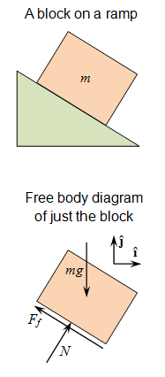
Reason #1 - Friction
Force resisting the relative motion of solid surfaces in contact
Actually this is dry kinetic friction…
Coulomb friction
$$F_{f}≤μF_{n}$$
Does not depend on velocity!
Depends on the normal force between two surfaces
Images adapted from www.wikipedia.org

Slide 115
Reason #2 - Drag
Forces which act on a solid object in the direction of the relative fluid flow
Air resistance
Fluid resistance
Depends on velocity and the object’s cross-sectional area
More complex than friction
Use simple models (Stokes’, Newton…)

Slide 116
Why do things float?

Slide 117
Buoyancy
Archimedes’ principle
A body immersed in a fluid suffers an upward force equal to the weight of the fluid the body displaces
Objects float if they are less dense than the fluid they are in
Can you model such an object falling on a fluid?
Images adapted from www.wikipedia.org

Slide 118
How do explosions work? How can I model turbulence? How do things fly? Why do cars get lighter as they go faster? ...

Slide 119
Go read about physics!

Slide 120
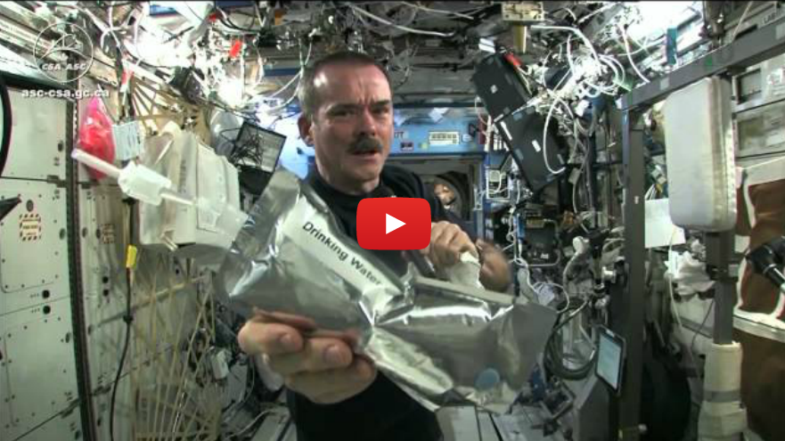
Physics in space? ☺
http://youtu.be/o8TssbmY-GM

