Slide 1
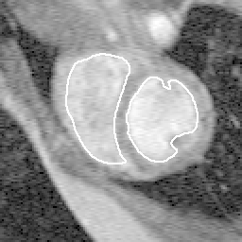
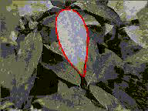
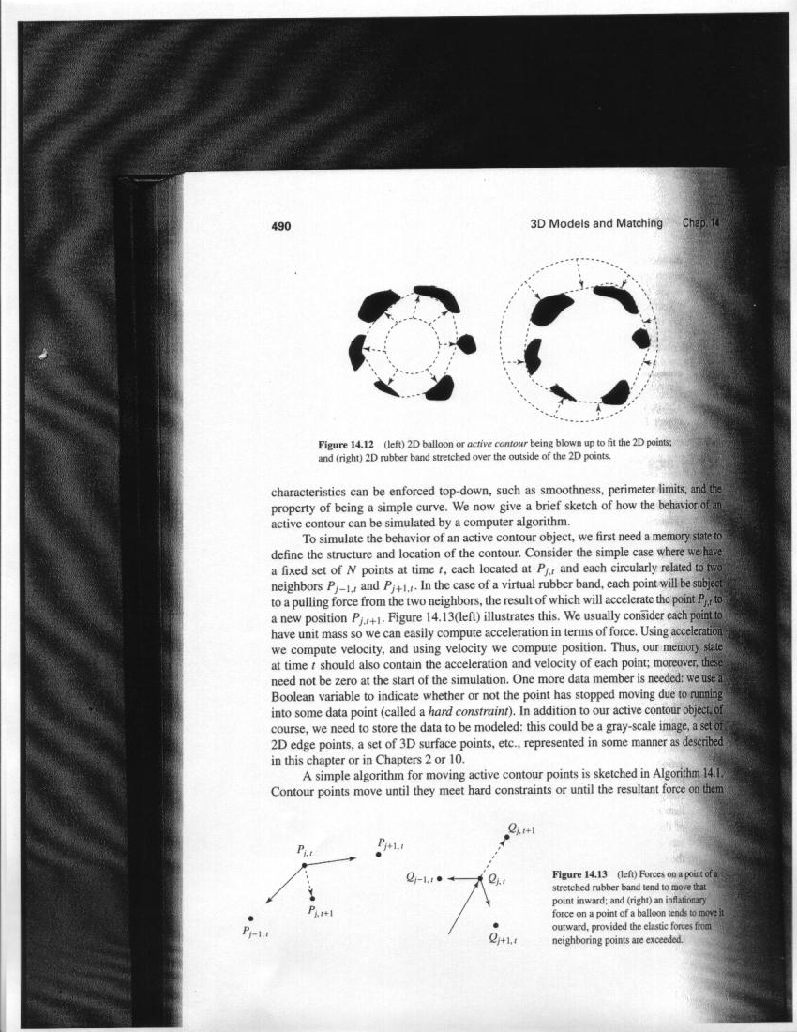
TP11 - Fitting:
Deformable contours
Computer Vision, FCUP, 2017/18
Miguel Coimbra
Slides by Prof. Kristen Grauman

Slide 2

Deformable contours
a.k.a. active contours, snakes
Given: initial contour (model) near desired object
[Snakes: Active contour models, Kass, Witkin, & Terzopoulos, ICCV1987]
Figure credit: Yuri Boykov

Slide 3
Deformable contours
a.k.a. active contours, snakes
Given: initial contour (model) near desired object
Goal: evolve the contour to fit exact object boundary
Main idea: elastic band is iteratively adjusted so as to
be near image positions with high gradients, and
satisfy shape “preferences” or contour priors
[Snakes: Active contour models, Kass, Witkin, & Terzopoulos, ICCV1987]
Figure credit: Yuri Boykov

Slide 4
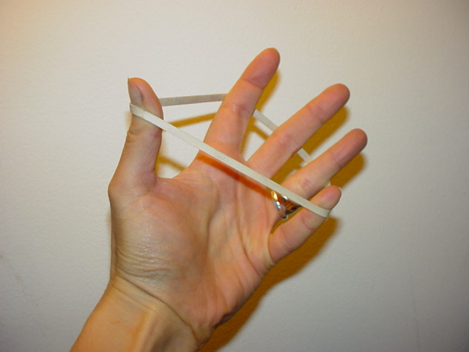
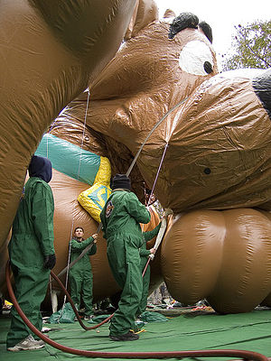
Deformable contours: intuition
Image from http://www.healthline.com/blogs/exercise_fitness/uploaded_images/HandBand2-795868.JPG
Kristen Grauman

Slide 5
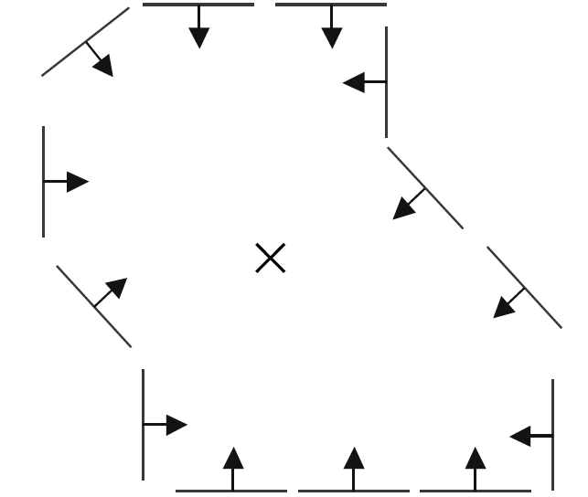
Deformable contours vs. Hough
Like generalized Hough transform, useful for shape fitting; but
initial
intermediate
final
Hough
Rigid model shape
Single voting pass can detect multiple instances
Deformable contours
Prior on shape types, but shape iteratively adjusted (deforms)
Requires initialization nearby
One optimization “pass” to fit a single contour
Kristen Grauman

Slide 6
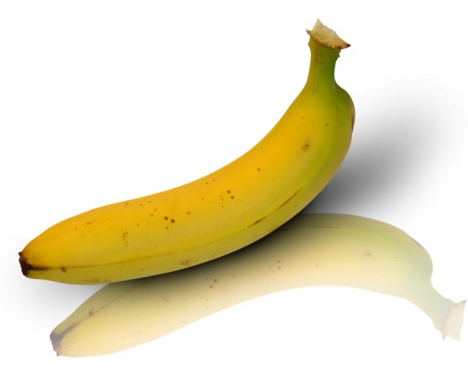
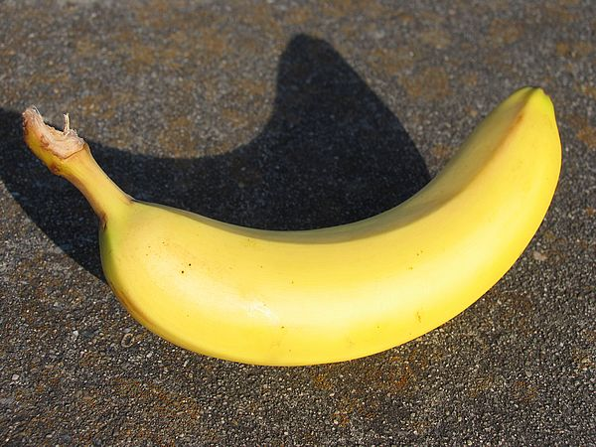
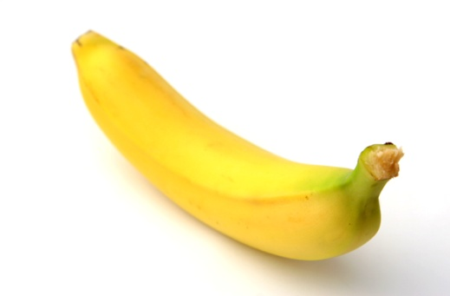
Why do we want to fit deformable shapes?
Some objects have similar basic form but some variety in the contour shape.
Kristen Grauman

Slide 7
Why do we want to fit deformable shapes?
Non-rigid, deformable objects can change their shape over time, e.g. lips, hands…
Figure from Kass et al. 1987
Kristen Grauman

Slide 8
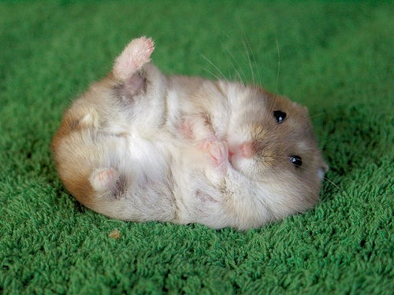
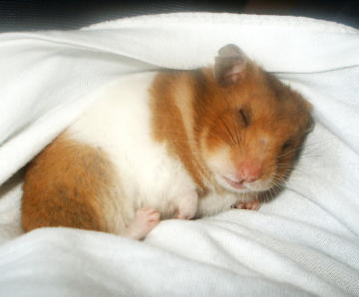
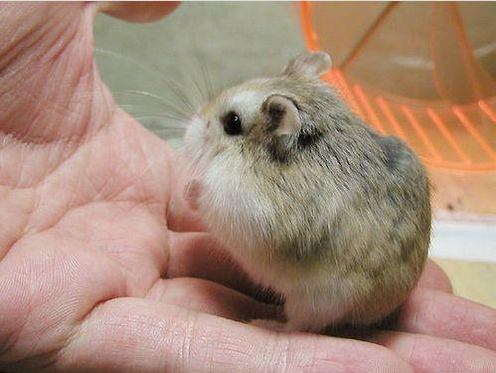
Why do we want to fit deformable shapes?
Non-rigid, deformable objects can change their shape over time, e.g. lips, hands…
Kristen Grauman

Slide 9
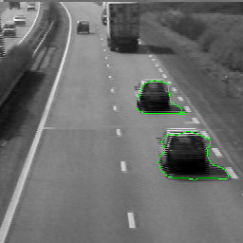
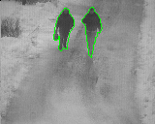
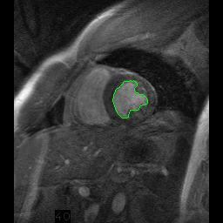
Why do we want to fit deformable shapes?
Non-rigid, deformable objects can change their shape over time.
Figure credit: Julien Jomier
Kristen Grauman

Slide 10
Aspects we need to consider
Representation of the contours
Defining the energy functions
  External
  Internal
Minimizing the energy function
Extensions:
  Tracking
  Interactive segmentation
Kristen Grauman

Slide 11
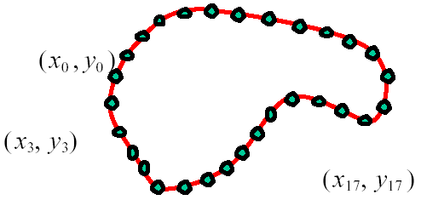
Representation
We’ll consider a discrete representation of the contour, consisting of a list of 2d point positions (“vertices”).
for
At each iteration, we’ll have the option to move each vertex to another nearby location (“state”).
Kristen Grauman

Slide 12
Fitting deformable contours
How should we adjust the current contour to form the new contour at each iteration?
Define a cost function (“energy” function) that says how good a candidate configuration is.
Seek next configuration that minimizes that cost function.
initial
intermediate
final

Slide 13
Energy function
The total energy (cost) of the current snake is defined as:
Internal energy: encourage prior shape preferences: e.g., smoothness, elasticity, particular known shape.
External energy (“image” energy): encourage contour to fit on places where image structures exist, e.g., edges.
A good fit between the current deformable contour and the target shape in the image will yield a low value for this cost function.

Slide 14
External energy: intuition
Measure how well the curve matches the image data
“Attract” the curve toward different image features
  Edges, lines, texture gradient, etc.

Slide 15


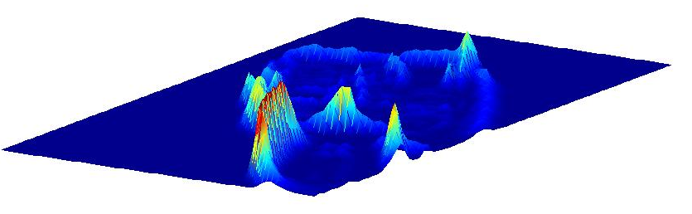
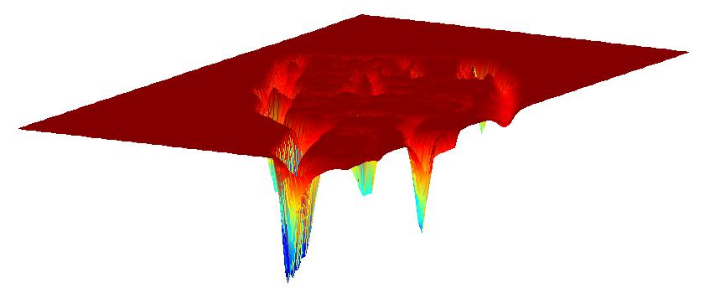
External image energy
How do edges affect “snap” of rubber band?
Think of external energy from image as gravitational pull towards areas of high contrast
Magnitude of gradient
- (Magnitude of gradient)
Kristen Grauman

Slide 16
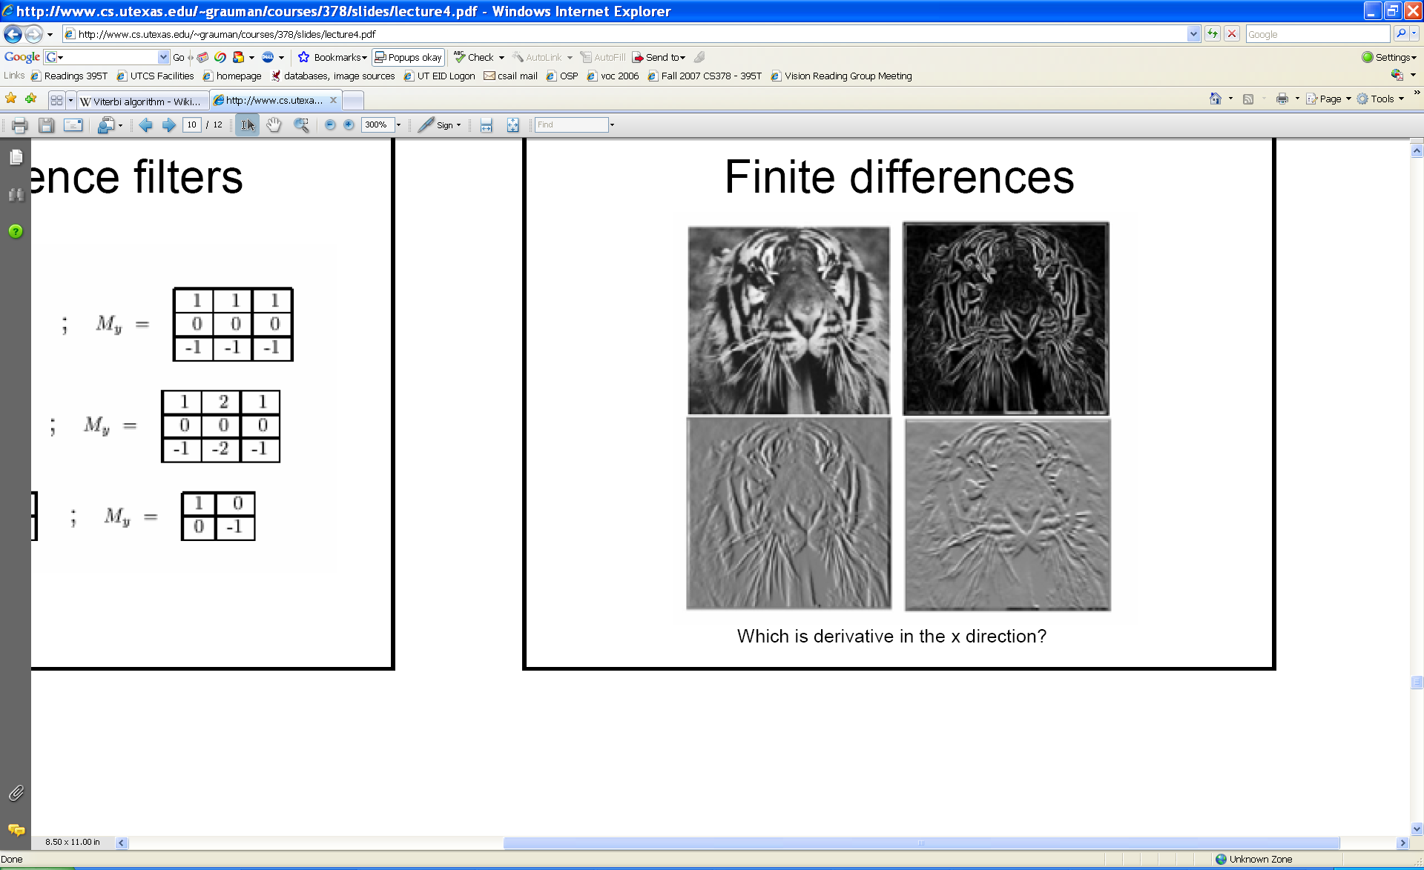
External image energy
Gradient images and
External energy at a point on the curve is:
External energy for the whole curve:
Kristen Grauman

Slide 17

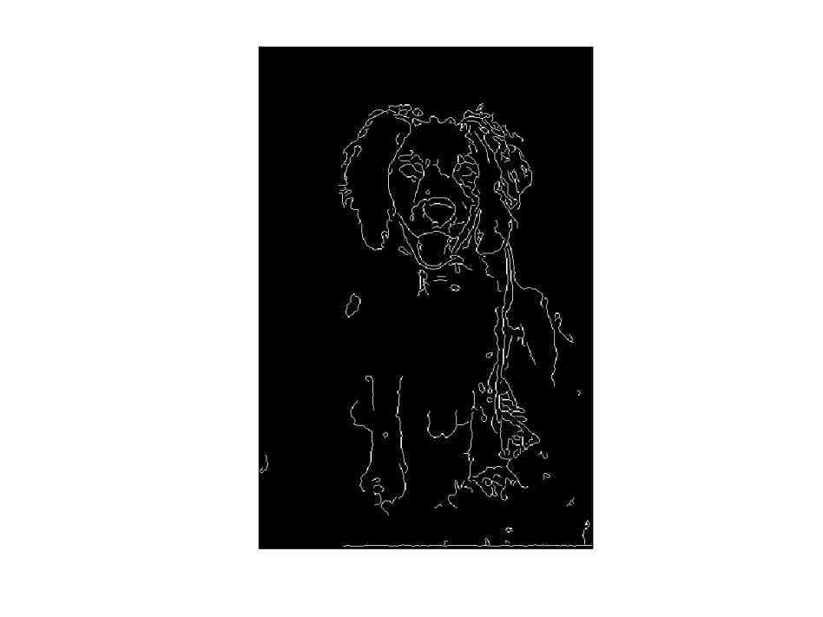
Internal energy: intuition
What are the underlying boundaries in this fragmented edge image?
And in this one?
Kristen Grauman

Slide 18
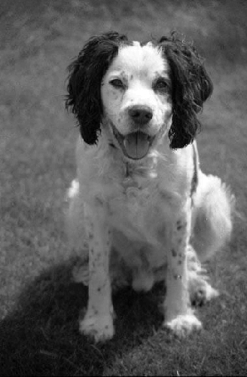
Internal energy: intuition
A priori, we want to favor smooth shapes, contours with low curvature, contours similar to a known shape, etc. to balance what is actually observed (i.e., in the gradient image).
Kristen Grauman

Slide 19

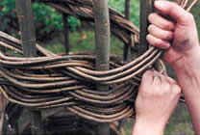
Internal energy
For a continuous curve, a common internal energy term is the “bending energy”.
At some point v(s) on the curve, this is:
Tension,
Elasticity
Stiffness,
Curvature
Kristen Grauman

Slide 20
Internal energy
For our discrete representation,
Internal energy for the whole curve:
…
Note these are derivatives relative to position---not spatial image gradients.
Why do these reflect tension and curvature?
Kristen Grauman

Slide 21


Example: compare curvature
(2,5)
(2,2)
(3,1)
(1,1)
(3,1)
(1,1)
$$\left(3−2\left(2\right)+1\right)2+\left(1−2\left(5\right)+1\right)2$$
$$\left(3−2\left(2\right)+1\right)2+\left(1−2\left(2\right)+1\right)2$$
$$=\left(−8\right)2=64$$
$$=\left(−2\right)2=4$$
Kristen Grauman

Slide 22
Penalizing elasticity
Current elastic energy definition uses a discrete estimate of the derivative:
What is the possible problem with this definition?
Kristen Grauman

Slide 23
Penalizing elasticity
Current elastic energy definition uses a discrete estimate of the derivative:
Instead:
where d is the average distance between pairs of points – updated at each iteration.
Kristen Grauman

Slide 24
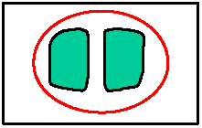
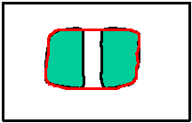
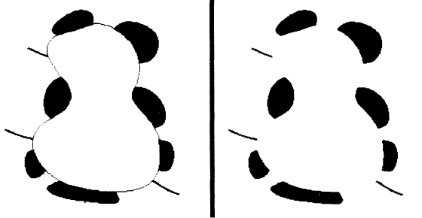
Dealing with missing data
The preferences for low-curvature, smoothness help deal with missing data:
Illusory contours found!
[Figure from Kass et al. 1987]

Slide 25
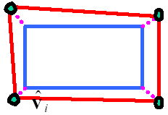
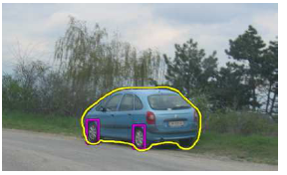
Extending the internal energy: capture shape prior
If object is some smooth variation on a known shape, we can use a term that will penalize deviation from that shape:
    where are the points of the known shape.
Fig from Y. Boykov

Slide 26
Total energy: function of the weights

Slide 27
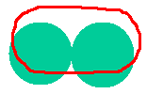


Total energy: function of the weights
e.g., weight controls the penalty for internal elasticity
large
medium
small
Fig from Y. Boykov

Slide 28
Recap: deformable contour
A simple elastic snake is defined by:
  A set of n points,
  An internal energy term (tension, bending, plus optional shape prior)
  An external energy term (gradient-based)
To use to segment an object:
  Initialize in the vicinity of the object
  Modify the points to minimize the total energy
Kristen Grauman

Slide 29
Energy minimization
Several algorithms have been proposed to fit deformable contours.
We’ll look at two:
  Greedy search
  Dynamic programming (for 2d snakes)

Slide 30
Energy minimization: greedy
For each point, search window around it and move to where energy function is minimal
  Typical window size, e.g., 5 x 5 pixels
Stop when predefined number of points have not changed in last iteration, or after max number of iterations
Note:
  Convergence not guaranteed
  Need decent initialization
Kristen Grauman

Slide 31
Energy minimization
Several algorithms have been proposed to fit deformable contours.
We’ll look at two:
  Greedy search
  Dynamic programming (for 2d snakes)

Slide 32
Energy minimization: dynamic programming
With this form of the energy function, we can minimize using dynamic programming, with the Viterbi algorithm.
Iterate until optimal position for each point is the center of the box, i.e., the snake is optimal in the local search space constrained by boxes.
Fig from Y. Boykov
[Amini, Weymouth, Jain, 1990]

Slide 33
Energy minimization: dynamic programming
Possible because snake energy can be rewritten as a sum of pair-wise interaction potentials:
Or sum of triple-interaction potentials.

Slide 34
Snake energy: pair-wise interactions
Re-writing the above with :
where
Kristen Grauman

Slide 35
Viterbi algorithm
Main idea: determine optimal position (state) of predecessor, for each possible position of self. Then backtrack from best state for last vertex.
vertices
states
1
2
…
m
Complexity:
vs. brute force search ____?
Example adapted from Y. Boykov

Slide 36
Energy minimization: dynamic programming
With this form of the energy function, we can minimize using dynamic programming, with the Viterbi algorithm.
Iterate until optimal position for each point is the center of the box, i.e., the snake is optimal in the local search space constrained by boxes.
Fig from Y. Boykov
[Amini, Weymouth, Jain, 1990]

Slide 37
Energy minimization:
dynamic programming
DP can be applied to optimize an open ended snake
For a closed snake, a “loop” is introduced into the total energy.
Work around:
Fix v₁ and solve for rest .
Fix an intermediate node at its position found in (1), solve for rest.

Slide 38
Aspects we need to consider
Representation of the contours
Defining the energy functions
  External
  Internal
Minimizing the energy function
Extensions:
  Tracking
  Interactive segmentation

Slide 39
Tracking via deformable contours
Use final contour/model extracted at frame t as an initial solution for frame t+1
Evolve initial contour to fit exact object boundary at frame t+1
Repeat, initializing with most recent frame.
Tracking Heart Ventricles
(multiple frames)
Kristen Grauman

Slide 40
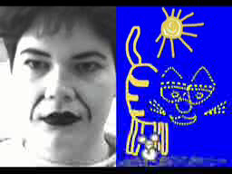
Tracking via deformable contours
Visual Dynamics Group, Dept. Engineering Science, University of Oxford.
Applications:
Traffic monitoring
Human-computer interaction
Animation
Surveillance
Computer assisted diagnosis in medical imaging
Kristen Grauman
Notes:
http://www.robots.ox.ac.uk/~vdg/dynamics.html

Slide 41
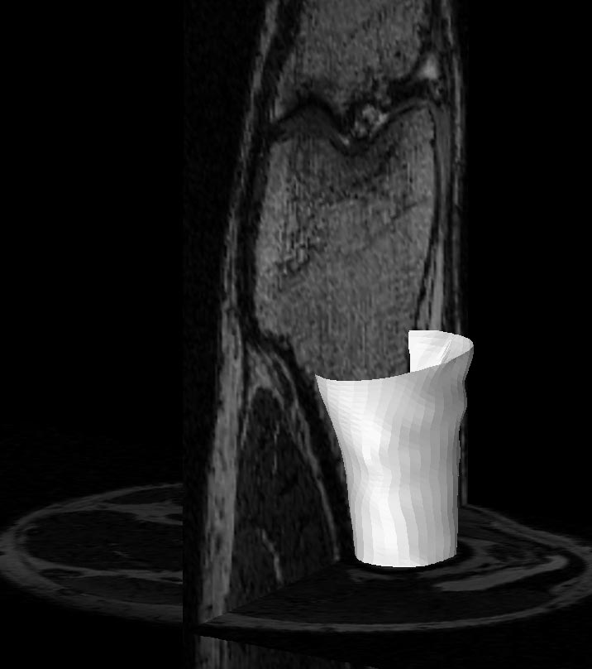
3D active contours
Jörgen Ahlberg
http://www.cvl.isy.liu.se/ScOut/Masters/Papers/Ex1708.pdf
Kristen Grauman

Slide 42
Limitations
May over-smooth the boundary
Cannot follow topological changes of objects

Slide 43
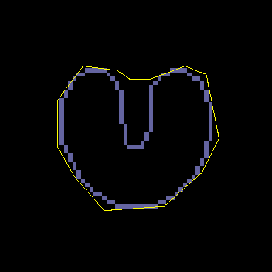
Limitations
External energy: snake does not really “see” object boundaries in the image unless it gets very close to it.
image gradients
are large only directly on the boundary

Slide 44

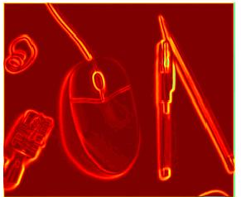
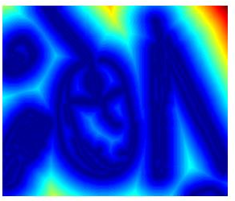

Distance transform
External image can instead be taken from the distance transform of the edge image.
original
-gradient
distance transform
Value at (x,y) tells how far that position is from the nearest edge point (or other binary mage structure)
edges
>> help bwdist
Kristen Grauman

Slide 45
Deformable contours: pros and cons
Pros:
Useful to track and fit non-rigid shapes
Contour remains connected
Possible to fill in “subjective” contours
Flexibility in how energy function is defined, weighted.
Cons:
Must have decent initialization near true boundary, may get stuck in local minimum
Parameters of energy function must be set well based on prior information
Kristen Grauman

Slide 46
Summary
Deformable shapes and active contours are useful for
  Segmentation: fit or “snap” to boundary in image
  Tracking: previous frame’s estimate serves to initialize the next
Fitting active contours:
  Define terms to encourage certain shapes, smoothness, low curvature, push/pulls, …
  Use weights to control relative influence of each component cost
  Can optimize 2d snakes with Viterbi algorithm.
Image structure (esp. gradients) can act as attraction force for interactive segmentation methods.
Kristen Grauman

