Slide 1
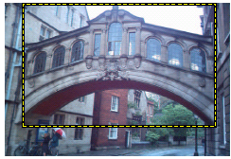
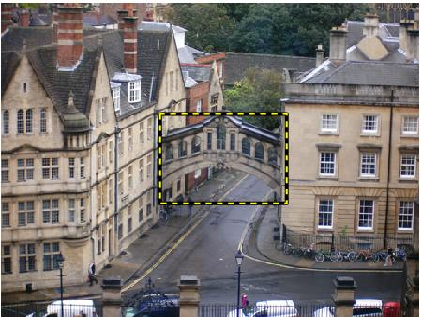
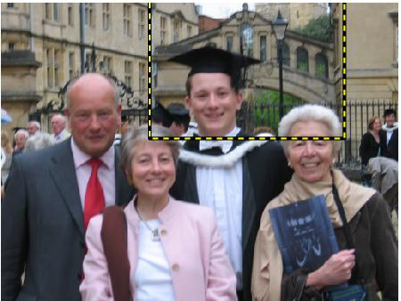
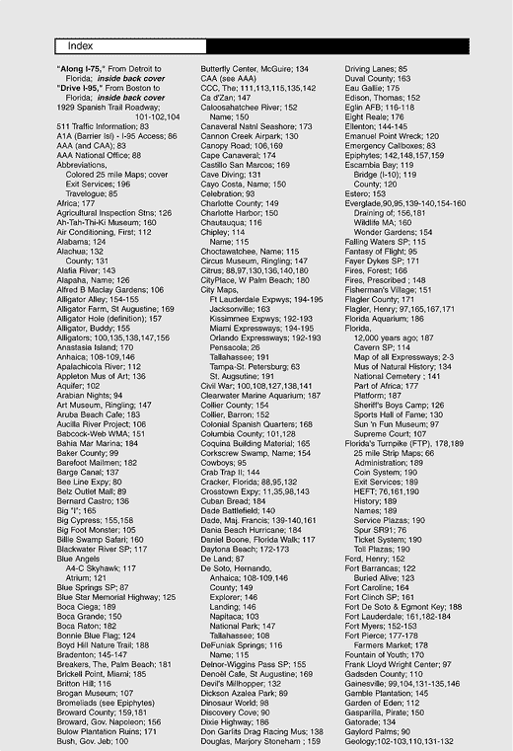


TP13 - Indexing local features
Computer Vision, FCUP, 2017/18
Miguel Coimbra
Slides by Prof. Kristen Grauman

Slide 2
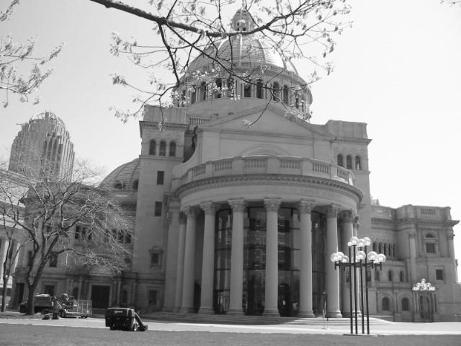
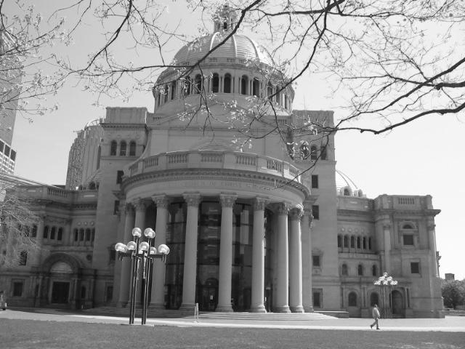
Matching local features
Kristen Grauman

Slide 3
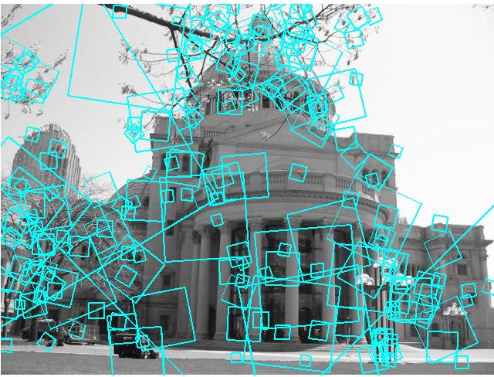
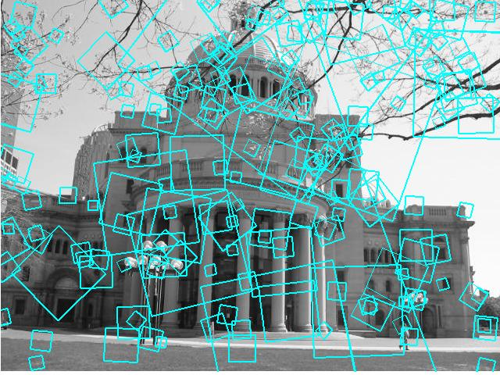
Matching local features
?
Image 1
Image 2
To generate candidate matches, find patches that have the most similar appearance (e.g., lowest SSD)
Simplest approach: compare them all, take the closest (or closest k, or within a thresholded distance)
Kristen Grauman

Slide 4
Matching local features
Image 1
Image 2
In stereo case, may constrain by proximity if we make assumptions on max disparities.
Kristen Grauman

Slide 5
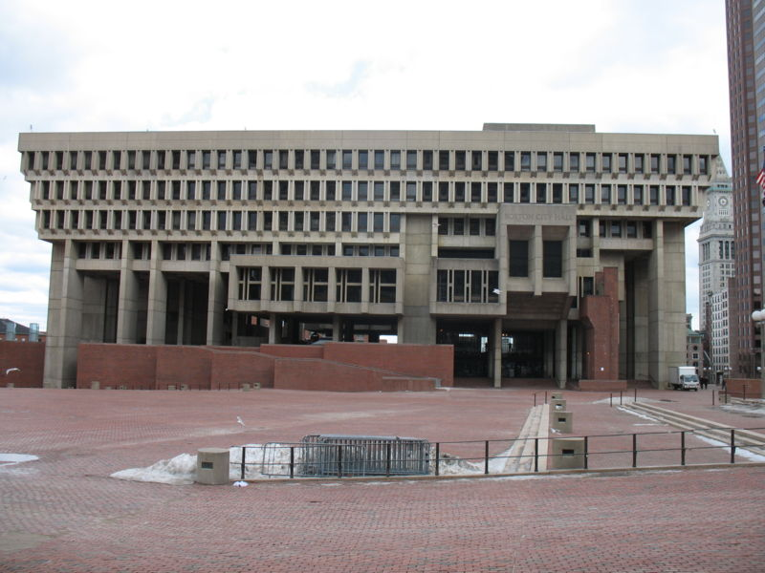
Indexing local features
…
Kristen Grauman

Slide 6
Indexing local features
Each patch / region has a descriptor, which is a point in some high-dimensional feature space (e.g., SIFT)
Descriptor’s feature space
Kristen Grauman
Notes:
6

Slide 7
Indexing local features
When we see close points in feature space, we have similar descriptors, which indicates similar local content.
Query image
Descriptor’s feature space
Database images
Kristen Grauman

Slide 8
Indexing local features
With potentially thousands of features per image, and hundreds to millions of images to search, how to efficiently find those that are relevant to a new image?
Kristen Grauman
Notes:
8

Slide 9
Indexing local features: inverted file index
For text documents, an efficient way to find all pages on which a word occurs is to use an index…
We want to find all images in which a feature occurs.
To use this idea, we’ll need to map our features to “visual words”.
Kristen Grauman

Slide 10
Text retrieval vs. image search
What makes the problems similar, different?
Kristen Grauman

Slide 11
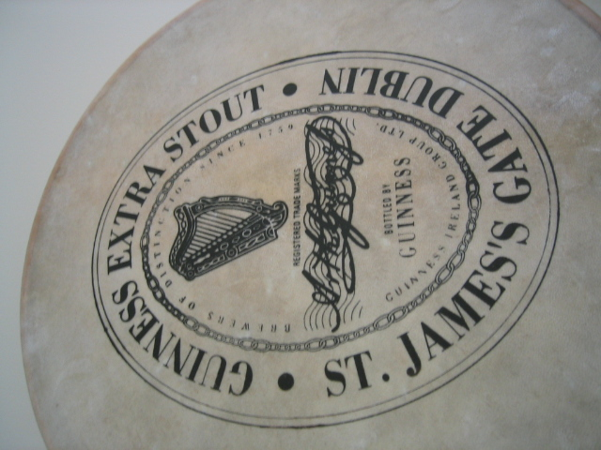
Visual words: main idea
Extract some local features from a number of images …
e.g., SIFT descriptor space: each point is 128-dimensional
Slide credit: D. Nister, CVPR 2006

Slide 12
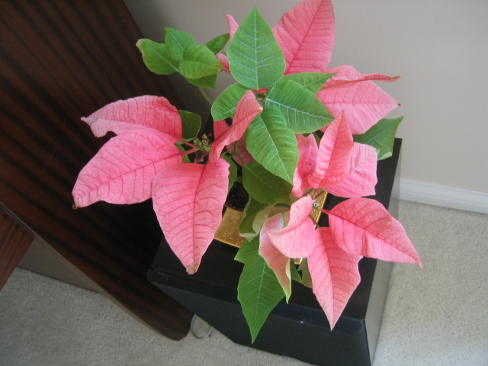
Visual words: main idea

Slide 13
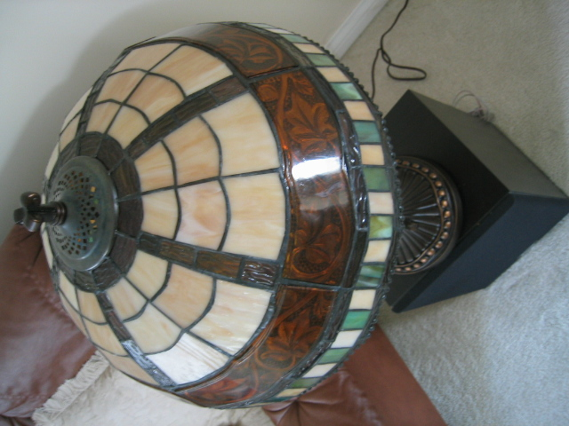
Visual words: main idea

Slide 14
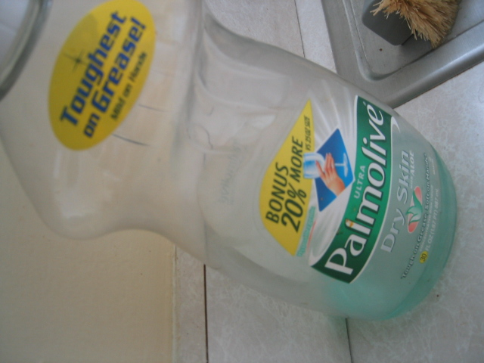
Visual words: main idea

Slide 15
Each point is a local descriptor, e.g. SIFT vector.

Slide 17
Visual words
Map high-dimensional descriptors to tokens/words by quantizing the feature space
Quantize via clustering, let cluster centers be the prototype “words”
Word #2
Determine which word to assign to each new image region by finding the closest cluster center.
Descriptor’s feature space
Kristen Grauman

Slide 18
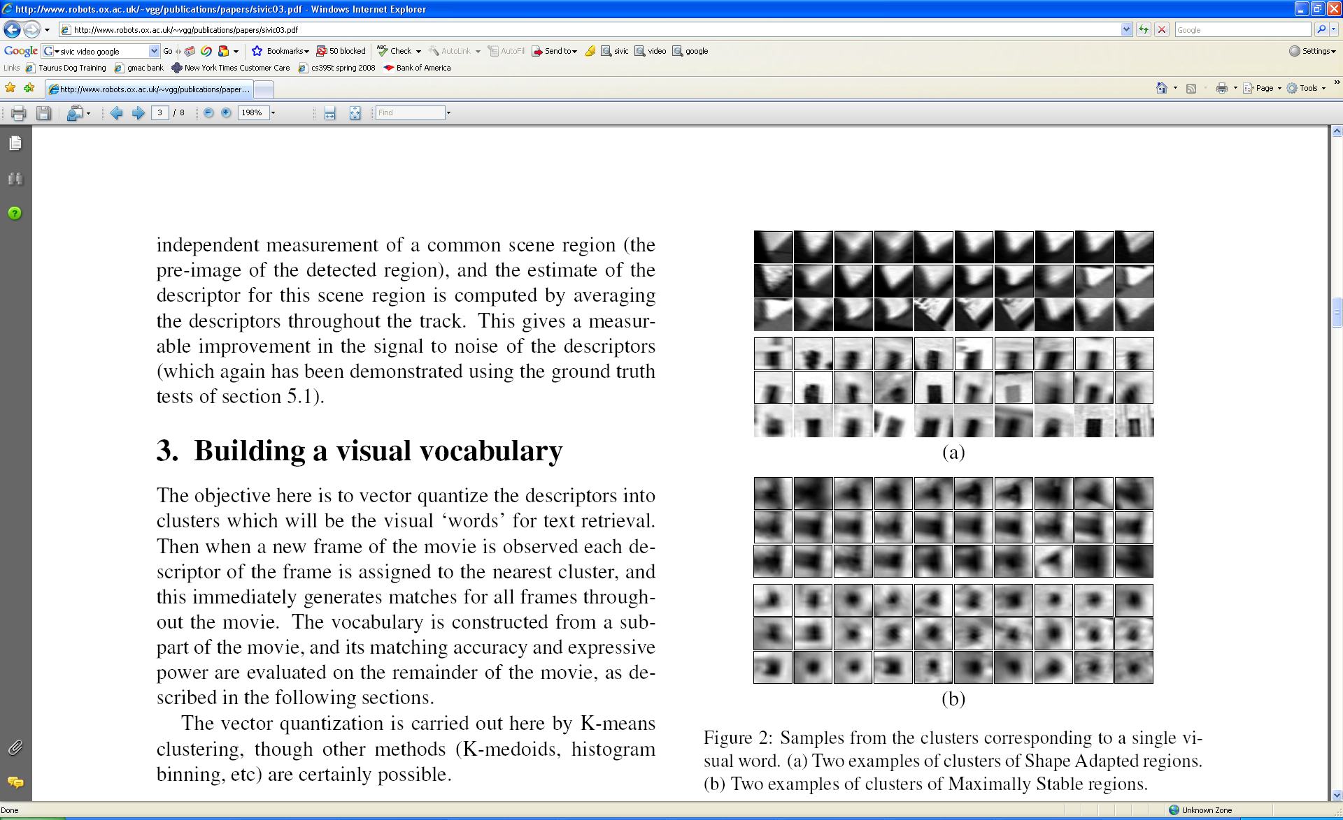
Visual words
Example: each group of patches belongs to the same visual word
Figure from Sivic & Zisserman, ICCV 2003
Kristen Grauman

Slide 19
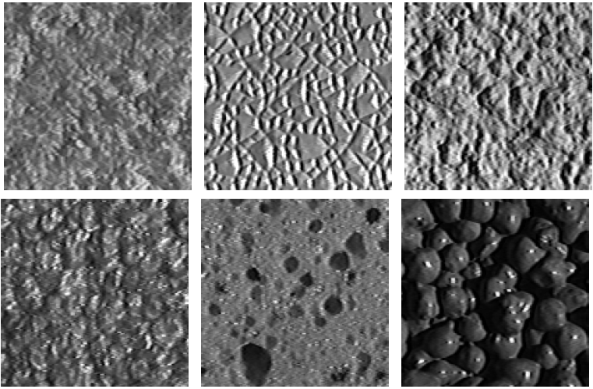
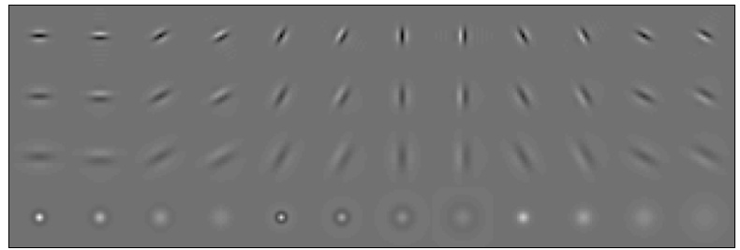
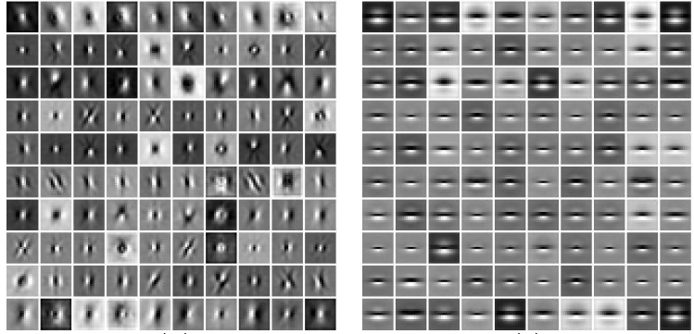
Visual words and textons
First explored for texture and material representations
Texton = cluster center of filter responses over collection of images
Describe textures and materials based on distribution of prototypical texture elements.
Leung & Malik 1999; Varma & Zisserman, 2002
Kristen Grauman

Slide 20
Recall: Texture representation example
Windows with primarily horizontal edges
Both
 | mean d/dx value | mean d/dy value
Win. #1 | 4 | 10
Win.#2 | 18 | 7
Win.#9 | 20 | 20
Dimension 2 (mean d/dy value)
Dimension 1 (mean d/dx value)
…
statistics to summarize patterns in small windows
…
Windows with small gradient in both directions
Windows with primarily vertical edges
Kristen Grauman

Slide 21
Visual vocabulary formation
Issues:
Sampling strategy: where to extract features?
Clustering / quantization algorithm
Unsupervised vs. supervised
What corpus provides features (universal vocabulary?)
Vocabulary size, number of words
Kristen Grauman

Slide 22
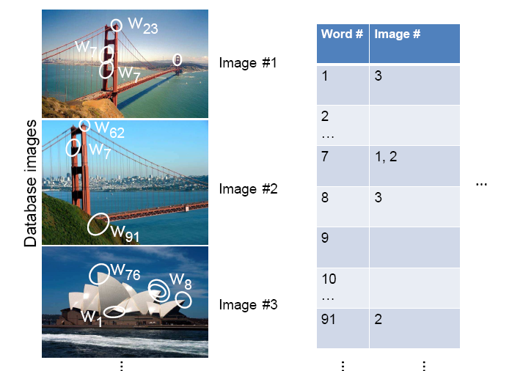
Inverted file index
Database images are loaded into the index mapping words to image numbers
Kristen Grauman

Slide 23
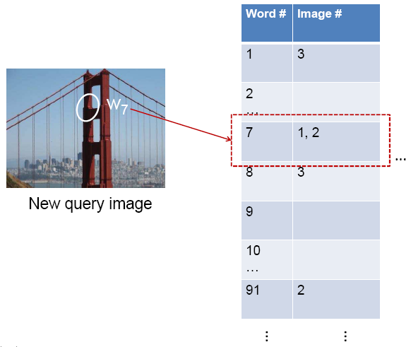
Inverted file index
When will this give us a significant gain in efficiency?
New query image is mapped to indices of database images that share a word.
Kristen Grauman

Slide 24
If a local image region is a visual word, how can we summarize an image (the document)?

Slide 25

Analogy to documents
Of all the sensory impressions proceeding to the brain, the visual experiences are the dominant ones. Our perception of the world around us is based essentially on the messages that reach the brain from our eyes. For a long time it was thought that the retinal image was transmitted point by point to visual centers in the brain; the cerebral cortex was a movie screen, so to speak, upon which the image in the eye was projected. Through the discoveries of Hubel and Wiesel we now know that behind the origin of the visual perception in the brain there is a considerably more complicated course of events. By following the visual impulses along their path to the various cell layers of the optical cortex, Hubel and Wiesel have been able to demonstrate that the message about the image falling on the retina undergoes a step-wise analysis in a system of nerve cells stored in columns. In this system each cell has its specific function and is responsible for a specific detail in the pattern of the retinal image.
China is forecasting a trade surplus of $90bn (£51bn) to $100bn this year, a threefold increase on 2004's $32bn. The Commerce Ministry said the surplus would be created by a predicted 30% jump in exports to $750bn, compared with a 18% rise in imports to $660bn. The figures are likely to further annoy the US, which has long argued that China's exports are unfairly helped by a deliberately undervalued yuan. Beijing agrees the surplus is too high, but says the yuan is only one factor. Bank of China governor Zhou Xiaochuan said the country also needed to do more to boost domestic demand so more goods stayed within the country. China increased the value of the yuan against the dollar by 2.1% in July and permitted it to trade within a narrow band, but the US wants the yuan to be allowed to trade freely. However, Beijing has made it clear that it will take its time and tread carefully before allowing the yuan to rise further in value.
sensory, brain,
visual, perception,
retinal, cerebral cortex,
eye, cell, optical
nerve, image
Hubel, Wiesel
China, trade,
surplus, commerce,
exports, imports, US,
yuan, bank, domestic,
foreign, increase,
trade, value
ICCV 2005 short course, L. Fei-Fei

Slide 26
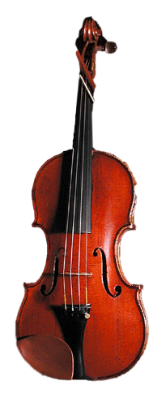
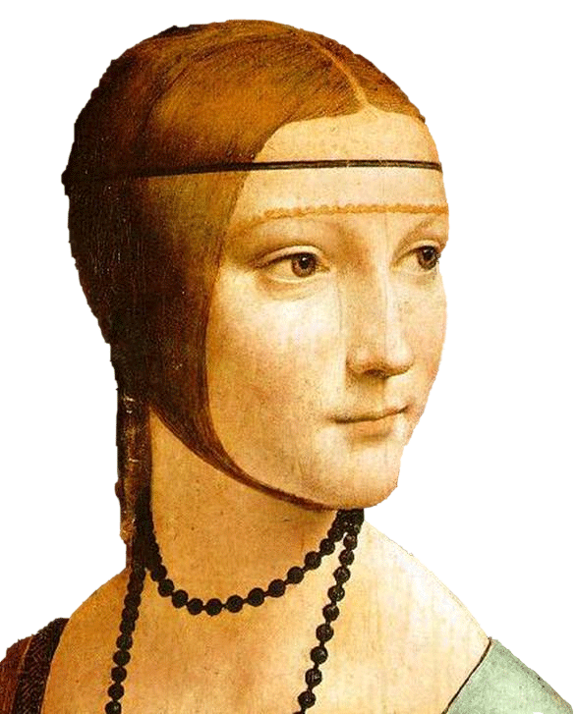
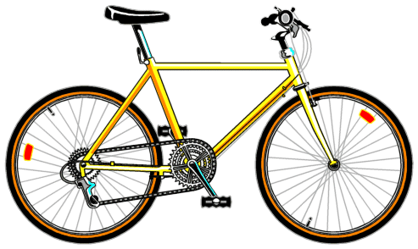
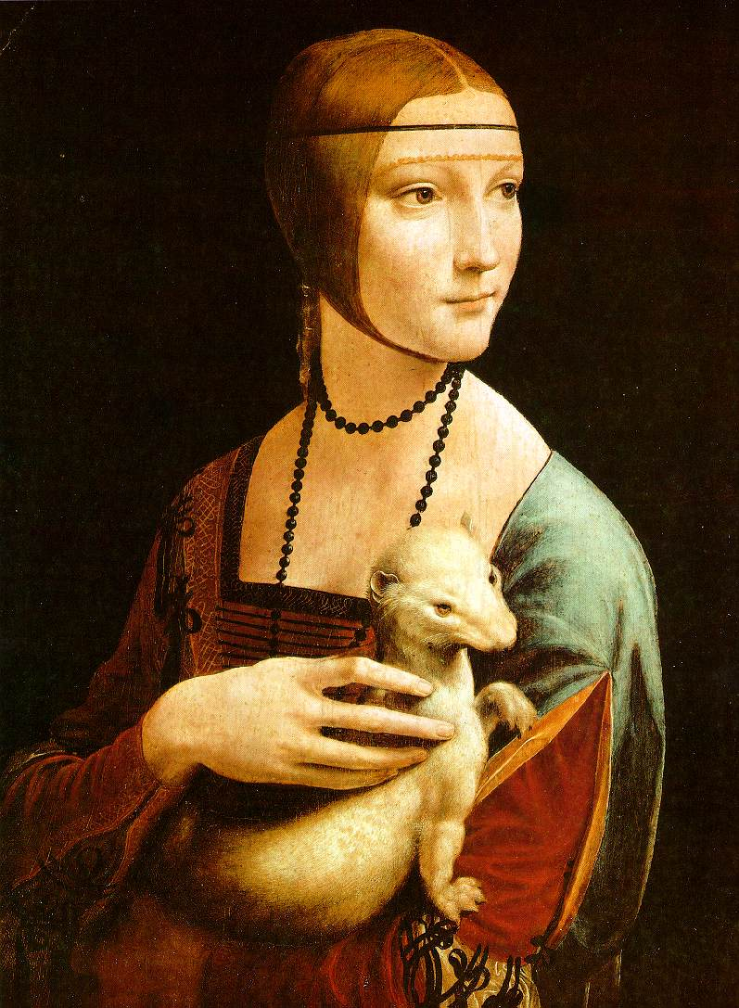

Slide 27
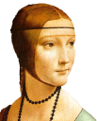






Bags of visual words
Summarize entire image based on its distribution (histogram) of word occurrences.
Analogous to bag of words representation commonly used for documents.
Notes:
27

Slide 28





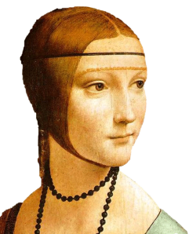
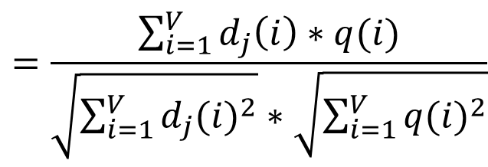
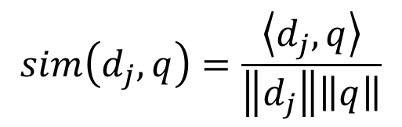
Comparing bags of words
Rank frames by normalized scalar product between their (possibly weighted) occurrence counts---nearest neighbor search for similar images.
[1 8 1 4]
[5 1 1 0]
$$sim\left(d_{j},q\right)=\frac{\left\langle d_{j},q\right\rangle }{\left\|d_{j}\right\|\left\|q\right\|}$$
$$=\frac{\sum_{i=1}^{V}{d_{j}\left(i\right)∗q(i)}}{\sqrt{\sum_{i=1}^{V}{{d_{j}(i)}^{2}}}∗\sqrt{\sum_{i=1}^{V}{{q(i)}^{2}}}}$$
for vocabulary of V words
Kristen Grauman

Slide 29
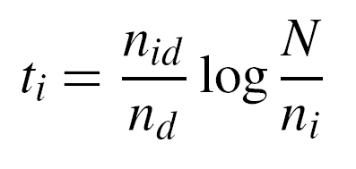
tf-idf weighting
Term frequency – inverse document frequency
Describe frame by frequency of each word within it, downweight words that appear often in the database
(Standard weighting for text retrieval)
Number of occurrences of word i in document d
Total number of documents in database
Number of documents word i occurs in, in whole database
Number of words in document d
Kristen Grauman

Slide 30
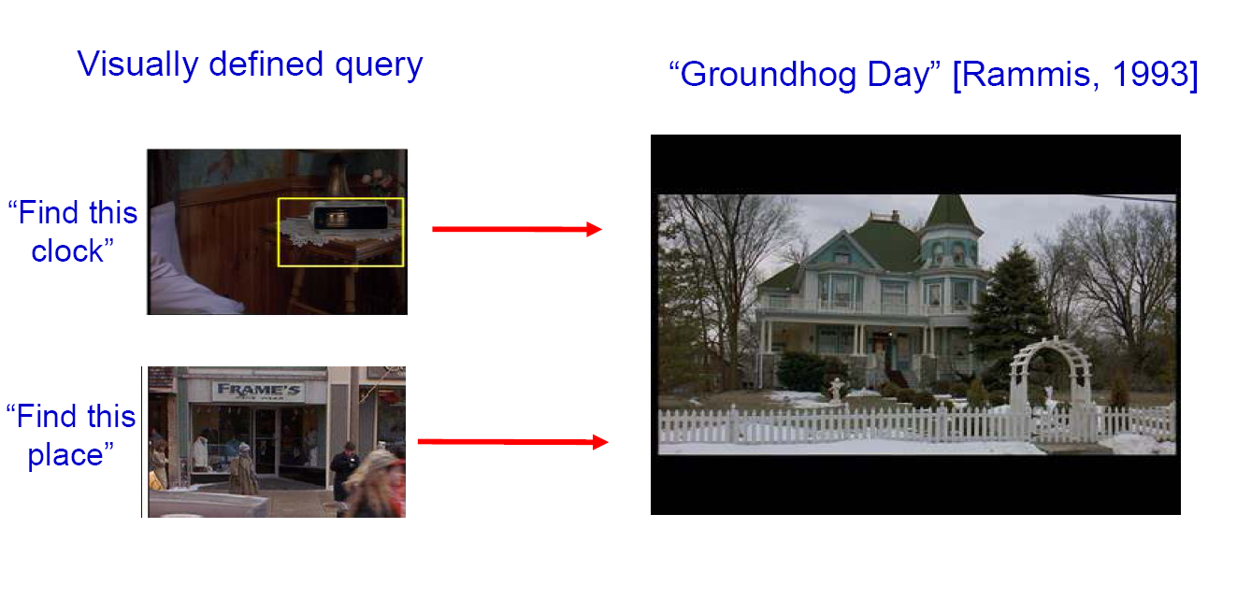
Bags of words for content-based image retrieval
Slide from Andrew Zisserman
Sivic & Zisserman, ICCV 2003

Slide 31
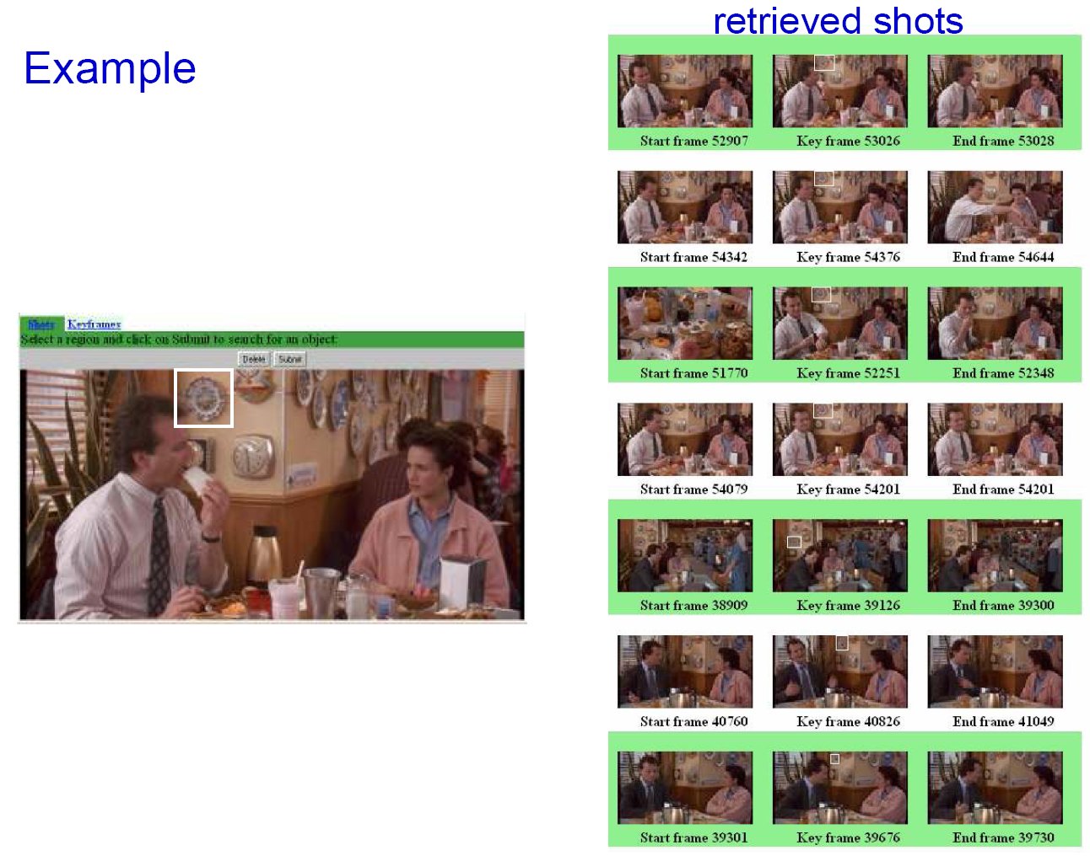
Slide from Andrew Zisserman
Sivic & Zisserman, ICCV 2003

Slide 32
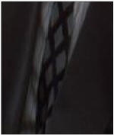
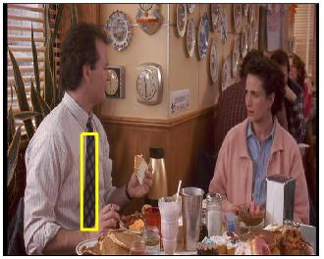
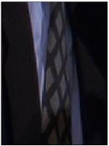
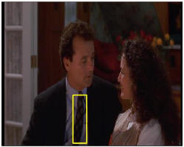
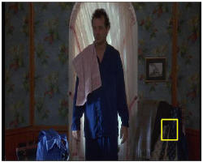
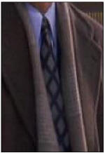
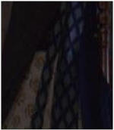
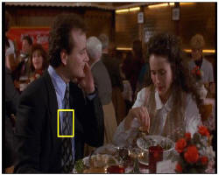
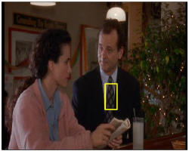
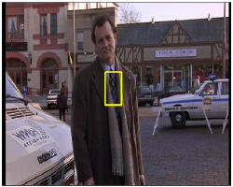
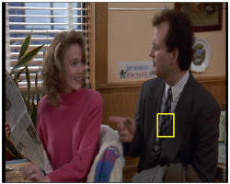
Video Google System
Query region
Collect all words within query region
Inverted file index to find relevant frames
Compare word counts
Spatial verification
Sivic & Zisserman, ICCV 2003
Demo online at : http://www.robots.ox.ac.uk/~vgg/research/vgoogle/index.html
Retrieved frames
32
K. Grauman, B. Leibe
Notes:
32

Slide 33
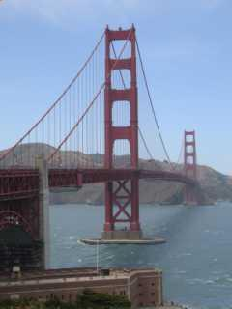
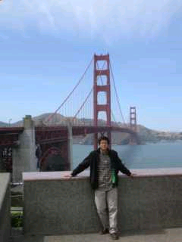
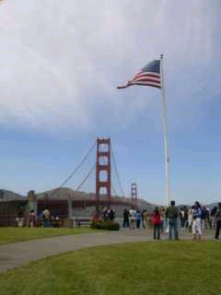
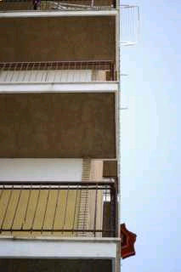
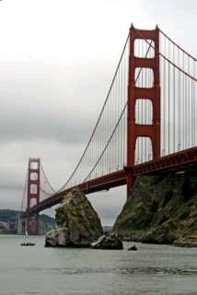
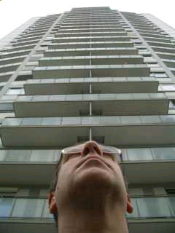
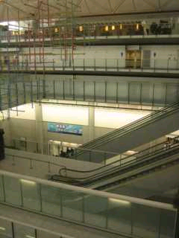
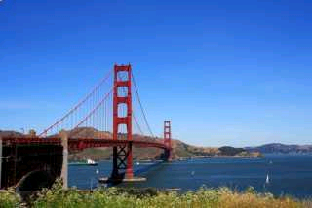
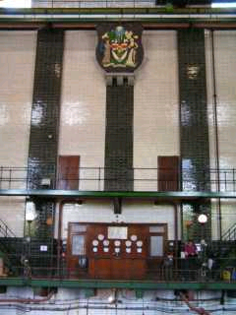


Scoring retrieval quality
Results (ordered):
Database size: 10 images
Relevant (total): 5 images
Query
precision = #relevant / #returned
recall = #relevant / #total relevant
1
0.8
0.6
precision
0.4
0.2
0
0
0.2
0.4
0.6
0.8
1
recall
Slide credit: Ondrej Chum

Slide 34
Vocabulary Trees: hierarchical clustering for large vocabularies
[Nister & Stewenius, CVPR’06]
Slide credit: David Nister
Tree construction:

Slide 35
Vocabulary Tree
[Nister & Stewenius, CVPR’06]
K. Grauman, B. Leibe
Slide credit: David Nister
Training: Filling the tree

Slide 36


Vocabulary Tree
[Nister & Stewenius, CVPR’06]
K. Grauman, B. Leibe
Slide credit: David Nister
Training: Filling the tree

Slide 37


Vocabulary Tree
[Nister & Stewenius, CVPR’06]
K. Grauman, B. Leibe
Slide credit: David Nister
Training: Filling the tree

Slide 38


Vocabulary Tree
[Nister & Stewenius, CVPR’06]
K. Grauman, B. Leibe
Slide credit: David Nister
Training: Filling the tree

Slide 39


Vocabulary Tree
[Nister & Stewenius, CVPR’06]
39
K. Grauman, B. Leibe
Slide credit: David Nister
Training: Filling the tree

Slide 40
What is the computational advantage of the hierarchical representation bag of words, vs. a flat vocabulary?

Slide 41

Vocabulary Tree
RANSAC
verification
[Nister & Stewenius, CVPR’06]
Slide credit: David Nister
Recognition

Slide 42
Bags of words: pros and cons
+ flexible to geometry / deformations / viewpoint
+ compact summary of image content
+ provides vector representation for sets
+ very good results in practice
basic model ignores geometry – must verify afterwards, or encode via features
background and foreground mixed when bag covers whole image
optimal vocabulary formation remains unclear
Notes:
42

Slide 43
Summary
Matching local invariant features: useful not only to provide matches for multi-view geometry, but also to find objects and scenes.
Bag of words representation: quantize feature space to make discrete set of visual words
  Summarize image by distribution of words
  Index individual words
Inverted index: pre-compute index to enable faster search at query time

