Slide 1
VC 19/20 – TP14
Pattern Recognition
Mestrado em Ciência de Computadores
Mestrado Integrado em Engenharia de Redes e Sistemas Informáticos
Miguel Tavares Coimbra

Slide 2
Outline
Introduction to Pattern Recognition
Statistical Pattern Recognition
Classifiers

Slide 3
Topic: Introduction to Pattern Recognition
Introduction to Pattern Recognition
Statistical Pattern Recognition
Classifiers

Slide 4
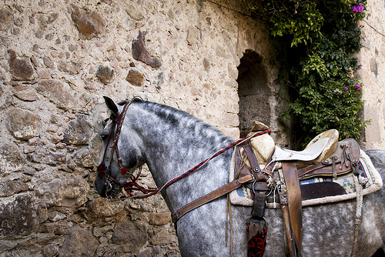
This is a horse
http://www.flickr.com/photos/kimbar/2027234083/

Slide 5
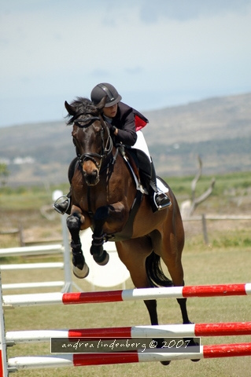
This is a horse
http://www.flickr.com/photos/genewolf/2031802050/

Slide 6
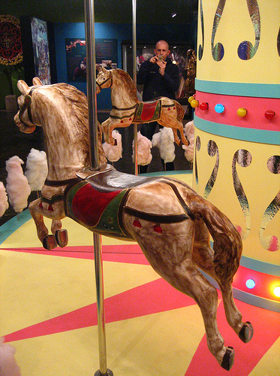
This is a... Horse?
http://www.flickr.com/photos/masheeebanshee/413465808/

Slide 7
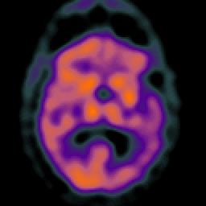
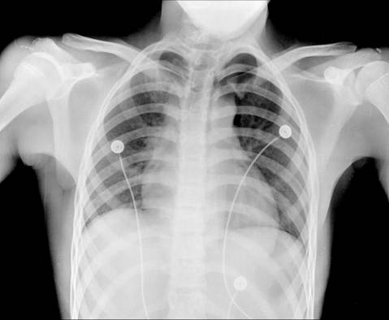
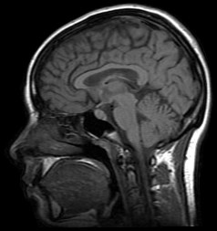
Decisions
I can manipulate images.
I want to make decisions!
Classify / Identify features.
Recognize patterns.

Slide 8
One definition
Pattern recognition
  "the act of taking in raw data and taking an action based on the category of the data".
  Wikipedia
How do I do this so well?
How can I make machines do this?

Slide 9
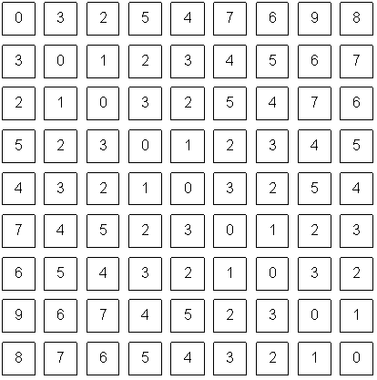
The problem
Do you ‘see’ a horse?
What a computer sees

Slide 10
Mathematics
We only deal with numbers.
  How do we represent knowledge?
  How do we represent visual features?
  How do we classify them?
Very complex problem!!
  Let’s break it into smaller ones...

Slide 11
Typical PR system
Sensor
Gathers the observations to be classified or described
Feature Extraction
Computes numeric or symbolic information from the observations;
Classifier
Does the actual job of classifying or describing observations, relying on the extracted features.

Slide 12
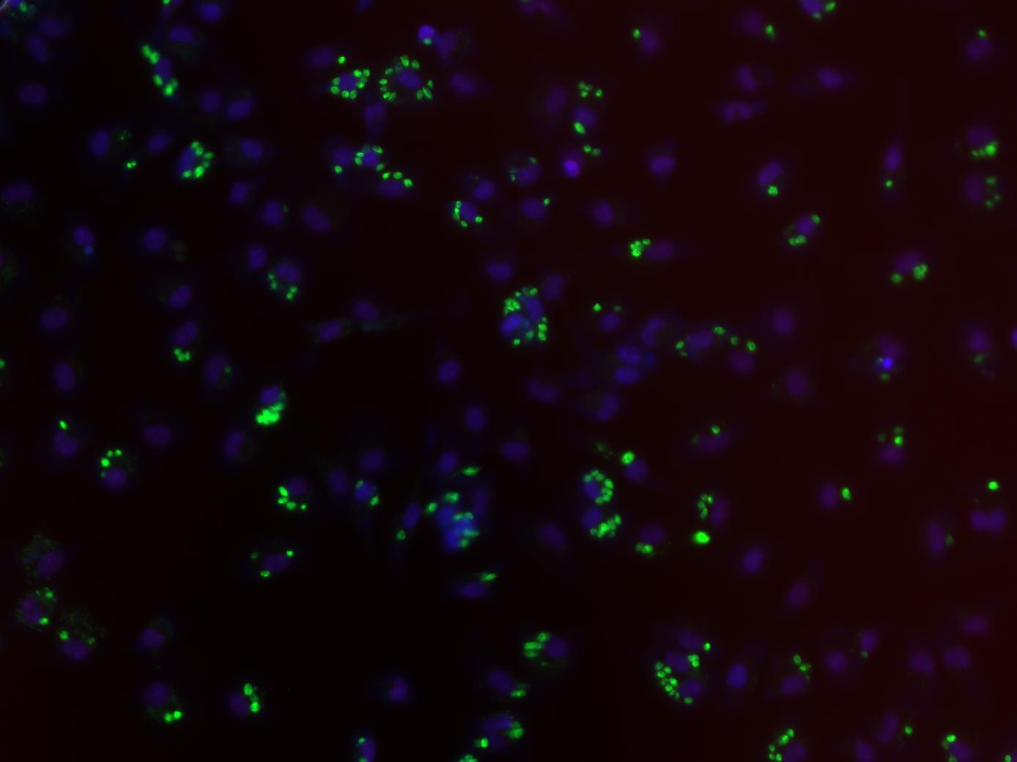
Sensor
In our specific case:
  Image acquiring mechanism.
  Let’s assume we don’t control it.
  One observation = One Image
  Video = Multiple Observations

Slide 13
Feature Extraction
What exactly are features?
  Colour, texture, shape, etc.
  Animal with 4 legs.
  Horse.
  Horse jumping.
These vary a lot!
Some imply some sort of ‘recognition’
    e.g. How do I know the horse is jumping?

Slide 14
Broad classification of features
Low-level
  Colour, texture
Middle-level
  Object with head and four legs.
  Object moving up.
  Horse
High-level
  Horse jumping.
  Horse competition.

Slide 15


Low-level features
Objective
Directly reflect specific image and video features.
  Colour
  Texture
  Shape
  Motion
  Etc.

Slide 16
Middle-level features
Some degree of subjectivity
They are typically one solution of a problem with multiple solutions.
Examples:
  Segmentation
  Optical Flow
  Identification
  Etc.

Slide 17

High-level features
Semantic Interpretation
Knowledge
Context
Examples:
  This person suffers from epilepsy.
  The virus attacks the cell with some degree of intelligence.
  This person is running from that one.
How do humans do this so well?

Slide 18
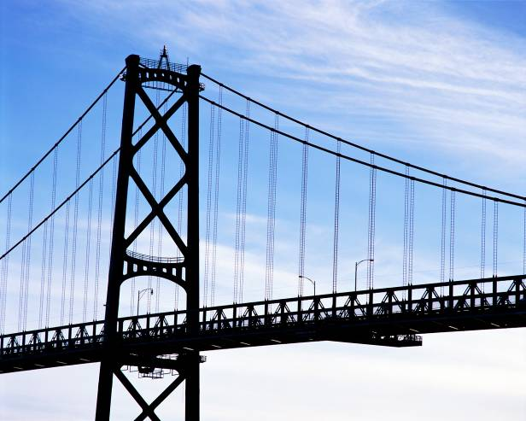
The semantic gap
Fundamental problem of current research!
Low-level:
Colour
Texture
Shape
…
High-level:
Interpretation
Decision
-Understanding
…
Now what??
How do i cross this bridge?

Slide 19
Features & Decisions
Various
Possible
Solutions
Low-Level Features
Middle-Level Features
High-Level Features
How do I decide?
Decision
Decision
One
Solution

Slide 20
Classification
Middle-Level Features
High-Level Features
Horse
Classifier
Competition
Rider
Horse
Jumping
Upward
Motion
M inputs, N outputs

Slide 21
Layers of classification
First layer of classificaiton
Second layer of classificaiton
Brown
Horse
Competition
Head
Four legs
Rider
...
Horse
Jumping
...
Upward
Motion
...

Slide 22
Classifiers
How do I map my M inputs to my N outputs?
Mathematical tools:
  Distance-based classifiers.
  Rule-based classifiers.
  Neural Networks.
  Support Vector Machines
  ...

Slide 23
Types of PR methods
Statistical pattern recognition
  based on statistical characterizations of patterns, assuming that the patterns are generated by a probabilistic system.
Syntactical (or structural) pattern recognition
  based on the structural interrelationships of features.

Slide 24
Topic: Statistical Pattern Recognition
Introduction to Pattern Recognition
Statistical Pattern Recognition
Classifiers

Slide 25
Is Porto in Portugal?

Slide 26
Porto is in Portugal
I want to make decisions.
  Is Porto in Portugal?
I know certain things.
  A world map including cities and countries.
I can make this decision!
  Porto is in Portugal.
I had enough a priori knowledge to make this decision.

Slide 27
What if I don’t have a map?
I still want to make this decision.
I observe:
  Amarante has coordinates x₁,y₁ and is in Portugal.
  Viseu has coordinates x₂, y₂ and is in Portugal.
  Vigo has coordinates x₃, y₃ and is in Spain.
I classify:
  Porto is close to Amarante and Viseu so Porto is in Portugal.
What if I try to classify Valença?

Slide 28
Statistical PR
I used statistics to make a decision.
  I can make decisions even when I don’t have full a priori knowledge of the whole process.
  I can make mistakes.
How did I recognize this pattern?
  I learned from previous observations where I knew the classification result.
  I classified a new observation.
What pattern?

Slide 29
Back to the Features
Feature F_{i}
Feature F_{i} with N values.
Feature vector F with M features.
Naming conventions:
  Elements of a feature vector are called coefficients.
  Features may have one or more coefficients.
  Feature vectors may have one or more features.

Slide 30
Back to our Porto example
I’ve classified that Porto is in Portugal.
What feature did I use?
  Spatial location
Let’s get more formal
  I’ve defined a feature vector F with one feature F₁, which has two coefficients f_{1x}, f_{1y}.

Slide 31
Feature Space
Feature Vector
  Two total coefficients.
  Can be seen as a feature ‘space’ with two orthogonal axis.
Feature Space
  Hyper-space with N dimensions where N is the total number of coefficients of my feature vector.

Slide 32
A Priori Knowledge
I have a precise model of my feature space based on a priori knowledge.
  City is in Spain if F_{1Y}>23
Great models = Great classifications.
  F_{1Y}(London) = 100
  London is in Spain (??)
I know the border is here
Porto is in Portugal!

Slide 33
What if I don’t have a model?
I need to learn from observations.
  Derive a model.
  Direct classification.
Training stage.
  Learn model parameters.
Classification
‘Learned’
Model

Slide 34
Classes
In our example, cities can belong to:
  Portugal
  Spain
I have two classes of cities.
A class represents a sub-space of my feature space.
SPAIN
PORTUGAL

Slide 35
Classifiers
A Classifier C maps a class into the feature space.
Various types of classifiers.
  Nearest-Neighbours.
  Bayesian.
  Soft-computing machines.
  Etc...

Slide 36
Topic: Classifiers
Introduction to Pattern Recognition
Statistical Pattern Recognition
Classifiers

Slide 37
Distance to Mean
I can represent a class by its mean feature vector.
To classify a new object, I choose the class with the closest mean feature vector.
Different distance measures!
Euclidean Distance

Slide 38
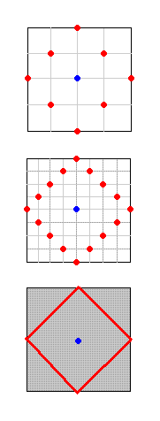
Possible Distance Measures
L1 Distance
Euclidean Distance (L2 Distance)
L1 or Taxicab Distance

Slide 39
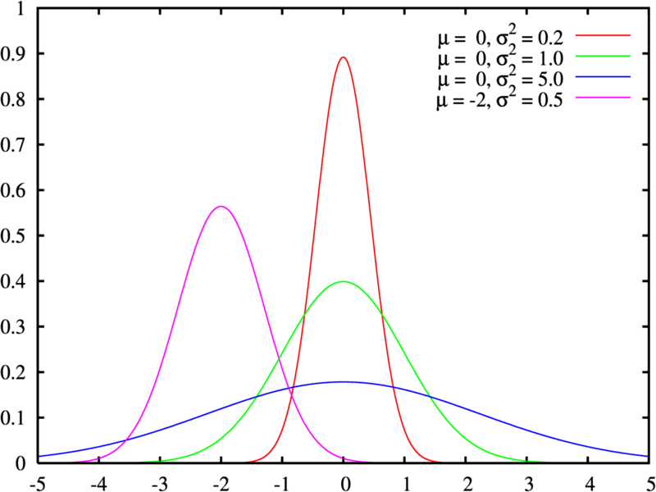
Gaussian Distribution
Defined by two parameters:
  Mean: μ
  Variance: σ²
Great approximation to the distribution of many phenomena.
  Central Limit Theorem

Slide 40



Multivariate Distribution
For N dimensions:
Mean feature vector:
Covariance Matrix:

Slide 41
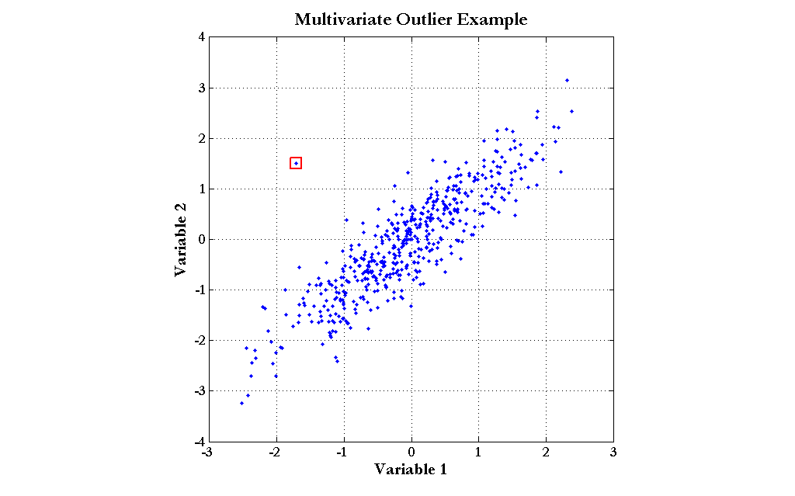
Mahalanobis Distance
Based on the covariance of coefficients.
Superior to the Euclidean distance.

Slide 42
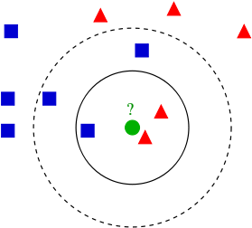
K-Nearest Neighbours
Algorithm
  Choose the closest K neighbours to a new observation.
  Classify the new object based on the class of these K objects.
Characteristics
  Assumes no model.
  Does not scale very well...

Slide 43
Resources
Gonzalez & Woods, 3rd Ed, Chapter 12.
Andrew Moore, Statistic Data Mining Tutorial, http://www.autonlab.org/tutorials/

