Slide 1
Computer Vision – TP10
Pattern Recognition
Miguel Tavares Coimbra

Slide 2
Outline
Introduction to Pattern Recognition
Statistical Pattern Recognition
Visual Features

Slide 3
Topic: Introduction to Pattern Recognition
Introduction to Pattern Recognition
Statistical Pattern Recognition
Visual Features

Slide 4
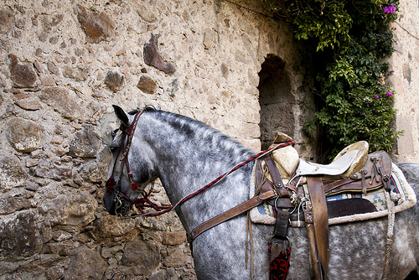
This is a horse
http://www.flickr.com/photos/kimbar/2027234083/

Slide 5
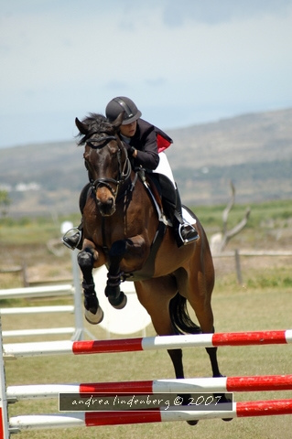
This is a horse
http://www.flickr.com/photos/genewolf/2031802050/

Slide 6
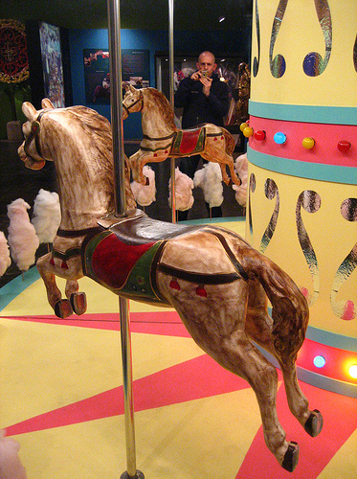
This is a... Horse?
http://www.flickr.com/photos/masheeebanshee/413465808/

Slide 7
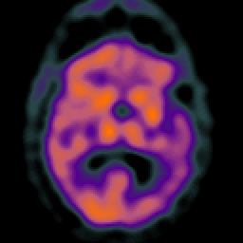
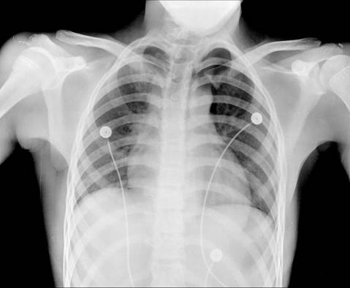
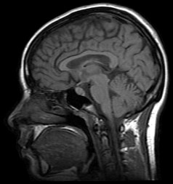
Decisions
I can manipulate images
I want to make decisions!
Classify / Identify features
Recognize patterns

Slide 8
One definition
Pattern recognition
  "the act of taking in raw data and taking an action based on the category of the data"
  Wikipedia
How do I do this so well?
How can I make machines do this?

Slide 9

The problem
Do you ‘see’ a horse?
What a computer sees

Slide 10
Mathematics
We only deal with numbers.
  How do we represent knowledge?
  How do we represent visual features?
  How do we classify them?
Very complex problem!!
  Let’s break it into smaller ones...

Slide 11
Typical PR system
Sensor
Gathers the observations to be classified or described
Feature Extraction
Computes numeric or symbolic information from the observations;
Classifier
Does the actual job of classifying or describing observations, relying on the extracted features.

Slide 12
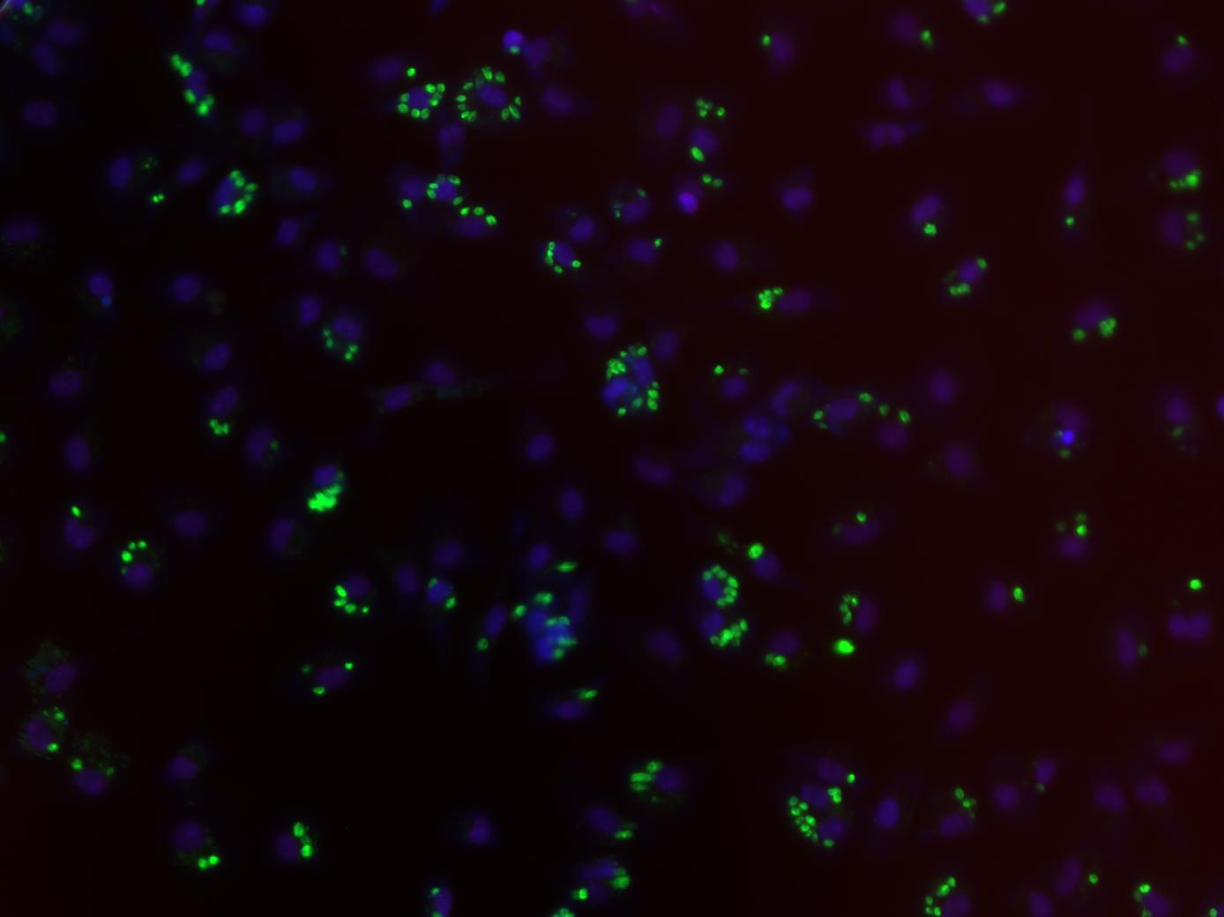
Sensor
In our specific case:
  Image acquiring mechanism
  Let’s assume we don’t control it
  One observation = One Image
  Video = Multiple Observations

Slide 13
Feature Extraction
What exactly are features?
  Colour, texture, shape, etc
  Animal with 4 legs
  Horse
  Horse jumping
These vary a lot!
Some imply some sort of ‘recognition’
    e.g. How do I know the horse is jumping?

Slide 14
Broad classification of features
Low-level
  Colour, texture
Middle-level
  Object with head and four legs
  Object moving up
  Horse
High-level
  Horse jumping
  Horse competition

Slide 15

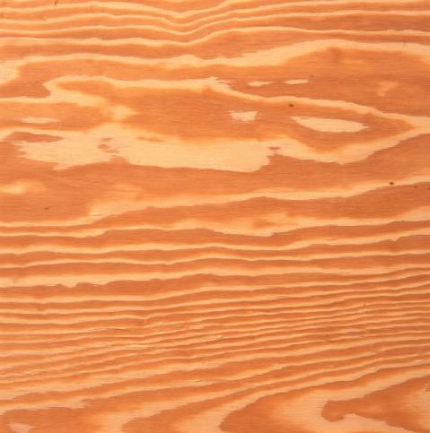
Low-level features
Objective
Directly reflect specific image and video features
  Colour
  Texture
  Shape
  Motion
  Etc.

Slide 16
Middle-level features
Some degree of subjectivity
They are typically one solution of a problem with multiple solutions
Examples:
  Segmentation
  Optical Flow
  Identification
  Etc.

Slide 17

High-level features
Semantic Interpretation
Knowledge
Context
Examples:
  This person suffers from epilepsy
  The virus attacks the cell with some degree of intelligence
  This person is running from that one
How do humans do this so well?

Slide 18
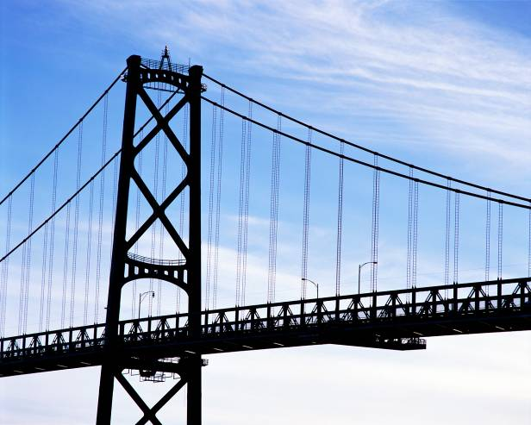
The semantic gap
Fundamental problem of current research!
Low-level:
Colour
Texture
Shape
…
High-level:
Interpretation
Decision
-Understanding
…
Now what??
How do i cross this bridge?

Slide 19
Features & Decisions
Various
Possible
Solutions
Low-Level Features
Middle-Level Features
High-Level Features
How do I decide?
Decision
Decision
One
Solution

Slide 20
Classification
Middle-Level Features
High-Level Features
Horse
Classifier
Competition
Rider
Horse
Jumping
Upward
Motion
M inputs, N outputs

Slide 21
Layers of classification
First layer of classificaiton
Second layer of classificaiton
Brown
Horse
Competition
Head
Four legs
Rider
...
Horse
Jumping
...
Upward
Motion
...

Slide 22
Classifiers
How do I map my M inputs to my N outputs?
Mathematical tools:
  Distance-based classifiers
  Rule-based classifiers
  Neural Networks
  Support Vector Machines
  ...

Slide 23
Types of PR methods
Statistical pattern recognition
  based on statistical characterizations of patterns, assuming that the patterns are generated by a probabilistic system
Syntactical (or structural) pattern recognition
  based on the structural interrelationships of features

Slide 24
Topic: Statistical Pattern Recognition
Introduction to Pattern Recognition
Statistical Pattern Recognition
Visual Features

Slide 25
Is Porto in Portugal?

Slide 26
Porto is in Portugal
I want to make decisions
  Is Porto in Portugal?
I know certain things
  A world map including cities and countries
I can make this decision!
  Porto is in Portugal
I had enough a priori knowledge to make this decision

Slide 27
What if I don’t have a map?
I still want to make this decision
I observe:
  Amarante has coordinates x₁,y₁ and is in Portugal
  Viseu has coordinates x₂, y₂ and is in Portugal
  Vigo has coordinates x₃, y₃ and is in Spain
I classify:
  Porto is close to Amarante and Viseu so Porto is in Portugal
What if I try to classify Valença?

Slide 28
Statistical PR
I used statistics to make a decision
  I can make decisions even when I don’t have full a priori knowledge of the whole process
  I can make mistakes
How did I recognize this pattern?
  I learned from previous observations where I knew the classification result
  I classified a new observation
What pattern?

Slide 29
Back to the Features
Feature F_{i}
Feature F_{i} with N values.
Feature vector F with M features.
Naming conventions:
  Elements of a feature vector are called coefficients
  Features may have one or more coefficients
  Feature vectors may have one or more features

Slide 30
Back to our Porto example
I’ve classified that Porto is in Portugal
What feature did I use?
  Spatial location
Let’s get more formal
  I’ve defined a feature vector F with one feature F₁, which has two coefficients f_{1x}, f_{1y}

Slide 31
Feature Space
Feature Vector
  Two total coefficients
  Can be seen as a feature ‘space’ with two orthogonal axis
Feature Space
  Hyper-space with N dimensions where N is the total number of coefficients of my feature vector

Slide 32
A Priori Knowledge
I have a precise model of my feature space based on a priori knowledge
  City is in Spain if F_{1Y}>23
Great models = Great classifications
  F_{1Y}(London) = 100
  London is in Spain (??)
I know the border is here
Porto is in Portugal!

Slide 33
What if I don’t have a model?
I need to learn from observations.
  Derive a model
  Direct classification
Training stage
  Learn model parameters
Classification
‘Learned’
Model

Slide 34
Classes
In our example, cities can belong to:
  Portugal
  Spain
I have two classes of cities
A class represents a sub-space of my feature space
SPAIN
PORTUGAL

Slide 35
Classifiers
A Classifier C maps a class into the feature space
Various types of classifiers
  Nearest-Neighbours
  Bayesian
  Soft-computing machines
  Etc...

Slide 36
Distance to Mean
I can represent a class by its mean feature vector
To classify a new object, I choose the class with the closest mean feature vector
Different distance measures!
Euclidean Distance

Slide 37
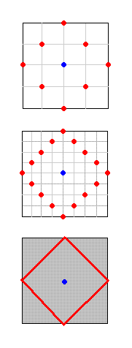
Possible Distance Measures
L1 Distance
Euclidean Distance (L2 Distance)
L1 or Taxicab Distance

Slide 38
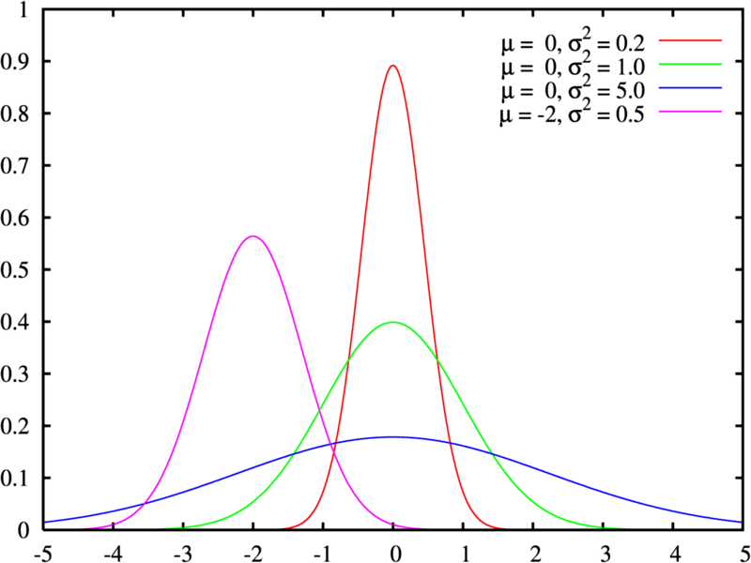
Gaussian Distribution
Defined by two parameters:
  Mean: μ
  Variance: σ²
Great approximation to the distribution of many phenomena.
  Central Limit Theorem

Slide 39



Multivariate Distribution
For N dimensions:
Mean feature vector:
Covariance Matrix:

Slide 40
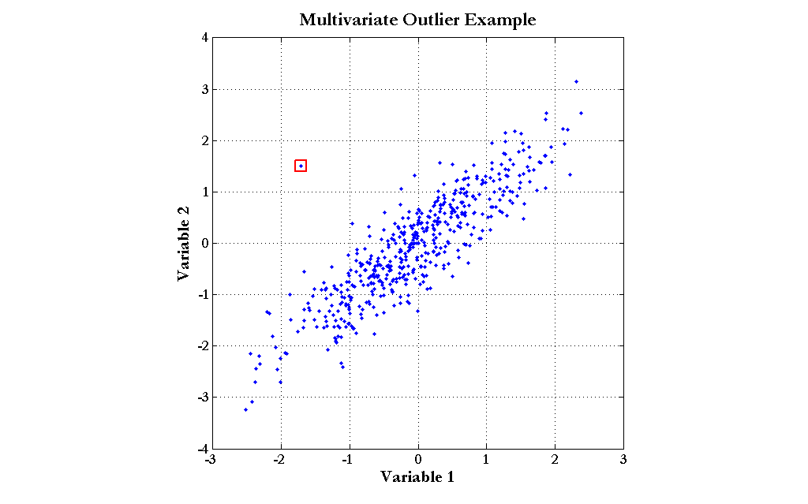
Mahalanobis Distance
Based on the covariance of coefficients
Superior to the Euclidean distance

Slide 41
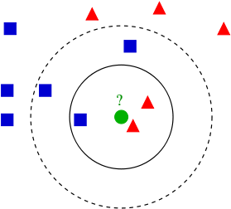
K-Nearest Neighbours
Algorithm
  Choose the closest K neighbours to a new observation
  Classify the new object based on the class of these K objects
Characteristics
  Assumes no model
  Does not scale very well...

Slide 42
Topic: Visual Features
Introduction to Pattern Recognition
Statistical Pattern Recognition
Visual Features

Slide 43
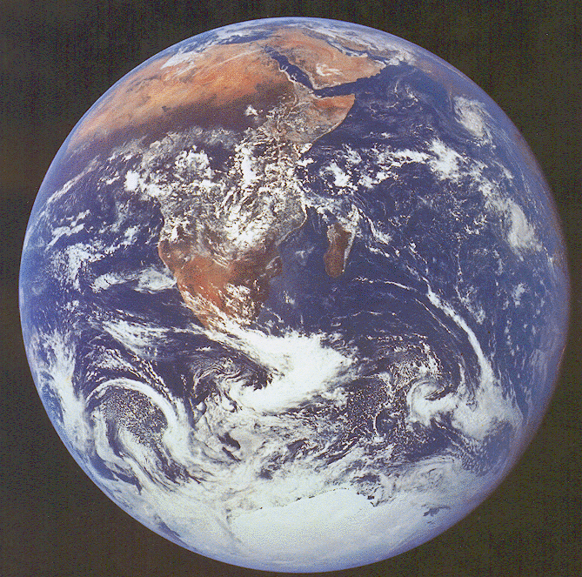
Visual Features
The earth is blue,
white and
brown
The earth is round
The south pole has
a smooth texture

Slide 44
Visual Features
Features
  Measure specific characteristics
  Numerical values
  May have multiple values
Visual Features
  Quantify visual characteristics of an image
  Popular features
    Colour, Texture, Shape

Slide 45
Feature vector
Feature F_{i}
Feature F_{i} with N values.
Feature vector F with M features.
Naming conventions for this module:
  Elements of a feature vector are called coefficients
  Features may have one or more coefficients
  Feature vectors may have one or more features

Slide 46
Features & Decisions
Various
Possible
Solutions
Low-Level Features
Starting point of most classification tasks!
Middle-Level Features
High-Level Features
How do I decide?
Decision
Decision
One
Solution

Slide 47
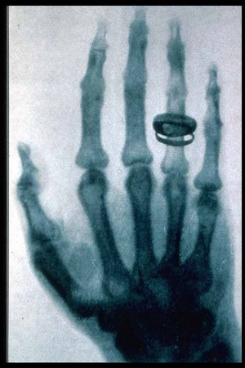
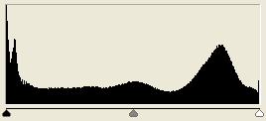
Gray-Level Histogram
Intensity distribution (HSI)
We can define the number of histogram bins
Histogram bins = Feature coefficients

Slide 48
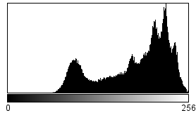
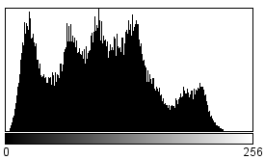
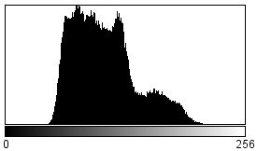
Colour Histogram
We typically have three histograms
  Ex: RGB Colour space
  - Red Histogram
  - Green Histogram
  - Blue Histogram
How do we build a feature vector?
  Concatenate vectors
  Multi-dimensional quantization of colour space
Red
Green
Blue

Slide 49
RGB Histogram
Simply concatenate vectors
Not very smart... (why?)

Slide 50
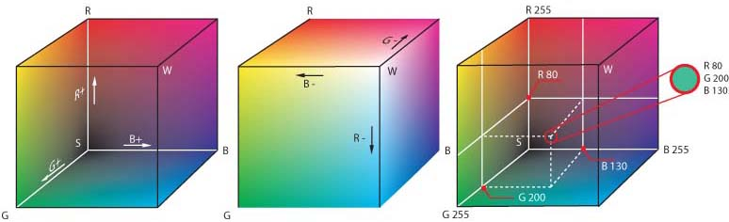
Combined Histogram
Quantize multi-dimensional colour space
RGB
  Each coefficient is a small ‘cube’ inside the RGB cube

Slide 51
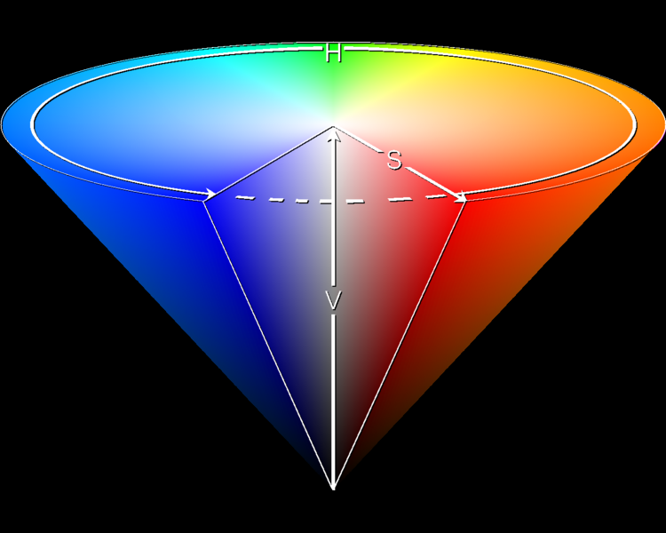
HSI Histogram
Quantize HSI space
  Define number of bins N.
  Feature vector
Typically better for object description

Slide 52
Example: MPEG-7 Scalable Colour
HSI Histogram
Typical quantization: 256 bins.
  16 levels in H
  4 levels in S
  4 levels in I
Very popular for CBIR (Content-Based Image Retrieval).

Slide 53
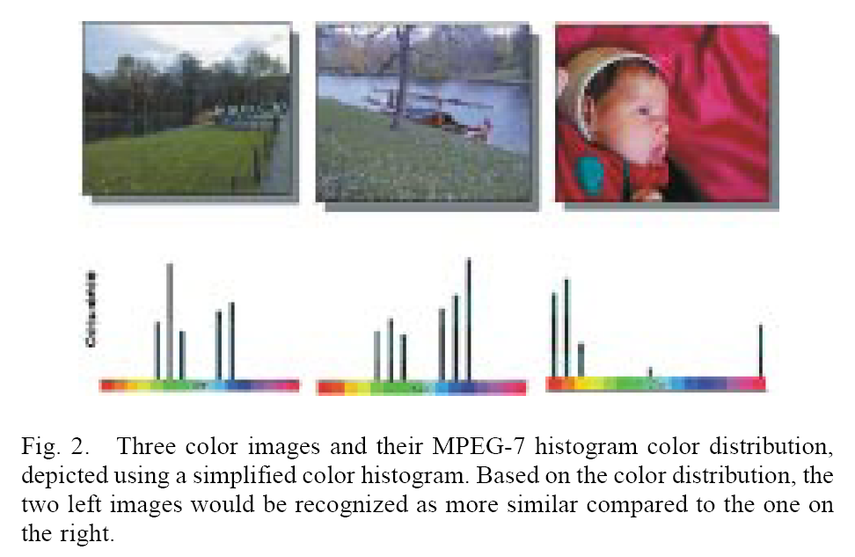
[Sikora 2001]

Slide 54
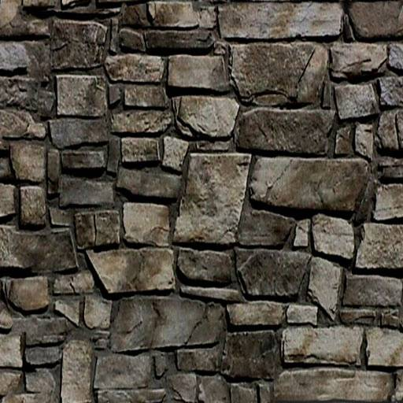
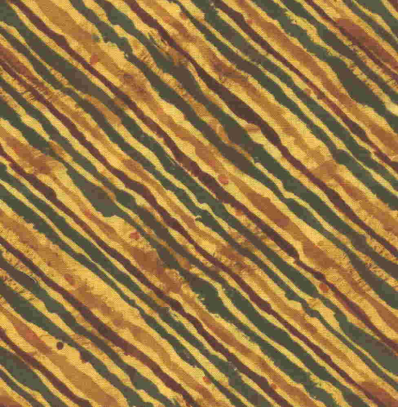
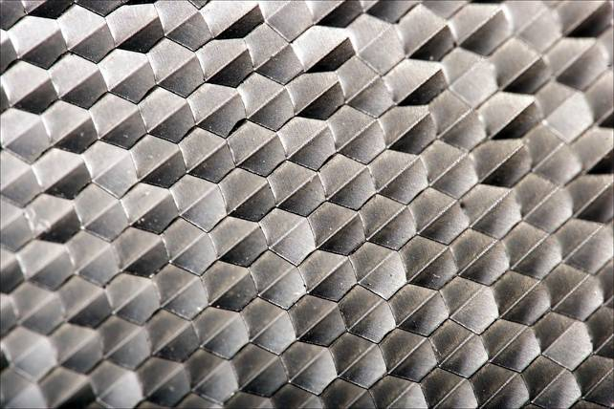
What is texture?
“Texture gives us information about the spatial arrangement of the colours or intensities in an image”
[L. Shapiro]

Slide 55
Two approaches to texture
Structural approach
  Texture is a set of primitive texels in some regular or repeated relationship
  Good for regular, ‘man-made’ textures
Statistical approach
  Texture is a quantitative measure of the arrangement of intensities in a region
  More general and easier to compute

Slide 56
Statistical approaches
Grey level of central pixels
Average of grey levels in window
Median
Standard deviation of grey levels
Difference of maximum and minimum grey levels
Difference between average grey level in small and large windows
Sobel feature
Kirsch feature
Derivative in x window
Derivative in y window
Diagonal derivatives
Combine features
How do I pick one??

Slide 57
Gabor Filter Banks
Filters the image with a set of orientation and scale sensitive filters
Computes mean and standard deviation of response
Example: 30 channels
  6 in angular direction, 5 in radial direction
$$F_{GFB}=\left[f_{DC},f_{SC},e_{1},e_{2},...,e_{30},d_{1},d_{2},...,d_{30}\right]$$
fDC, fSC are the mean intensity and the standard deviation of image texture), where
ex and dx are the logarithmically scaled texture energy and texture energy deviation coefficients.

Slide 58
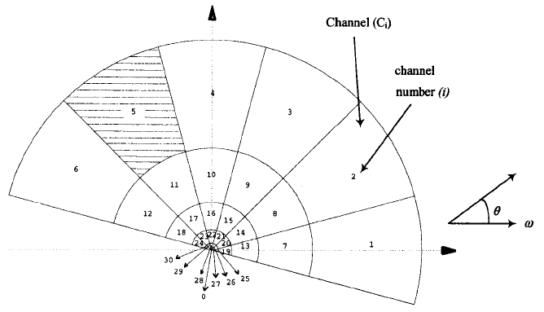
GFB Channels

Slide 59
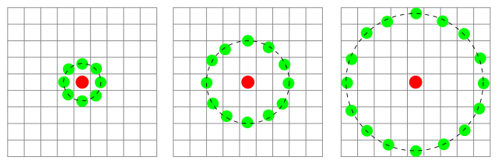
Local Binary Patterns
Idea: Compare the intensity value of a pixel with its neighbors
  1 if neighbor is larger
  0 if not
Combine results to generate a unique binary code
Create a histogram of occurences of each binary pattern

Slide 60
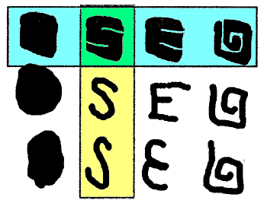
Shape Descriptors
Blue: Similar shapes by Region-Based
Yellow: Similar shapes by Contour-Based

Slide 61
Example: Region-Based Shape Descriptor
Use a set of separable ART (angular radial transformation) functions
Classify shape along various angular and radial directions
Totals 35 coefficients

Slide 62
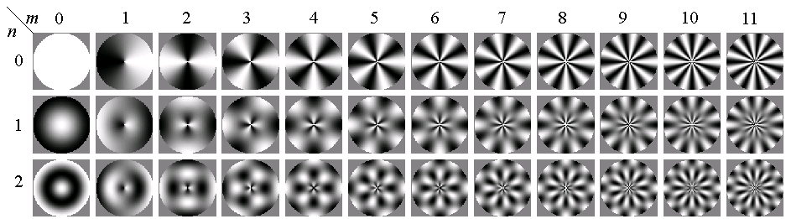
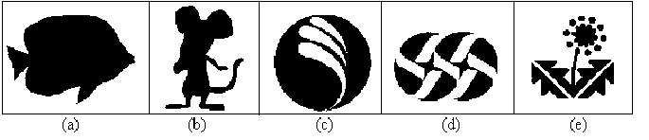
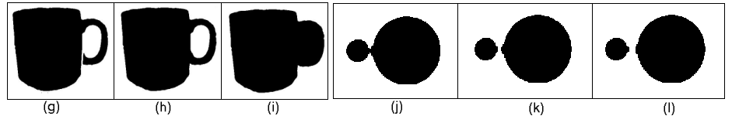
ART Basis Functions
Applicable to figures (a) – (e)
Distinguishes (i) from (g) and (h)
(j), (k), and (l) are similar

Slide 63
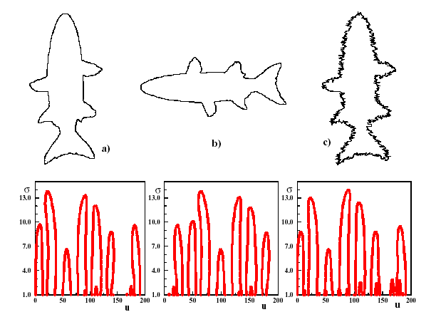
Example: Contour-Based Shape Descriptor
Finds curvature zero crossing points of the shape’s contour (key points)
Reduces the number of key points step by step, by applying Gaussian smoothing
The position of key points are expressed relative to the length of the contour curve

Slide 64
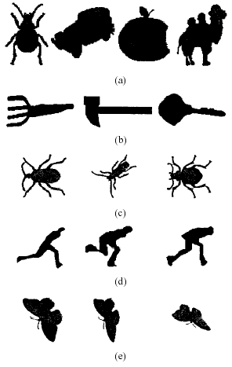
Applicable to (a)
Distinguishes differences in (b)
Find similarities in (c) - (e)
Advantages:
        Captures the shape very well
  Robust to the noise, scale, and orientation
  It is fast and compact

Slide 65
Resources
Szeliski, “Computer Vision: Algorithms and Applications”, Springer, 2011
  Chapter 14 – “Recognition”

