Slide 1
Computer Vision – TP11
Local Invariant Descriptors
Miguel Tavares Coimbra
Acknowledgement: Slides adapted from Kristen Grauman

Slide 2
Outline
Detection of interest points
Local invariant descriptors
Classification using visual words

Slide 3
Topic: Detection of interest points
Detection of interest points
Local invariant descriptors
Classification using visual words

Slide 4
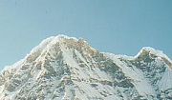

Motivation: Same interest points
We want to detect the same points in both images
No chance to find true matches!
Notes:
4

Slide 5
Motivation: ‘Unique’ descriptor per interest point
We want to match the same interest points
Need a descriptor invariant to geometric and photometric differences
?

Slide 6
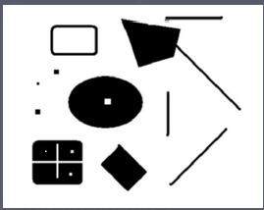
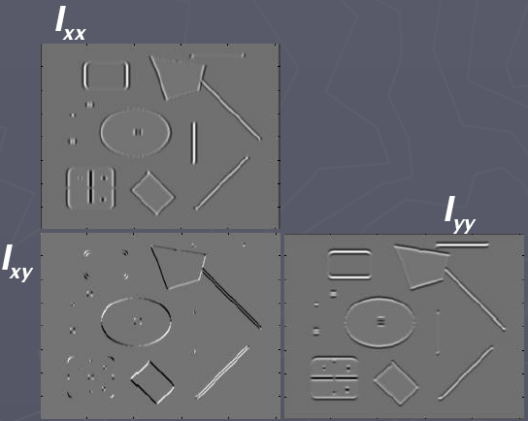
Corners are distinctive interest points
2 x 2 matrix of image derivatives (averaged in neighborhood of a point)
Notation:

Slide 7

Gradient strength
Since M is symmetric, we have
The eigenvalues of M reveal the amount of intensity change in the two principal orthogonal gradient directions in the window

Slide 8
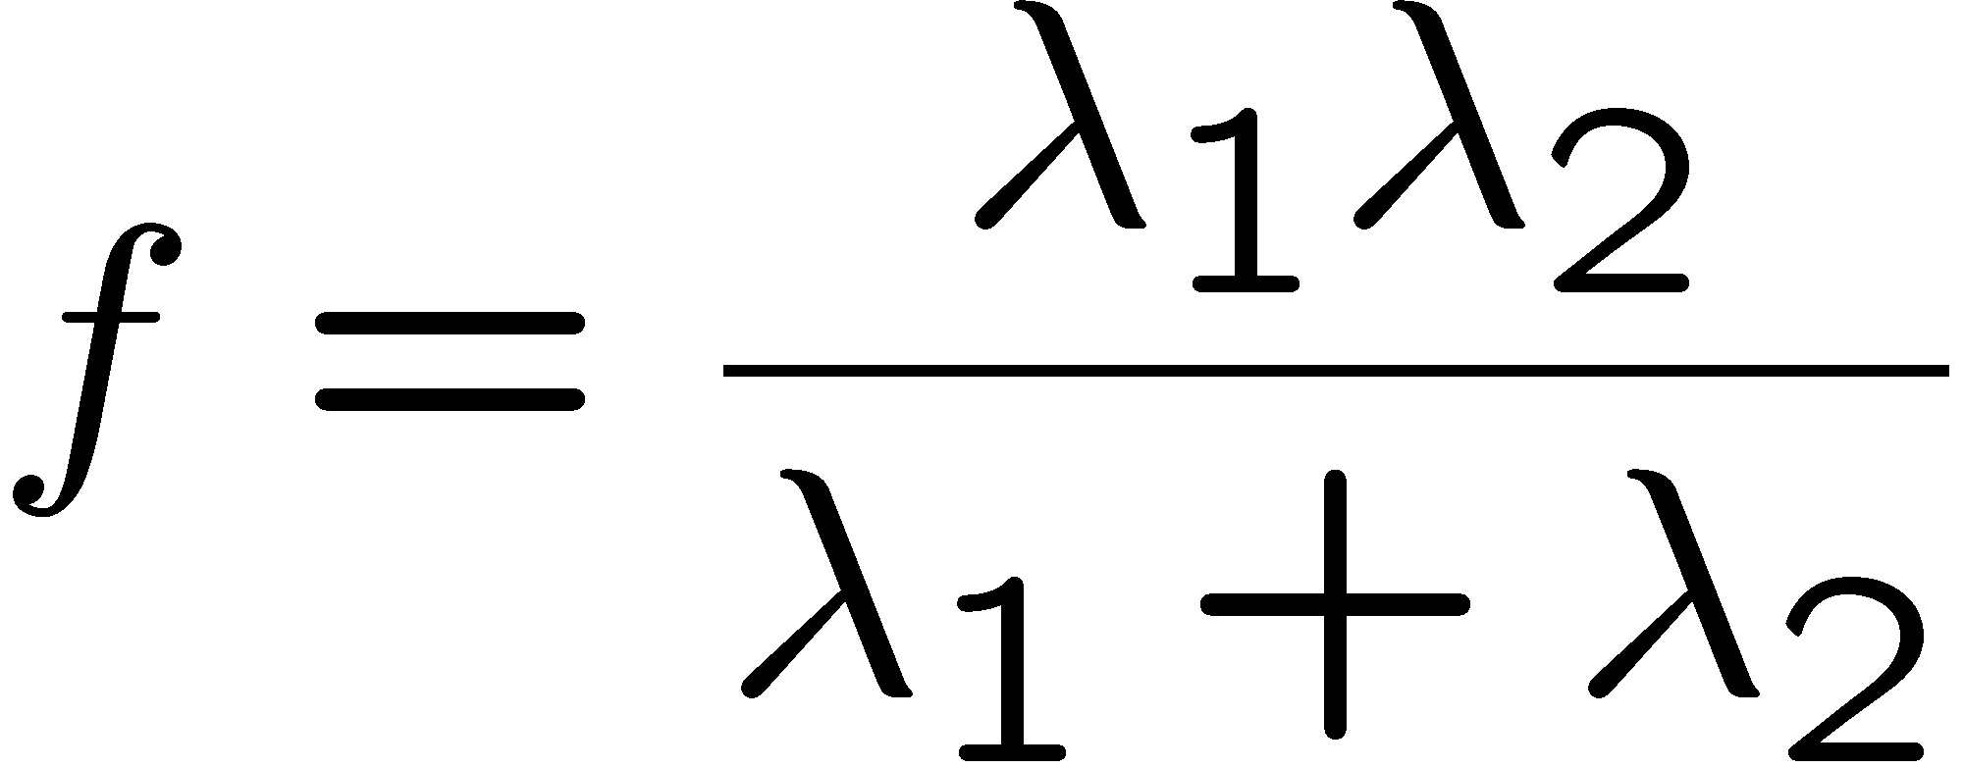
Scoring ‘cornerness’
“edge”:
“corner”:
“flat” region
λ₁ >> λ₂
λ₁ and λ₂ are large,
λ₁ ~ λ₂;
λ₁ and λ₂ are small;
λ₂ >> λ₁
One way to score the cornerness:

Slide 9
Harris corner detector
Compute M matrix for image window surrounding each pixel to get its cornerness score.
Find points with large corner response (f > threshold)
Take the points of local maxima, i.e., perform non-maximum suppression
Notes:
9

Slide 10
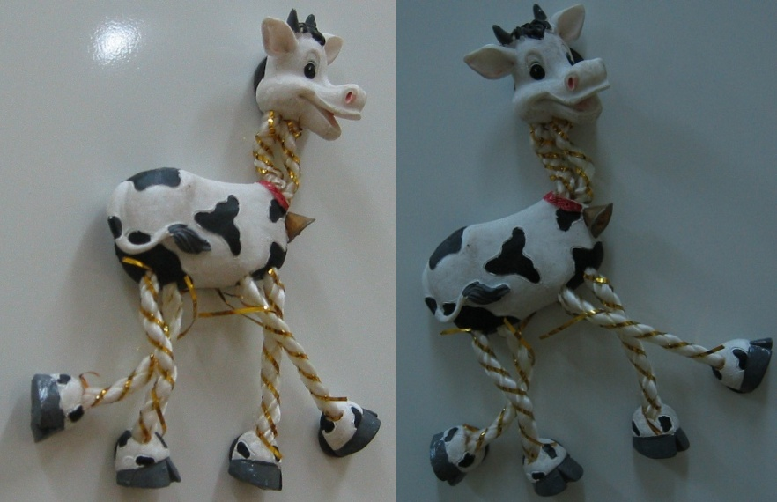

Slide 11
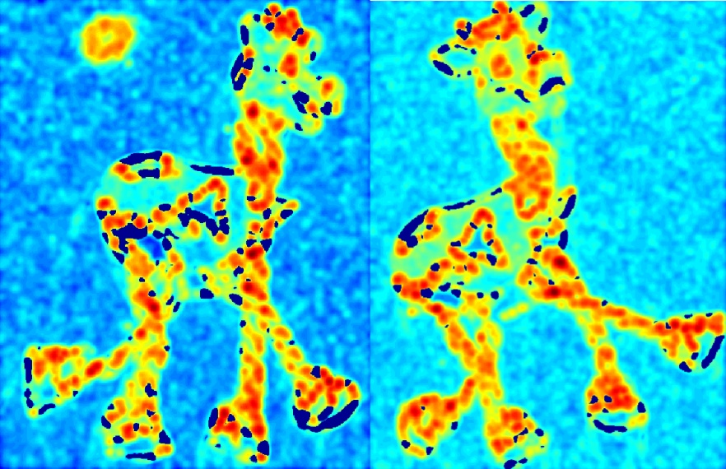

Slide 12
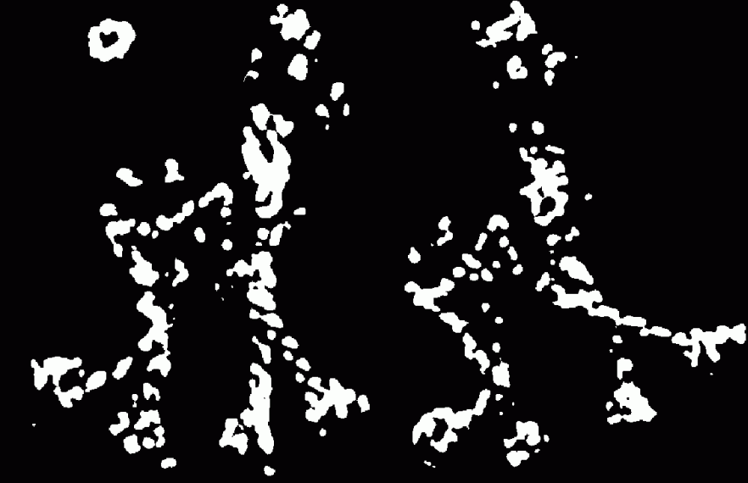

Slide 13


Slide 14


Slide 15
Properties of the Harris corner detector
Rotation invariant?
Scale invariant?
Yes

Slide 16
Properties of the Harris corner detector
Rotation invariant?
Scale invariant?
Yes
No
All points will be classified as edges
Corner !

Slide 17
Automatic scale selection
f
f
Image 1
Image 2
s₁
region size
s₂
region size

Slide 18
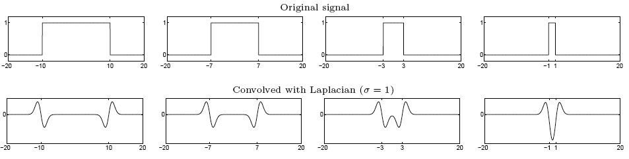
From edges to blobs
Edge = ripple
Blob = superposition of two ripples
Spatial selection: the magnitude of the Laplacian
response will achieve a maximum at the center of
the blob, provided the scale of the Laplacian is
“matched” to the scale of the blob
maximum

Slide 19
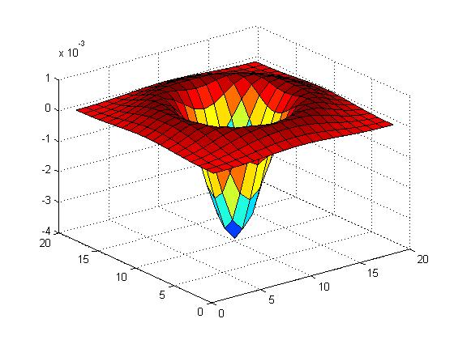

Blob detection in 2D
Laplacian of Gaussian: Circularly symmetric operator for blob detection in 2D

Slide 20
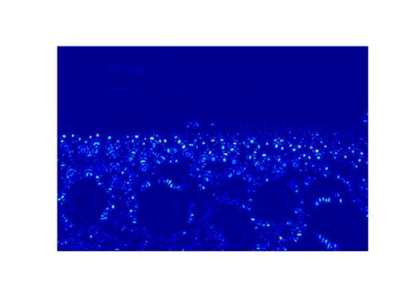
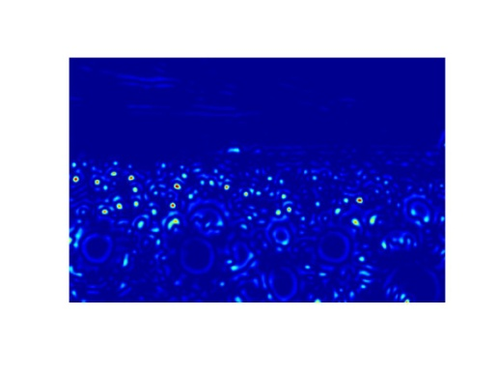
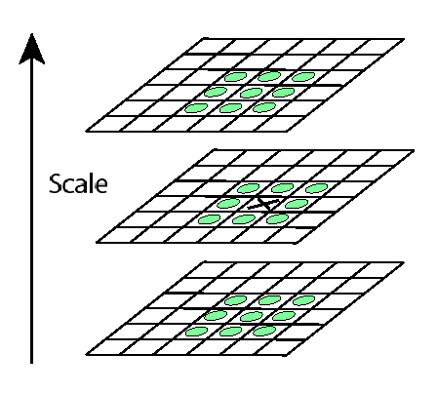
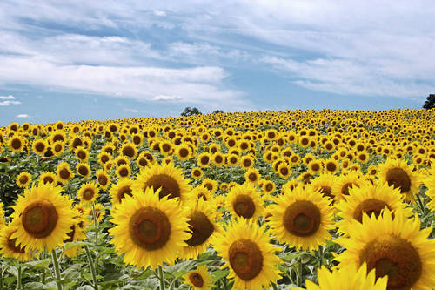
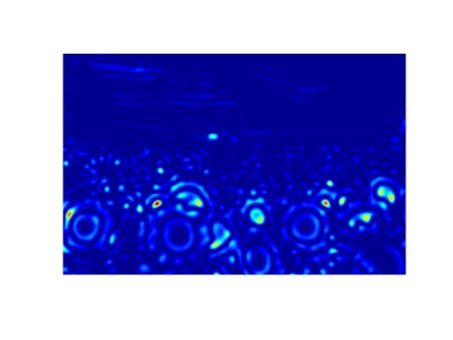
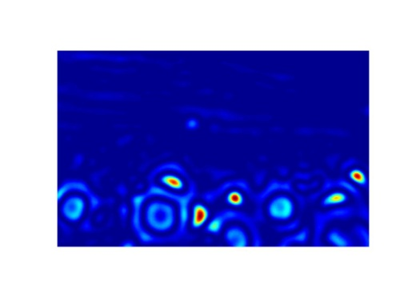
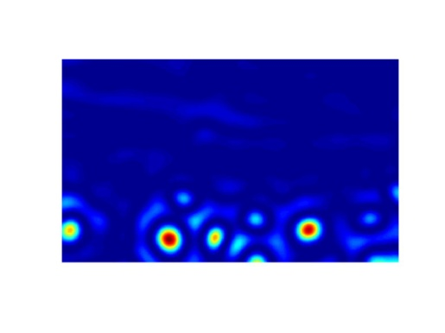
Scale invariant interest points
Interest points are local maxima in both position and scale
σ5
scale
σ4
σ3
σ2
⇒ List of
(x, y, σ)
Squared filter response maps
σ1

Slide 21
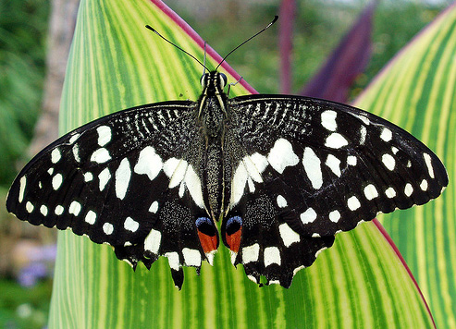
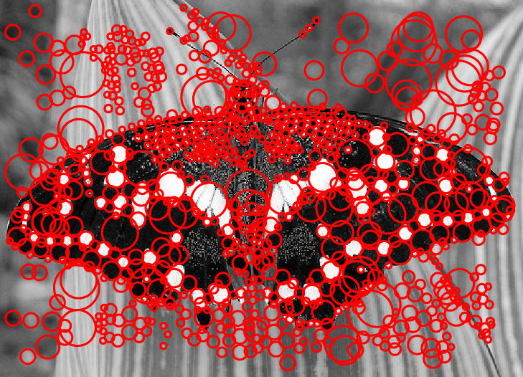
Example

Slide 22
Topic: Local invariant descriptors
Detection of interest points
Local invariant descriptors
Classification using visual words

Slide 23




Geometric transformations
e.g. scale, translation, rotation

Slide 24
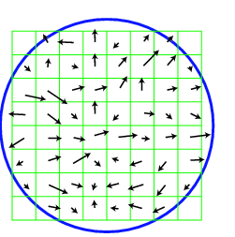
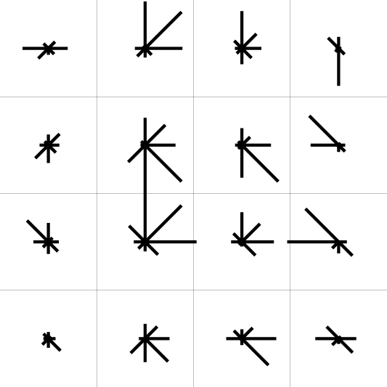
SIFT descriptor [Lowe 2004]
Use histograms to bin pixels within sub-patches according to their orientation
0
2
π
Why subpatches?
Why does SIFT have some illumination invariance?

Slide 25
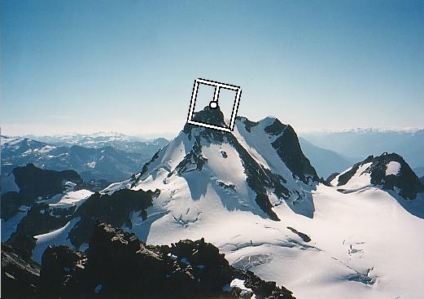
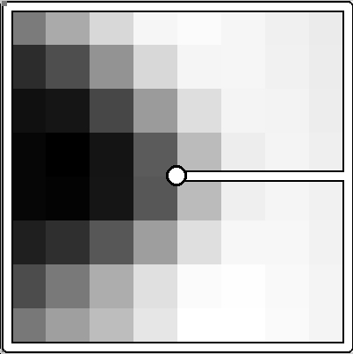
Making descriptor rotation invariant
Rotate patch according to its dominant gradient orientation
This puts the patches into a canonical orientation
CSE 576: Computer Vision

Slide 26
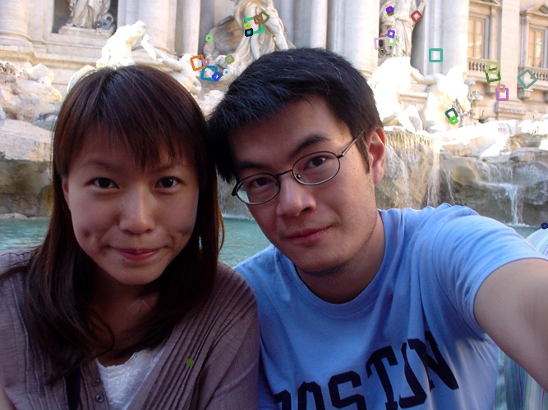
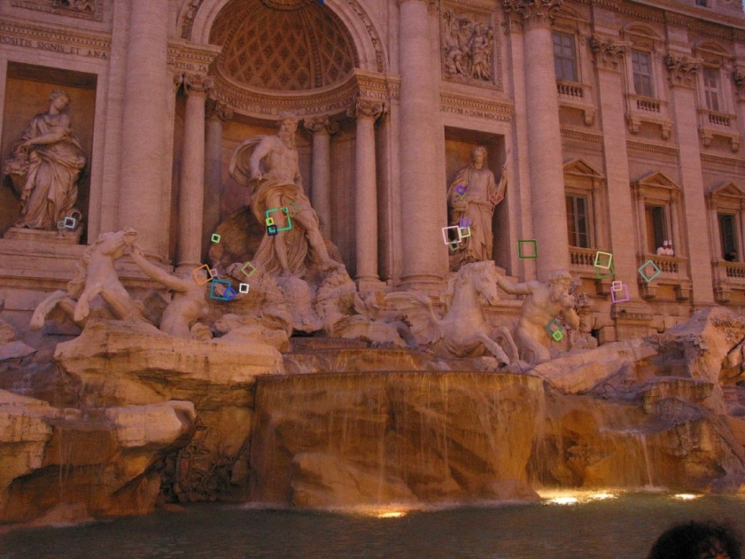
SIFT descriptor [Lowe 2004]
Extraordinarily robust matching technique
  Can handle changes in viewpoint
  Can handle significant changes in illumination
  Fast and efficient—can run in real time
  Lots of code available

Slide 27
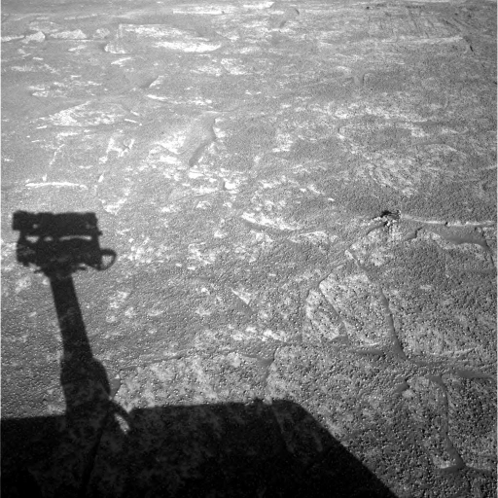
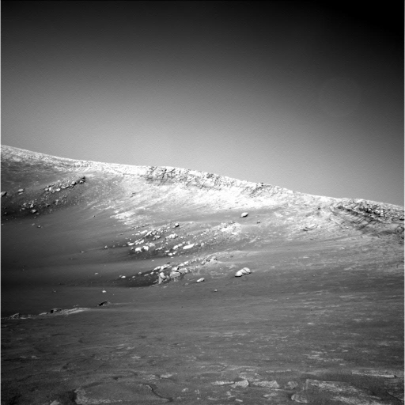
Example
NASA Mars Rover images

Slide 28
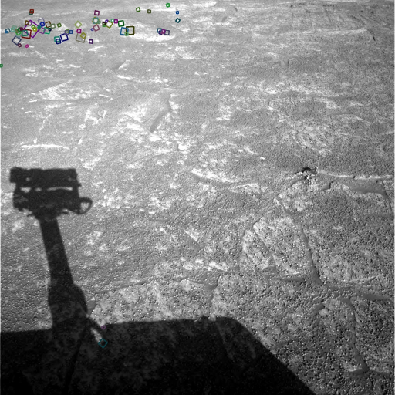
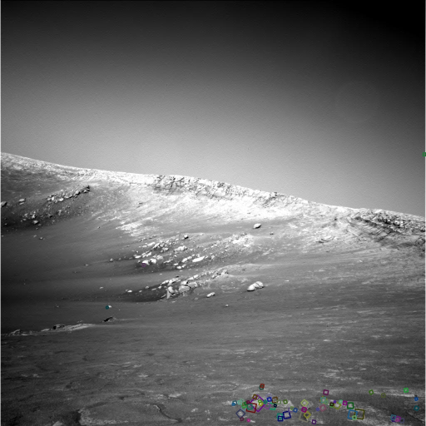
Example
NASA Mars Rover images

Slide 29
SIFT properties
Invariant to
  Scale
  Rotation
Partially invariant to
  Illumination changes
  Camera viewpoint
  Occlusion, clutter

Slide 30
Summary
Interest point detection
  Harris corner detector
  Laplacian of Gaussian, automatic scale selection
Invariant descriptors
  Rotation according to dominant gradient direction
  Histograms for robustness to small shifts and translations (SIFT descriptor)

Slide 31
Topic: Classification using visual words
Detection of interest points
Local invariant descriptors
Classification using visual words

Slide 32

Visual words: main idea
Extract some local features from a number of images …

Slide 33
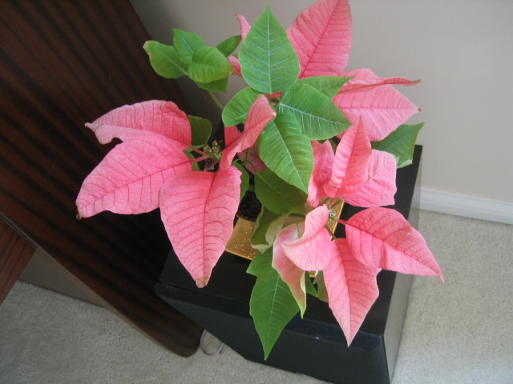
Visual words: main idea

Slide 34
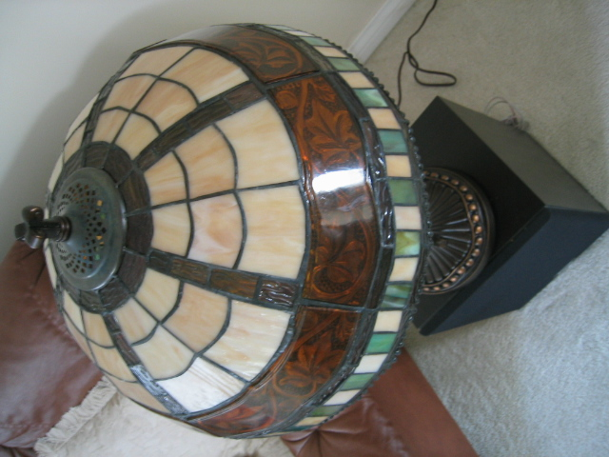
Visual words: main idea

Slide 35

Visual words: main idea

Slide 36
Each point is a local descriptor, e.g. SIFT vector.

Slide 38
Visual words
Map high-dimensional descriptors to tokens by quantizing the feature space
Quantize via clustering, let cluster centers be the prototype “words”
Determine which word to assign to each new image region by finding the closest cluster center
Descriptor’s feature space

Slide 39
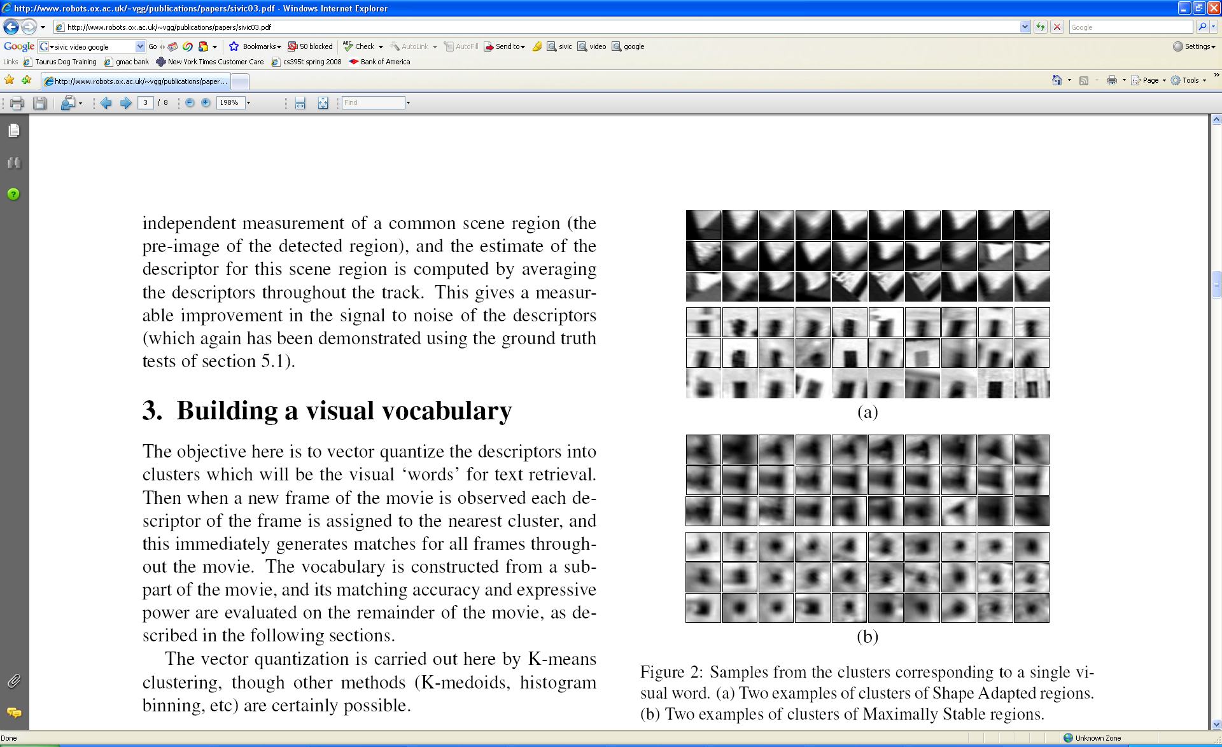
Visual words
Example: each group of patches belongs to the same visual word

Slide 40
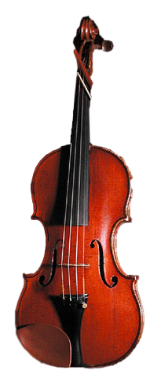
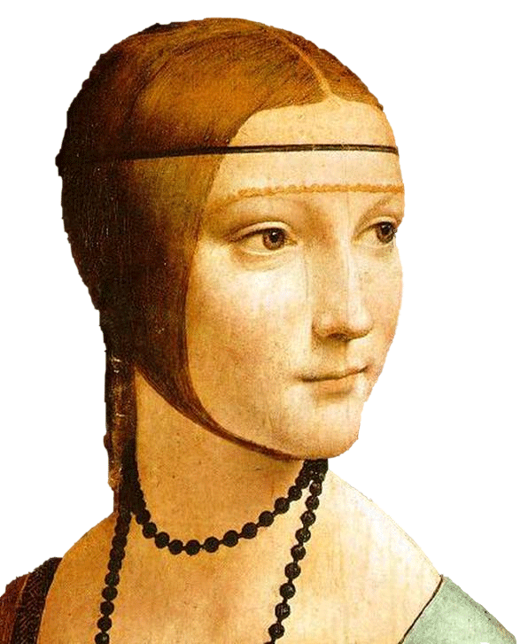
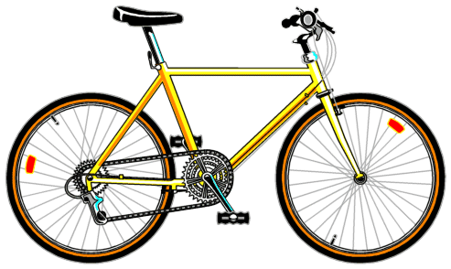
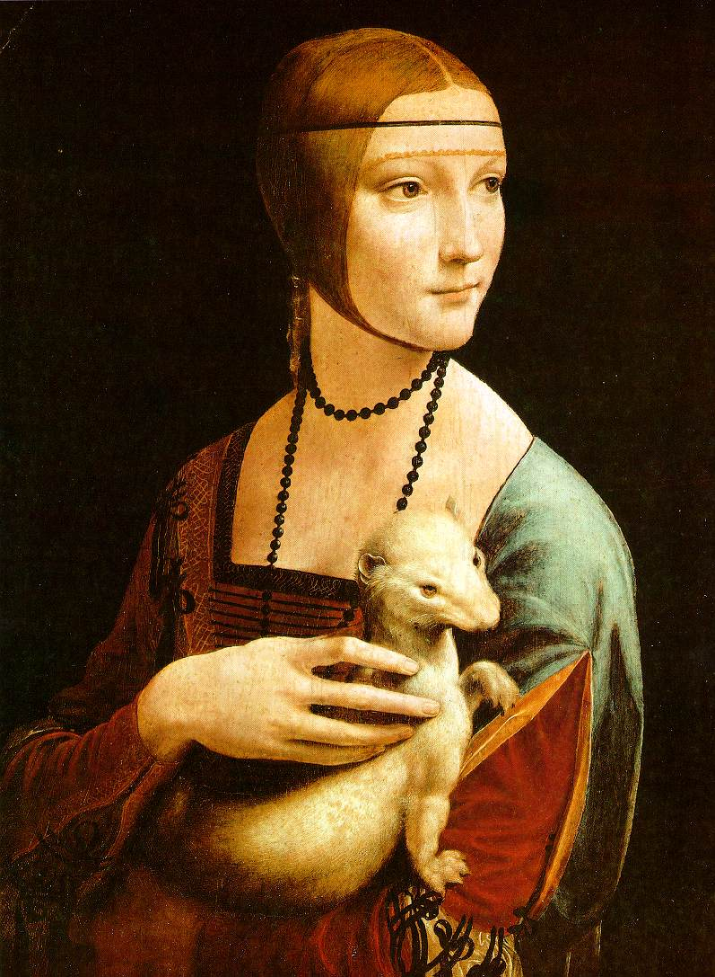

Slide 41
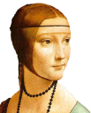






Bags of visual words
Summarize entire image based on its distribution (histogram) of word occurrences
Analogous to bag of words representation commonly used for documents
Notes:
41

Slide 42





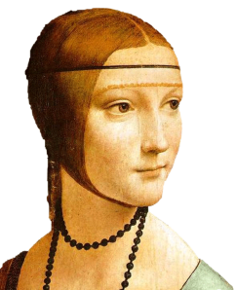
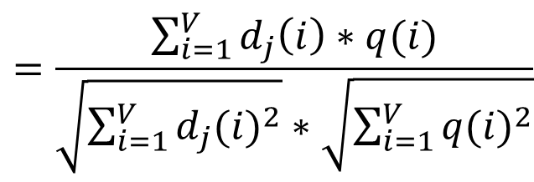
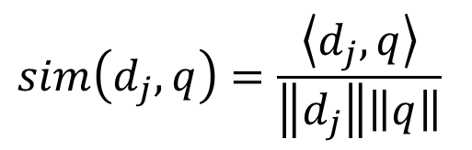
Comparing bags of words
Rank frames by normalized scalar product between their (possibly weighted) occurrence counts---nearest neighbor search for similar images
$$sim\left(d_{j},q\right)=\frac{\left\langle d_{j},q\right\rangle }{\left\|d_{j}\right\|\left\|q\right\|}$$
$$=\frac{\sum_{i=1}^{V}{d_{j}\left(i\right)∗q(i)}}{\sqrt{\sum_{i=1}^{V}{{d_{j}(i)}^{2}}}∗\sqrt{\sum_{i=1}^{V}{{q(i)}^{2}}}}$$
for vocabulary of V words

Slide 43
Bags of words: pros and cons
+ flexible to geometry / deformations / viewpoint
+ compact summary of image content
+ provides vector representation for sets
+ very good results in practice
basic model ignores geometry – must verify afterwards, or encode via features
background and foreground mixed when bag covers whole image
optimal vocabulary formation remains unclear
Notes:
43

Slide 44
Resources
Szeliski, “Computer Vision: Algorithms and Applications”, Springer, 2011
  Chapter 4 – “Feature Detection and Matching”

