Slide 1
Computer Vision – TP12
Optical Flow
Miguel Tavares Coimbra

Slide 2
Outline
Optical Flow Constraint Equation
Lucas & Kanade Algorithm

Slide 3
Topic: Optical Flow Constraint Equation
Optical Flow Constraint Equation
Lucas & Kanade Algorithm

Slide 4
Optical Flow and Motion
We are interested in finding the movement of
scene objects from time-varying images (videos)
Lots of uses
  Track object behavior
  Correct for camera jitter (stabilization)
  Align images (mosaics)
  3D shape reconstruction
  Special effects

Slide 5
Exemplo
Where can i find motion?

Slide 6
Lucas & Kanade Optical Flow method

Slide 7
Optical Flow – What is that?
Optical flow is “the distribution of apparent velocities of movement of brightness patterns in an image” – Horn and Schunck 1980
The optical flow field approximates the true motion field which is a “purely geometrical concept..., it is the [2D] projection into the image [plane] of [the sequence’s] 3D motion vectors” – Horn and Schunk 1993
y
Motion
Plane
Image
Plane
z
x
What can i use it for?

Slide 8
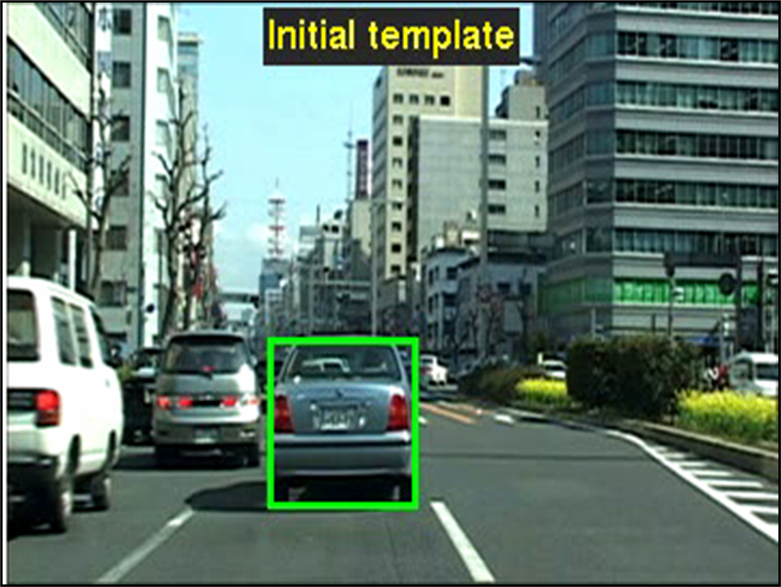
Tracking Rigid Objects
(Simon Baker, CMU)

Slide 9
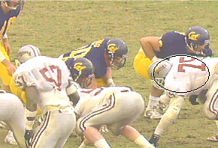
Tracking – Non-rigid Objects
(Comaniciu et al, Siemens)

Slide 10
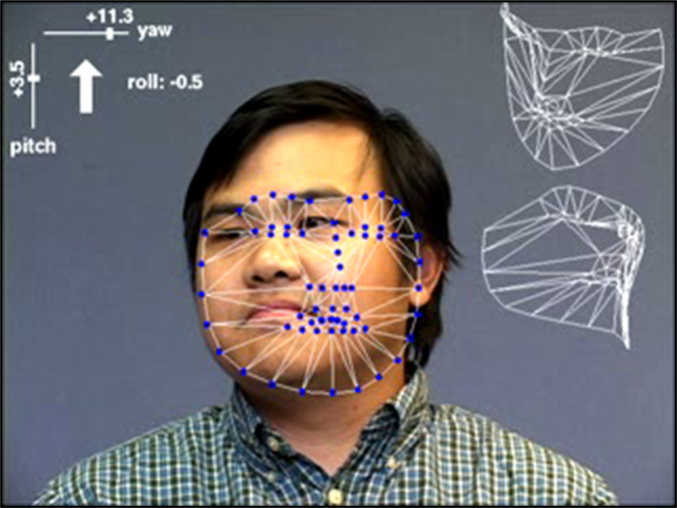
Face Tracking
(Simon Baker et al, CMU)

Slide 11
Motion Field
Image velocity of a point moving in the scene

Slide 12
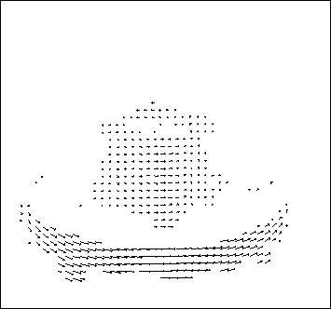
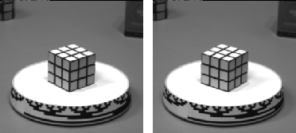
Optical Flow
Motion of brightness patterns in the image
Ideally Optical flow = Motion field

Slide 13
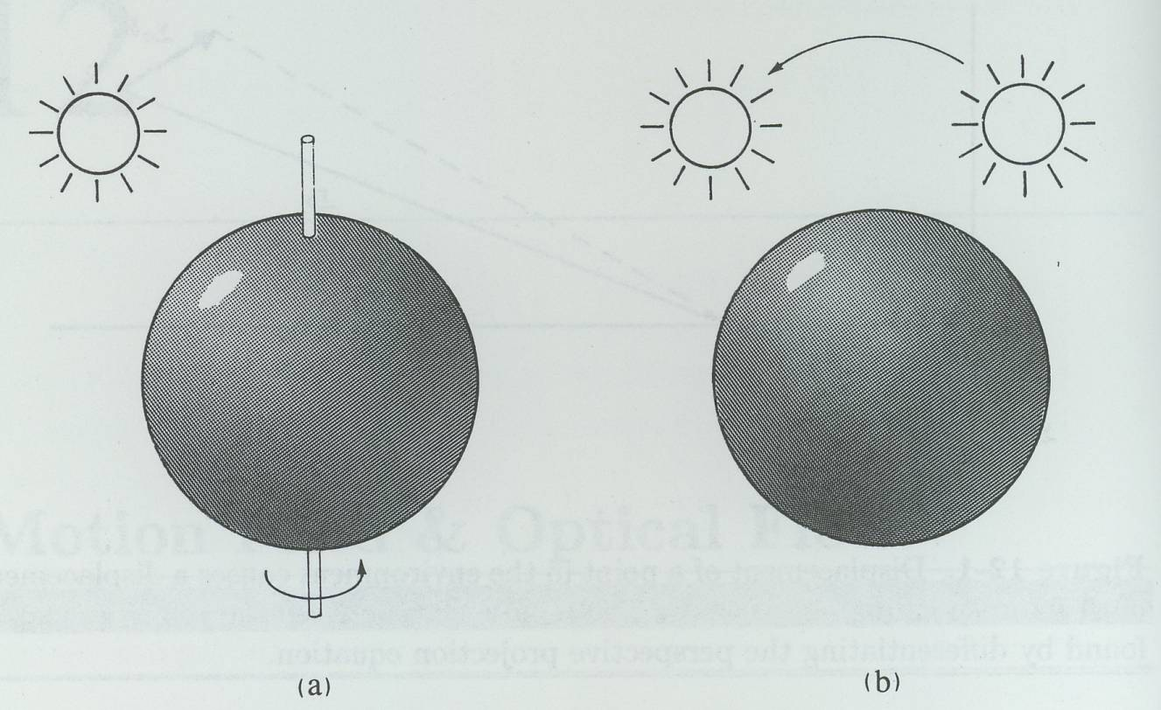
Optical Flow Motion Field
Motion field exists but no optical flow
No motion field but shading changes

Slide 14


Problem Definition: Optical Flow
How to estimate pixel motion from image H to image I?
  Find pixel correspondences
    Given a pixel in H, look for nearby pixels of the same color in I
Key assumptions
  color constancy: a point in H looks “the same” in image I
    For grayscale images, this is brightness constancy
  small motion: points do not move very far

Slide 15
Optical Flow Constraint Equation
Optical Flow: Velocities
Displacement:
  Assume brightness of patch remains same in both images:
  Assume small motion: (Taylor expansion of LHS up to first order)

Slide 16
Optical Flow Constraint Equation
Divide by and take the limit
Constraint Equation

Slide 17
Optical Flow Constraint
Intuitively, what does this constraint mean?
  The component of the flow in the gradient direction is determined
  The component of the flow parallel to an edge is unknown

Slide 18
How does this show up visually?
Known as the “Aperture Problem”

Slide 19
Aperture Problem Exposed
Motion along just
an edge is ambiguous

Slide 20
Computing Optical Flow
Formulate Error in Optical Flow Constraint:
We need additional constraints!
Smoothness Constraint (as in shape from shading and stereo):
Usually motion field varies smoothly in the image.
So, penalize departure from smoothness:
Find (u,v) at each image point that MINIMIZES:
weighting
factor

Slide 21
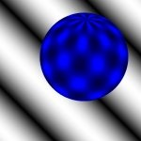

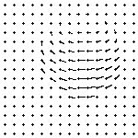
Example

Slide 23
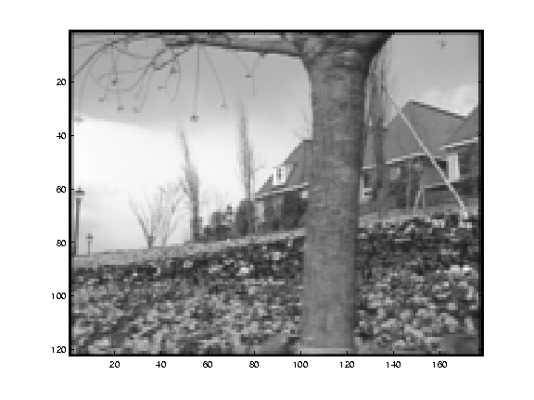
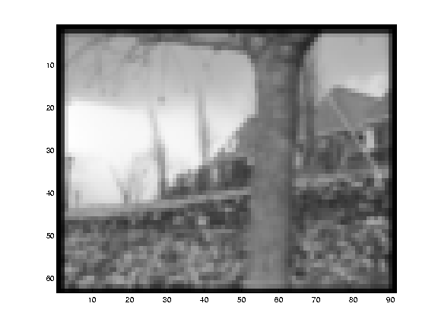
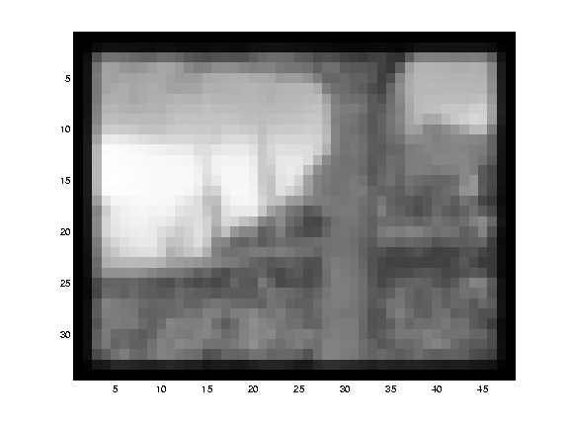
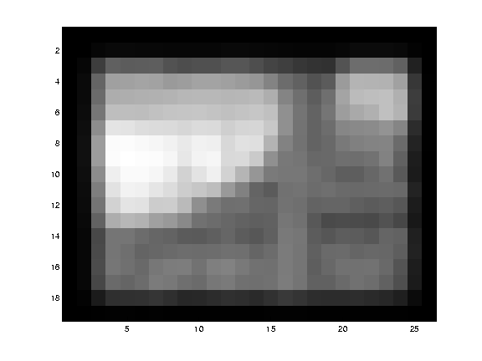
Small Motion Assumption

Slide 24
Coarse-to-fine Optical Flow Estimation
run iterative OF
upsample
run iterative OF
.
.
.
image H
image I
Gaussian pyramid of image H
Gaussian pyramid of image I

Slide 25
Types of OF methods
Differential
  Horn and Schunck [HS80], Lucas Kanade [LK81], Nagel [83].
Region-based matching
  Anandan [Anan87], Singh [Singh90], Digital video encoding standards.
Energy-based
  Heeger [Heeg87]
Phase-based
  Fleet and Jepson [FJ90]

Slide 26
Topic: Lucas & Kanade Algorithm
Optical Flow Constraint Equation
Lucas & Kanade Algorithm

Slide 27
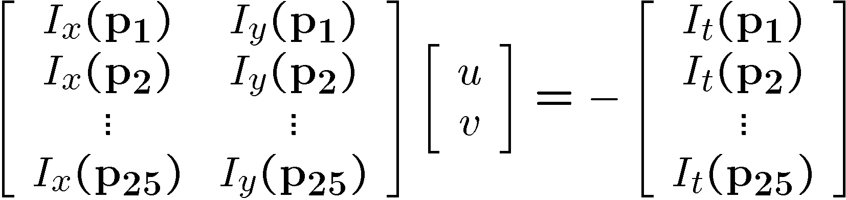



Lucas & Kanade Method
How to get more equations for a pixel?
  Basic idea: impose additional constraints
    most common is to assume that the flow field is smooth locally
    one method: pretend the pixel’s neighbors have the same (u,v)
      If we use a 5x5 window, that gives us 25 equations per pixel!

Slide 28





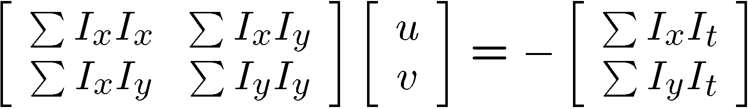


Lukas-Kanade flow
Problem: we have more equations than unknowns
minimum least squares solution given by solution (in d) of:
  The summations are over all pixels in the K x K window
  This technique was first proposed by Lukas & Kanade (1981)

Slide 29
Eigenvectors of A^{T}A
Eigenvectors give us the axes of higher intensity variability (gradient)
Eigenvalues give us a measure of gradient strength associated with each eigenvector direction
Notes:
Suppose M = vv^T . What are the eigenvectors and eigenvalues? Start by considering Mv

Slide 30
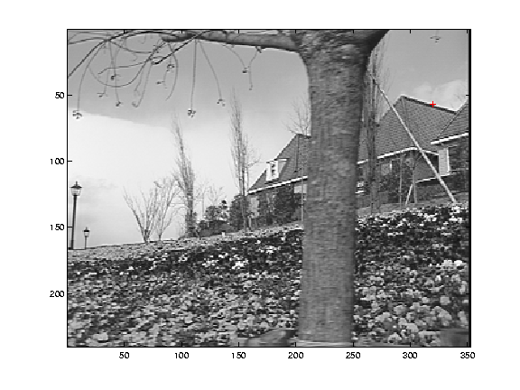
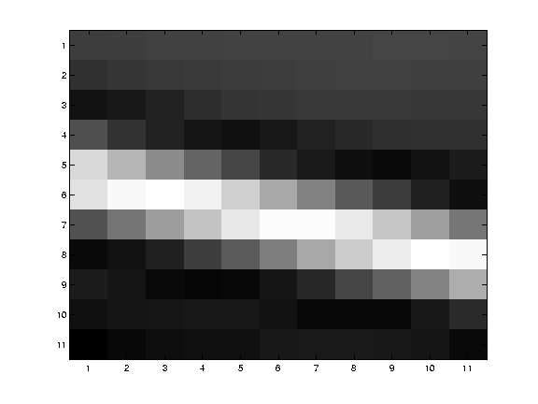
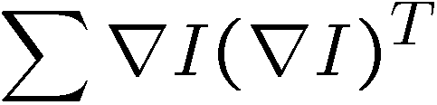
Edges
large λ₁, small λ₂

Slide 31
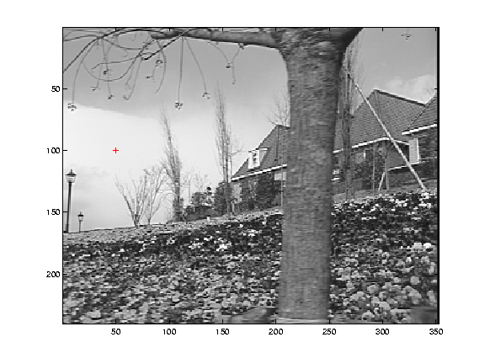
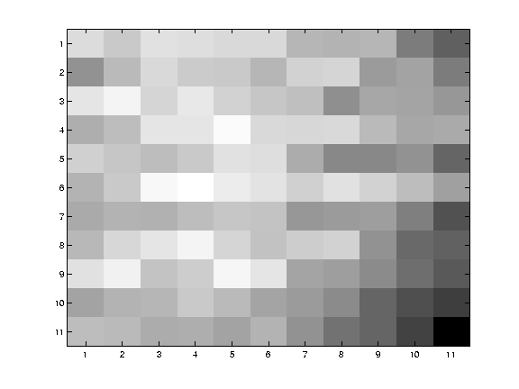
Low texture region
small λ₁, small λ₂

Slide 32
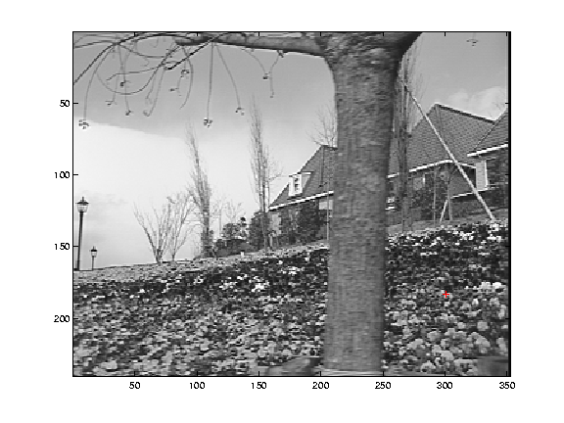
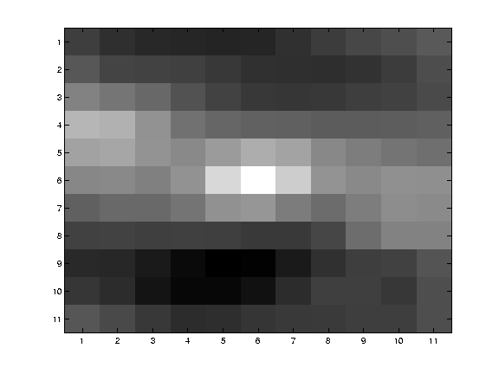
High textured region
large λ₁, large λ₂

Slide 33
Sparse Motion Field
We are only confident in motion vectors of areas with two strong eigenvectors.
  Optical flow
Not so confident when we have one or zero strong eigenvectors.
  Normal flow (apperture problem)
  Unknown flow (blank-wall problem)

Slide 34
Summing all up
Optical flow:
  Algorithms try to approximate the true motion field of the image plane
  The Optical Flow Constraint Equation needs an additional constraint (e.g. smoothness, constant local flow)
  The Lucas Kanade method is the most popular Optical Flow Algorithm
What applications is this useful for?
What about block matching?

Slide 35
Resources
Szeliski, “Computer Vision: Algorithms and Applications”, Springer, 2011
  Chapter 8 – “Dense Motion Estimation”

