Slide 1
Computer Vision – TP14
Introduction to Deep Learning
Miguel Tavares Coimbra

Slide 2
Outline
What is deep learning?
Convolutional neural networks
Deep neural network architectures

Slide 3
Topic: What is deep learning?
What is deep learning?
Convolutional neural networks
Deep neural network architectures

Slide 4
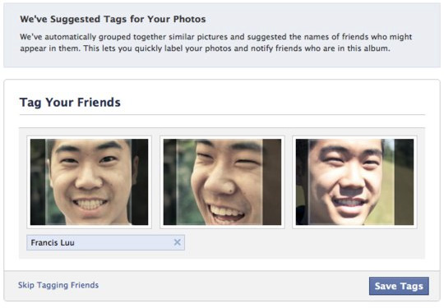
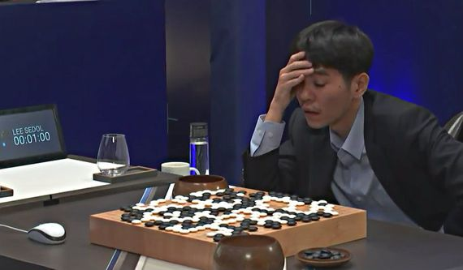


Deep learning: did you hear about that?
Google image recognition
Facebook face recognition
Google translator
DeepMind AlphaGo player
Netflix, Amazon, Spotify recommendation engines
Image colorization
Image caption generation
Sentiment analysis
Etc…

Slide 5



What is deep learning?
It is a specific area of machine learning
  Supervised learning
  Unsupervised learning
  Reinforcement learning
Idea (supervised learning): learn how to make decisions, perform a task, from examples
dog
cat
dog or cat?

Slide 6
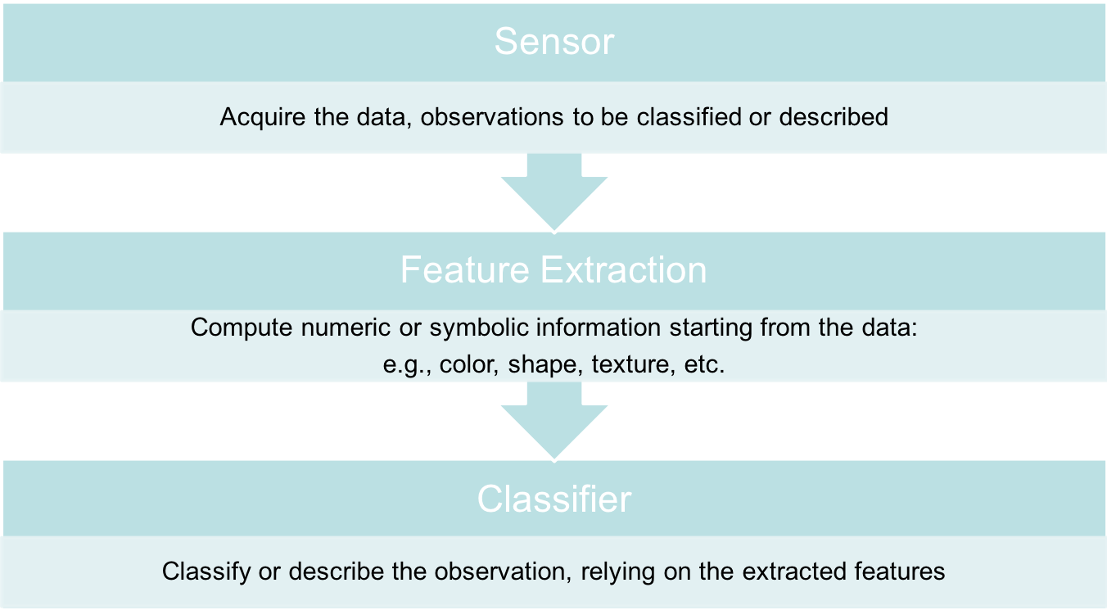
Remember!

Slide 7
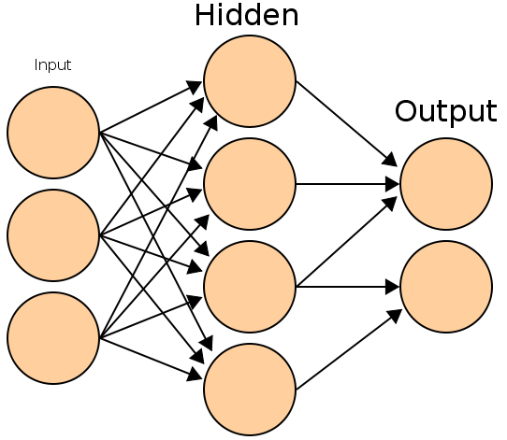
Remember: Neural Networks
Basic principles:
  One neuron can perform a simple decision
  Many connected neurons can make more complex decisions

Slide 8
Learning paradigms
We can define the network configuration
How do we define neuron weights and decision thresholds?
  Learning step
  We train the NN to classify what we want
  (Supervised learning): We need to have access to a set of training data for which we know the correct class/answer

Slide 9
Learning
We want to obtain an optimal solution given a set of observations
A cost function measures how close our solution is to the optimal solution
Objective of our learning step:
  Minimize the cost function
Backpropagation Algorithm

Slide 10
In formulas
Network output:
Training set:
Optimization: find such that
It is solved with (variants of) the gradient descent, where gradients are computed via the backpropagation algorithm
input
label

Slide 11
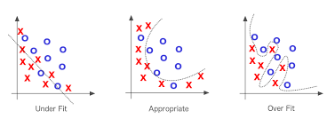
Warnings!
Is the NN too simple for the data?
  Underfitting: cannot capture data behavior
Is the NN too complex for the data?
  Overfitting: fit perfectly training data, but will not generalize well on unseen data

Slide 12
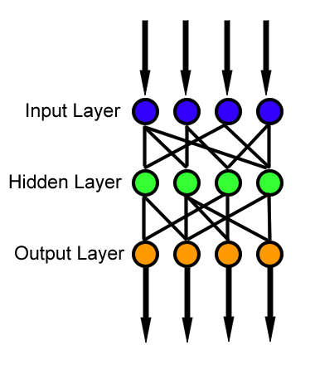
Feedforward neural network
Simplest type of NN
Has no cycles
Input layer
  Need as many neurons as coefficients of my feature vector
Hidden layers
Output layer
  Classification results

Slide 13
Deep learning = Deep neural networks
Deep = high number of hidden layers
  Learn a larger number of parameters!
It has been recently (~ in the last 6 years) possible since we have:
  Access to big amounts of (training) data
  Increased computational capabilities (e.g. GPUs)

Slide 14
Topic: Convolutional neural networks
What is deep learning?
Convolutional neural networks
Deep neural network architectures

Slide 15
Convolutional neural networks (CNNs)
Feedforward neural networks
Weight multiplications are replaced by convolutions (filters)
Change of paradigm: can be directly applied to the raw signal, without computing first ad hoc features
Features are learnt automatically!

Slide 16
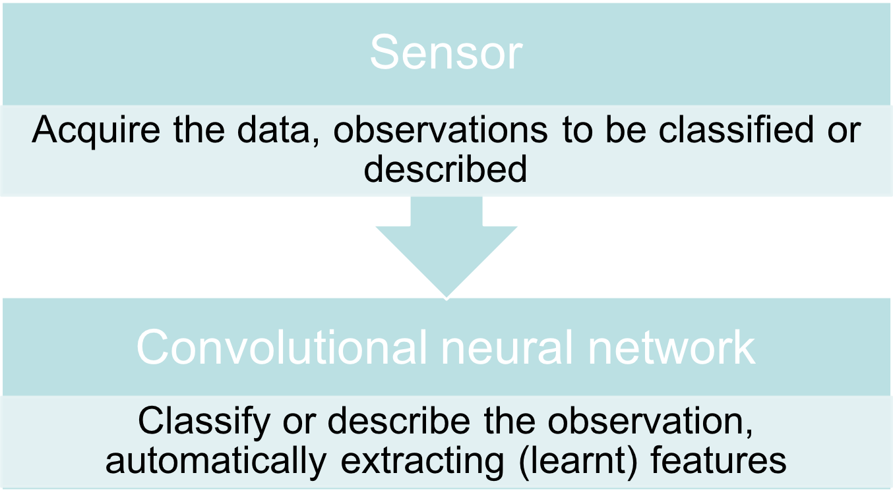
End-to-end learning

Slide 17
Convolution
I. Goodfellow, Y. Bengio, and A. Courville. Deep learning. Vol. 1. Cambridge: MIT press, 2016.

Slide 18
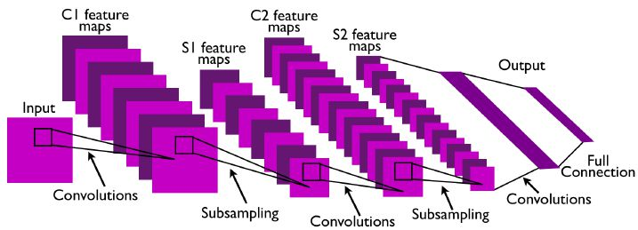
CNN example
Convolutional layers, followed by nonlinear activation and subsampling
Output of hidden layers (feature maps) = features learnt by the CNN
Before classification, fully connected layers (as in “standard” NN)

Slide 19
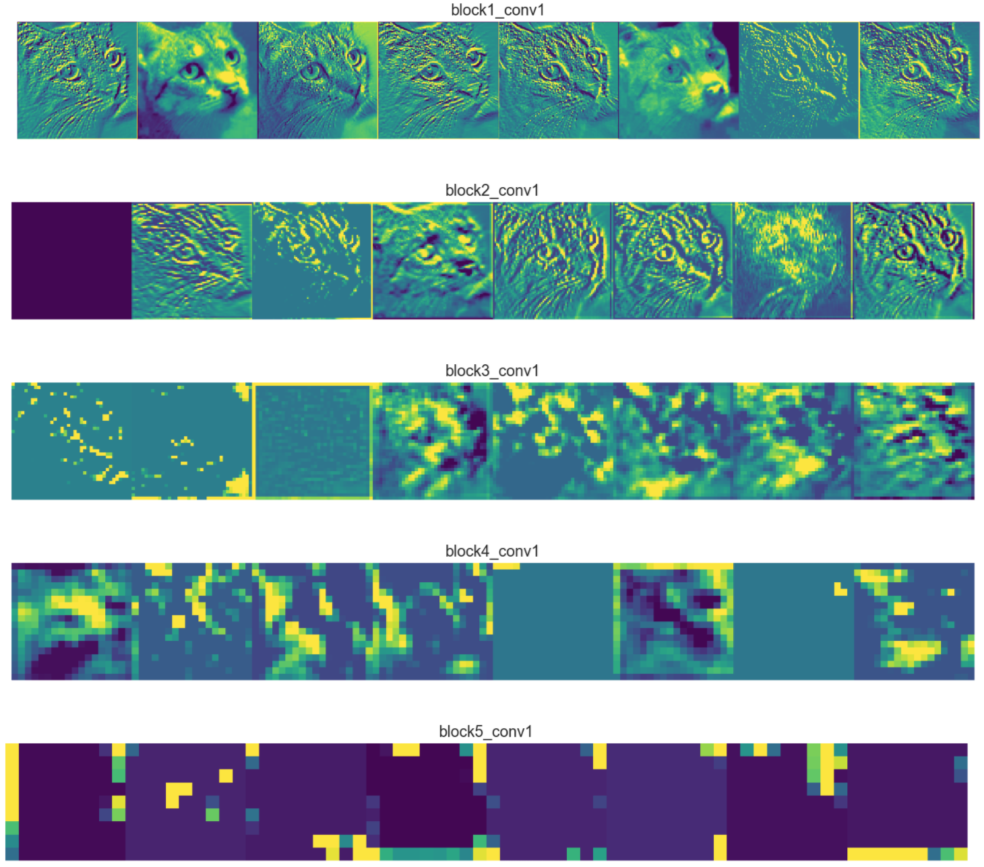
Automatically learnt features
Retain most information (edge detectors)
Towards more abstract representation
Encode high level concepts
Sparser representations:
Detect less (more abstract) features

Slide 20
CNN - Properties
Reduced amount of parameters to learn (local features)
More efficient than dense multiplication
Specifically thought for images or data with grid-like topology
Convolutional layers are equivariant to translation (useful for classification!)
Currently state-of-the-art in several tasks

Slide 21
Topic: Deep neural network architectures
What is deep learning?
Convolutional neural networks
Deep neural network architectures

Slide 22
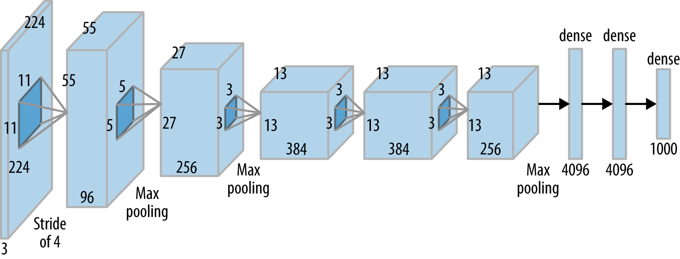
AlexNet
Winner of ILSVRC 2012
Marked the beginning of recent deep learning revolution
A. Krizhevsky, I. Sutskever, and G. Hinton. "ImageNet Classification with Deep Convolutional Neural." In NIPS, pp. 1-9. 2014.

Slide 23
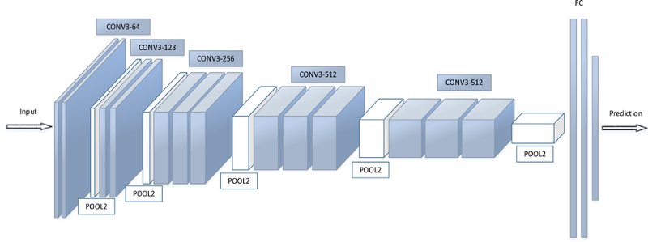
VGG-16
Very small filters (3x3)
Deeper than AlexNet:16 layers
K. Simonyan and A. Zisserman, “Very deep convolutional networks for large-scale image recognition,” in Proc. Int. Conf. Learn. Representations, 2015.

Slide 24
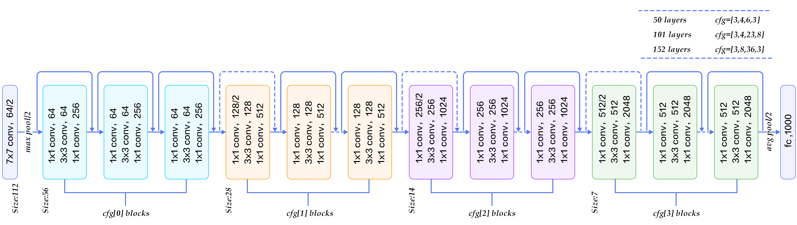
ResNet
K. He, X. Zhang, S. Ren, and J. Sun. "Deep residual learning for image recognition." In Proceedings of the IEEE conference on computer vision and pattern recognition, pp. 770-778. 2016.
Increase the number of layers by introducing a residual connection
Blocks are actually learning residual functions: easier!
From: https://www.codeproject.com/Articles/1248963/Deep-Learning-using-Python-plus-Keras-Chapter-Re

Slide 25
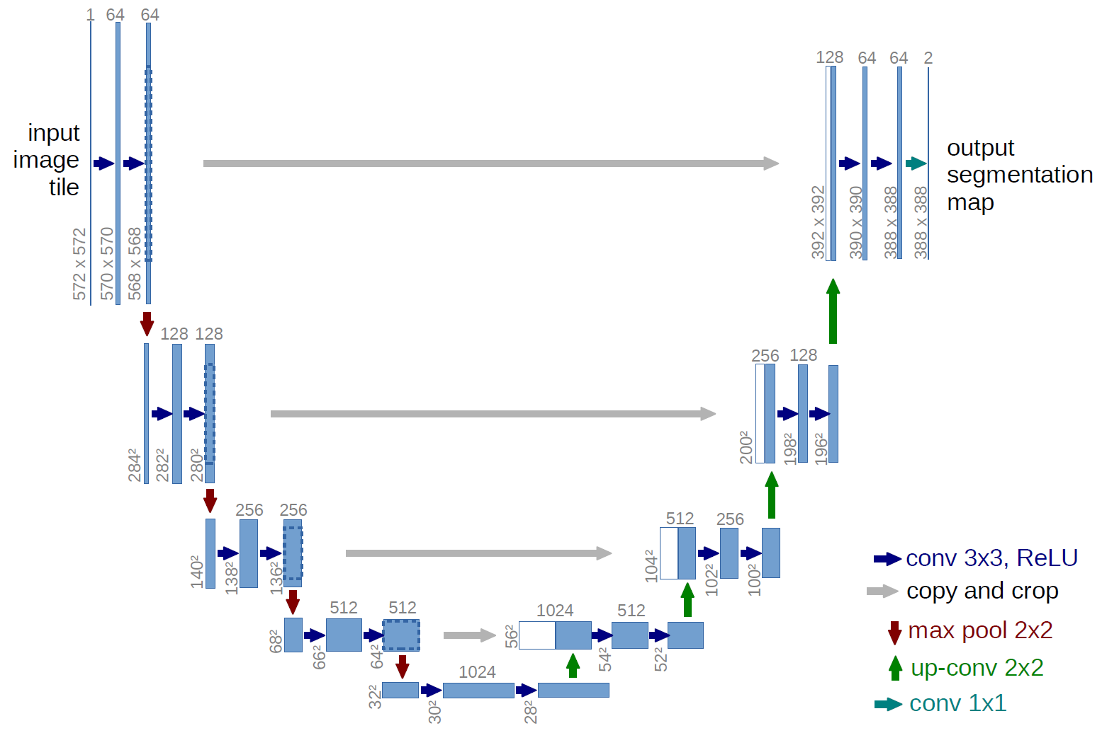
U-Net
O. Ronneberger, P. Fischer, and T. Brox. "U-net: Convolutional networks for biomedical image segmentation." In International Conference on Medical image computing and computer-assisted intervention, pp. 234-241. Springer, Cham, 2015.
Encoder-decoder structure

Slide 26
Modified U-Net
K. Jin, M. McCann, E. Froustey, and M. Unser. "Deep convolutional neural network for inverse problems in imaging." IEEE Transactions on Image Processing 26, no. 9 (2017): 4509-4522.

Slide 27
Application challenges
Great results! But…
  Difficult to select best architecture for a problem
  Require new training for each task/configuration
  (Most commonly) require a large training dataset to generalize well
    Data augmentation, weight regularization, transfer learning, etc.
  Still not fully understood why it works so well
    Robustness against adversarial examples
    Approval from government agencies (ex. FDA)?

Slide 28
Resources
Theory
  I. Goodfellow, Y. Bengio, and A. Courville. Deep learning. Vol. 1. Cambridge: MIT press, 2016. (https://www.deeplearningbook.org/)
Survey papers
  "Deep Learning for Visual Understanding," in IEEE Signal Processing Magazine, vol. 34, no. 6, Nov. 2017.
  A. Lucas, M. Iliadis, R. Molina and A. K. Katsaggelos, "Using Deep Neural Networks for Inverse Problems in Imaging: Beyond Analytical Methods," in IEEE Signal Processing Magazine, vol. 35, no. 1, pp. 20-36, Jan. 2018.
Tutorial
  Oxford Visual Geometry Group: VGG Convolutional Neural Networks Practical (http://www.robots.ox.ac.uk/~vgg/practicals/cnn/)

Slide 29
Coding Resources
Coding frameworks for deep learning
  TensorFlow (https://www.tensorflow.org/),
  PyTorch (https://pytorch.org/),
  Theano (http://deeplearning.net/software/theano/),
  MatConNet (http://www.vlfeat.org/matconvnet/),
  etc.
High-level wrappers
  Keras (https://keras.io/),
  TensorLayer (https://tensorlayer.readthedocs.io/en/stable/),
  Lasagne (https://lasagne.readthedocs.io/en/latest/),
  etc.
GPU strongly recommended!

