Slide 1
Computer Vision – TP15
Deep Learning Resources and Examples
Miguel Tavares Coimbra

Slide 2
Outline
Deep Learning Resources
Examples

Slide 3
Topic: Deep Learning Resources
Deep Learning Resources
Examples

Slide 4

TensorFlow
https://www.tensorflow.org/

Slide 5

PyTorch
https://pytorch.org/

Slide 6
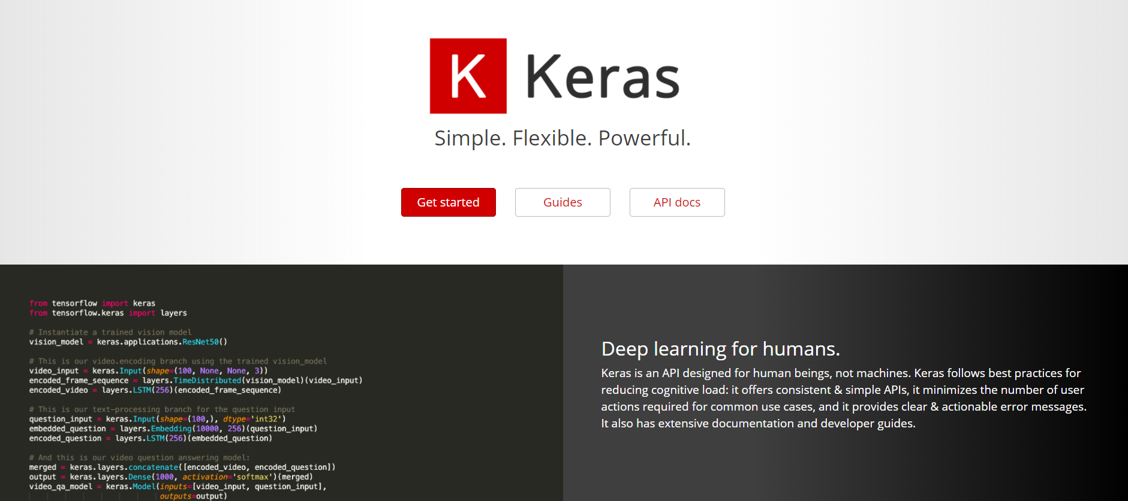
Keras
https://keras.io/

Slide 7
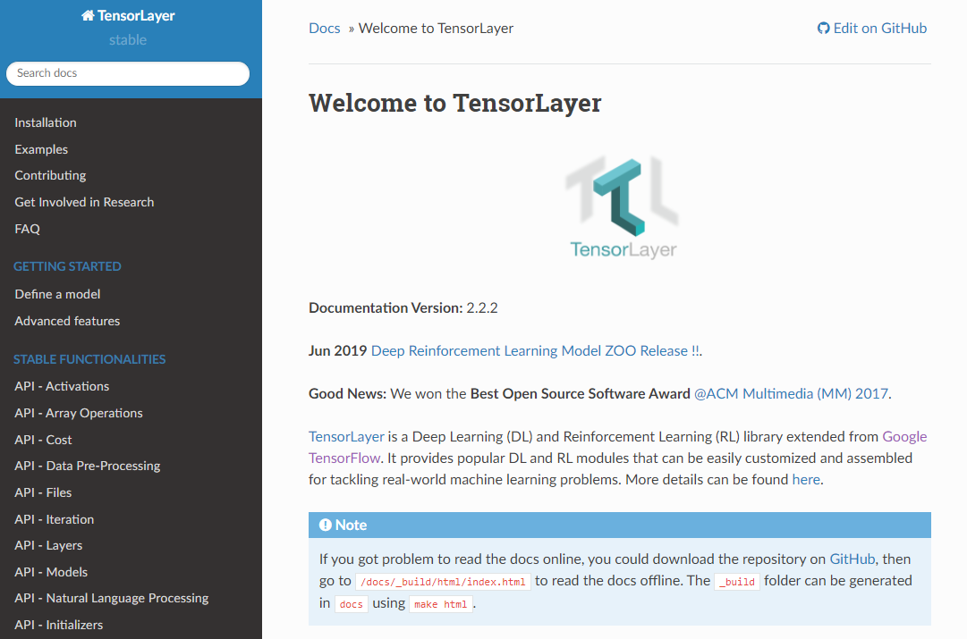
TensorLayer
https://tensorlayer.readthedocs.io/en/stable/

Slide 8
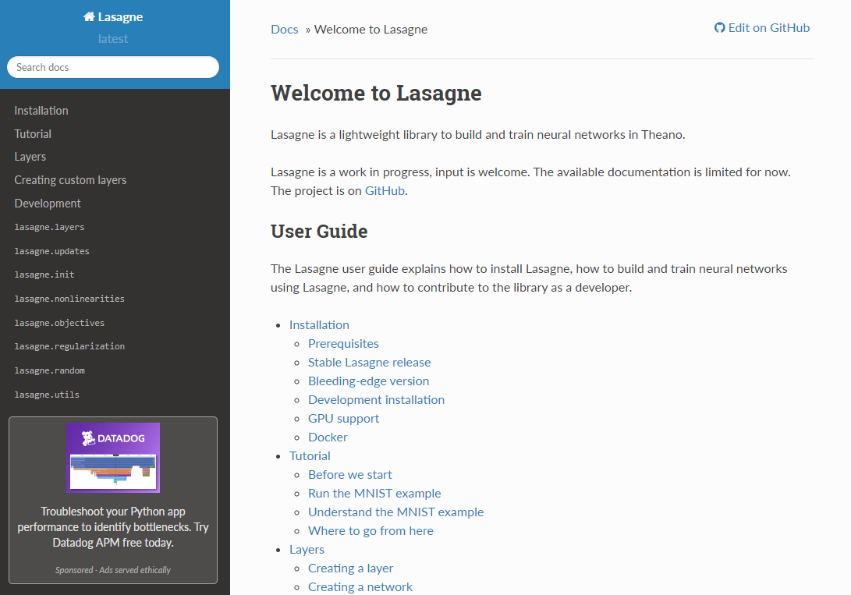
Lasagne
https://lasagne.readthedocs.io/en/latest/

Slide 9
Topic: Examples
Deep Learning Resources
Examples

Slide 10
Invited Speaker
Slides of the invited speaker

Slide 11
Resources
Theory
  I. Goodfellow, Y. Bengio, and A. Courville. Deep learning. Vol. 1. Cambridge: MIT press, 2016. (https://www.deeplearningbook.org/)
Survey papers
  "Deep Learning for Visual Understanding," in IEEE Signal Processing Magazine, vol. 34, no. 6, Nov. 2017.
  A. Lucas, M. Iliadis, R. Molina and A. K. Katsaggelos, "Using Deep Neural Networks for Inverse Problems in Imaging: Beyond Analytical Methods," in IEEE Signal Processing Magazine, vol. 35, no. 1, pp. 20-36, Jan. 2018.
Tutorial
  Oxford Visual Geometry Group: VGG Convolutional Neural Networks Practical (http://www.robots.ox.ac.uk/~vgg/practicals/cnn/)

