Slide 1
Computer Vision – TP7
Segmentation
Miguel Tavares Coimbra

Slide 2
Outline
Introduction to segmentation
Thresholding
Region based segmentation

Slide 3
Topic: Introduction to segmentation
Introduction to segmentation
Thresholding
Region based segmentation

Slide 4
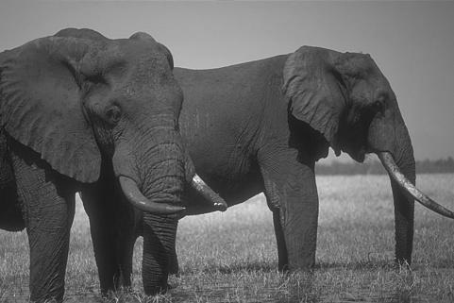
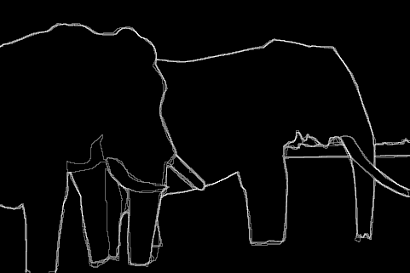
Boundaries of Objects
Marked by many users
http://www.eecs.berkeley.edu/Research/Projects/CS/vision/grouping/segbench/bench/html/images.html

Slide 5

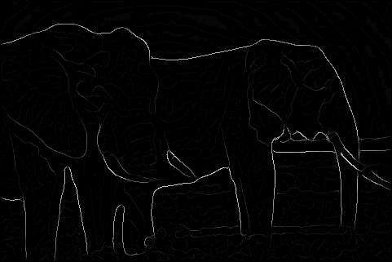
Boundaries of Objects from Edges
Brightness Gradient (Edge detection)
Missing edge continuity, many spurious edges

Slide 6
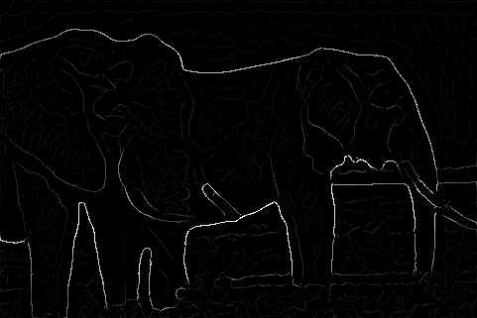
Boundaries of Objects from Edges
Multi-scale Brightness Gradient
But, low strength edges may be very important

Slide 7
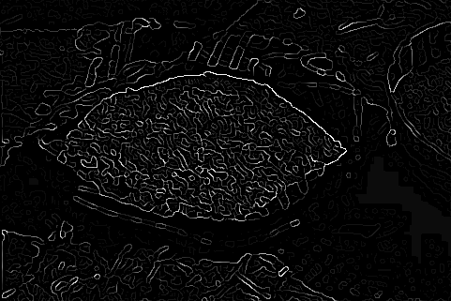
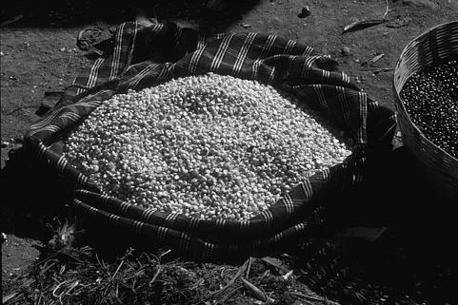
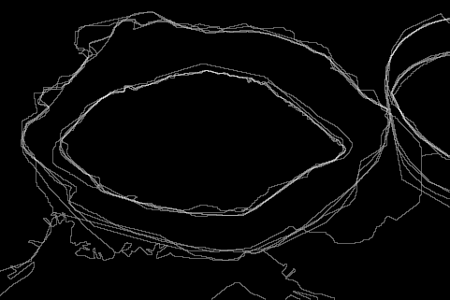
Machine Edge Detection
Image
Human Boundary Marking

Slide 8
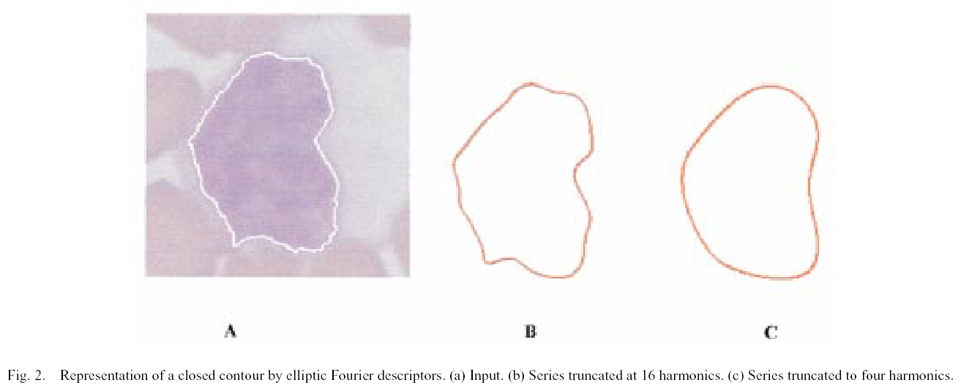
Boundaries in Medical Imaging
Detection of cancerous regions
[Foran, Comaniciu, Meer, Goodell, 00]

Slide 9
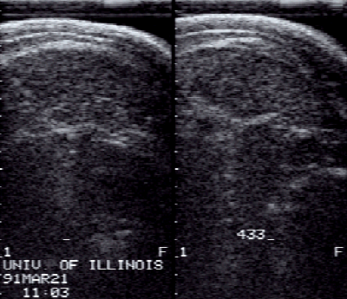
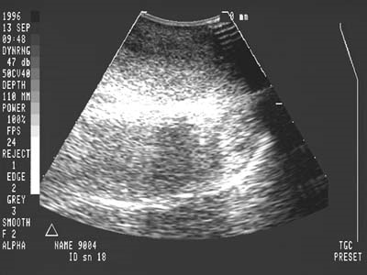
Boundaries in Ultrasound Images
Hard to detect in the presence of large amount of speckle noise

Slide 10
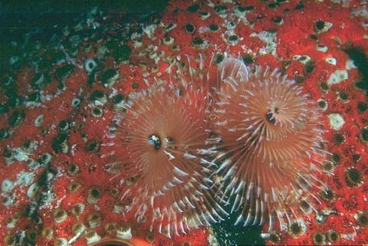
Sometimes hard even for humans!

Slide 11
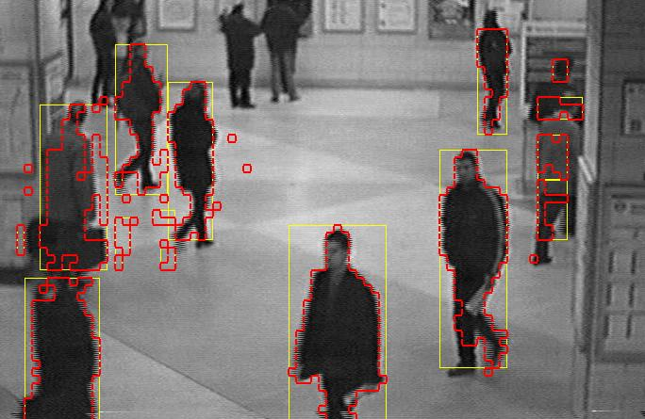
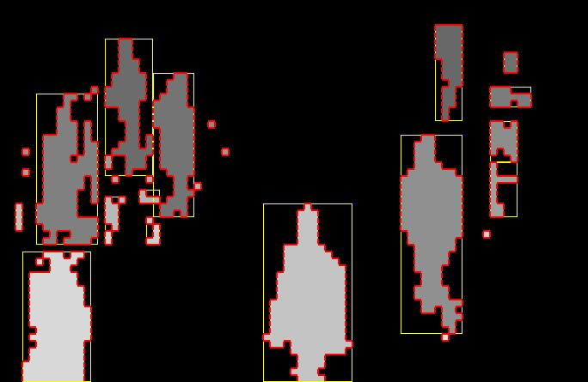
What is ‘Segmentation’?
Separation of the image in different areas
  Objects
  Areas with similar visual or semantic characteristics
Not trivial! It is the holy grail of most computer vision problems!

Slide 12


Subjectivity
A ‘correct’ segmentation result is only valid for a specific context
  Subjectivity!
  Hard to implement
  Hard to evaluate
What is the correct segmentation?
Face
Person
Suitcase

Slide 13
Topic: Thresholding
Introduction to segmentation
Thresholding
Region based segmentation

Slide 14
Core Technique: Thresholding
Divide the image into two areas:
  1, if f(x,y)>K
  0, if f(x,y)<=K
Not easy to find the ideal k magic number
Core segmentation technique
  Simple
  Reasonably effective
Adequate threshold

Slide 15
Finding the ‘magic number’
Correct
(k = 74)
Wrong!
(k = 128)

Slide 16
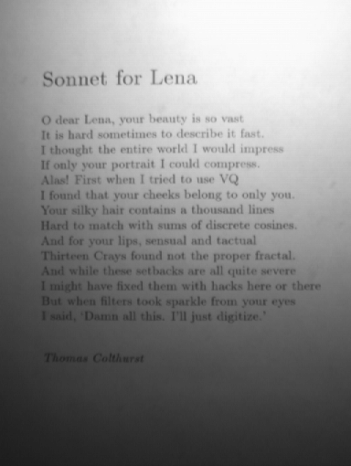
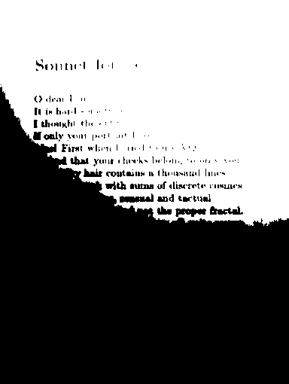
Global thresholds are not
always adequate...

Slide 17
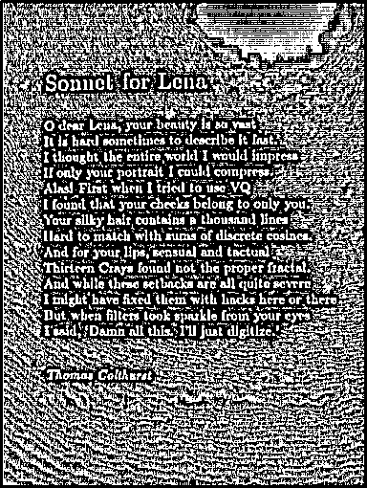
Adaptive Thresholding
Adapt the threshold value for each pixel
Use characteristics of nearby pixels
How?
  Mean
  Median
  Mean + K
  ...
Mean of 7x7 neighborhood

Slide 18
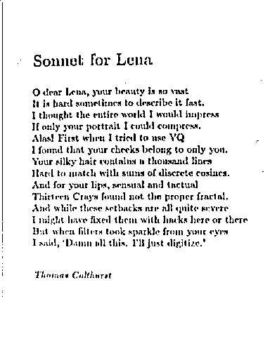

7x7 window; K = 7
75x75 window; K = 10

Slide 19
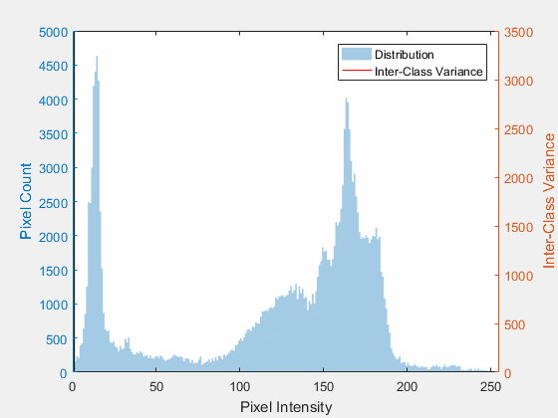
Otsu’s Thresholding
Is there an optimal threshold for a bimodal distribution?
  Yes
  Gist: Minimize Within-Class Variance
  Alternatively: Maximize Between-Class Variance
By Lucas(CA) - Own work, CC BY-SA 4.0, https://commons.wikimedia.org/w/index.php?curid=67144384

Slide 20

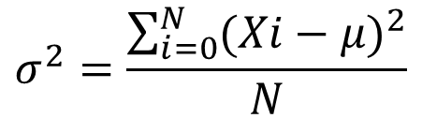
Within Class Variance
Class Variance
  The lower the variance, the less dispersed the data is for each class
Within Class Variance
  Weighted sum of each class variance:
    Background (b);
    Foreground (f)
$$σ^{2}=\frac{\sum_{i=0}^{N}{{(Xi−μ)}^{2}}}{N}$$
$$σ_{w}^{2}=W_{b}σ_{b}^{2}+W_{f}σ_{f}^{2}$$
Xi is the pixel value, μ is the mean, and N is the number of pixels in one image
Wj is the percentage of image pixels belonging to class j

Slide 21
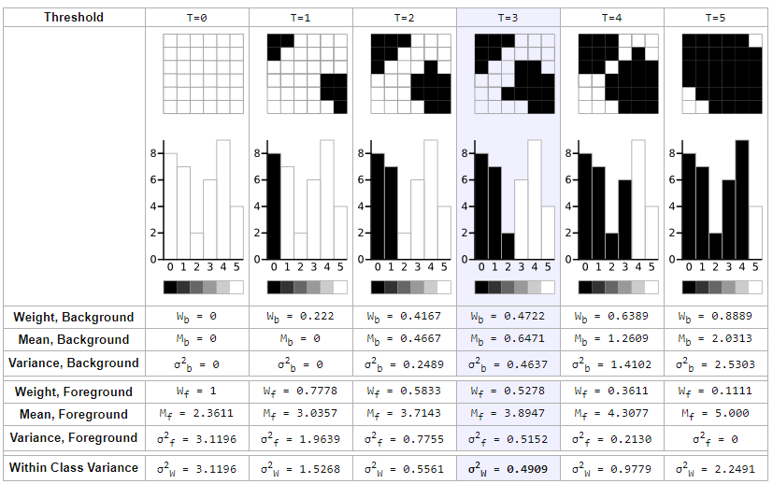
Link: http://www.labbookpages.co.uk/software/imgProc/otsuThreshold.html

Slide 22
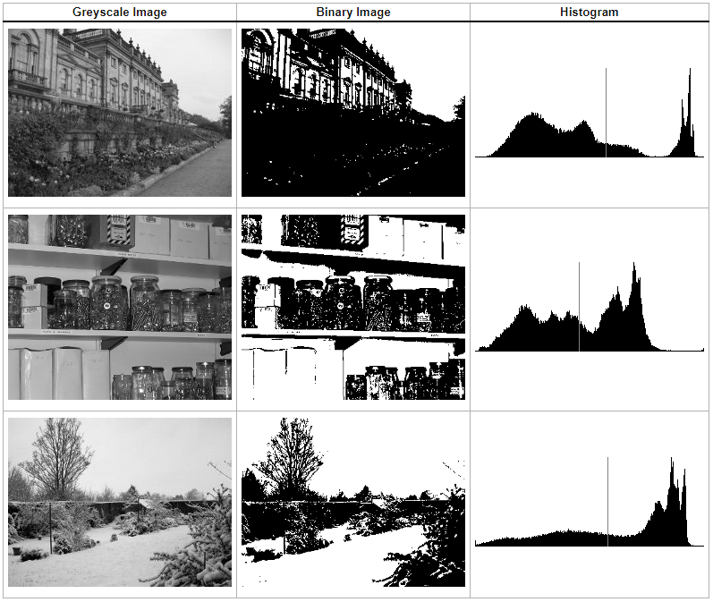
Link: http://www.labbookpages.co.uk/software/imgProc/otsuThreshold.html

Slide 23
Topic: Region based segmentation
Introduction to segmentation
Thresholding
Region based segmentation

Slide 24
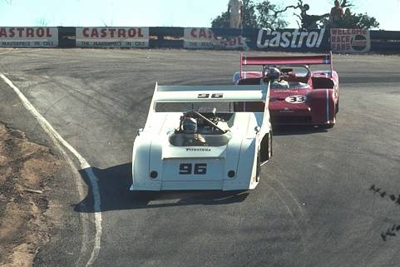

Why Region Based Segmentation?
Segmentation
  Edge detection and Thresholding not always effective
Homogenous regions
  Region-based segmentation
  Effective in noisy images

Slide 25
Definitions
Based on sets
Each image R is a set of regions R_{i}
  Every pixel belongs to one region
  One pixel can only belong to a single region
R₇
R₆
R₁
R₅
R₂
R₃
R₄

Slide 27
R₇
R₆
R₁
R₅
R₂
R₃
R₄

Slide 28
Basic Formulation
Let R represent the entire image region. Segmentation partitions R into n subregions, R₁, R₂, ..., R_{n}, such that:
a)
b)
c)
d)
e)
Every pixel must be in a region
Points in a region must be connected
Regions must be disjoint
All pixels in a region satisfy specific properties
Different regions have different properties

Slide 29
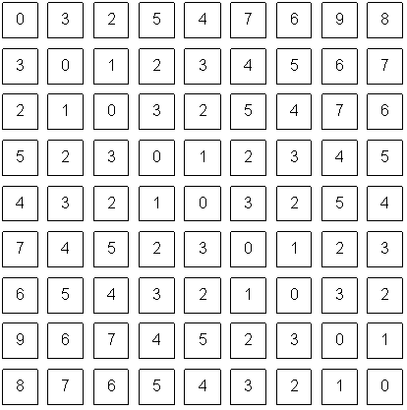
How do we form regions?
Region Growing
Region Merging
Region Splitting
Split and Merge
Watershed
...
What a computer sees

Slide 30
Region growing
Groups pixels into larger regions.
Starts with a seed region.
Grows region by merging neighboring pixels.
Iterative process
  How to start?
  How to iterate?
  When to stop?
Finish
Initial
Regions
Iterations
Stop
Condition

Slide 31
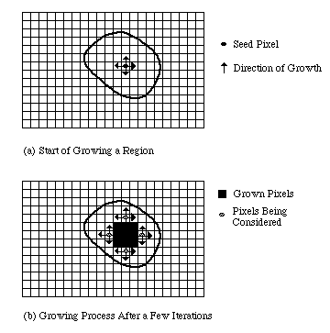

Slide 32
Region merging
Algorithm
  Divide image into an initial set of regions
    One region per pixel
  Define a similarity criteria for merging regions
  Merge similar regions
  Repeat previous step until no more merge operations are possible

Slide 33
Similarity Criteria
Homogeneity of regions is used as the main segmentation criterion in region growing
  gray level
  color, texture
  shape
  model
  etc.
Choice of criteria affects segmentation results dramatically!

Slide 34
Gray-Level Criteria
Comparing to Original Seed Pixel
  Very sensitive to choice of seed point
Comparing to Neighbor in Region
  Allows gradual changes in the region
  Can cause significant drift
Comparing to Region Statistics
  Acts as a drift dampener
Other possibilities!

Slide 35
Region splitting
Algorithm
  One initial set that includes the whole image
  Similarity criteria
  Iteratively split regions into sub-regions
  Stop when no more splittings are possible
R₁
R₁
R₂
R₃
R₄
R₁
R₂
R₁
R₂
R₃
R₃
R₄
R₅
R₄
R₅
R₆
R₇
R₆
R₇

Slide 36
[Machine Vision; David Vernon]

Slide 37
Split and Merge
Combination of both algorithms
Can handle a larger variety of shapes
  Simply apply previous algorithms consecutively

Slide 38
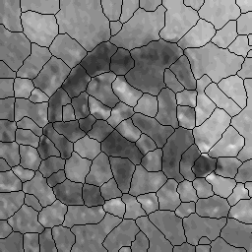
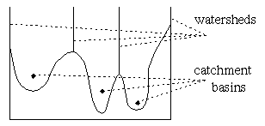
The Watershed Transform
Geographical inspiration
  Shed water over rugged terrain
  Each lake corresponds to a region
Characteristics
  Computationally complex
  Great flexibility in segmentation
  Risk of over-segmentation

Slide 39
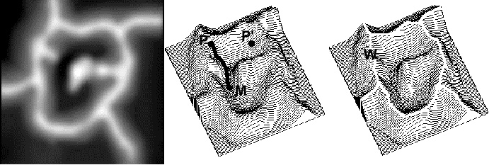
The Drainage Analogy
Two points are in the same region if they drain to the same point
Courtesy of Dr. Peter Yim at National Institutes of Health, Bethesda, MD

Slide 40
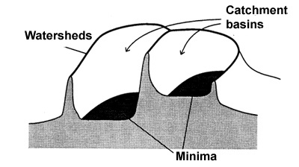
The Immersion Analogy

Slide 41
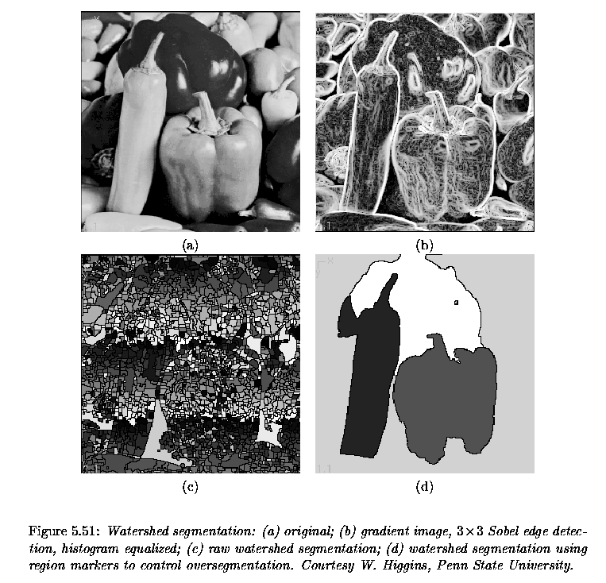
[Milan Sonka, Vaclav Hlavac, and Roger Boyle]

Slide 42
Over-Segmentation
Over-segmentation
  Raw watershed segmentation produces a severely oversegmented image with hundreds or thousands of catchment basins
Post-Processing
  Region merging
  Edge information
  Etc.

Slide 43
Resources
Szeliski, “Computer Vision: Algorithms and Applications”, Springer, 2011
  Chapter 5 – “Segmentation”

