Slide 1
Computer Vision – TP8
Advanced Segmentation
Miguel Tavares Coimbra

Slide 2
Outline
Segmentation by Clustering
Segmentation by Fitting
Semantic Segmentation

Slide 3
Topic: Segmentation by Clustering
Segmentation by Clustering
Segmentation by Fitting
Semantic Segmentation

Slide 4
What is ‘Segmentation’? (again?)
Traditional definition:
  “Separation of the image in different areas“
  Decompose an image into “superpixels”
  Colour and texture coherence.
Aren’t there other ways to look at the ‘Segmentation’ concept?

Slide 5
Other ‘Segmentation’ problems
Fitting lines to edge points
Fitting a fundamental matrix to a set of feature points
We can’t see this as ‘separating an image in different areas’!
This one is complicated!
Check Forsyth and Ponce, chap.14

Slide 6
Segmentation as Clustering
Tries to answer the question:
  “Which components of the data set naturally belong together?”
Two approaches:
  Partitioning
    Decompose a large data set into pieces that are ‘good’ according to our model
  Grouping
    Collect sets of data items that ‘make sense’ according to our model

Slide 7
Simple clustering
Two natural types of clustering:
  Divisive clustering
    Entire data set is regarded as a cluster
    Clusters are recursively split
  Agglomerative clustering
    Each data item is a cluster
    Clusters are recursively merged
Where have I seen this before?

Slide 8
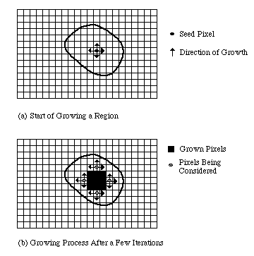
Split and Merge (Region-based segmentation) is in fact a clustering algorithm

Slide 9
Generic simple clustering algorithms
Divisive Clustering
  Construct a single cluster containing all points
  While the clustering is not satisfactory
    Split the cluster that yields the two components with the largest inter-cluster distance
  end
Agglomerative Clustering
  Make each point a separate cluster
  Until the clustering is satisfactory
    Merge the two clusters with smallest inter-cluster distance
  end
Which inter-cluster distance?
What does this mean?

Slide 10
Simple clustering with images
Some specific problems arise:
  Lots of pixels! Graphical representations are harder to read
  Segmentation: It is desirable that certain objects are connected. How to enforce this?
  When do we stop splitting/merging process?
Complex situations require more complex clustering solutions!

Slide 11
K-means Clustering
What if we know that there are k clusters in the image?
We can define an objective function!
  Expresses how good my representation is
We can now build an algorithm to obtain the best representation
Caution! “Best” given my objective function!

Slide 12
K-means Clustering
Assume:
  We have k clusters
  Each cluster i has a centre c_{i}
  Element j to be clustered is described by a feature vector x_{j}
Our objective function is thus:
What does this mean?

Slide 13
Iteration step
Too many possible allocations of points to clusters to search this space for a minimum
Iterate!
  Assume cluster centres are known and allocate each point to the closest cluster centre
  Assume the allocation is known and choose a new set of cluster centres. Each centre is the mean of the points allocated to that cluster

Slide 14
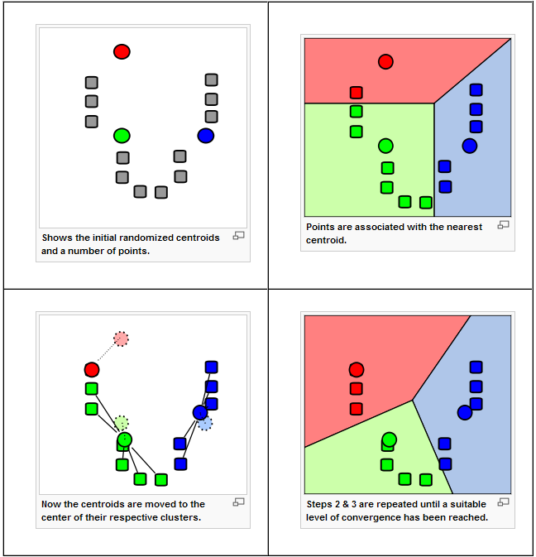
[Wikipedia]

Slide 15
Mean Shift
K-means:
  Segments our feature space (and not the image!) into clusters (and not regions)
  Uses a parametric model for its distributions (e.g. Gaussians), whose locations (centers) and shape (covariance) can be estimated
Mean shift:
  Segments an image (and not the feature space) into regions
  Uses a non-parametric model (simply tries to find distribution peaks)

Slide 16
Comaniciu, D. and Meer, P. (2002). Mean shift: A robust approach toward feature space analysis. IEEE Transactions on Pattern Analysis and Machine Intelligence, 24(5):603– 619.

Slide 17
How does it work?
Each pixel ‘finds’ its nearest distribution peak by ‘climbing uphill’ the image’s kernel density function f(x)
The gradient of f(x) defines the direction for this ‘climb’, by defining mean-shift vectors
Pixels that ‘climb’ to the same peak form a region

Slide 18
One-dimensional example
Szeliski, “Computer Vision: Algorithms and Applications”, Springer, 2011

Slide 19
Mean Shift
Comaniciu, D. and Meer, P. (2002). Mean shift: A robust approach toward feature space analysis. IEEE Transactions on Pattern Analysis and Machine Intelligence, 24(5):603– 619.

Slide 20
Normalized Cuts
Clustering can be seen as a problem of “cutting graphs into good pieces”
Data Items
  Vertex in a weighted graph
  Weights are large if elements are similar
Cut edges
  Cut edges with small weights
  Keep connected components with large interior weights
Regions!

Slide 21
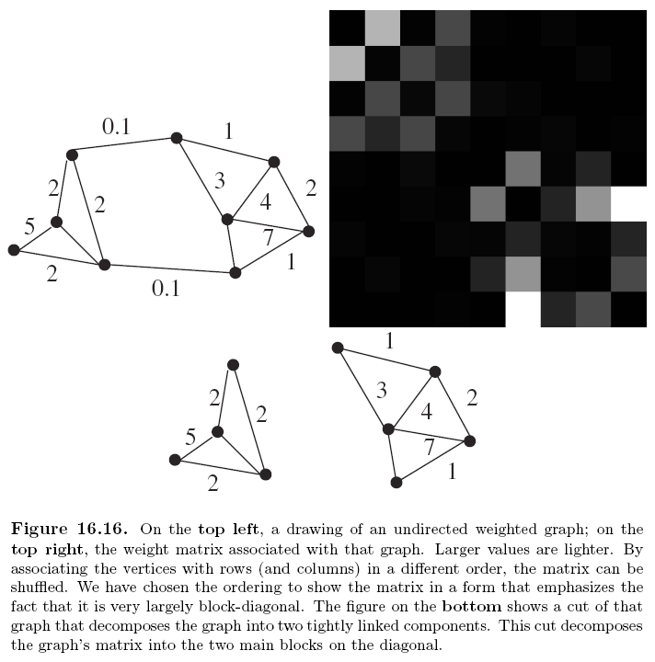

Slide 22
Graphs and Clustering
Associate each element to be clustered with a vertex on a graph
Construct an edge from every element to every other
Associate a weight with each edge based on a similarity measure
Cut the edges in the graph to form a good set of connected components

Slide 23
Weight Matrices
Typically look like block diagonal matrices
Why?
  Interclusters similarities are strong
  Intracluster similarities are weak
Split a matrix into smaller matrices, each of which is a block
Define Affinity Measures

Slide 24
More on this
Affinity measures
  Affinity by Distance
  Affinity by Intensity
  Affinity by Colour
  Affinity by Texture
Popular method: Normalized cuts
    Jianbo Shi and Jitendra Malik, “Normalized Cuts and Image Segmentation”, IEEE Transactions on Pattern Analysis And Machine Intelligence, Vol. 22, No. 8, August 2000
Want to know more?
Check out: Forsyth and Ponce, Section 14.5

Slide 25
Topic: Segmentation by Fitting
Segmentation by Clustering
Segmentation by Fitting
Semantic Segmentation

Slide 26
Fitting and Clustering
Another definition for segmentation:
  Pixels belong together because they conform to some model
Sounds like “Segmentation by Clustering”...
Key difference:
  The model is now explicit
We have a mathematical model for the object we want to segment.
Ex: A line

Slide 27
Hough Transform
Elegant method for direct object recognition
Edges need not be connected
Complete object need not be visible
Key Idea: Edges VOTE for the possible model

Slide 28
Image and Parameter Spaces
Equation of Line:
Find:
Consider point:
Image
Space
Parameter
Space
Parameter space also called Hough Space

Slide 29
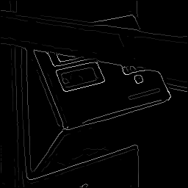
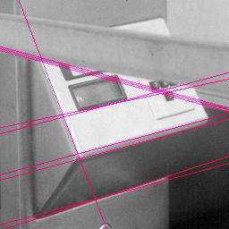
Example - Lines

Slide 30
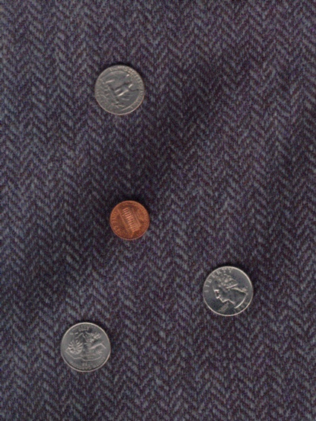
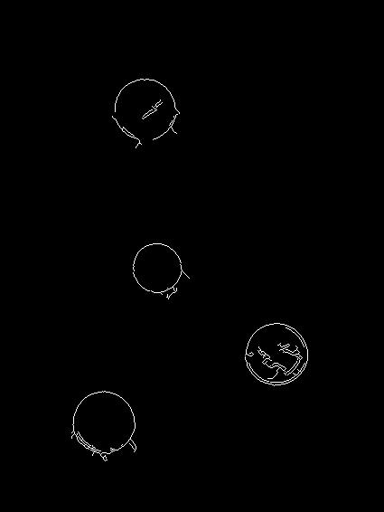
Example - Circles

Slide 31
Least Squares Line Fitting
Popular fitting procedure
Simple but biased (why?)
Consider a line:
  y = ax + b
What is the line that best predicts all observations (x_{i},y_{i})?
  Minimize:

Slide 32
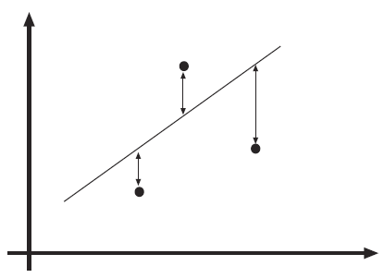
What happens if the line is vertical?

Slide 33
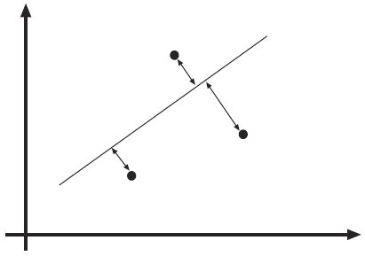
This looks better…

Slide 34
Total Least Squares
Works with the actual distance between the point and the line (rather than the vertical distance)
Lines are represented as a collection of points where:
And:
Again... Minimize the error, obtain the line with the ‘best fit’.

Slide 35
Point correspondence
We can estimate a line but, which points are on which line?
Usually:
  We are fitting lines to edge points, so…
  Edge directions can give us hints!
What if I only have isolated points?
Let’s look at two options:
  Incremental fitting
  Allocating points to lines with K-means

Slide 36
Incremental Fitting
Start with connected curves of edge points
Fit lines to those points in that curve
Incremental fitting:
  Start at one end of the curve
  Keep fitting all points in that curve to a line
  Begin another line when the fitting deteriorates too much
Great for closed curves!

Slide 37
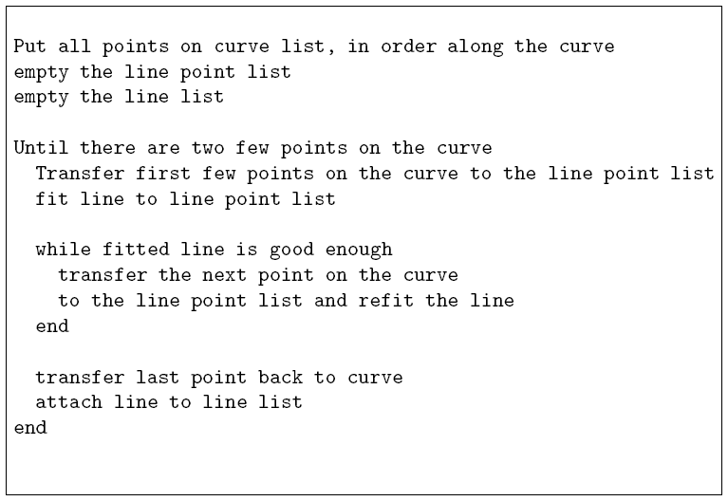

Slide 38
K-means allocation
What if points carry no hints about which line they lie on?
Assume there are k lines for the x points.
Minimize:
Iteration:
  Allocate each point to the closest line
  Fir the best line to the points allocated to each line

Slide 39
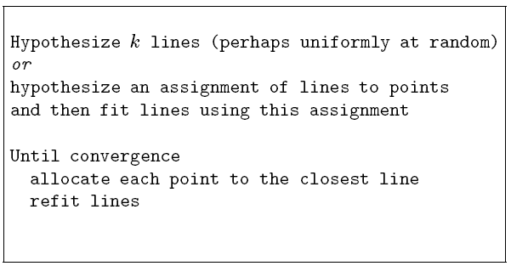

Slide 40

Active Contours
Goal: evolve the contour to fit exact object boundary
How?
  Reward solutions next to high image gradients
  Punish solutions that deform shape too much
  Iteratively find the ‘best’ solution to these requirements

Slide 41
Topic: Semantic Segmentation
Segmentation by Clustering
Segmentation by Fitting
Semantic Segmentation

Slide 42
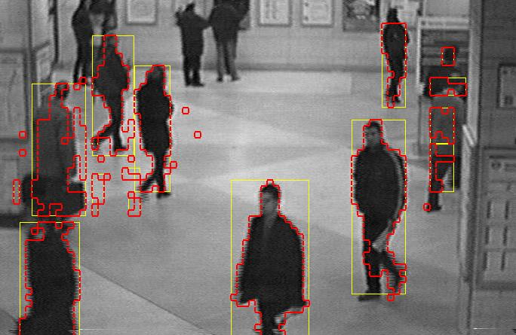
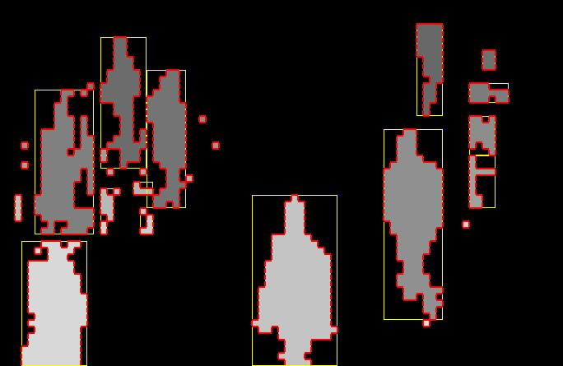
Remember ‘Segmentation’?
Separation of the image in different areas
  Objects
  Areas with similar visual or semantic characteristics
First form regions based on visual characteristics, then find the semantics of each region

Slide 43
Semantic Segmentation
Separation of the image in different areas
  Objects
  Areas with similar visual or semantic characteristics
First classify each pixel, and only then form regions (much harder!!)

Slide 44
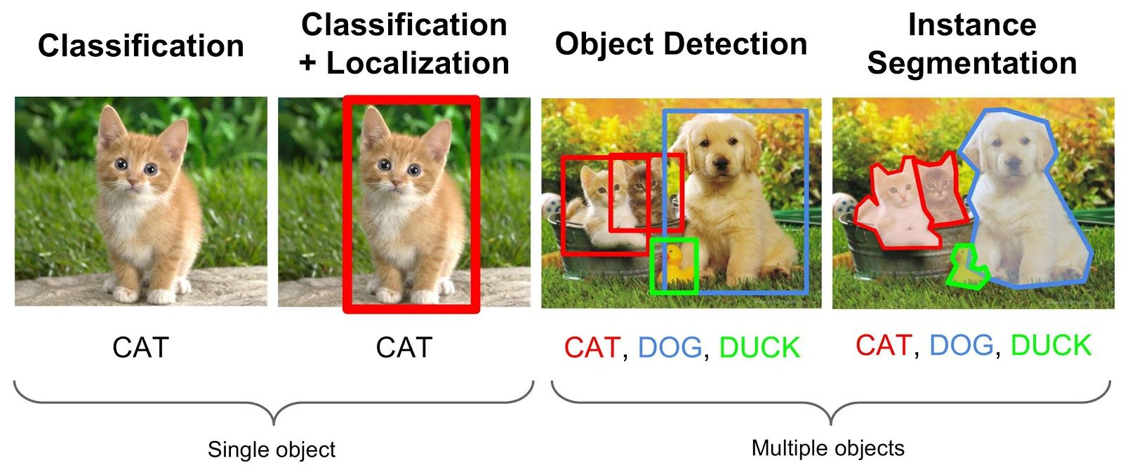
Classification and Segmentation
Source http://cs224d.stanford.edu/index.html

Slide 45
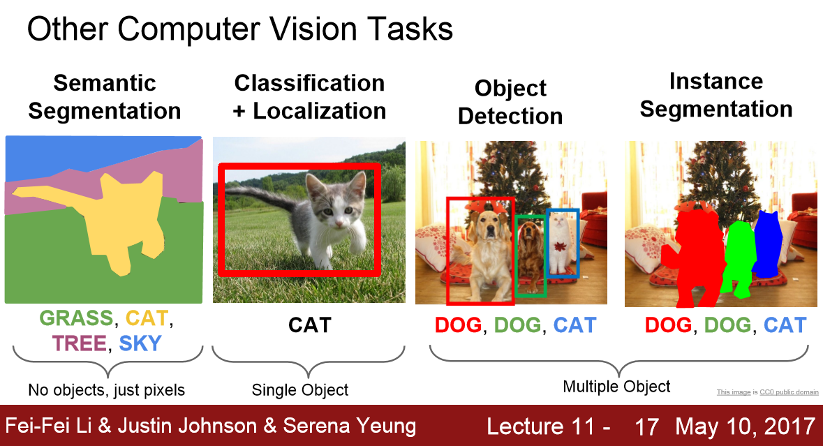
Semantic Segmentation
Source http://cs231n.stanford.edu/slides/2017/cs231n_2017_lecture11.pdf

Slide 46
Semantic Segmentation
Requires sophisticated pixel-level classification algorithms to be effective
Powerful data-based approach to segmentation
Fueled by recent advances in deep neural networks, such as U-NET

Slide 47
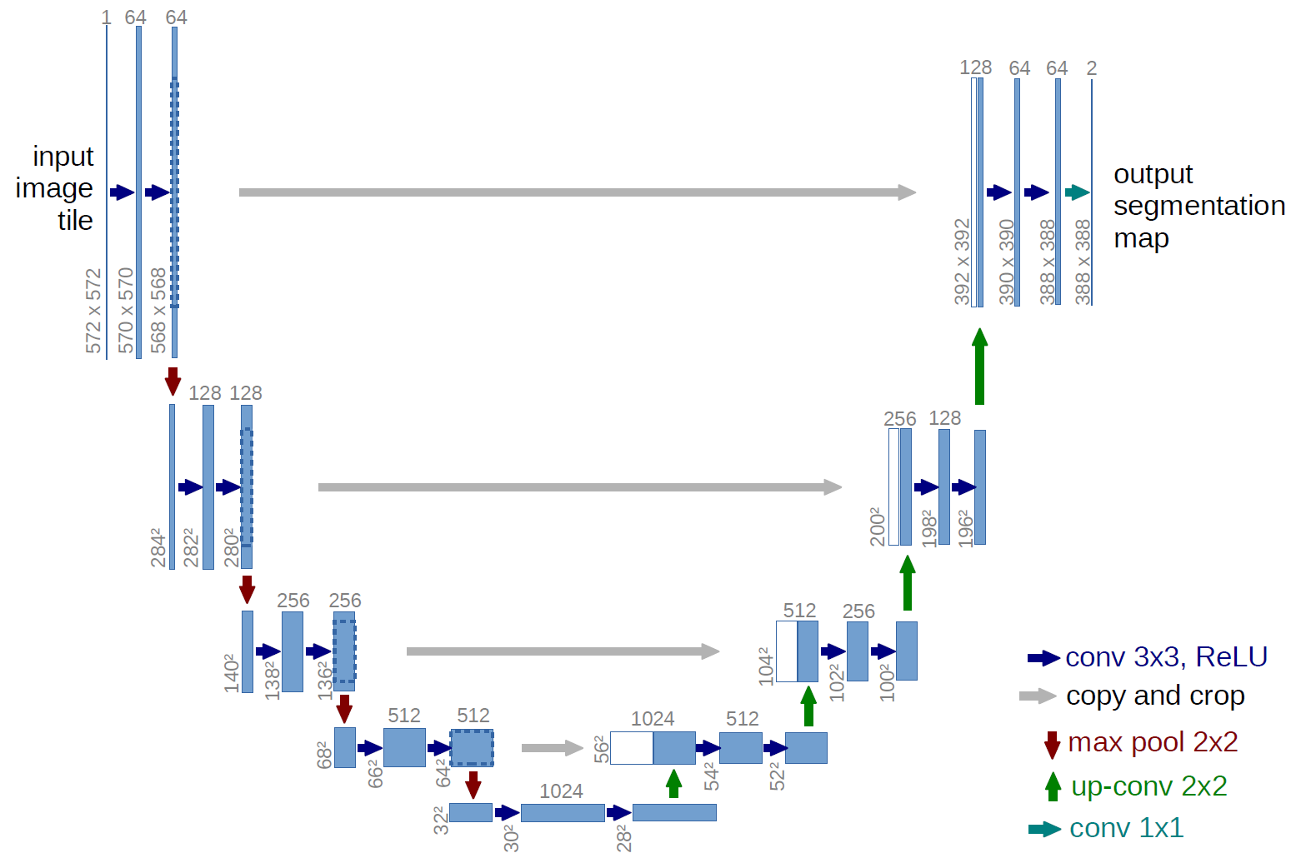
U-Net
O. Ronneberger, P. Fischer, and T. Brox. "U-net: Convolutional networks for biomedical image segmentation." In International Conference on Medical image computing and computer-assisted intervention, pp. 234-241. Springer, Cham, 2015.
Encoder-decoder structure

Slide 48
Resources
Szeliski, “Computer Vision: Algorithms and Applications”, Springer, 2011
  Chapter 5 – “Segmentation”

