Slide 1
Computer Vision – TP12 Advanced Segmentation
Miguel Coimbra, Francesco Renna

Slide 2
Outline
Segmentation by Fitting
Active Contours
Semantic Segmentation

Slide 3
Topic: Segmentation by Fitting
Segmentation by Fitting
Active Contours
Semantic Segmentation

Slide 4
Fitting and Clustering
Another definition for segmentation:
Pixels belong together because they conform to some model
Sounds like “Segmentation by Clustering”...
Key difference:
The model is now explicit
We have a mathematical model for the object we want to segment.
Ex: A line

Slide 5
Hough Transform
Elegant method for direct object recognition
Edges need not be connected
Complete object need not be visible
Key Idea: Edges VOTE for the possible model

Slide 6
Image and Parameter Spaces
Equation of Line:
Find:
Consider point:
Image Space
Parameter
Space
Parameter space also called Hough Space

Slide 7
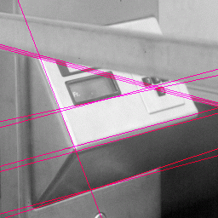
Example - Lines

Slide 8
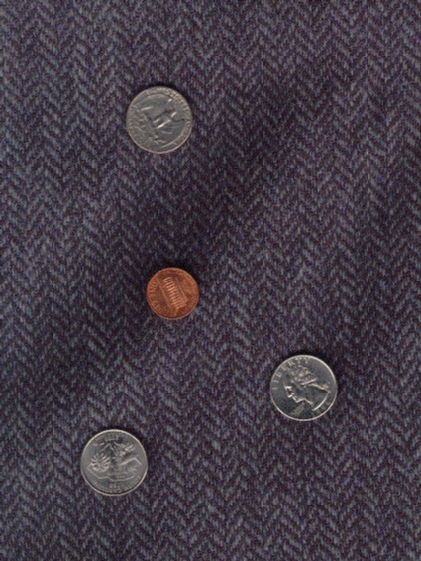
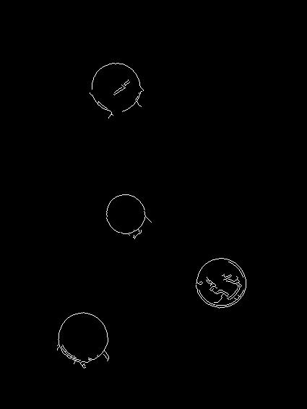
Example - Circles

Slide 9
Least Squares Line Fitting
Popular fitting procedure
Simple but biased (why?)
Consider a line:
y = ax + b
What is the line that best predicts all observations (x_{i},y_{i})?
Minimize:

Slide 10
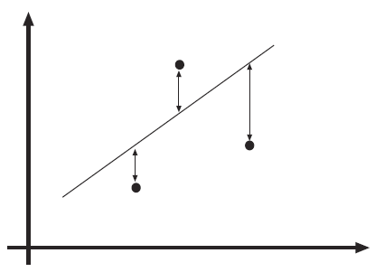
What happens if the line is vertical?

Slide 11
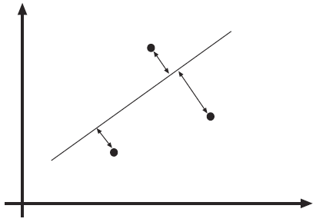
This looks better…

Slide 12
Total Least Squares
Works with the actual distance between the point and the line (rather than the vertical distance)
Lines are represented as a collection of points where:
And:
Again... Minimize the error, obtain the line with the ‘best fit’.

Slide 13
Point correspondence
We can estimate a line but, which points are on which line?
Usually:
We are fitting lines to edge points, so…
Edge directions can give us hints!
What if I only have isolated points?
Let’s look at two options:
Incremental fitting
Allocating points to lines with K-means

Slide 14
Incremental Fitting
Start with connected curves of edge points
Fit lines to those points in that curve
Incremental fitting:
Start at one end of the curve
Keep fitting all points in that curve to a line
Begin another line when the fitting deteriorates too much
Great for closed curves!

Slide 16
K-means allocation
What if points carry no hints about which line they lie on?
Assume there are k lines for the x points.
Minimize:
Iteration:
Allocate each point to the closest line
Fir the best line to the points allocated to each line

Slide 17
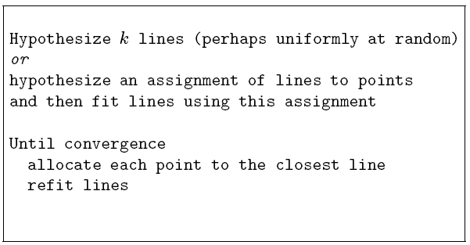

Slide 18
Topic: Active Contours
Segmentation by Fitting
Active Contours
Semantic Segmentation
Acknowledgement: Slides adapted from Kristen Grauman

Slide 19
Active Contours
Given: initial contour (model) near desired object
Acknowledgement: Slides adapted from Kristen Grauman

Slide 20
Active Contours
Goal: evolve the contour to fit exact object boundary
How?
Reward solutions next to high image gradients
Punish solutions that deform shape too much
Iteratively find the ‘best’ solution to these requirements
Acknowledgement: Slides adapted from Kristen Grauman

Slide 21
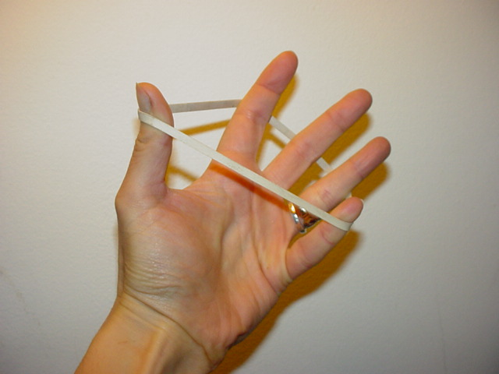
Intuition - Elastic Band
Contour evolves to a low-energy solution, but is hindered by obstacles
Better intuition: Gravity
Contour is ‘attracted’ to specific image features
Contour resists to any deformation of its shape
Acknowledgement: Slides adapted from Kristen Grauman

Slide 22
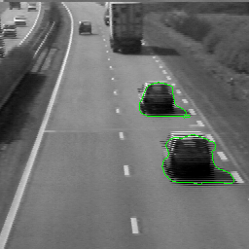
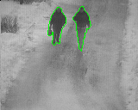
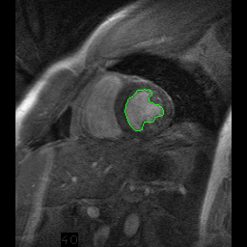
Strong motivation – Moving deformable objects
Acknowledgement: Slides adapted from Kristen Grauman

Slide 23
Things we need to consider
Representation of the contours
Defining the energy functions
External
Internal
Minimizing the energy function
Acknowledgement: Slides adapted from Kristen Grauman

Slide 24
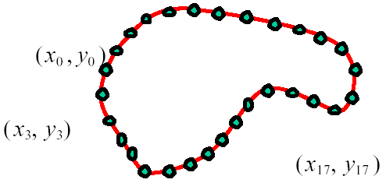
Representation
We’ll consider a discrete representation of the contour, consisting of a list of 2d point positions (“vertices”)
At each iteration, we’ll have the option to move each vertex to another nearby location (“state”)
for
Acknowledgement: Slides adapted from Kristen Grauman

Slide 25
Energy function
The total energy (cost) of the current snake is defined as:
External energy: encourage contour to fit on places where specific image structures exist
Internal energy: encourage prior shape preferences
A good fit between the current deformable contour and the target shape in the image will yield a low value for this cost function
$$E_{total}=E_{external}+E_{internal}$$
Acknowledgement: Slides adapted from Kristen Grauman

Slide 26
External image energy
Magnitude of gradient
- (Magnitude of gradient)
Acknowledgement: Slides adapted from Kristen Grauman

Slide 27
External image energy
Gradient images and
External energy at a point on the curve is:
External energy for the whole curve:
Acknowledgement: Slides adapted from Kristen Grauman

Slide 28
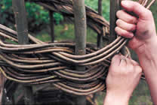
Internal energy
For a continuous curve, a common internal energy term is the “bending energy”
At some point v(s) on the curve, this is:
Tension,
Elasticity
Stiffness,
Curvature
Acknowledgement: Slides adapted from Kristen Grauman

Slide 29
Internal energy
For our discrete representation:
Internal energy for the whole curve:
Acknowledgement: Slides adapted from Kristen Grauman

Slide 30
Example: compare curvature
(2,5)
(2,2)
(3,1)
(1,1)
(3,1)
(1,1)
$$\left(3−2\left(2\right)+1\right)2+\left(1−2\left(5\right)+1\right)2$$
$$\left(3−2\left(2\right)+1\right)2+\left(1−2\left(2\right)+1\right)2$$
$$=\left(−8\right)2=64$$
$$=\left(−2\right)2=4$$
Acknowledgement: Slides adapted from Kristen Grauman

Slide 31
Penalizing elasticity
Current elastic energy definition uses a discrete estimate of the derivative:
This rewards very small shapes!
Instead -> Reward an ‘average distance d between pairs of points’
Acknowledgement: Slides adapted from Kristen Grauman

Slide 32
Total energy
Acknowledgement: Slides adapted from Kristen Grauman

Slide 33
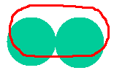
Energy weights
e.g., weight controls the penalty for internal elasticity
large
medium
small
Acknowledgement: Slides adapted from Kristen Grauman

Slide 34
Energy minimization: greedy
For each point, search window around it and move to where energy function is minimal
Typical window size, e.g., 5 x 5 pixels
Stop when predefined number of points have not changed in last iteration, or after max number of iterations
Note:
Convergence not guaranteed
Need decent initialization
Acknowledgement: Slides adapted from Kristen Grauman

Slide 35
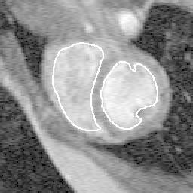
Tracking via deformable contours
Use final contour/model extracted at frame t as an initial solution for frame t+1
Evolve initial contour to fit exact object boundary at frame t+1
Repeat, initializing with most recent frame
Tracking Heart Ventricles
(multiple frames)
Acknowledgement: Slides adapted from Kristen Grauman

Slide 36
Deformable contours: pros and cons
Pros:
Useful to track and fit non-rigid shapes
Contour remains connected
Possible to fill in “subjective” contours
Flexibility in how energy function is defined, weighted.
Cons:
Must have decent initialization near true boundary, may get stuck in local minimum
Parameters of energy function must be set well based on prior information
Acknowledgement: Slides adapted from Kristen Grauman

Slide 37
Topic: Semantic Segmentation
Segmentation by Fitting
Active Contours
Semantic Segmentation

Slide 38
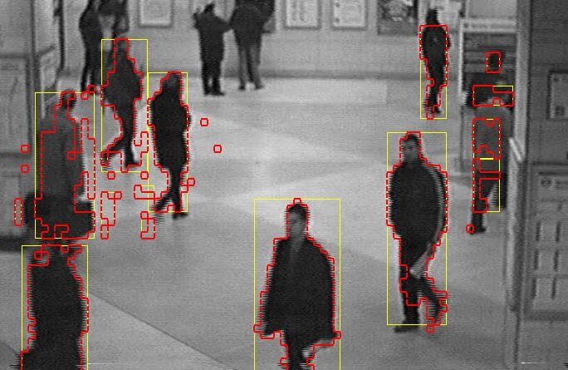
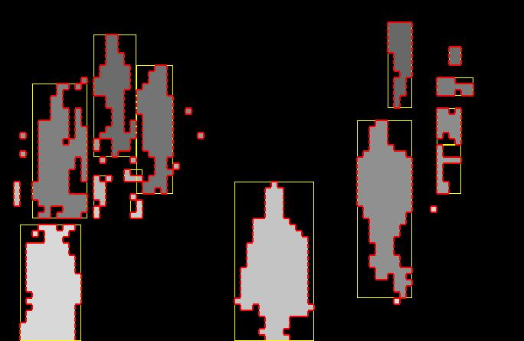
Remember ‘Segmentation’?
Separation of the image in different areas
Objects
Areas with similar visual or semantic characteristics
First form regions based on visual characteristics, then find the semantics of each region

Slide 39
Semantic Segmentation
Separation of the image in different areas
Objects
Areas with similar visual or semantic characteristics
First classify each pixel, and only then form regions (much harder!!)

Slide 40
Classification and Segmentation
Source http://cs224d.stanford.edu/index.html

Slide 41
Semantic Segmentation
Source http://cs231n.stanford.edu/slides/2017/cs231n_2017_lecture11.pdf

Slide 42
Semantic Segmentation
Requires sophisticated pixel-level classification algorithms to be effective
Powerful data-based approach to segmentation
Fueled by recent advances in deep neural networks, such as U-NET

Slide 43
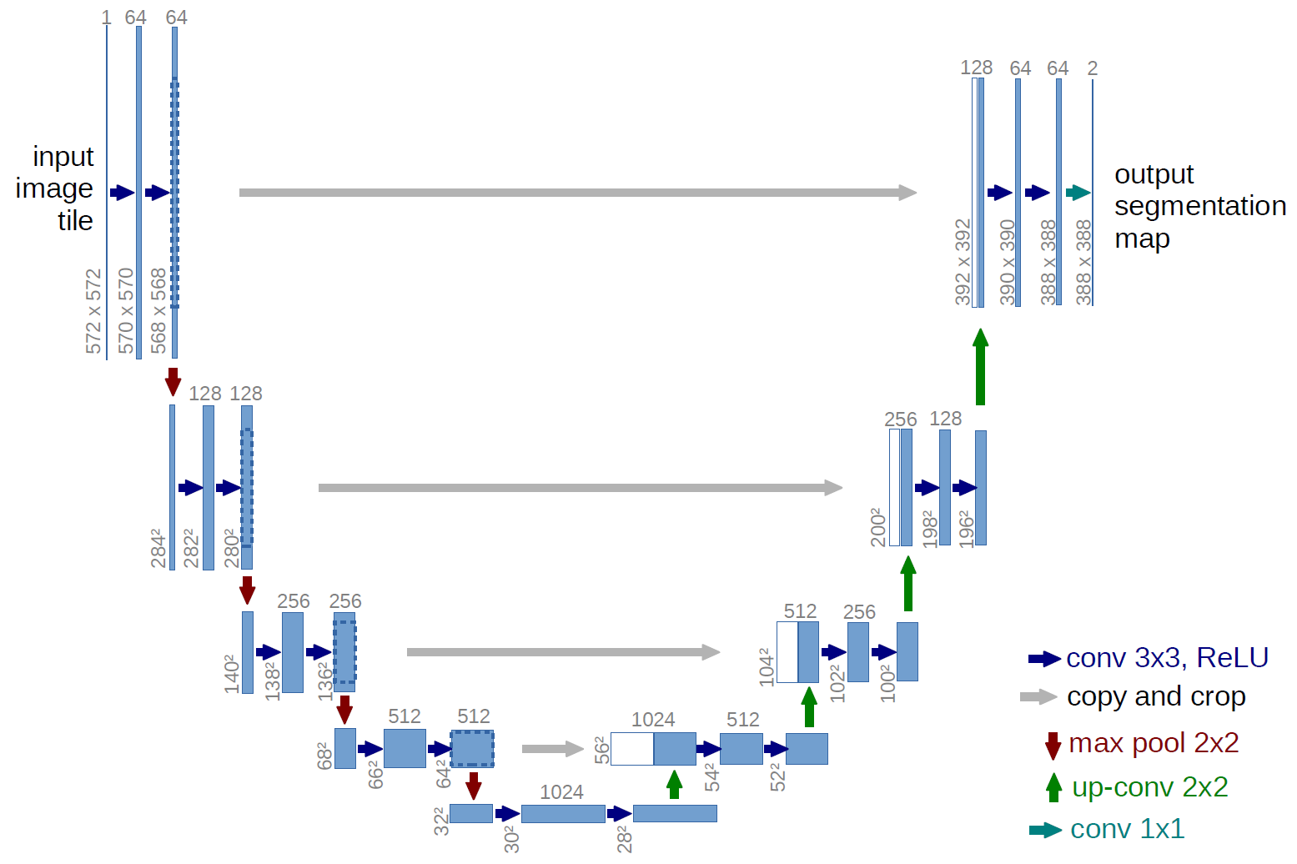
U-Net
O. Ronneberger, P. Fischer, and T. Brox. "U-net: Convolutional networks for biomedical image segmentation." In International Conference on Medical image computing and computer-assisted intervention, pp. 234-241. Springer, Cham, 2015.
Encoder-decoder structure

Slide 44
Resources
Szeliski, “Computer Vision: Algorithms and Applications”, Springer, 2011
Chapter 5 – “Segmentation”

