Slide 1
Computer Vision – TP13
Advanced Deep Learning Topics
Miguel Coimbra, Francesco Renna

Slide 2
Outline
Autoencoders
Deep learning for segmentation

Slide 3
Outline
Autoencoders
Deep learning for segmentation

Slide 4
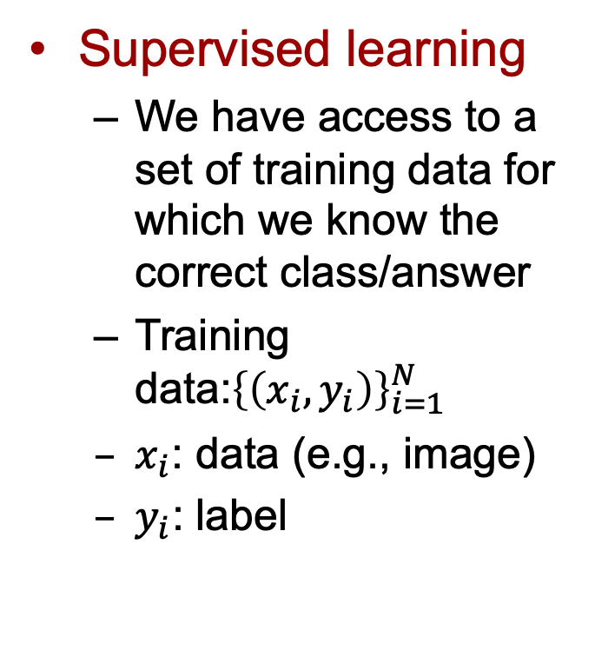
Supervised vs. Unsupervised
Supervised learning
  We have access to a set of training data for which we know the correct class/answer
  Training data:${\left\{\left(x_{i},y_{i}\right)\right\}}_{i=1}^{N}$
  $x_{i}$: data (e.g., image)
  $y_{i}$: label
Examples
  Image classification
  Image segmentation
  Object detection
  Etc.

Slide 5
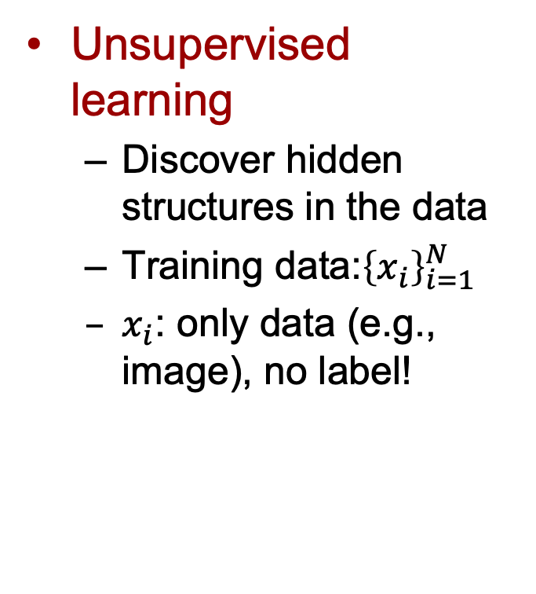
Supervised vs. Unsupervised
Unsupervised learning
  Discover hidden structures in the data
  Training data:${\left\{x_{i}\right\}}_{i=1}^{N}$
  $x_{i}$: only data (e.g., image), no label!
Examples
  Clustering
  Dimensionality reduction
  Generative models
  Etc.

Slide 6
Autoencoders
Objective
  Find representative features of the data
Unsupervised learning
  No data labels required
Simple idea
  Learn a representation of the data and try to recover the original data from that!

Slide 7
Autoencoders
Representative features

Slide 8
Autoencoders
Representative features

Slide 9
Autoencoders
Reconstruction

Slide 10
Autoencoders
Reconstruction

Slide 11
Autoencoders
Reconstruction

Slide 12
Autoencoders
Training

Slide 13
Autoencoders
Use the learned features for other tasks!

Slide 14
Autoencoders
Use the learned features for other tasks!

Slide 15
Avoid trivial solutions
Undercomplete: dim(z) << dim(x)
  Forces to capture the most salient features
  Dimensionality reduction
  Capture meaningful factors of variation
Regularized
  Encourage the model to have some properties

Slide 16
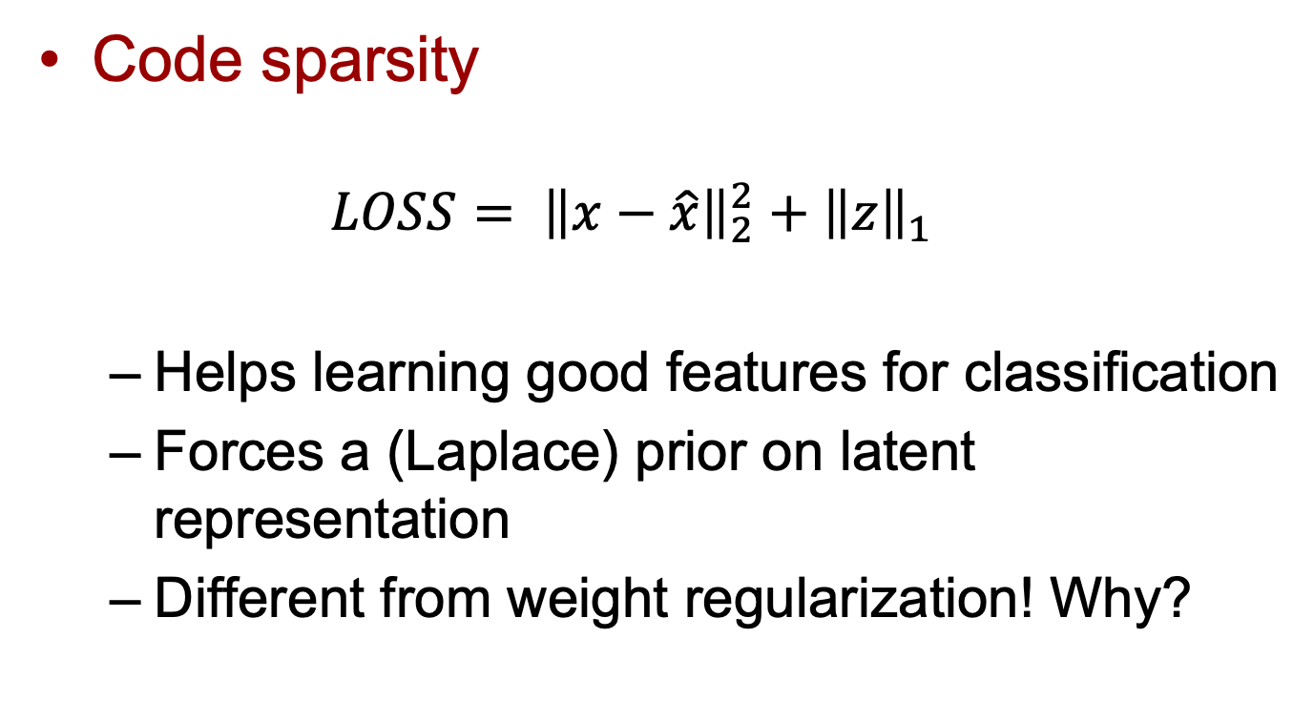
Sparse Autoencoders
Code sparsity
  $$LOSS= {\left\|x−\hat{x}\right\|}_{2}^{2}+{\left\|z\right\|}_{1}$$
  Helps learning good features for classification
  Forces a (Laplace) prior on latent representation
  Different from weight regularization! Why?

Slide 17
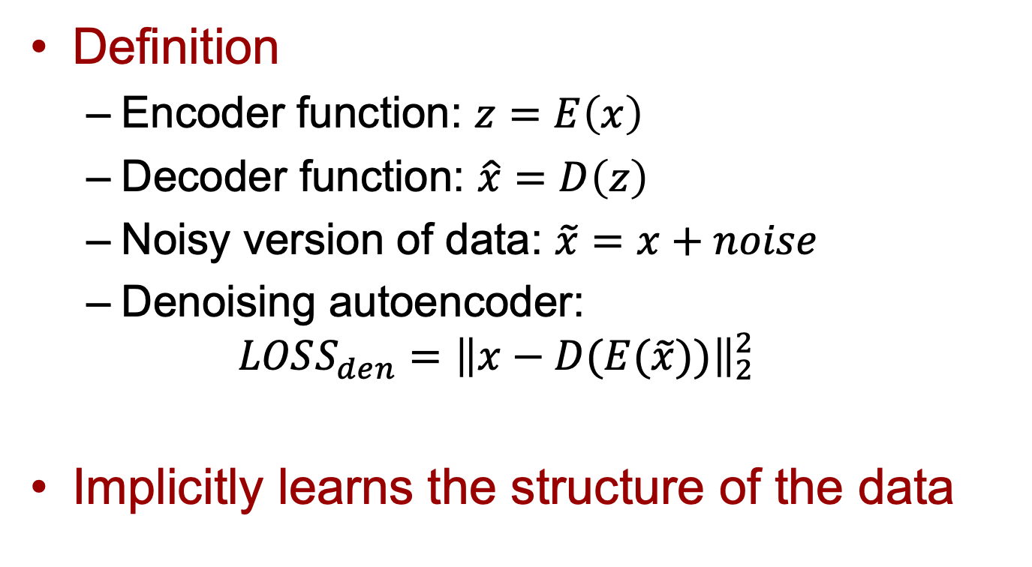
Denoising Autoencoders
Definition
  Encoder function: $z=E\left(x\right)$
  Decoder function: $\hat{x}=D\left(z\right)$
  Noisy version of data: $\tilde{x}=x+noise$
  Denoising autoencoder:
  $$LOSS_{den}={\left\|x−D(E(\tilde{x}))\right\|}_{2}^{2}$$
Implicitly learns the structure of the data

Slide 18
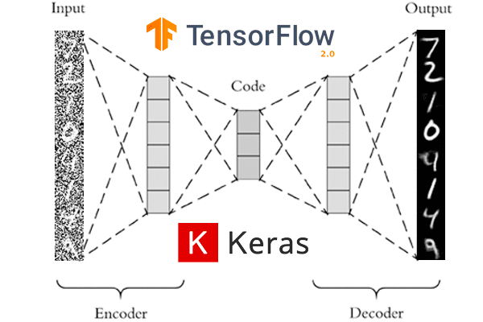
Denoising Autoencoders
https://www.pyimagesearch.com/2020/02/24/denoising-autoencoders-with-keras-tensorflow-and-deep-learning/

Slide 19
Autoencoder Applications
Dimensionality reduction
Denoising
Information retrieval
  Low-dimensional, binary code (semantic hashing)
Generative models
  Variational autoencoders (VAEs)

Slide 20
Variational Autoencoders
Idea: we can use the autoencoder approach to generate data from a specific distribution
Training: data sampled from such distribution
Use autoencoder to generate the statistical description of the data

Slide 21
Variational Autoencoders
Generative model:
  Given a set of training data, learn their distribution in order to generate new data from a similar distribution

Slide 22
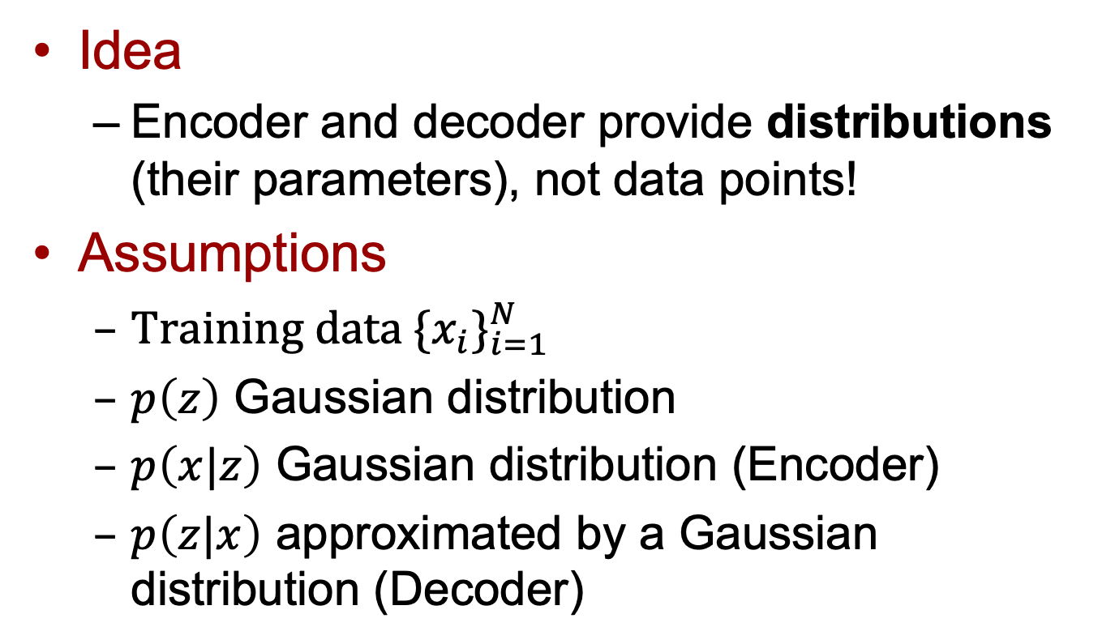
Variational Autoencoders
Idea
  Encoder and decoder provide distributions (their parameters), not data points!
Assumptions
  Training data ${\{x_{i}\}}_{i=1}^{N}$
  $p\left(z\right)$ Gaussian distribution
  $p\left(x|z\right)$ Gaussian distribution (Encoder)
  $p\left(z|x\right)$ approximated by a Gaussian distribution (Decoder)

Slide 23
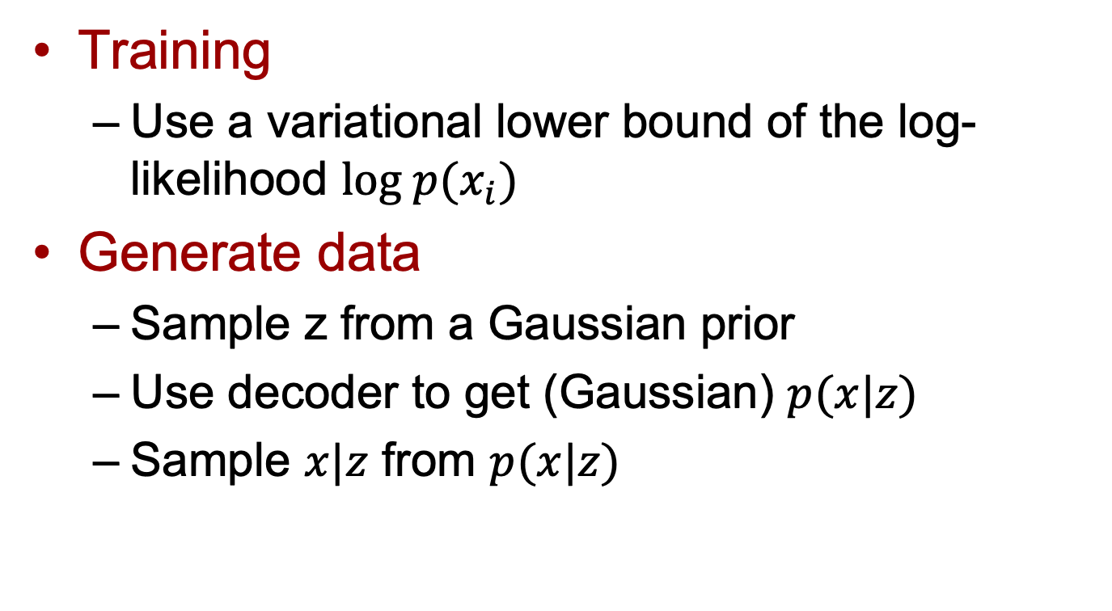
Variational Autoencoders
Training
  Use a variational lower bound of the log-likelihood $log p(x_{i})$
Generate data
  Sample z from a Gaussian prior
  Use decoder to get (Gaussian) $p(x|z)$
  Sample $x|z$ from $p(x|z)$

Slide 24
Outline
Autoencoders
Deep learning for segmentation

Slide 25
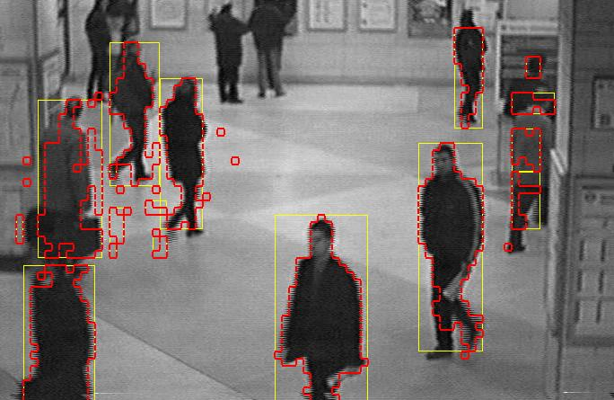
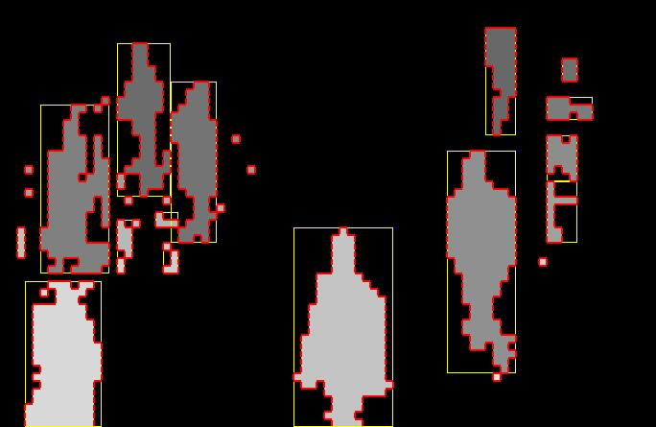
Semantic Segmentation
Separation of the image in different areas
  Objects
  Areas with similar visual or semantic characteristics
First classify each pixel, and only then form regions (much harder!!)

Slide 26
Deep Learning Semantic Segmentation
Basic idea: use deep learning models to classify pixels with semantic labels
  Can we simply use CNN architectures previously presented for classification?
More demanding task than image classification

Slide 27
Fully Convolutional Networks
Remove fully connected layers from existing CNN models (e.g., VGG16)
  Variable size input
  Output can have same size of input. (Why?)
J. Long, E. Shelhamer, and T. Darrell, “Fully convolutional networks for semantic segmentation,” in IEEE Conference on Computer Vision and Pattern Recognition, 2015, pp. 3431–3440.

Slide 28
Fully Convolutional Networks
Upsampling/Skip connections
  Project information to image domain
  Keep global information

Slide 29
Fully Convolutional Networks
Limitations:
  Too complex for real time segmentation
  Global information not efficiently managed
  Not easily generalizable to 3D data

Slide 30
Encoder-Decoder Models
Encoder-decoder architectures
  Similar to autoencoders architectures
  Leverage latent representation
  But require labels to train (supervised)
Minaee S, Boykov YY, Porikli F, Plaza AJ, Kehtarnavaz N, Terzopoulos D. Image segmentation using deep learning: A survey. IEEE Transactions on Pattern Analysis and Machine Intelligence. 2021 Feb 17

Slide 31
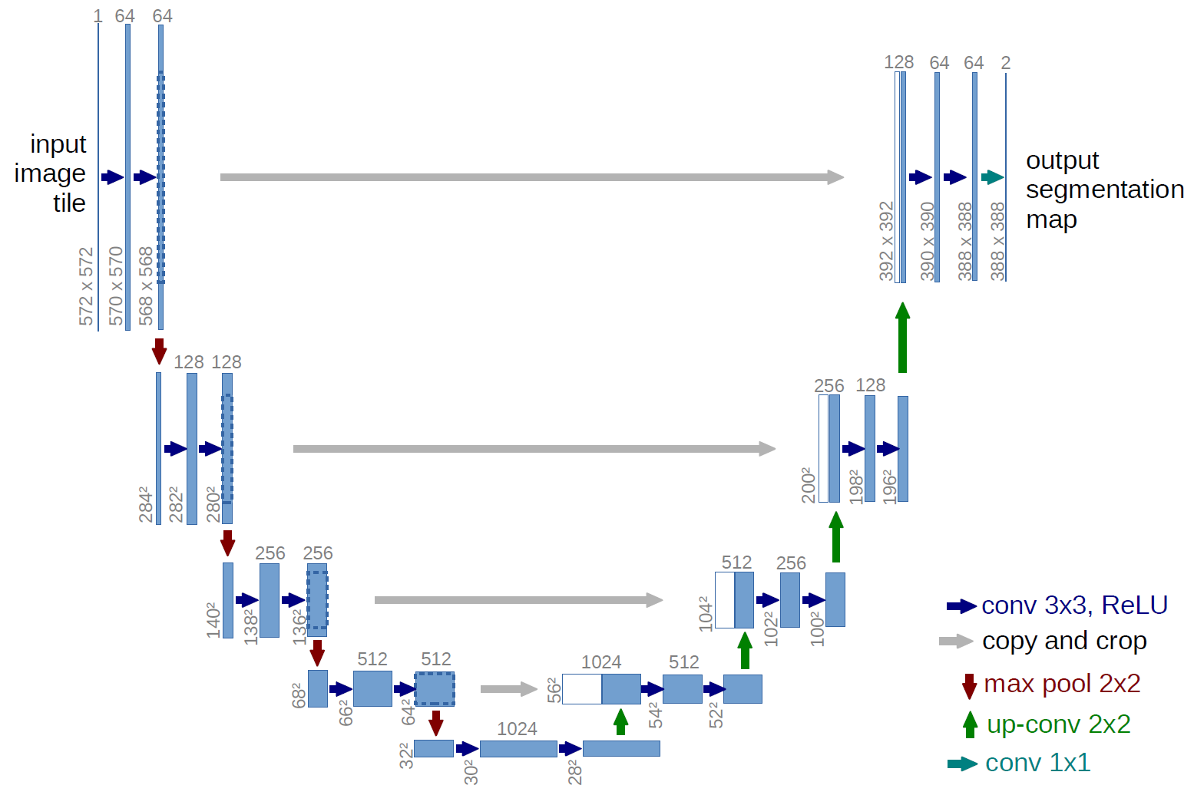
U-Net
2D segmentation
O. Ronneberger, P. Fischer, and T. Brox. "U-net: Convolutional networks for biomedical image segmentation." In International Conference on Medical image computing and computer-assisted intervention, pp. 234-241. Springer, Cham, 2015.

Slide 32
V-Net
3D segmentation
F. Milletari, N. Navab, and S.-A. Ahmadi, “V-Net: Fully convo- lutional neural networks for volumetric medical image segmen- tation,” in International Conference on 3D Vision. IEEE, 2016, pp. 565–571.

Slide 33
Encoder-Decoder Models
Extensively used in as state-of-the-art for different fields
  “General” image segmentation
  Autonomous driving
  Medical and biomedical image segmentation
Limitations
  Potential loss of fine-grained image information

Slide 34
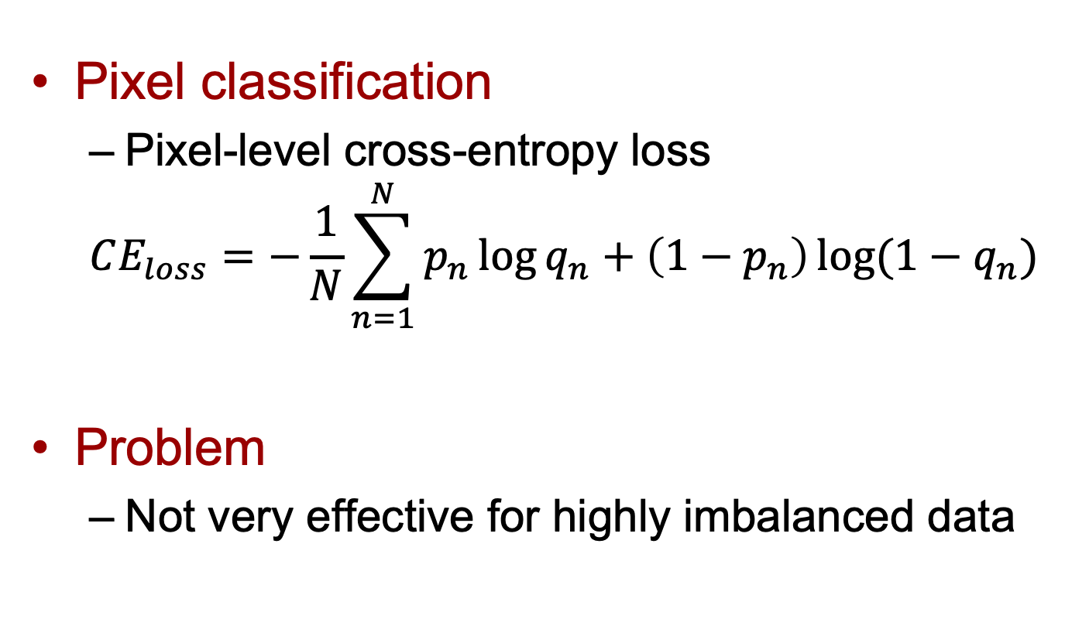
Training
Pixel classification
  Pixel-level cross-entropy loss
  $$CE_{loss}=−\frac{1}{N}\sum_{n=1}^{N}{p_{n}\log{q_{n}}+\left(1−p_{n}\right)\log{(1−q_{n})}}$$
Problem
  Not very effective for highly imbalanced data

Slide 35
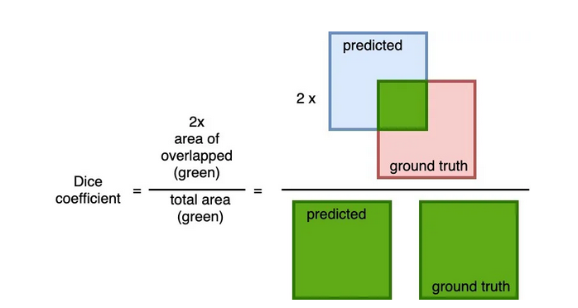
Training
Dice coefficient
https://datascience.stackexchange.com/questions/75708/neural-network-probability-output-and-loss-function-example-dice-loss

Slide 36
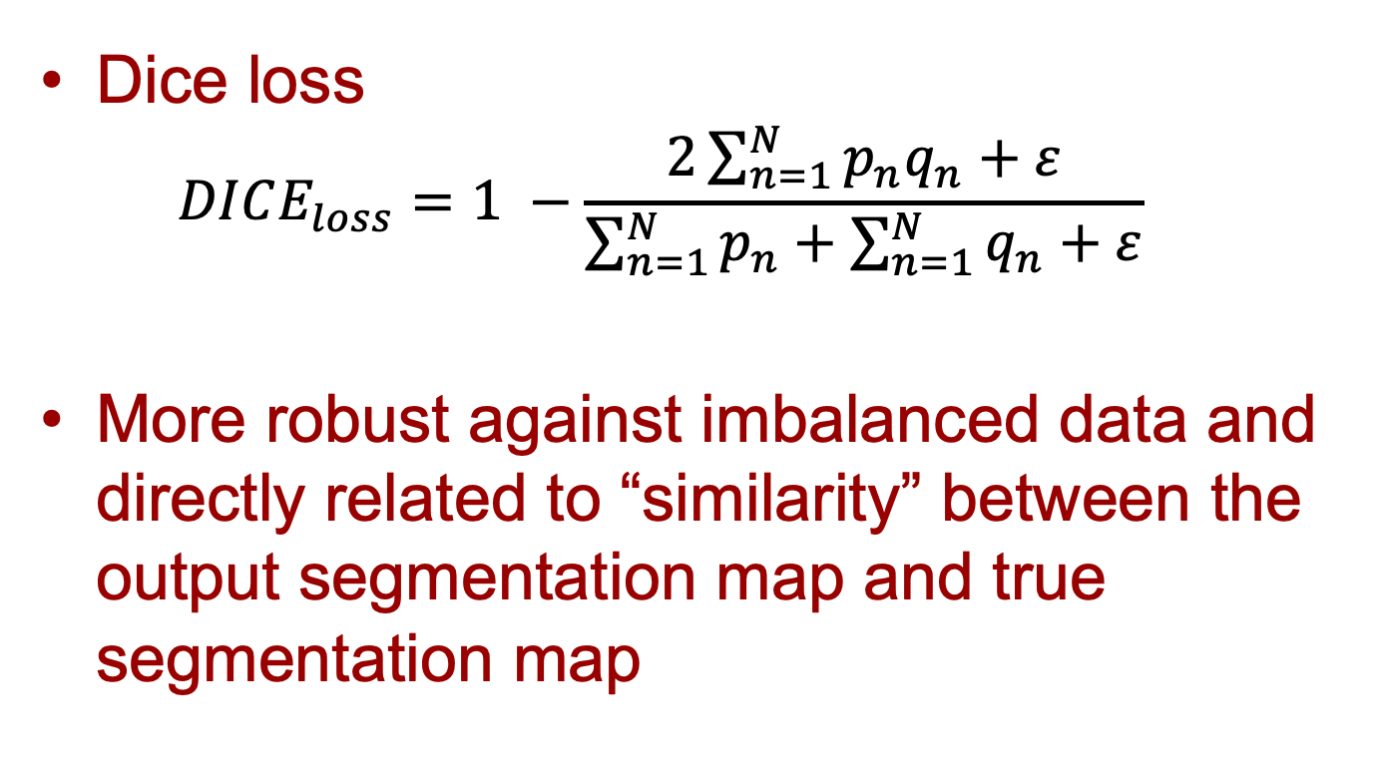
Training
Dice loss
  $$DICE_{loss}=1 −\frac{2\sum_{n=1}^{N}{p_{n}q_{n}+ε}}{\sum_{n=1}^{N}{p_{n}}+\sum_{n=1}^{N}{q_{n}+ε}}$$
More robust against imbalanced data and directly related to “similarity” between the output segmentation map and true segmentation map

Slide 37
Resources
F.F. Li, J. Johnson, S. Young. Convolutional Neural Networks for Visual Recognition, Stanford University, 2017
  Lecture 13- ”Generative models”
  http://cs231n.stanford.edu/slides/2017/cs231n_2017_lecture13.pdf
I. Goodfellow, Y. Bengio, and A. Courville. Deep learning. Cambridge: MIT press, 2016.
  Chapter 14 – “Autoencoders”
  Chapter 20 – “Deep Generative Models”

