Slide 1
Computer Vision – TP2
Digital Images
Miguel Coimbra, Francesco Renna

Slide 2
Outline
Sampling and quantization
Data structures for digital images

Slide 3
Topic: Sampling and quantization
Sampling and quantization
Data structures for digital images

Slide 4
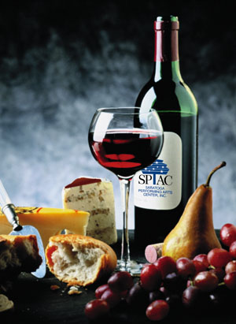
Components of a Computer Vision System
Camera
Lighting
Computer
Scene
Scene Interpretation

Slide 5
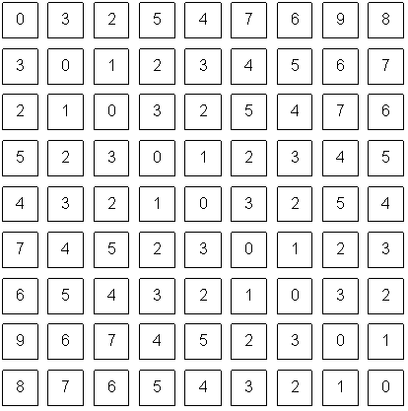
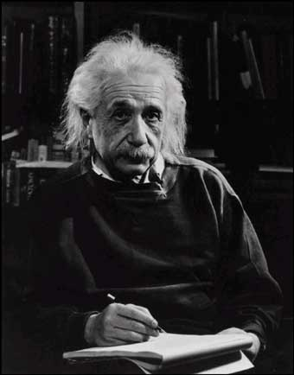
Digital Images
What we see
What a computer sees

Slide 6
Pinhole and the Perspective Projection
Is an image being formed
on the screen?
YES! But, not a “clear” one.
(x,y)
screen
image plane
scene
y
optical
axis
effective focal length, f’
z
pinhole
x

Slide 7

Simple Image Model
Image as a 2D light-intensity function
Continuous
Non-zero, finite value
Intensity
Position
[Gonzalez & Woods]

Slide 8
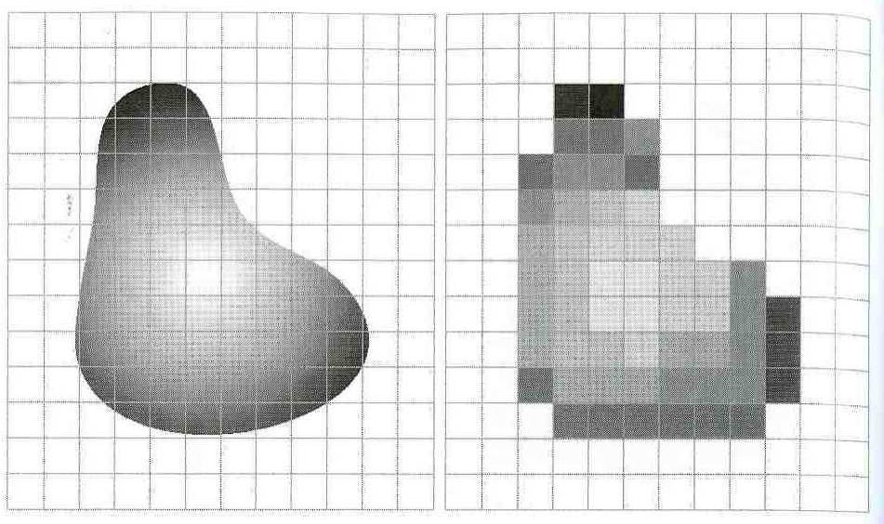
Analog to Digital
The scene is:
  projected on a 2D plane,
  sampled on a regular grid, and each sample is
  quantized (rounded to the nearest integer)

Slide 9
Images as Matrices
Each point is a pixel with amplitude:
  f(x,y)
An image is a matrix with size N x M
M = [(0,0) (0,1) …
[(1,0) (1,1) …
…
(0,0)
(0,N-1)
(M-1,0)
Pixel

Slide 10
Sampling Theorem
Continuous signal:
Shah function (Impulse train):
Sampled function:

Slide 11
Sampling Theorem
Sampled
function:
Sampling
frequency
Only if

Slide 12
Nyquist Theorem
If
Aliasing
Sampling frequency must be greater than

Slide 13
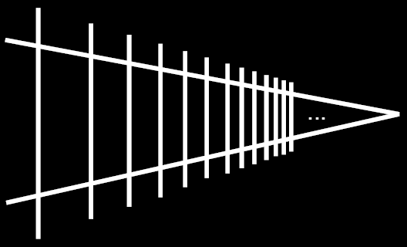
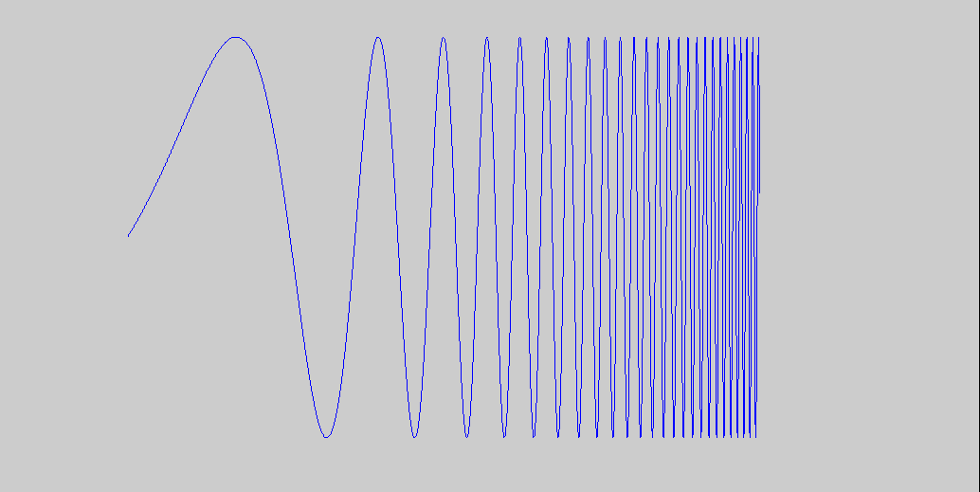
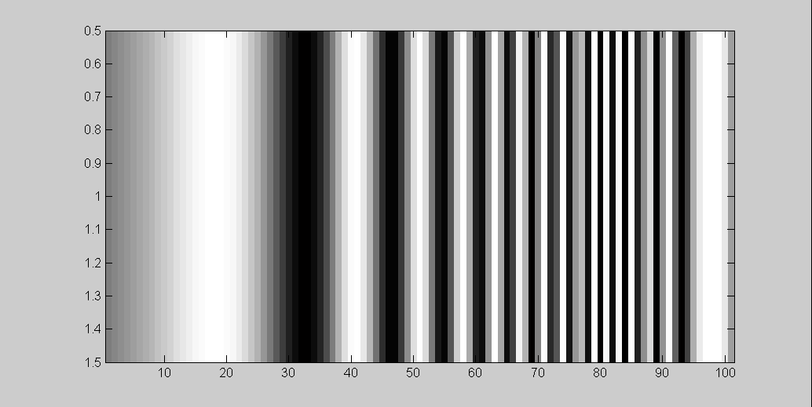
Aliasing
Input signal:
Picket fence receding
into the distance will
produce aliasing…
Matlab output:
WHY?
x = 0:.05:5; imagesc(sin((2.^x).*x))

Slide 14
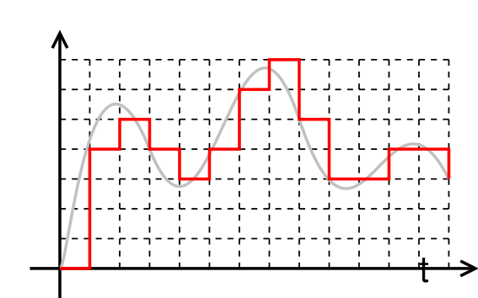
Quantization
Analog:
Digital: Infinite storage space per pixel!
Quantization

Slide 15
Quantization Levels
G - number of levels
m – storage bits
Round each value to its nearest level

Slide 16


Effect of quantization

Slide 17
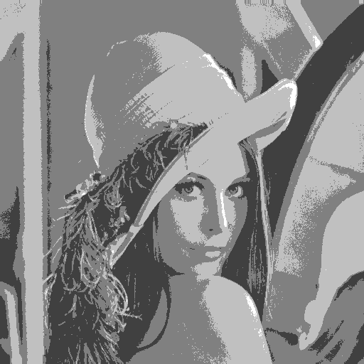
Effect of quantization

Slide 18
Image Size
Storage space
  Spatial resolution: N x M
  Quantization: m bits per pixel
  Required bits b:
Rule of thumb:
  More storage space means more image quality

Slide 19
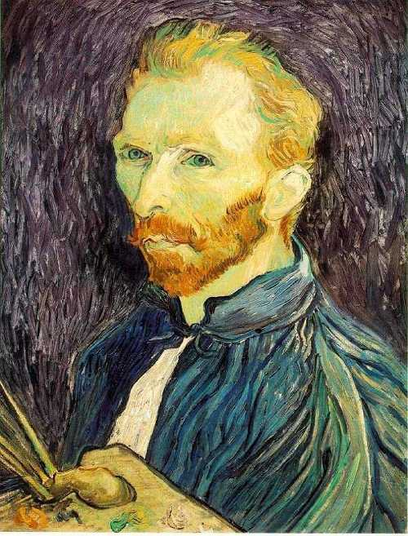
Image Scaling
This image is too big to
fit on the screen. How
can we reduce it?
How to generate a half-
sized version?

Slide 20

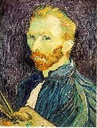

Sub-sampling
1/8
1/4
Throw away every other row and column to create a 1/2 size image
  - called image sub-sampling

Slide 21
Sub-sampling
1/2
1/4 (2x zoom)
1/8 (4x zoom)

Slide 22
Topic: Data structures for digital images
Sampling and quantization
Data structures for digital images

Slide 23
Data Structures for Digital Images
Are there other ways to represent digital images?
What we see
What a computer sees

Slide 24
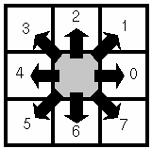
Chain codes
Chains represent the borders of objects.
Coding with chain codes.
  Relative.
  Assume an initial starting point for each object.
Needs segmentation!
Freeman Chain Code
Using a Freeman Chain Code and considering the top-left pixel as the starting point:
70663422

Slide 25
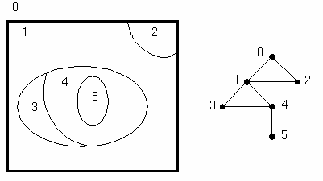
Topological Data Structures
Region Adjacency Graph
  Nodes - Regions
  Arcs – Relationships
Describes the elements of an image and their spatial relationships.
Needs segmentation!
Region Adjacency Graph

Slide 26
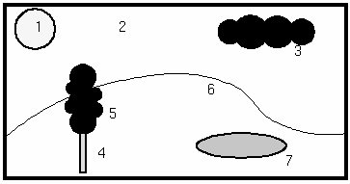
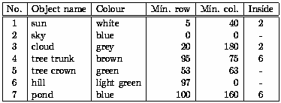
Relational Structures
Stores relations between objects.
Important semantic information of an image.
Needs segmentation and an image description (features)!
Relational Table

Slide 27
Resources
Szeliski, “Computer Vision: Algorithms and Applications”, Springer, 2011
  Chapter 2 – “Image Formation”

