Slide 1
Computer Vision – TP3
Frequency Space
Miguel Coimbra, Francesco Renna

Slide 2
Outline
Fourier Transform
Frequency Space
Spatial Convolution

Slide 3
Topic: Fourier Transform
Fourier Transform
Frequency Space
Spatial Convolution

Slide 4

How to Represent Signals?
Option 1: Taylor series represents any function using polynomials.
Polynomials are not the best - unstable and not very physically meaningful.
Easier to talk about “signals” in terms of its “frequencies”
(how fast/often signals change, etc).

Slide 5
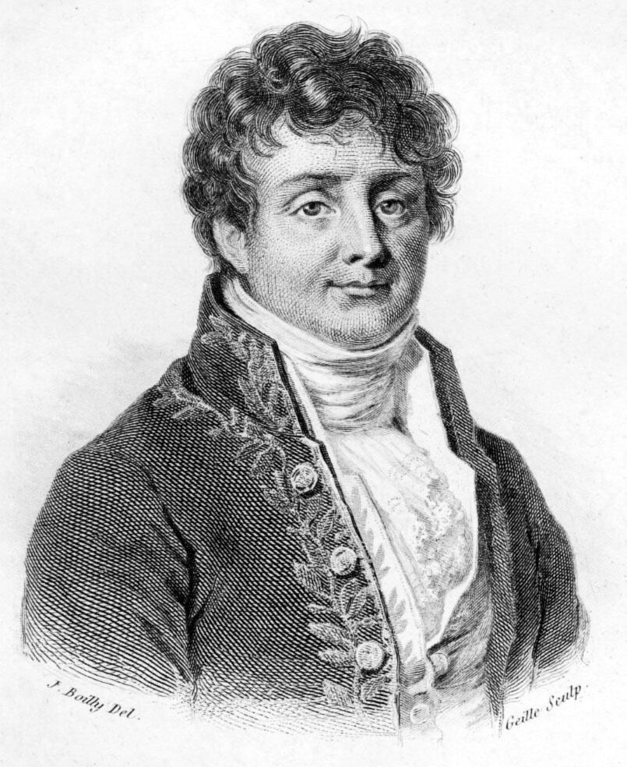
Jean Baptiste Joseph Fourier (1768-1830)
Had a crazy idea (1807):
Any periodic function can be rewritten as a weighted sum of Sines and Cosines of different frequencies.
Don’t believe it?
  Neither did Lagrange, Laplace, Poisson and other big wigs
  Not translated into English until 1878!
But it’s true!
  called Fourier Series
  Possibly the greatest tool
  used in Engineering

Slide 6
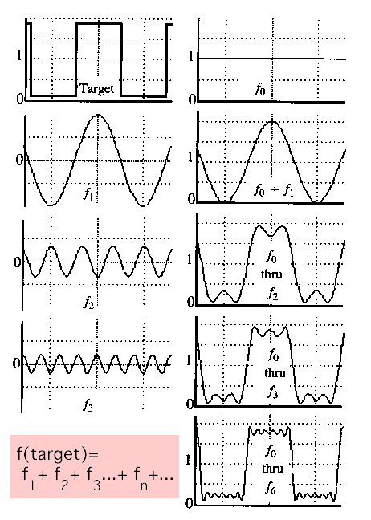
A Sum of Sinusoids
Our building block:
Add enough of them to get any signal f(x) you want!
How many degrees of freedom?
What does each control?
Which one encodes the coarse vs. fine structure of the signal?

Slide 7
Fourier Transform
We want to understand the frequency ω of our signal. So, let’s reparametrize the signal by ω instead of x:
For every ω from 0 to inf, F(ω) holds the amplitude A and phase φ of the corresponding sine
  How can F hold both? Complex number trick!
f(x)
Fourier
Transform
F(ω)

Slide 8
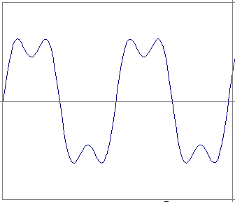
Time and Frequency
example : g(t) = sin(2pf t) + (1/3)sin(2p(3f) t)

Slide 9
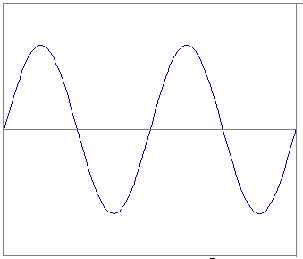
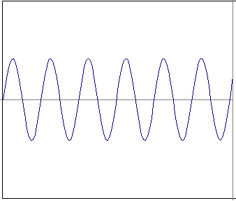
Time and Frequency
example : g(t) = sin(2pf t) + (1/3)sin(2p(3f) t)
=
+

Slide 10
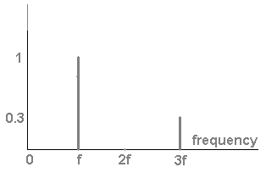
Frequency Spectra
example : g(t) = sin(2pf t) + (1/3)sin(2p(3f) t)
=
+

Slide 11

Frequency Spectra
Usually, frequency is more interesting than the phase

Slide 12
Frequency Spectra
=
+
=

Slide 13
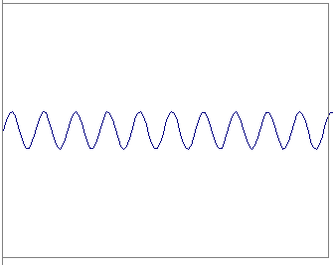
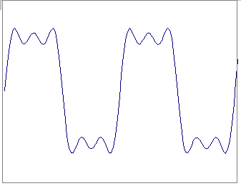
Frequency Spectra
=
+
=

Slide 14
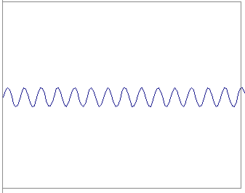
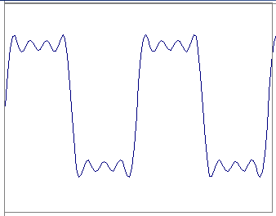
Frequency Spectra
=
+
=

Slide 15
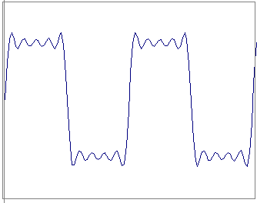
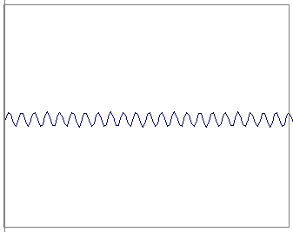
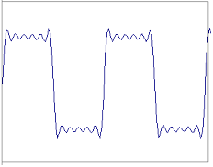
Frequency Spectra
=
+
=

Slide 16
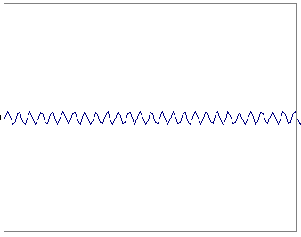
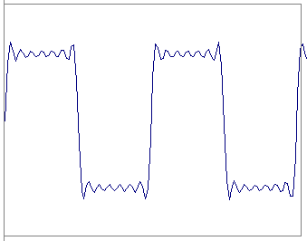
Frequency Spectra
=
+
=

Slide 17
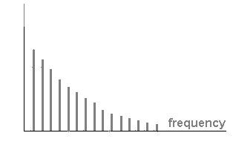
Frequency Spectra
=

Slide 18
Fourier Transform – more formally
Represent the signal as an infinite weighted sum of an infinite number of sinusoids
Note:
Arbitrary function
Single Analytic Expression
Spatial Domain (x)
Frequency Domain (u)
(Frequency Spectrum F(u))
Inverse Fourier Transform (IFT)

Slide 19
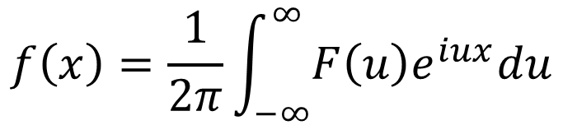
Fourier Transform
Also, defined as:
Note:
Inverse Fourier Transform (IFT)
$$f\left(x\right)=\frac{1}{2π}\int_{−∞}^{∞}{F\left(u\right)e^{iux}du}$$

Slide 20
Properties of Fourier Transform
Linearity
Scaling
Spatial
Domain
Frequency
Domain
Shifting
Symmetry
Conjugation
Convolution
Differentiation

Slide 21
Topic: Frequency Space
Fourier Transform
Frequency Space
Spatial Convolution

Slide 22
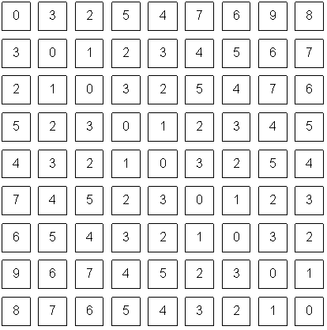
How does this apply to images?
We have defined the Fourier Transform as
But images are:
  Discrete.
  Two-dimensional.
What a computer sees

Slide 23
2D Discrete FT
In a 2-variable case, the discrete FT pair is:
New matrix with the same size!
For u=0,1,2,…,M-1 and v=0,1,2,…,N-1
AND:
For x=0,1,2,…,M-1 and y=0,1,2,…,N-1

Slide 24
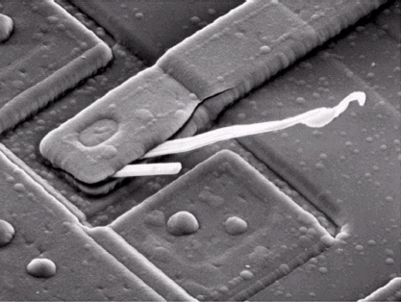
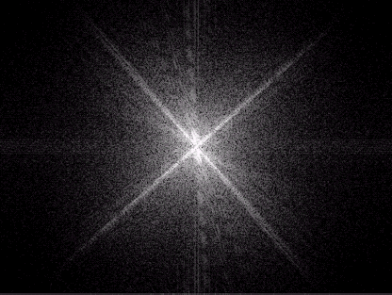
Frequency Space
Image Space
  f(x,y)
  Intuitive
Frequency Space
  F(u,v)
  What does this mean?

Slide 25
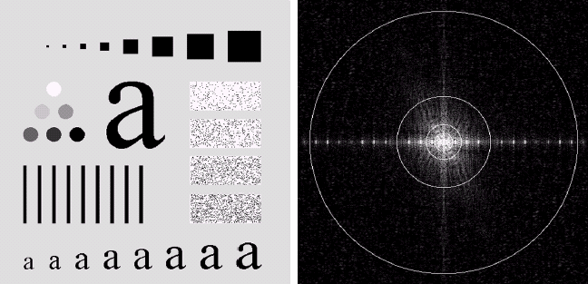
Power distribution
An image (500x500 pixels) and its Fourier spectrum. The super-imposed circles have radii values of 5, 15, 30, 80, and 230, which respectively enclose 92.0, 94.6, 96.4, 98.0, and 99.5% of the image power.

Slide 26
Power distribution
Most power is in low frequencies.
Means we are using more of this:
And less of this:
To represent our signal.
Why?

Slide 27
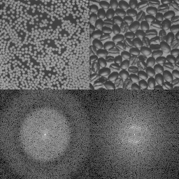
What does this mean??

Slide 28
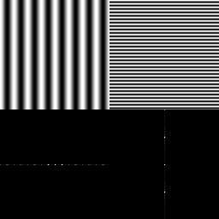
Horizontal and Vertical Frequency
Frequencies:
  Horizontal frequencies correspond to horizontal gradients.
  Vertical frequencies correspond to vertical gradients.
What about diagonal lines?

Slide 30
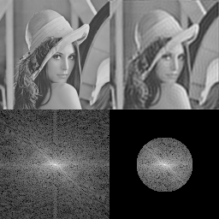
If I discard high-frequencies, I get a blurred image...
Why?

Slide 31
Why bother with FT?
Great for filtering.
Great for compression.
In some situations: Much faster than operating in the spatial domain.
Convolutions are simple multiplications in Frequency space!
...

Slide 32
Topic: Spatial Convolution
Fourier Transform
Frequency Space
Spatial Convolution

Slide 33
Convolution
kernel h

Slide 34
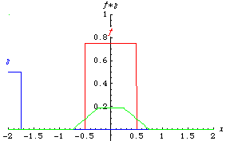
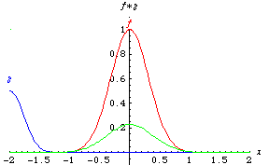
Convolution - Example
Eric Weinstein’s Math World

Slide 35
Convolution - Example
1
1
-1
1
-1
1
1
-2
-1
1
2

Slide 36
Convolution Kernel – Impulse Response
What h will give us g = f ?
Dirac Delta Function (Unit Impulse)

Slide 37
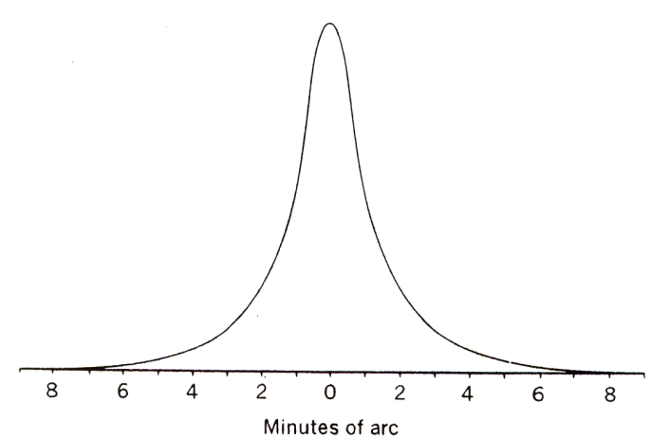
Point Spread Function
Ideally, the optical system should be a Dirac delta function.
However, optical systems are never ideal.
Point spread function of Human Eyes.
scene
Optical
System
image
Optical
System
point source
point spread function

Slide 38
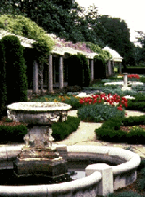


Point Spread Function
normal vision
myopia
hyperopia
Images by Richmond Eye Associates

Slide 39
Properties of Convolution
Commutative
Associative
Cascade system

Slide 40
Fourier Transform and Convolution
Let
Then
Convolution in spatial domain
Multiplication in frequency domain

Slide 41
Fourier Transform and Convolution
Spatial Domain (x)
Frequency Domain (u)
So, we can find g(x) by Fourier transform
IFT
FT
FT

Slide 42
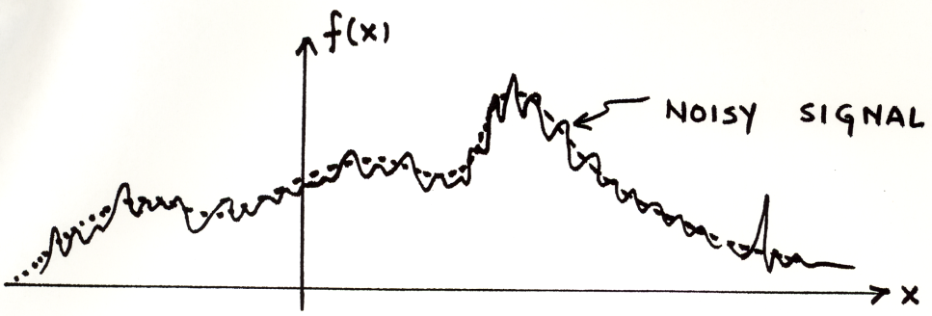
Example use: Smoothing/Blurring
We want a smoothed function of f(x)
Let us use a Gaussian kernel
Then

Slide 43
Resources
Szeliski, “Computer Vision: Algorithms and Applications”, Springer, 2011
  Chapter 3 – “Image Processing”

