Slide 1
Computer Vision – TP6
Spatial Filters
Miguel Coimbra, Francesco Renna

Slide 2
Outline
Spatial filters
Frequency domain filtering
Edge detection
Morphological filters

Slide 3
Topic: Spatial filters
Spatial filters
Frequency domain filtering
Edge detection
Morphological filters

Slide 4
Images are Discrete and Finite
Convolution
Fourier Transform
Inverse Fourier Transform

Slide 5
Spatial Mask
Simple way to process an image
Mask defines the processing function
Corresponds to a multiplication in frequency domain
Mask
Image
Convolution – Mask ‘slides’ over the image

Slide 6
Example
Each mask position has weight w
The result of the operation for each pixel is given by:
1 | 2 | 1
0 | 0 | 0
-1 | -2 | -1
2 | 2 | 2
4 | 4 | 4
4 | 5 | 6
Mask
Image
=1*2+2*2+1*2+…
=8+0-20
=-12

Slide 7
Definitions
Spatial filters
  Use a mask (kernel) over an image region
  Work directly with pixels
  As opposed to: Frequency filters
Advantages
  Simple implementation: convolution with the kernel function
  Different masks offer a large variety of functionalities

Slide 8
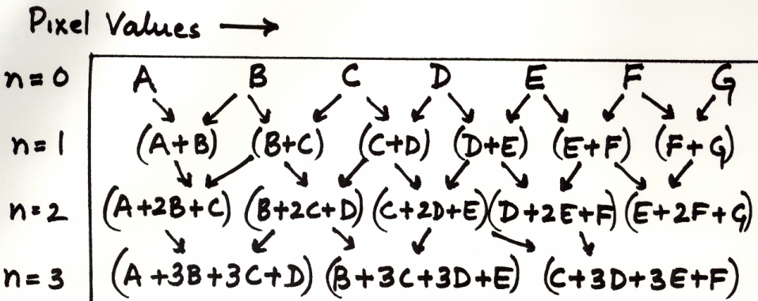
Averaging
Let’s think about averaging pixel values
For n=2, convolve pixel values with
1
2
1
Which is faster?
2D images:
1
1
1
2
1
(a) use
1
2
1
then
or (b) use
1
2
1
4
2
2
2
2
1
1
1
2
1

Slide 9
Averaging
The convolution kernel
large
Repeated averaging
Gaussian smoothing

Slide 10
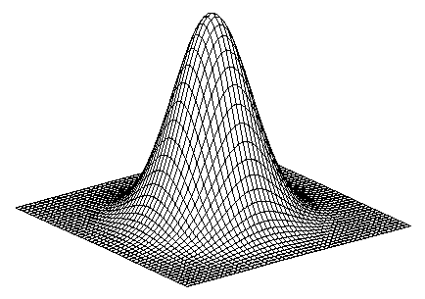
Gaussian Smoothing
Gaussian
kernel
Filter size
…can be very large
(truncate, if necessary)
pixels
Use two 1D
Gaussian
Filters!
2D Gaussian is separable!

Slide 11



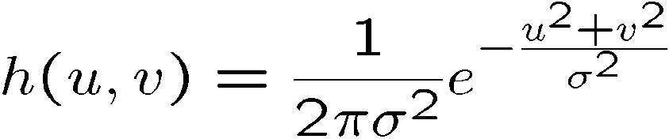
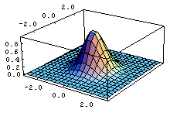
Gaussian Smoothing
A Gaussian kernel gives less weight to pixels further from the center of the window
This kernel is an approximation of a Gaussian function:
1 | 2 | 1
2 | 4 | 2
1 | 2 | 1

Slide 12
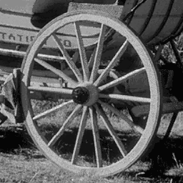
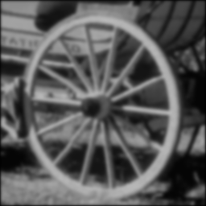


original

Slide 13
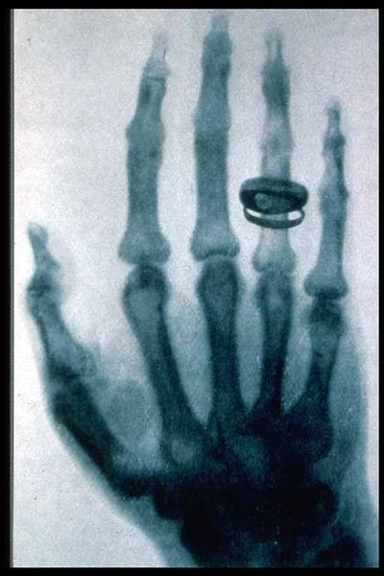

Mean Filtering
We are degrading the energy of the high spatial frequencies of an image (low-pass filtering)
  Makes the image ‘smoother’
  Used in noise reduction
Can be implemented with spatial masks or in the frequency domain
1/9 | 1/9 | 1/9
1/9 | 1/9 | 1/9
1/9 | 1/9 | 1/9

Slide 14
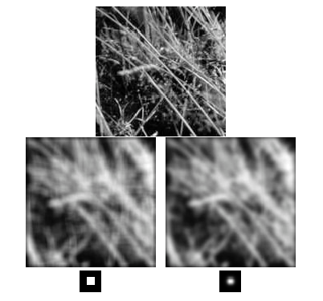
Mean filter
Gaussian filter

Slide 15
Median Filter
(a)
Smoothing is averaging
  (a) Blurs edges
  (b) Sensitive to outliers
(b)
Median filtering
  Sort values around the pixel
  Select middle value (median)
  Non-linear (Cannot be implemented with convolution)
sort
median

Slide 16
Salt and pepper noise
Gaussian noise
3x3
5x5
7x7

Slide 17
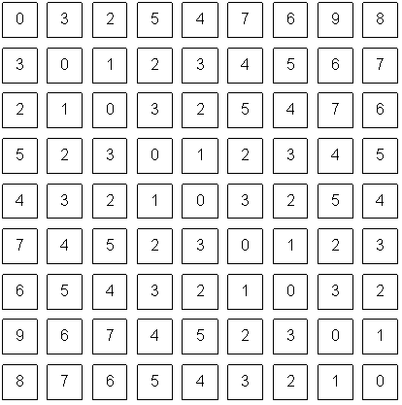
Border Problem
1 | 2 | 1
2 | 4 | 2
1 | 2 | 1
How do we apply our mask to this pixel?
What a computer sees

Slide 18
Border Problem
Ignore
  Output image will be smaller than original
Pad with constant values
  Can introduce substantial 1st order derivative values
Pad with reflection
  Can introduce substantial 2nd order derivative values

Slide 19
Topic: Frequency domain filtering
Spatial filters
Frequency domain filtering
Edge detection
Morphological filters

Slide 20
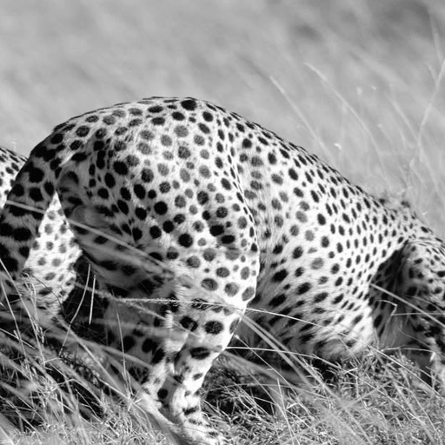
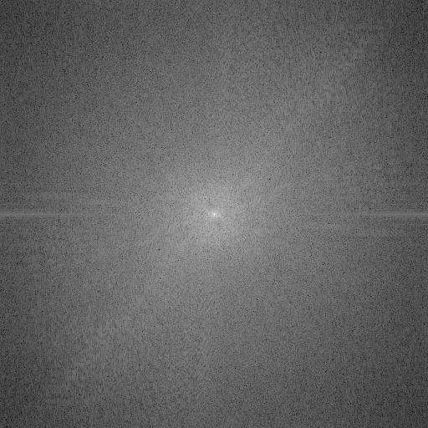
Image Processing in the Fourier Domain
Magnitude of the FT
Does not look anything like what we have seen

Slide 21
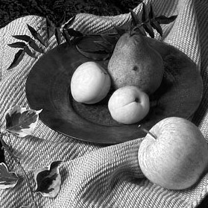
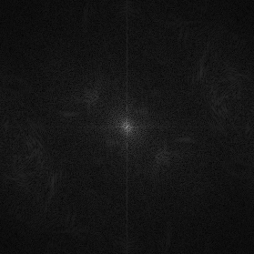


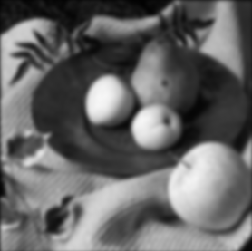

Convolution in the Frequency Domain
f(x,y)
|F(s_{x},s_{y})|
h(x,y)
|H(s_{x},s_{y})|
g(x,y)
|G(s_{x},s_{y})|

Slide 22
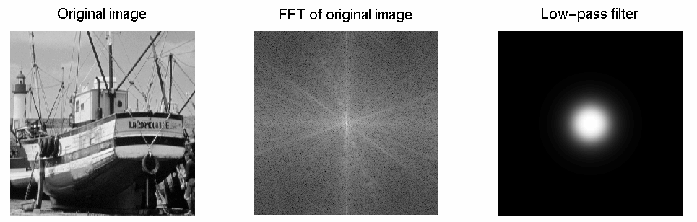
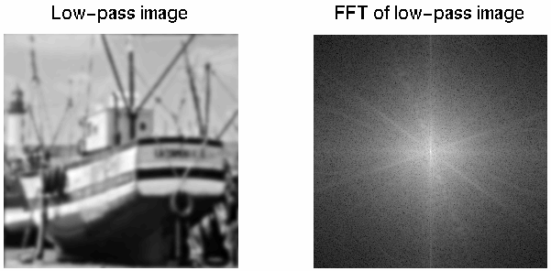
Low-pass Filtering
Lets the low frequencies pass and eliminates the high frequencies.
Generates image with overall
shading, but not much detail

Slide 23
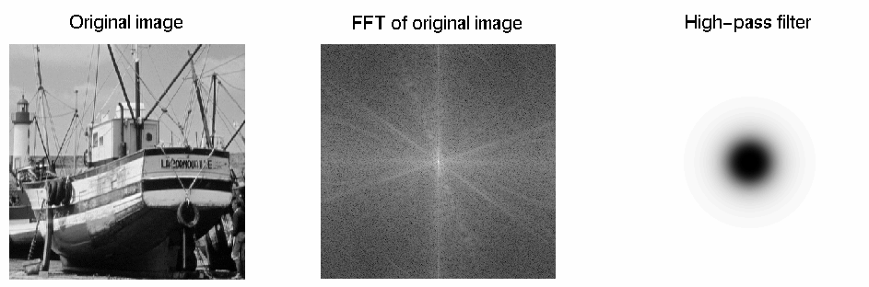
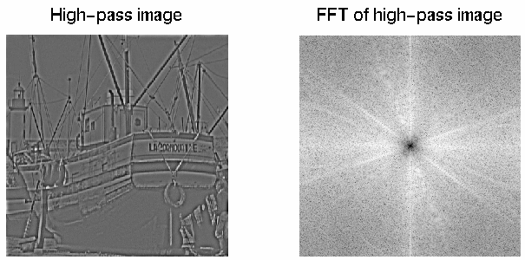
High-pass Filtering
Lets through the high frequencies (the detail), but eliminates the low frequencies (the overall shape). It acts like an edge enhancer.

Slide 24
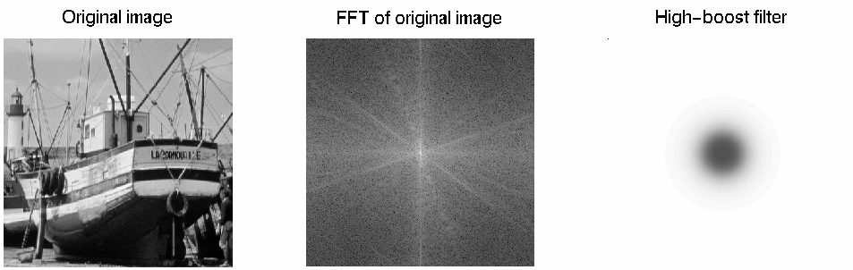
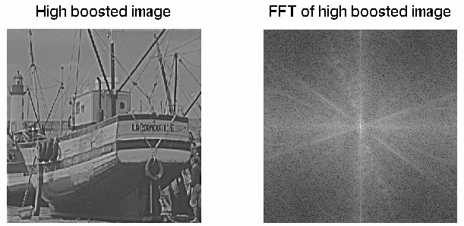
Boosting High Frequencies

Slide 25
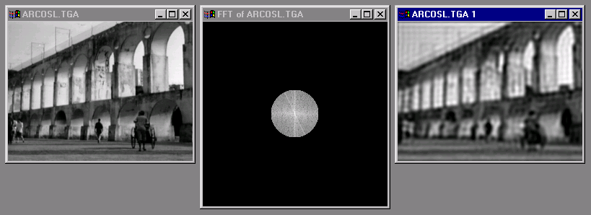
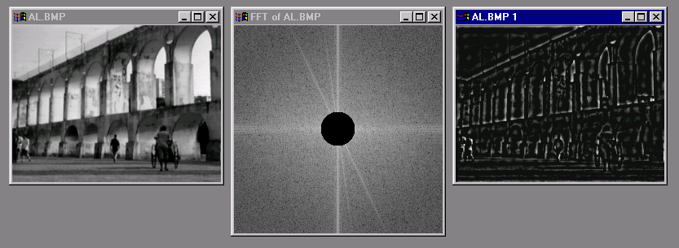

Slide 26
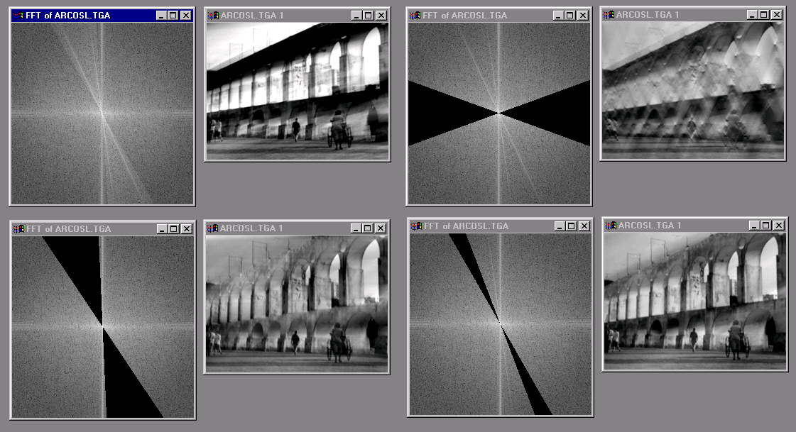

Slide 27
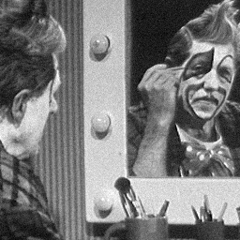
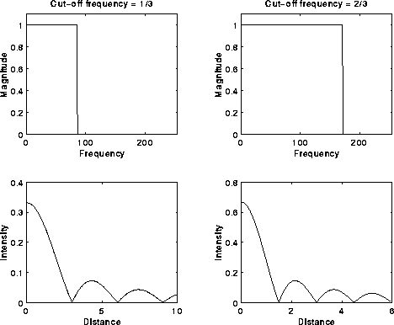
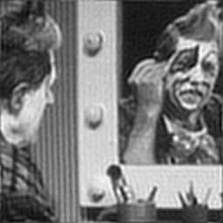
The Ringing Effect
An ideal low-pass filter causes ‘rings’ in the spatial domain!

Slide 28
Topic: Edge detection
Spatial filters
Frequency domain filtering
Edge detection
Morphological filters

Slide 29
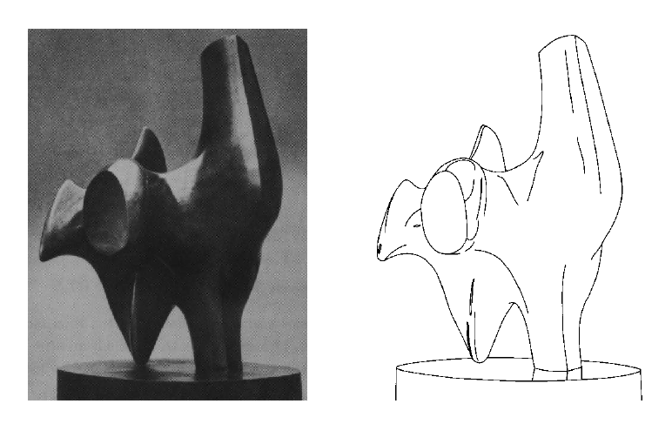
Edge Detection
Convert a 2D image into a set of curves
  Extracts salient features of the scene
  More compact than pixels

Slide 30
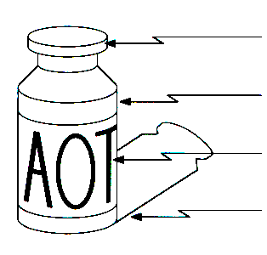
Origin of Edges
surface normal discontinuity
depth discontinuity
surface color discontinuity
illumination discontinuity
Edges are caused by a variety of factors

Slide 31
How can you tell that a pixel is on an edge?

Slide 32
Edge Types
Step Edges
Roof Edge
Line Edges

Slide 33
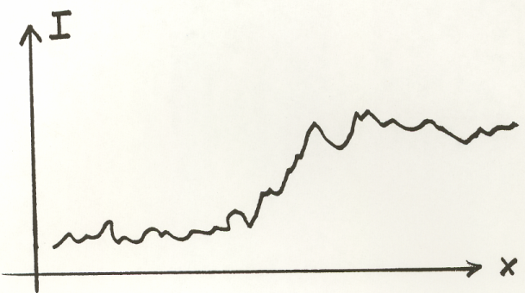
Real Edges
Noisy and Discrete!
We want an Edge Operator that produces:
  Edge Magnitude
  Edge Orientation
  High Detection Rate and Good Localization

Slide 34
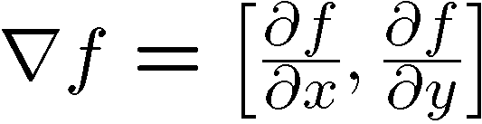




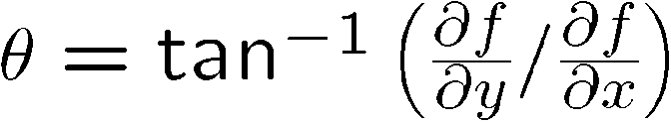
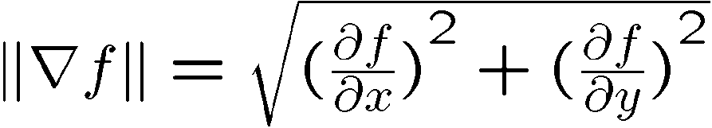
Gradient
Gradient equation:
Represents direction of most rapid change in intensity
Gradient direction:
The edge strength is given
by the gradient magnitude

Slide 35
Theory of Edge Detection
Ideal edge
Unit step function:
Image intensity (brightness):

Slide 36
Theory of Edge Detection
Partial derivatives (gradients):
Squared gradient:
Edge Magnitude:
Edge Orientation:
(normal of the edge)
Rotationally symmetric, non-linear operator

Slide 37
Theory of Edge Detection
Laplacian:
Rotationally symmetric, linear operator
zero-crossing

Slide 38
Discrete Edge Operators
How can we differentiate a discrete image?
Finite difference approximations:
Convolution masks :

Slide 39
Discrete Edge Operators
Second order partial derivatives:
Laplacian :
Convolution masks :
or
(more accurate)

Slide 40


The Sobel Operators
Better approximations of the gradients exist
  The Sobel operators below are commonly used
-1 | 0 | 1
-2 | 0 | 2
-1 | 0 | 1
1 | 2 | 1
0 | 0 | 0
-1 | -2 | -1

Slide 41
Comparing Edge Operators
Good Localization
Noise Sensitive
Poor Detection
Gradient:
Roberts (2 x 2):
0 | 1
-1 | 0
1 | 0
0 | -1
Sobel (3 x 3):
-1 | 0 | 1
-2 | 0 | 2
-1 | 0 | 1
1 | 2 | 1
0 | 0 | 0
-1 | -2 | 1
Sobel (5 x 5):
-1 | -2 | 0 | 2 | 1
-2 | -3 | 0 | 3 | 2
-3 | -5 | 0 | 5 | 3
-2 | -3 | 0 | 3 | 2
-1 | -2 | 0 | 2 | 1
1 | 2 | 3 | 2 | 1
2 | 3 | 5 | 3 | 2
0 | 0 | 0 | 0 | 0
-2 | -3 | -5 | -3 | -2
-1 | -2 | -3 | -2 | -1
Poor Localization
Less Noise Sensitive
Good Detection

Slide 42

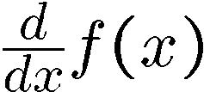
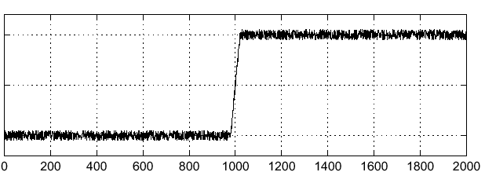
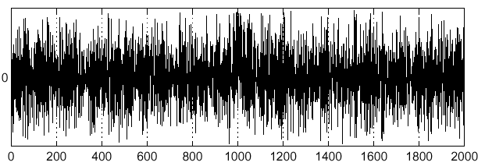
Effects of Noise
Consider a single row or column of the image
  Plotting intensity as a function of position gives a signal
Where is the edge??

Slide 43



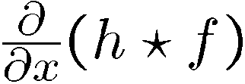
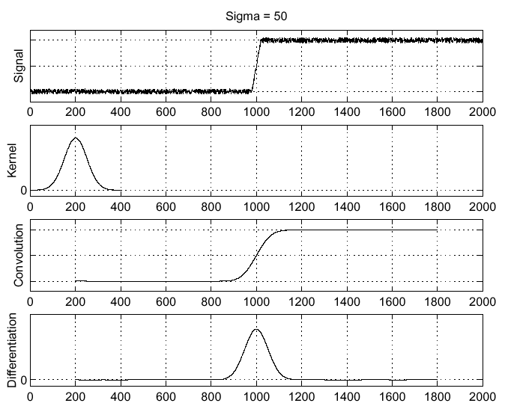
Solution: Smooth First
Where is the edge?
Look for peaks in

Slide 44
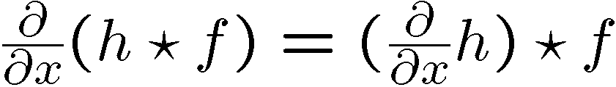
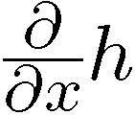
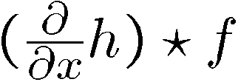
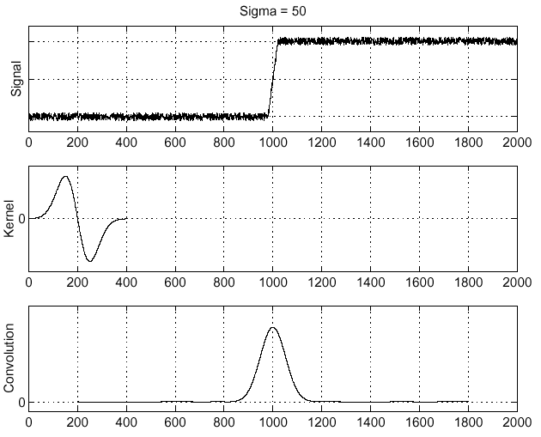
Derivative Theorem of Convolution
…saves us one operation.

Slide 45
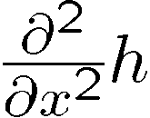
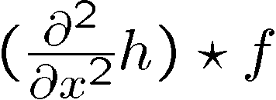
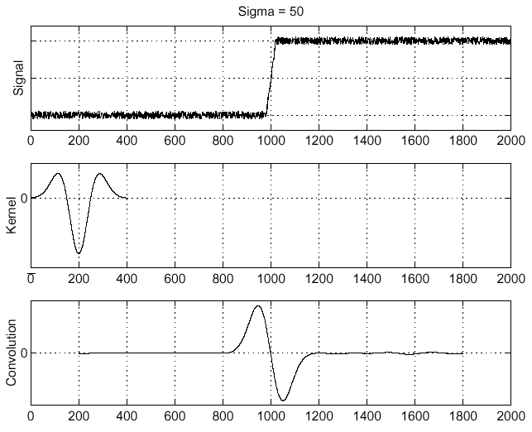
Laplacian of Gaussian (LoG)
Laplacian of Gaussian
Laplacian of Gaussian operator
Where is the edge?
Zero-crossings of bottom graph !

Slide 46
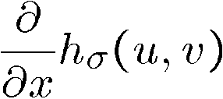

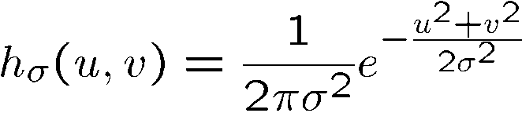

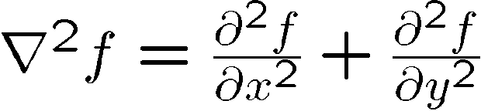
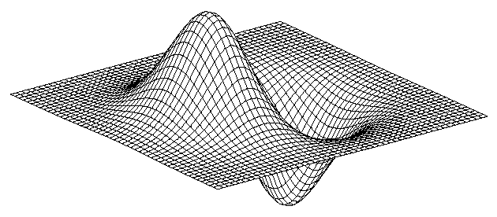
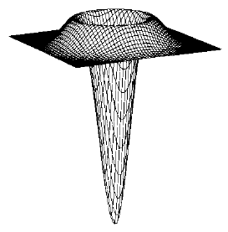
2D Gaussian Edge Operators
Derivative of Gaussian (DoG)
Laplacian of Gaussian
Gaussian
Mexican Hat (Sombrero)
is the Laplacian operator:

Slide 47
Canny Edge Operator
Smooth image I with 2D Gaussian:
Find local edge normal directions for each pixel
Compute edge magnitudes
Locate edges by finding zero-crossings along the edge normal directions (non-maximum suppression)

Slide 48

Non-maximum Suppression
Check if pixel is local maximum along gradient direction
  requires checking interpolated pixels p and r

Slide 49

original image

Slide 50
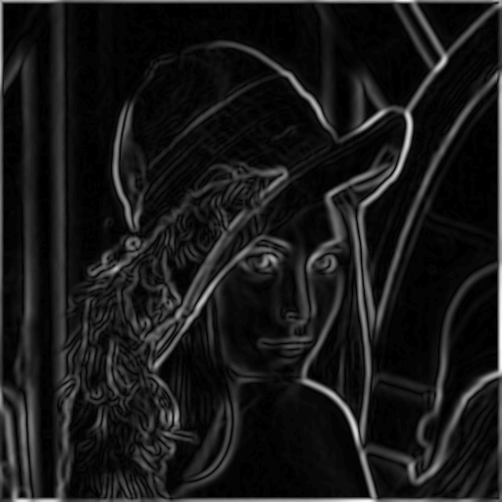
magnitude of the gradient

Slide 51

After non-maximum suppression

Slide 52






Canny Edge Operator
original
Canny with
Canny with
The choice of depends on desired behavior
  large detects large scale edges
  small detects fine features

Slide 53

Difference of Gaussians (DoG)
Laplacian of Gaussian can be approximated by the
difference between two different Gaussians

Slide 54



DoG Edge Detection
(a)
(b)
(b)-(a)

Slide 55
Unsharp Masking
–
=
+ a
=

Slide 56
Topic: Morphological Filters
Spatial filters
Frequency domain filtering
Edge detection
Morphological filters

Slide 57
Mathematical Morphology
Provides a mathematical description of geometric structures
Based on sets
  Groups of pixels which define an image region
What is this used for?
  Binary images
  Can be used for post-processing segmentation results!
Core techniques
  Erosion, Dilation
  Open, Close

Slide 58
Tumor Segmentation using Morphologic Filtering

Slide 59



Dilation, Erosion
Two sets:
  Image
  Morphological kernel
Dilation (D)
  Union of the kernel with the image set
  Increases resulting area
Erosion (E)
  Intersection
  Decreases resulting area

Slide 60

Dilation
Example using a 3x3 morphological kernel

Slide 61

Erosion
Example using a 3x3 morphological kernel

Slide 62


Opening, Closing
Opening
  Erosion, followed by dilation
  Less destructive than an erosion
  Adapts image shape to kernel shape
Closing
  Dilation, followed by erosion
  Less destructive than a dilation
  Tends to close shape irregularities

Slide 63

Opening
Example using a 3x3 morphological kernel

Slide 64

Closing
Example using a 3x3 morphological kernel

Slide 65




Core morphological operators
Dilation
Erosion
Closing
Opening

Slide 66



Example: Opening
Opening
Tresholding

Slide 67


Example: Closing
Closing

Slide 68


Connected Component Analysis
Define ‘connected’
  4 neighbors.
  8 neighbors.
Search the image for seed points
Recursively obtain all connected points of the seeded region

Slide 69
Resources
Szeliski, “Computer Vision: Algorithms and Applications”, Springer, 2011
  Chapter 3 – “Image Processing”
  Chapter 4 – “Feature Detection and Matching”

