Slide 1
Computer Vision – TP9
Introduction to Deep Learning
Miguel Coimbra, Francesco Renna

Slide 2
Outline
What is deep learning?
Artificial neural networks
Convolutional neural networks
CNN architectures

Slide 3
Outline
What is deep learning?
Artificial neural networks
Convolutional neural networks
CNN architectures

Slide 4
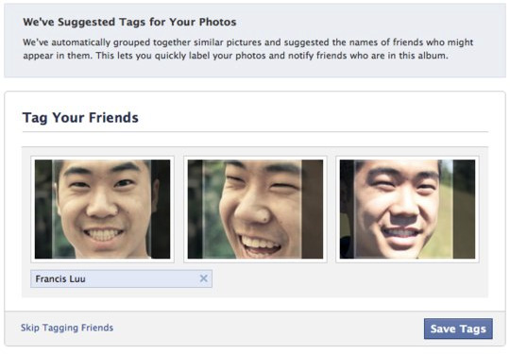
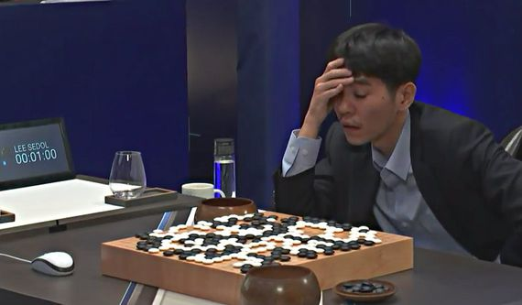


Deep learning: did you hear about that?
Google image recognition
Facebook face recognition
Image caption generation
Google translator
DeepMind AlphaGo player
Netflix, Amazon, Spotify recommendation engines
Protein folding
Sentiment analysis
Etc…

Slide 5
Deep learning and Computer Vision
https://cset.georgetown.edu/wp-content/uploads/CSET-Patent-Landscape-for-Computer-Vision.pdf

Slide 6
More specifically
Deep learning refers to a class of learning algorithms
They are based on the use of a specific kind of classifiers: neural networks (NNs)

Slide 7
Outline
What is deep learning?
Artificial neural networks
Convolutional neural networks
CNN architectures

Slide 8
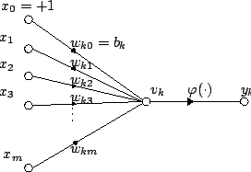

Artificial Neuron
Also called the McCulloch-Pitts neuron
Passes a weighted sum of inputs, to an activation function, which produces an output value
McCulloch, W. and Pitts, W. (1943). A logical calculus of the ideas immanent in nervous activity. Bulletin of Mathematical Biophysics, 7:115 - 133.

Slide 9
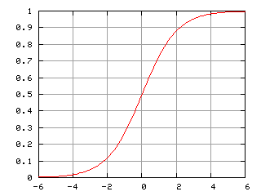
Sample activation functions
Rectified Linear Unit (ReLU)
Sigmoid function

Slide 10
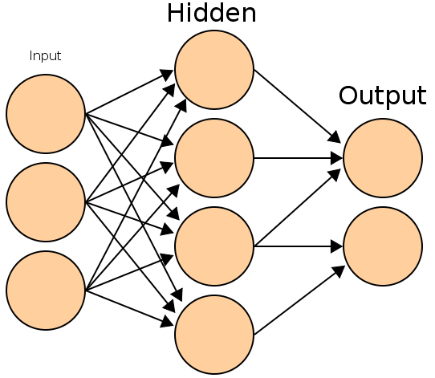
Artificial Neural Network
Commonly refered as Neural Network
Basic principles:
  One neuron can perform a simple decision
  Many connected neurons can make more complex decisions

Slide 11
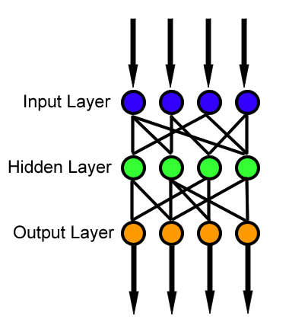
Feedforward neural network
Simplest type of NN.
Has no cycles.
Input layer
  Need as many neurons as coefficients of my feature vector.
Hidden layers.
Output layer
  Classification results.

Slide 12
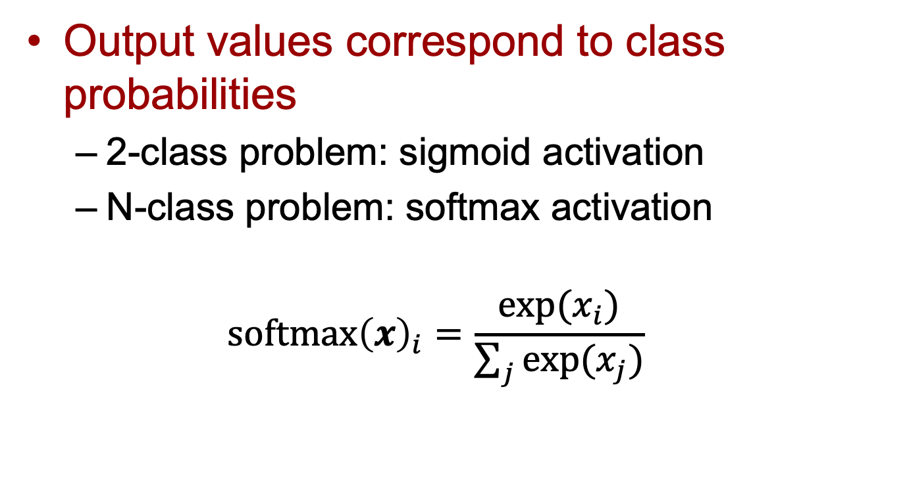
Output layer
Output values correspond to class probabilities
  2-class problem: sigmoid activation
  N-class problem: softmax activation
  $$\text{softmax}{\left(x\right)}_{i}=\frac{exp⁡(x_{i})}{\sum_{j}{exp⁡(x_{j})}}$$

Slide 13
Characteristics of a NN
Network configuration
  How are the neurons inter-connected?
  We typically use layers of neurons (input, output, hidden)
Individual Neuron parameters
  Weights associated with inputs
  Activation function
  Decision thresholds
How do we find these values?

Slide 14
Learning paradigms
We can define the network configuration
How do we define neuron weights and decision thresholds?
  Learning phase
  We train the NN to classify what we want
Different learning paradigms
  Supervised learning
  Unsupervised learning
  Reinforcement learning
Appropriate for Pattern Recognition.

Slide 15
Learning
We want to obtain an optimal solution given a set of observations
A cost function measures how close our solution is to the optimal solution
Objective of our learning step:
  Minimize the cost function
Backpropagation Algorithm

Slide 16
In formulas
Network output:
Training set:
Optimization: find such that
It is solved with (variants of) the gradient descent, where gradients are computed via backpropagation algorithm
input
label

Slide 17
Losses
They quantify the distance between the output of the network and the true label, i.e., the correct answer
Classification problems:
  The output (obtained usually with softmax) is a probability distribution
  Loss-function: cross-entropy. It can be interpreted in terms of the Kullback-Leibler divergence between probability distributions
Regression problems:
  The output is a scalar or a vector of continuous values (real or complex)
  Loss-function: mean-squared error. It is the distance associated with the L2-norm

Slide 18
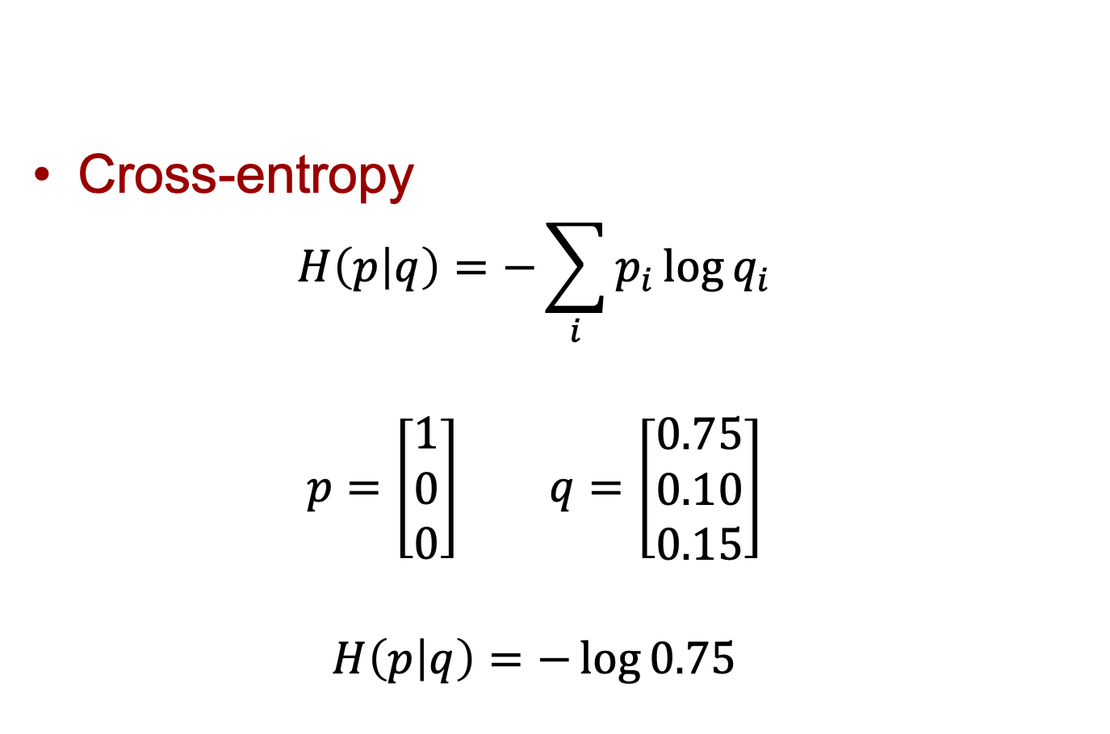
Cross-entropy loss
Cross-entropy
  $$H\left(p | q\right)=−\sum_{i}{p_{i}\log{q_{i}}}$$
  $$p=\left[\begin{matrix}1 \\ 0 \\ 0\end{matrix}\right] q=\left[\begin{matrix}0.75 \\ 0.10 \\ 0.15\end{matrix}\right]$$
  $$H\left(p | q\right)=−\log{0.75}$$
Output of
neural network
True label,
One-hot encoding

Slide 19
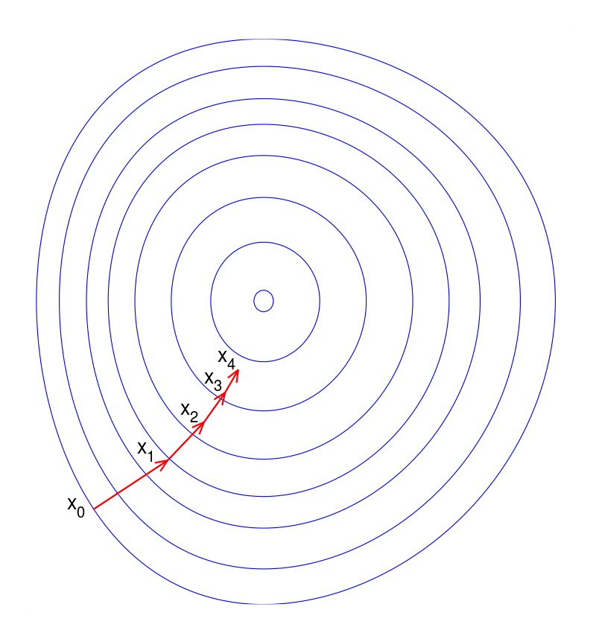

Gradient descent
https://en.wikipedia.org/wiki/Gradient_descent
Learning rate

Slide 20
Stochastic (mini-batch) gradient descent
Gradient descent:
  Compute the gradient of the loss using all available training samples
Stochastic gradient descent
  Compute the gradient of the loss using one training sample
Mini-batch gradient descent
  Compute the gradient using a subset (mini-batch) of the training samples
Training epochs
  Number of passes over the entire training dataset

Slide 21
Deep learning = Deep neural networks
Deep = high number of hidden layers
  Learn a larger number of parameters!
It has been recently (~ in the last 10 years) possible since we have:
  Access to big amounts of (training) data
  Increased computational capabilities
  (e.g., GPUs, TPUs)

Slide 22
Outline
What is deep learning?
Artificial neural networks
Convolutional neural networks
CNN architectures

Slide 23
Convolutional neural networks (CNNs)
Feedforward neural networks
Weight multiplications are replaced by convolutions (filters)
Change of paradigm: can be directly applied to the raw signal, without computing first ad hoc features
Features are learnt automatically!!

Slide 24
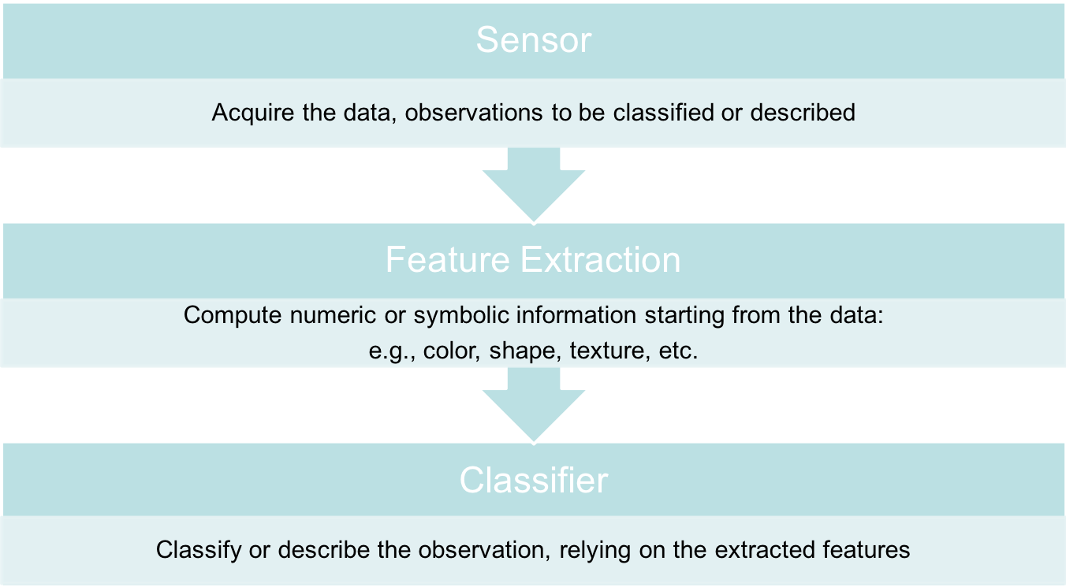
Feature engineering

Slide 25
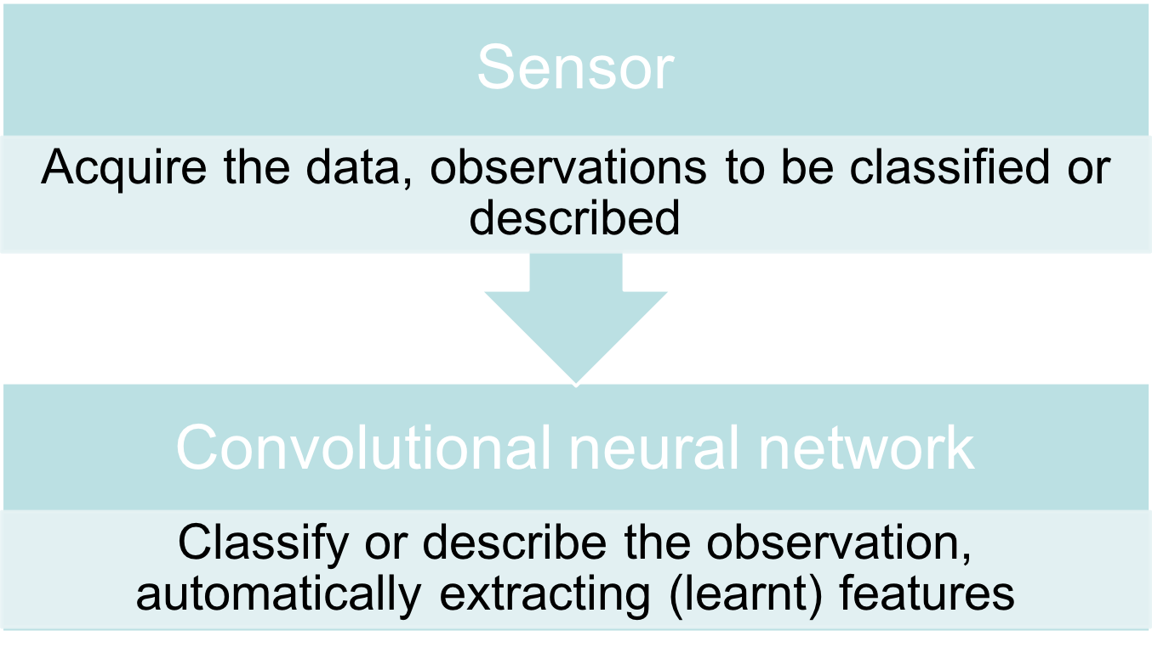
End-to-end learning

Slide 26
Convolution
In this example,
Stride = 1 x 1
I. Goodfellow, Y. Bengio, and A. Courville. Deep learning. Vol. 1. Cambridge: MIT press, 2016.

Slide 27
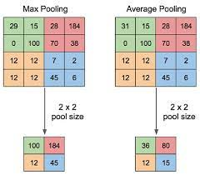
Pooling
Reduce data dimension
Invariance against small translations
Yani M. Application of transfer learning using convolutional neural network method for early detection of terry’s nail. In Journal of Physics: Conference Series 2019 May 1 (Vol. 1201, No. 1, p. 012052). IOP Publishing

Slide 28
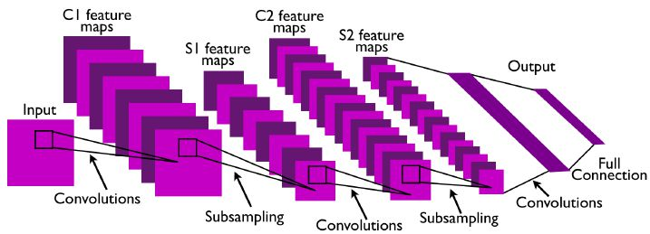
CNN example
Convolutional layers, followed by nonlinear activation and subsampling
Output of hidden layers (feature maps) = features learnt by the CNN
Before classification, fully connected layers (as in “standard” NN)

Slide 29
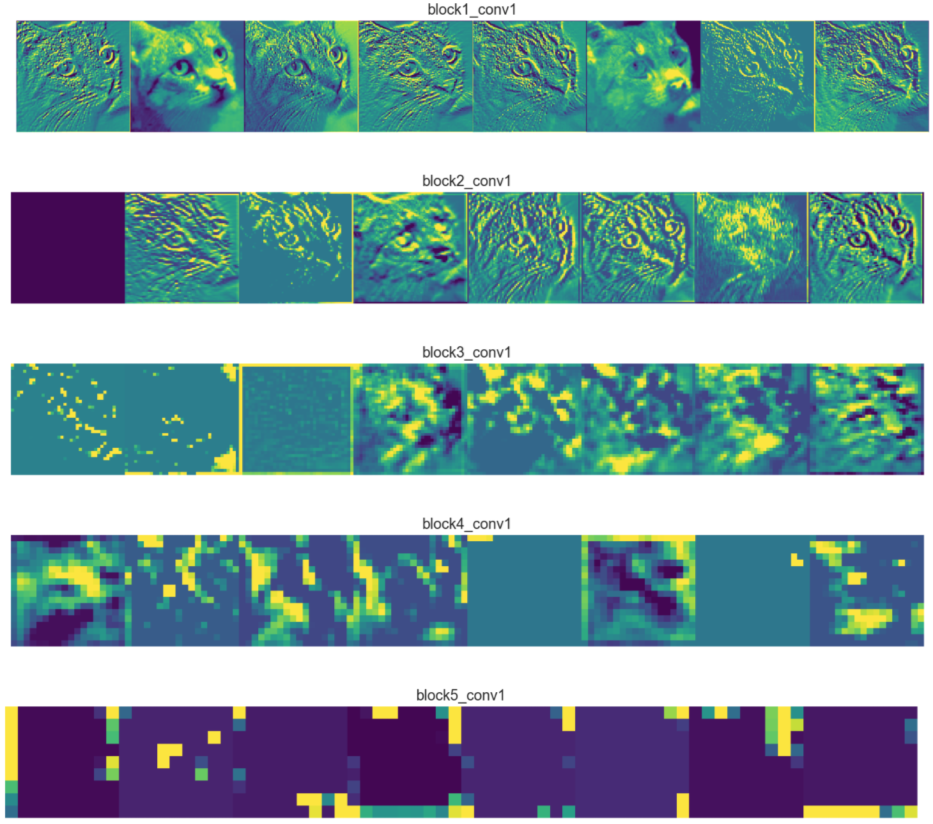
Automatically learnt features
Retain most information (edge detectors)
Towards more abstract representation
Encode high level concepts
Sparser representations:
Detect less (more abstract) features
https://towardsdatascience.com/applied-deep-learning-part-4-convolutional-neural-networks-584bc134c1e2

Slide 30
CNN - Properties
Reduced number of parameters to learn (local features)
More efficient than dense multiplication
Specifically thought for images or data with grid-like topology
Convolutional layers are equivariant to translation (useful for classification!)
Currently state-of-the-art in several tasks

Slide 31
Outline
What is deep learning?
Artificial neural networks
Convolutional neural networks
CNN architectures

Slide 32
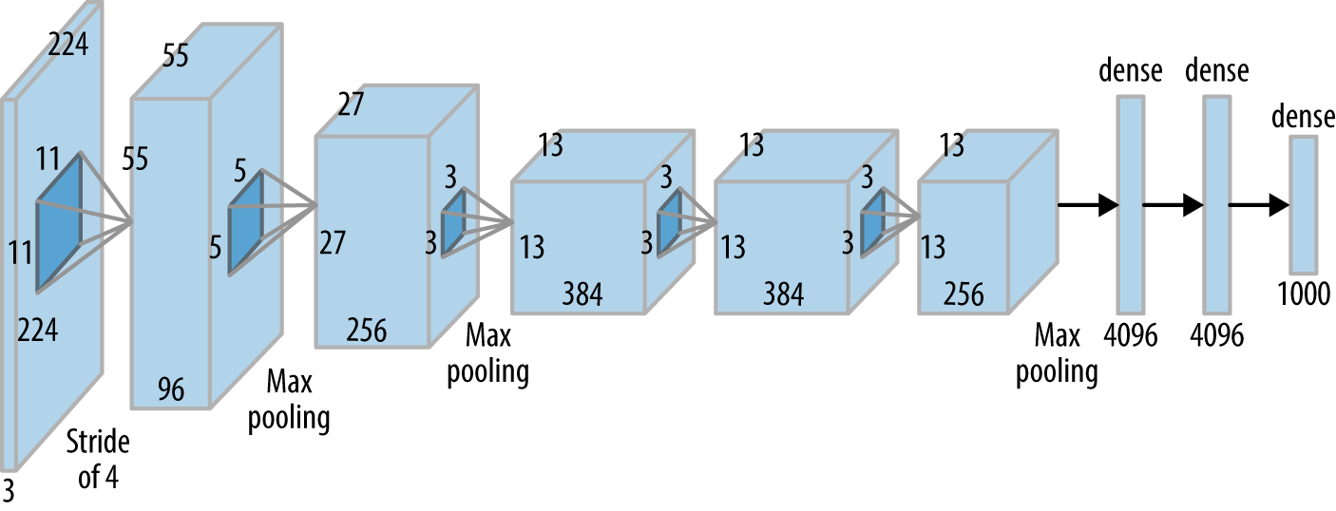
AlexNet
Winner of ILSVRC 2012
Marked the beginning of recent deep learning revolution
A. Krizhevsky, I. Sutskever, and G. Hinton. "ImageNet Classification with Deep Convolutional Neural." In NIPS, pp. 1-9. 2014.

Slide 33
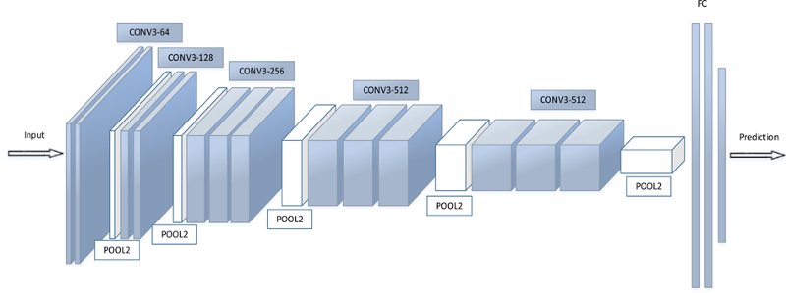
VGG-16
Very small filters (3x3)
Deeper than AlexNet:16 layers
K. Simonyan and A. Zisserman, “Very deep convolutional networks for large-scale image recognition,” in Proc. Int. Conf. Learn. Representations, 2015.

Slide 34
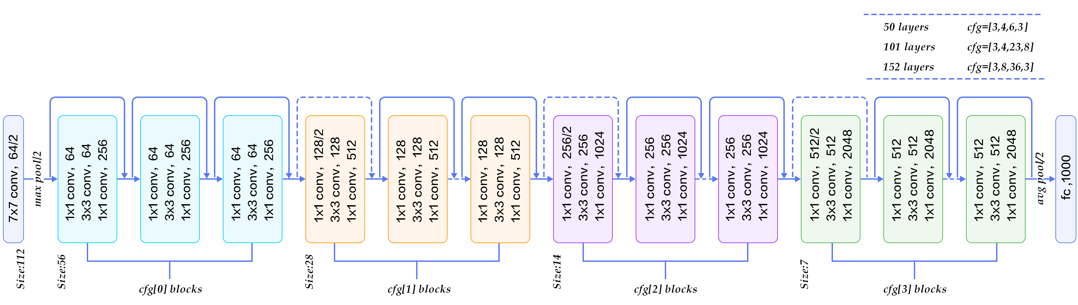
ResNet
More layers by using residual connections
Blocks are actually learning residual functions: easier!
Less prone to vanishing gradients
From: https://www.codeproject.com/Articles/1248963/Deep-Learning-using-Python-plus-Keras-Chapter-Re
K. He, X. Zhang, S. Ren, and J. Sun. "Deep residual learning for image recognition." In Proceedings of the IEEE conference on computer vision and pattern recognition, pp. 770-778. 2016.

Slide 35
Inception v1
Filters of different size at the same level
Capture patterns at different scales
Computationally efficient implementation
K. Szegedy C, Liu W, Jia Y, Sermanet P, Reed S, Anguelov D, Erhan D, Vanhoucke V, Rabinovich A. Going deeper with convolutions. In Proceedings of the IEEE conference on computer vision and pattern recognition 2015 (pp. 1-9).

Slide 36
DenseNet
Huang G, Liu Z, Van Der Maaten L, Weinberger KQ. Densely connected convolutional networks. In Proceedings of the IEEE conference on computer vision and pattern recognition 2017 (pp. 4700-4708).
Each layer connected to all previous layers
Alleviate vanishing gradient problem

Slide 37
EfficientNet
Tan M, Le Q. Efficientnet: Rethinking model scaling for convolutional neural networks. InInternational Conference on Machine Learning 2019 May 24 (pp. 6105-6114). PMLR.
Systematic approach to scale depth, width, and image resolution

Slide 38
Application challenges
Great results! But…
  Difficult to select best architecture for a problem
  Require new training for each task/configuration
  (Most commonly) require a large training dataset to generalize well
    Data augmentation, weight regularization, transfer learning, etc. (we will see them next week)
  Still not fully understood why it works so well
    Recent effort to add explainability
    Unstable against adversarial examples

Slide 39
To know more…
Theory
  I. Goodfellow, Y. Bengio, and A. Courville. Deep learning. Vol. 1. Cambridge: MIT press, 2016. (https://www.deeplearningbook.org/)
Survey papers
  "Deep Learning for Visual Understanding," in IEEE Signal Processing Magazine, vol. 34, no. 6, Nov. 2017.
Tutorials
  Tensorflow tutorials (https://www.tensorflow.org/tutorials)

Slide 40
To start coding
Coding frameworks for deep learning
  TensorFlow (https://www.tensorflow.org/),
    Version 2 recommended! (it contains Keras)
  PyTorch (https://pytorch.org/),
  Theano (http://deeplearning.net/software/theano/),
  etc.
High-level wrappers
  Keras (https://keras.io/),
  TensorLayer (https://tensorlayer.readthedocs.io/en/stable/),
  Lasagne (https://lasagne.readthedocs.io/en/latest/),
  etc.
GPU strongly recommended!

