Slide 1
Computer Vision – TP10
Deep Learning Resources
and Examples
Miguel Coimbra, Hélder Oliveira

Slide 2
Outline
Techniques to reduce overfitting
Deep learning examples

Slide 3
Outline
Techniques to reduce overfitting
Deep learning examples

Slide 4
Generalization
Deep neural network => high number of parameters (high complexity)
They require large training datasets
What can we do when we do not have a large annotated training dataset?

Slide 5
Regularization
“Regularization is any modification we make to a learning algorithm that is intended to reduce its generalization error but not its training error.”

Slide 6
Weight regularization

Slide 7
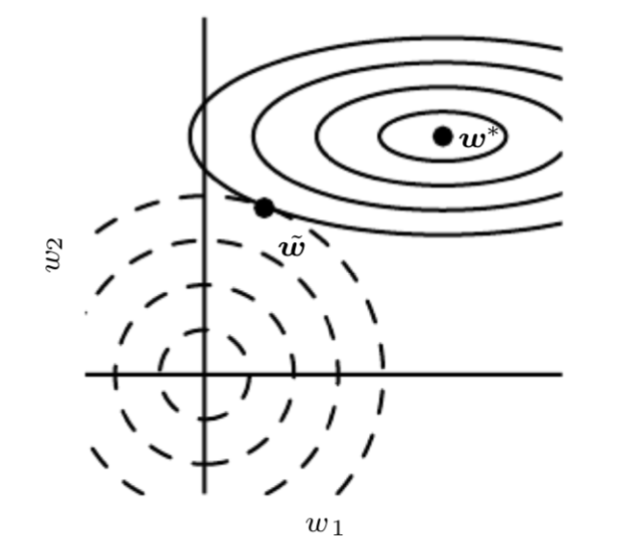
Weight decay
Notes:
Exemplo L1 no Quadro!! (talk about constrained optimization!)

Slide 8
Dropout
During training, randomly switch off a fraction of the input or hidden units
It avoids giving too much relevance to some training features
It approximates bagging and ensemble learning over all sub-models (Monte-Carlo sampling)
Notes:
Keep 80% input layer
Keep 50% hidden layers

Slide 9
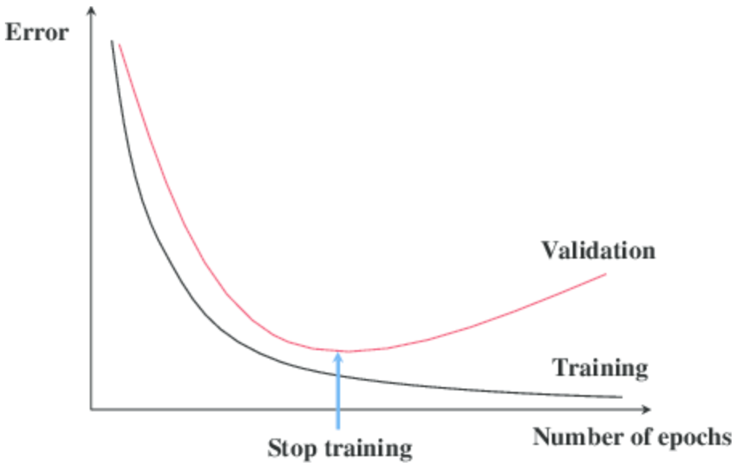
Early stopping
Retain the model which performs best on the validation set (hopefully, test set too)
https://towardsdatascience.com/a-practical-introduction-to-early-stopping-in-machine-learning-550ac88bc8fd
Notes:
Talk about validation set!

Slide 10
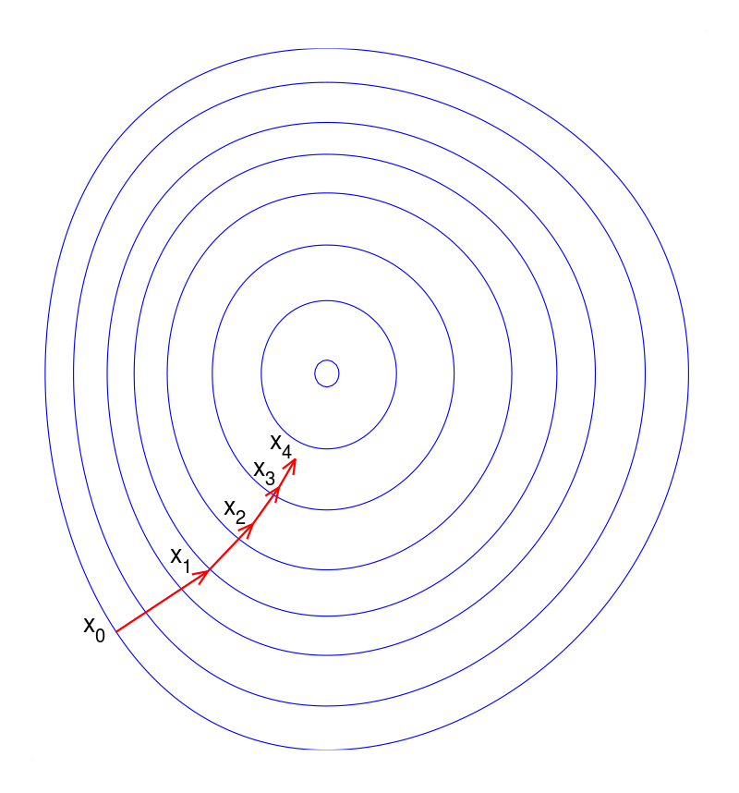
Early stopping
Regularization effect: constraint on the number of training steps
Region of
feasible weights

Slide 11
Data augmentation
Create fake data and add it to the training dataset (only training!)
Especially useful for imaging data
New data created from transformations of existing training data:
Different transformations may be more meaningful in different domains
A transformation should not change class meaning

Slide 12
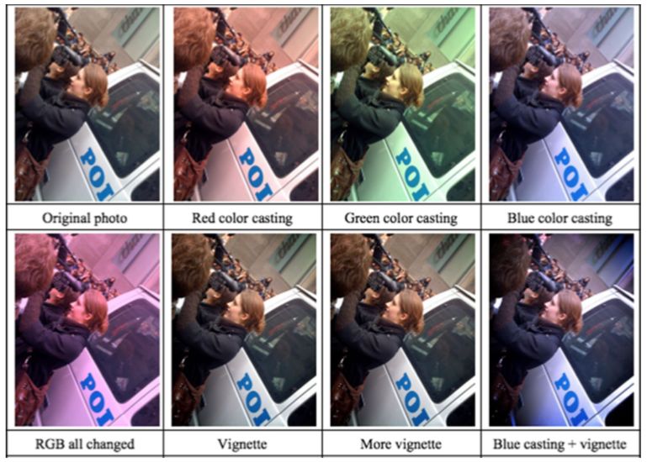
Data augmentation
Transformations:
Translating
Rotating
Cropping
Flipping
Color space
Adding noise
Image mixing
Generative Adversarial Networks (GANs)
Etc.
Shorten C, Khoshgoftaar TM. A survey on image data augmentation for deep learning. Journal of Big Data. 2019 Dec;6(1):1-48.

Slide 13
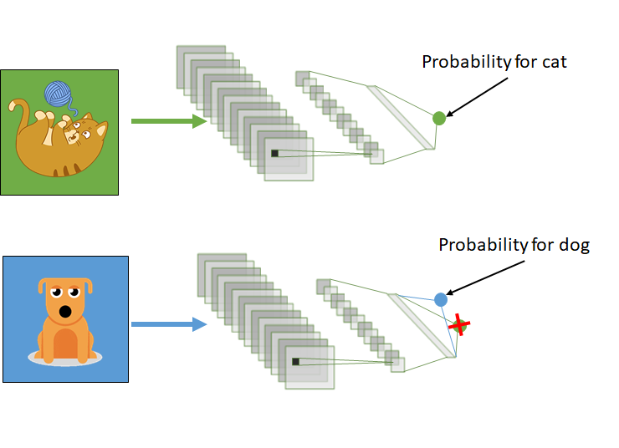
Transfer learning
Main idea:
Features to perform a task T1 may be relevant and useful for a different task T2
https://towardsdatascience.com/transfer-learning-3e9bb53549f6

Slide 14
Transfer learning
When is it useful:
Reduced number of training samples for the considered task
Large number of training samples for a related task
Low-level features could be common to both tasks!
Example:
Image classification
NNs pre-trained on the ImageNet dataset (~14 million images, ~20,000 categories)

Slide 15
Transfer learning schemes
https://towardsdatascience.com/a-comprehensive-hands-on-guide-to- transfer-learning-with-real-world-applications-in-deep-learning-212bf3b2f27a
Feature extraction:
Keep convolutional layers frozen
Pre-trained networks works as feature extractor
Train fully connected/classification layers
Fine-tuning:
Use pre-trained weights as starting point for training
Can keep frozen first convolutional layers (mostly edge/geometry detectors)
Notes:
- Talk about ”total” fine tuning (low learning rate)
- Talk about successive approach!!!

Slide 16
Outline
Techniques to reduce overfitting
Deep learning examples

Slide 17
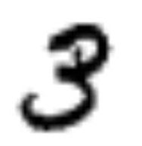
Example in Keras
Task:
Classify hand-written digits
Model:
Convolutional neural network
Full code available at:
https://keras.io/examples/vision/mnist_convnet/
3
CNN

Slide 18
Setup
Import useful libraries
import numpy as np
from tensorflow import keras
from tensorflow.keras import layers
Useful for processing matrix-like data in Python, and much more…

Slide 19
Prepare the data
Model/data parameters
num_classes = 10
input_shape = (28, 28, 1)
Train and test data
(x_train, y_train), (x_test, y_test) = keras.datasets.mnist.load_data()
Black and white images = 1 input channel
Training labels
Training images: dimensions (60000, 28, 28, 1), “channel-last” ordering

Slide 20
Prepare the data

Slide 21
Build the model - I
Feature extraction
model = keras.Sequential(
[
keras.Input(shape=input_shape),
layers.Conv2D(32, kernel_size=(3, 3), activation="relu"),
layers.MaxPooling2D(pool_size=(2, 2)),
layers.Conv2D(64, kernel_size=(3, 3), activation="relu"),
layers.MaxPooling2D(pool_size=(2, 2)),
Number of feature maps
Stride = 1 if omitted

Slide 22
Build the model - II
Classification
layers.Flatten(),
layers.Dropout(0.5),
layers.Dense(num_classes, activation="softmax"),
]
)
model.summary()
Reshape feature maps into a vector
50% of nodes are used at during training
Provides a description of the model
with number of parameters

Slide 23
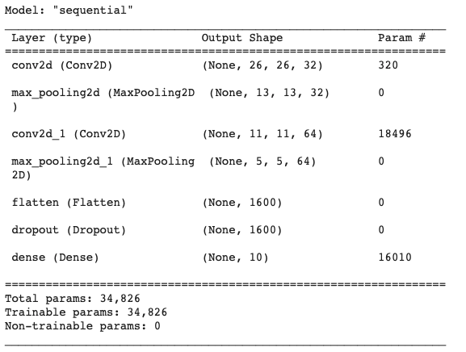
Build the model - III
Model summary

Slide 24
Train the model
batch_size = 128
epochs = 15
model.compile(loss="categorical_crossentropy", optimizer="adam", metrics=["accuracy"])
model.fit(x_train, y_train, batch_size=batch_size, epochs=epochs, validation_split=0.1)
Gradient-based optimizer
10% of the training data is used for validation

Slide 25
Evaluate the model
score = model.evaluate(x_test, y_test, verbose=0)
print("Test loss:", score[0])
print("Test accuracy:", score[1])
Results
Test loss: 0.023472992703318596
Test accuracy: 0.9912999868392944

Slide 26
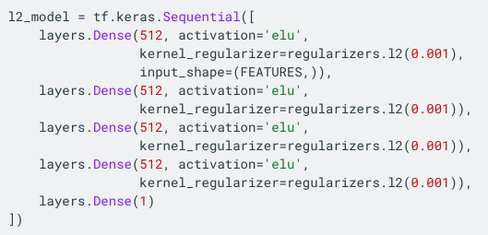
Weight decay in Keras
Added to each layer

Slide 27
Early stopping in Keras
Then call “callbacks” into model.fit()
Patience = number of epochs with no improvement after which training is stopped
Min_delta = minimum change
Restore_best_weights = keep best model

Slide 28
Transfer learning Keras
Load a pre-trained model
Feature extractor:
Fine-tuning:
Then add a classification head

Slide 29
Resources
I. Goodfellow, Y. Bengio, and A. Courville. Deep learning. Cambridge: MIT press, 2016.
Chapter 7 – “Regularization for deep learning”
https://www.tensorflow.org/tutorials/keras
https://www.tensorflow.org/tutorials/images

