Slide 1
Computer Vision – TP11
Introduction to Segmentation
Miguel Coimbra, Hélder Oliveira

Slide 2
Outline
Introduction to segmentation
Thresholding
Region based segmentation
Segmentation by clustering

Slide 3
Topic: Introduction to segmentation
Introduction to segmentation
Thresholding
Region based segmentation
Segmentation by clustering

Slide 4
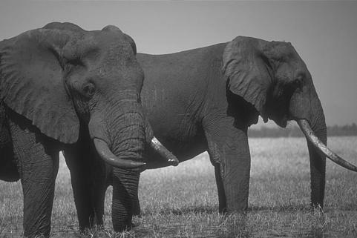
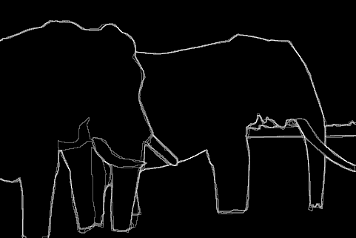
Boundaries of Objects
Marked by many users
http://www.eecs.berkeley.edu/Research/Projects/CS/vision/grouping/segbench/bench/html/images.html

Slide 5

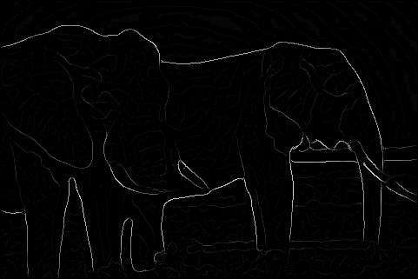
Boundaries of Objects from Edges
Brightness Gradient (Edge detection)
Missing edge continuity, many spurious edges

Slide 6
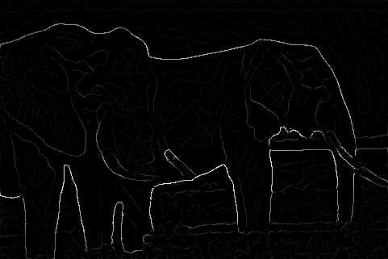
Boundaries of Objects from Edges
Multi-scale Brightness Gradient
But, low strength edges may be very important

Slide 7
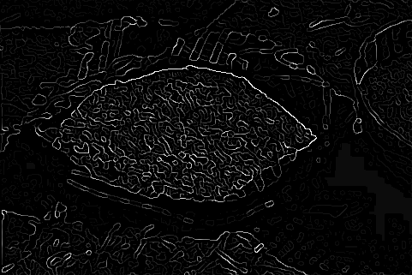
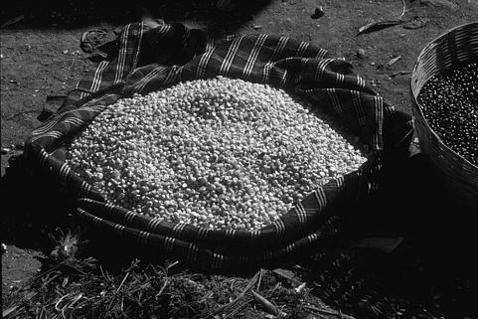
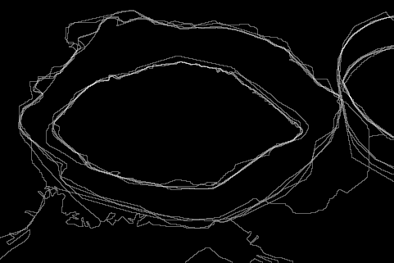
Machine Edge Detection
Image
Human Boundary Marking

Slide 8
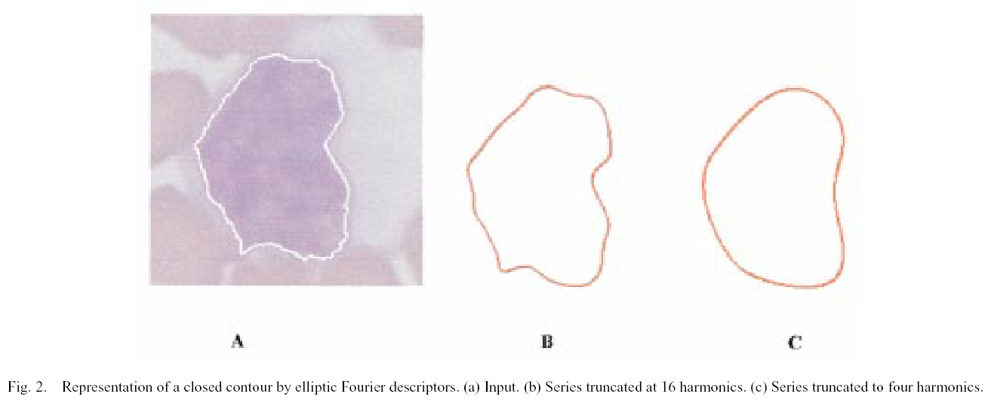
Boundaries in Medical Imaging
Detection of cancerous regions
[Foran, Comaniciu, Meer, Goodell, 00]

Slide 9
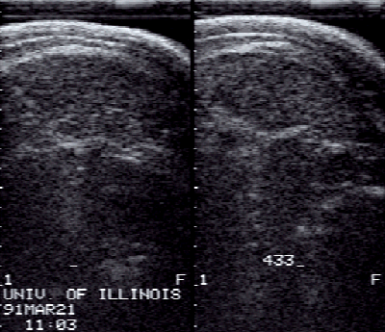
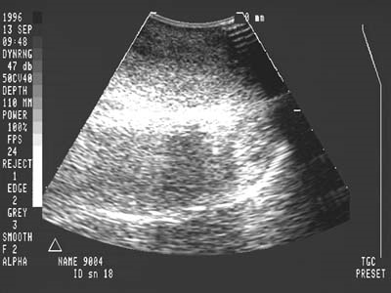
Boundaries in Ultrasound Images
Hard to detect in the presence of large amount of speckle noise

Slide 10
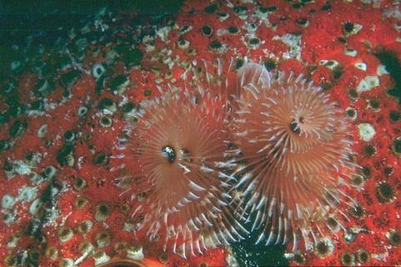
Sometimes hard even for humans!

Slide 11
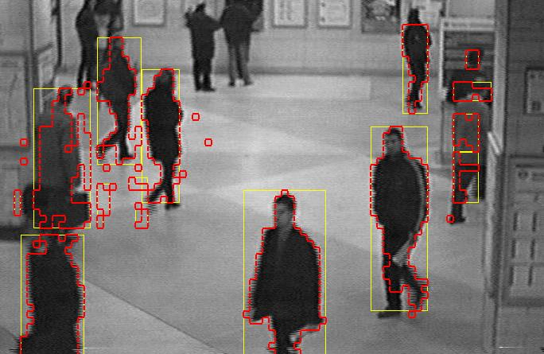
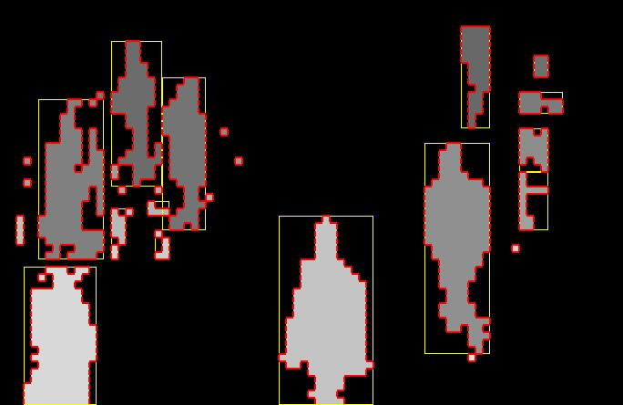
What is ‘Segmentation’?
Separation of the image in different areas
  Objects
  Areas with similar visual or semantic characteristics
Not trivial! It is the holy grail of most computer vision problems!

Slide 12


Subjectivity
A ‘correct’ segmentation result is only valid for a specific context
  Subjectivity!
  Hard to implement
  Hard to evaluate
What is the correct segmentation?
Face
Person
Suitcase

Slide 13
Topic: Thresholding
Introduction to segmentation
Thresholding
Region based segmentation
Segmentation by clustering

Slide 14
Core Technique: Thresholding
Divide the image into two areas:
  1, if f(x,y)>K
  0, if f(x,y)<=K
Not easy to find the ideal k magic number
Core segmentation technique
  Simple
  Reasonably effective
Adequate threshold

Slide 15
Finding the ‘magic number’
Correct
(k = 74)
Wrong!
(k = 128)

Slide 16
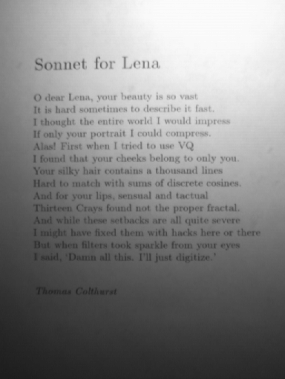
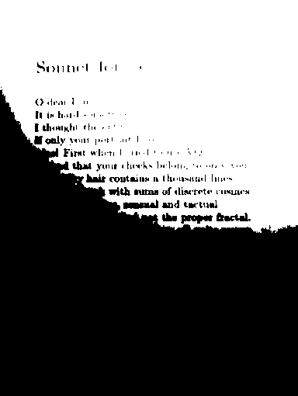
Global thresholds are not
always adequate...

Slide 17
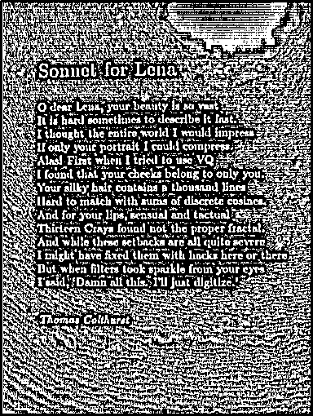
Adaptive Thresholding
Adapt the threshold value for each pixel
Use characteristics of nearby pixels
How?
  Mean
  Median
  Mean + K
  ...
Mean of 7x7 neighborhood

Slide 18
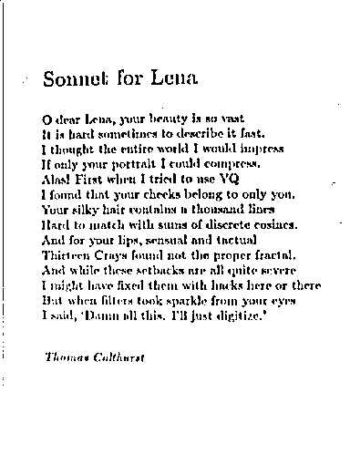
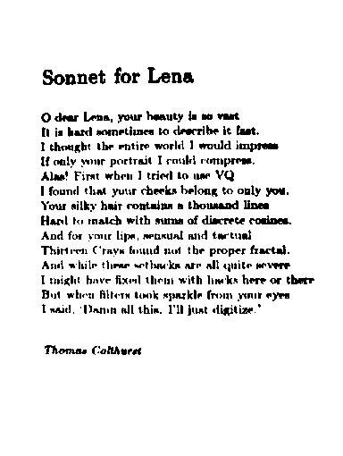
7x7 window; K = 7
75x75 window; K = 10

Slide 19
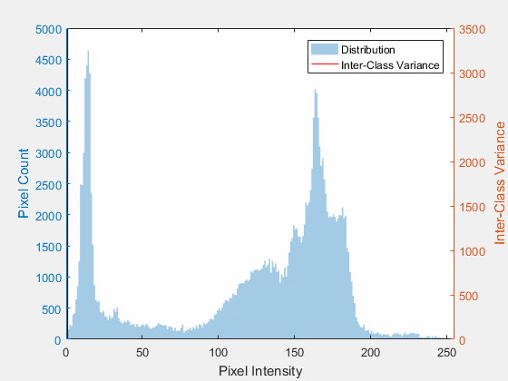
Otsu’s Thresholding
Is there an optimal threshold for a bimodal distribution?
  Yes
  Gist: Minimize Within-Class Variance
  Alternatively: Maximize Between-Class Variance
By Lucas(CA) - Own work, CC BY-SA 4.0, https://commons.wikimedia.org/w/index.php?curid=67144384

Slide 20

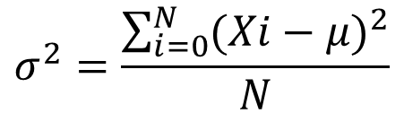
Within Class Variance
Class Variance
  The lower the variance, the less dispersed the data is for each class
Within Class Variance
  Weighted sum of each class variance:
    Background (b);
    Foreground (f)
$$σ^{2}=\frac{\sum_{i=0}^{N}{{(Xi−μ)}^{2}}}{N}$$
$$σ_{w}^{2}=W_{b}σ_{b}^{2}+W_{f}σ_{f}^{2}$$
Xi is the pixel value, μ is the mean, and N is the number of pixels in one image
Wj is the percentage of image pixels belonging to class j

Slide 21
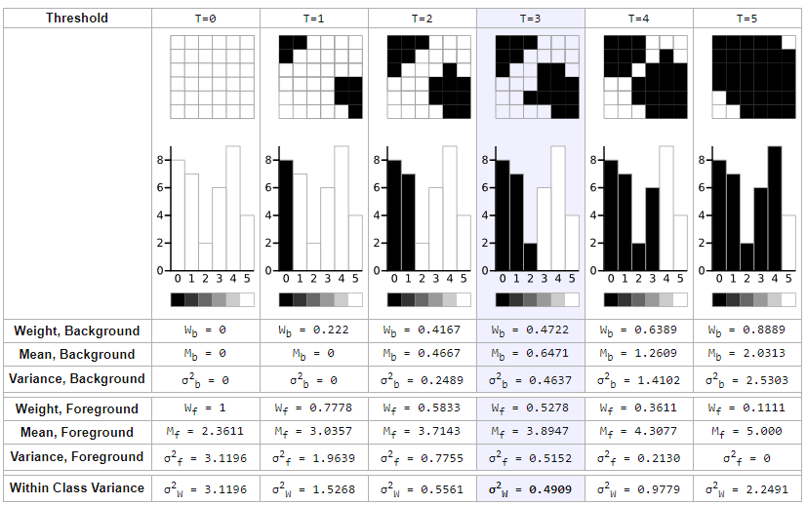
Link: http://www.labbookpages.co.uk/software/imgProc/otsuThreshold.html

Slide 22
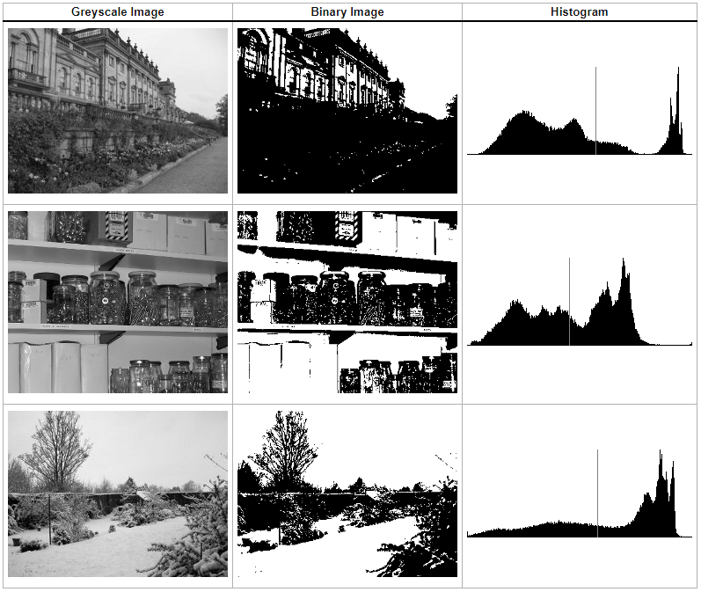
Link: http://www.labbookpages.co.uk/software/imgProc/otsuThreshold.html

Slide 23
Topic: Region based segmentation
Introduction to segmentation
Thresholding
Region based segmentation
Segmentation by clustering

Slide 24
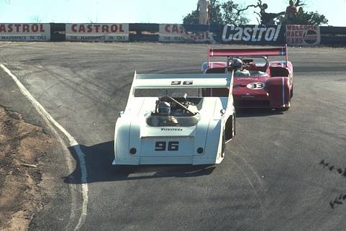

Why Region Based Segmentation?
Segmentation
  Edge detection and Thresholding not always effective
Homogenous regions
  Region-based segmentation
  Effective in noisy images

Slide 25
Definitions
Based on sets
Each image R is a set of regions R_{i}
  Every pixel belongs to one region
  One pixel can only belong to a single region
R₇
R₆
R₁
R₅
R₂
R₃
R₄

Slide 27
R₇
R₆
R₁
R₅
R₂
R₃
R₄

Slide 28
Basic Formulation
Let R represent the entire image region. Segmentation partitions R into n subregions, R₁, R₂, ..., R_{n}, such that:
a)
b)
c)
d)
e)
Every pixel must be in a region
Points in a region must be connected
Regions must be disjoint
All pixels in a region satisfy specific properties
Different regions have different properties

Slide 29
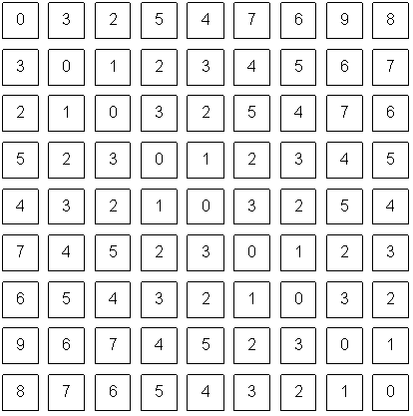
How do we form regions?
Region Growing
Region Merging
Region Splitting
Split and Merge
Watershed
...
What a computer sees

Slide 30
Region growing
Groups pixels into larger regions.
Starts with a seed region.
Grows region by merging neighboring pixels.
Iterative process
  How to start?
  How to iterate?
  When to stop?
Finish
Initial
Regions
Iterations
Stop
Condition

Slide 31
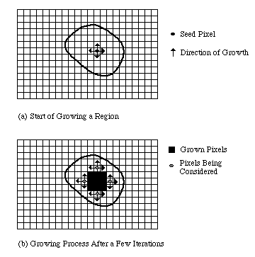

Slide 32
Region merging
Algorithm
  Divide image into an initial set of regions
    One region per pixel
  Define a similarity criteria for merging regions
  Merge similar regions
  Repeat previous step until no more merge operations are possible

Slide 33
Similarity Criteria
Homogeneity of regions is used as the main segmentation criterion in region growing
  gray level
  color, texture
  shape
  model
  etc.
Choice of criteria affects segmentation results dramatically!

Slide 34
Gray-Level Criteria
Comparing to Original Seed Pixel
  Very sensitive to choice of seed point
Comparing to Neighbor in Region
  Allows gradual changes in the region
  Can cause significant drift
Comparing to Region Statistics
  Acts as a drift dampener
Other possibilities!

Slide 35
Region splitting
Algorithm
  One initial set that includes the whole image
  Similarity criteria
  Iteratively split regions into sub-regions
  Stop when no more splittings are possible
R₁
R₁
R₂
R₃
R₄
R₁
R₂
R₁
R₂
R₃
R₃
R₄
R₅
R₄
R₅
R₆
R₇
R₆
R₇

Slide 36
[Machine Vision; David Vernon]

Slide 37
Split and Merge
Combination of both algorithms
Can handle a larger variety of shapes
  Simply apply previous algorithms consecutively

Slide 38
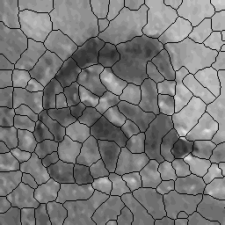
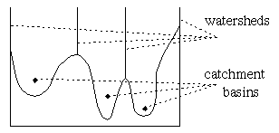
The Watershed Transform
Geographical inspiration
  Shed water over rugged terrain
  Each lake corresponds to a region
Characteristics
  Computationally complex
  Great flexibility in segmentation
  Risk of over-segmentation

Slide 39
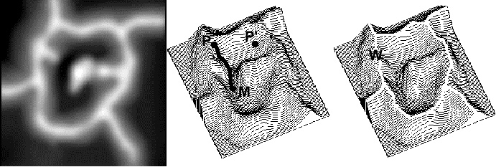
The Drainage Analogy
Two points are in the same region if they drain to the same point
Courtesy of Dr. Peter Yim at National Institutes of Health, Bethesda, MD

Slide 40
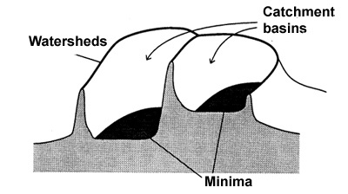
The Immersion Analogy

Slide 41
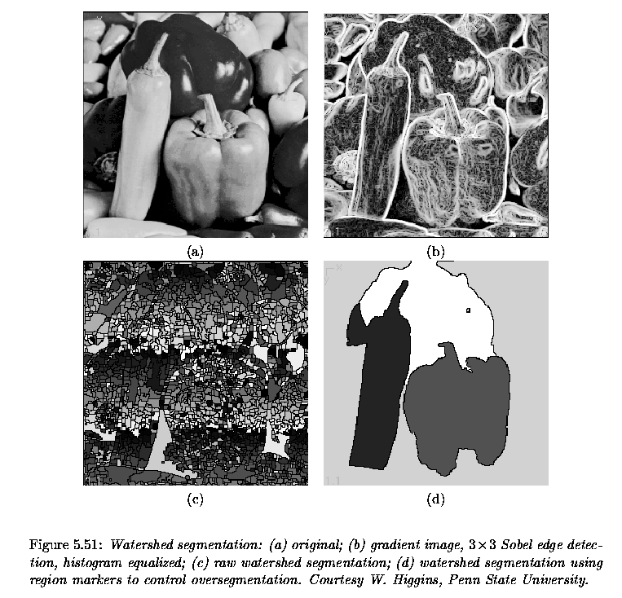
[Milan Sonka, Vaclav Hlavac, and Roger Boyle]

Slide 42
Over-Segmentation
Over-segmentation
  Raw watershed segmentation produces a severely oversegmented image with hundreds or thousands of catchment basins
Post-Processing
  Region merging
  Edge information
  Etc.

Slide 43
Topic: Segmentation by clustering
Introduction to segmentation
Thresholding
Region based segmentation
Segmentation by clustering

Slide 44
What is ‘Segmentation’? (again?)
Traditional definition:
  “Separation of the image in different areas“
  Decompose an image into “superpixels”
  Colour and texture coherence.
Aren’t there other ways to look at the ‘Segmentation’ concept?

Slide 45
Other ‘Segmentation’ problems
Fitting lines to edge points
Fitting a fundamental matrix to a set of feature points
We can’t see this as ‘separating an image in different areas’!
This one is complicated!
Check Forsyth and Ponce, chap.14

Slide 46
Segmentation as Clustering
Tries to answer the question:
  “Which components of the data set naturally belong together?”
Two approaches:
  Partitioning
    Decompose a large data set into pieces that are ‘good’ according to our model
  Grouping
    Collect sets of data items that ‘make sense’ according to our model

Slide 47
Simple clustering
Two natural types of clustering:
  Divisive clustering
    Entire data set is regarded as a cluster
    Clusters are recursively split
  Agglomerative clustering
    Each data item is a cluster
    Clusters are recursively merged
Where have I seen this before?

Slide 48
Split and Merge (Region-based segmentation) is in fact a clustering algorithm

Slide 49
Generic simple clustering algorithms
Divisive Clustering
  Construct a single cluster containing all points
  While the clustering is not satisfactory
    Split the cluster that yields the two components with the largest inter-cluster distance
  end
Agglomerative Clustering
  Make each point a separate cluster
  Until the clustering is satisfactory
    Merge the two clusters with smallest inter-cluster distance
  end
Which inter-cluster distance?
What does this mean?

Slide 50
Simple clustering with images
Some specific problems arise:
  Lots of pixels! Graphical representations are harder to read
  Segmentation: It is desirable that certain objects are connected. How to enforce this?
  When do we stop splitting/merging process?
Complex situations require more complex clustering solutions!

Slide 51
K-means Clustering
What if we know that there are k clusters in the image?
We can define an objective function!
  Expresses how good my representation is
We can now build an algorithm to obtain the best representation
Caution! “Best” given my objective function!

Slide 52
K-means Clustering
Assume:
  We have k clusters
  Each cluster i has a centre c_{i}
  Element j to be clustered is described by a feature vector x_{j}
Our objective function is thus:
What does this mean?

Slide 53
Iteration step
Too many possible allocations of points to clusters to search this space for a minimum
Iterate!
  Assume cluster centres are known and allocate each point to the closest cluster centre
  Assume the allocation is known and choose a new set of cluster centres. Each centre is the mean of the points allocated to that cluster

Slide 54
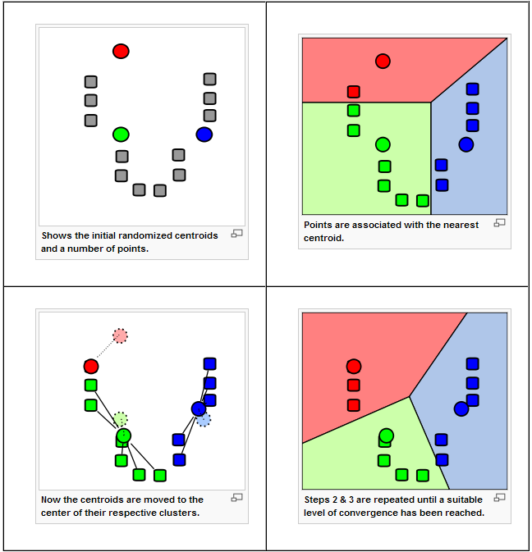
[Wikipedia]

Slide 55
Mean Shift
K-means:
  Segments our feature space (and not the image!) into clusters (and not regions)
  Uses a parametric model for its distributions (e.g. Gaussians), whose locations (centers) and shape (covariance) can be estimated
Mean shift:
  Segments an image (and not the feature space) into regions
  Uses a non-parametric model (simply tries to find distribution peaks)

Slide 56
Comaniciu, D. and Meer, P. (2002). Mean shift: A robust approach toward feature space analysis. IEEE Transactions on Pattern Analysis and Machine Intelligence, 24(5):603– 619.

Slide 57
How does it work?
Each pixel ‘finds’ its nearest distribution peak by ‘climbing uphill’ the image’s kernel density function f(x)
The gradient of f(x) defines the direction for this ‘climb’, by defining mean-shift vectors
Pixels that ‘climb’ to the same peak form a region

Slide 58
One-dimensional example
Szeliski, “Computer Vision: Algorithms and Applications”, Springer, 2011

Slide 59
Mean Shift
Comaniciu, D. and Meer, P. (2002). Mean shift: A robust approach toward feature space analysis. IEEE Transactions on Pattern Analysis and Machine Intelligence, 24(5):603– 619.

Slide 60
Normalized Cuts
Clustering can be seen as a problem of “cutting graphs into good pieces”
Data Items
  Vertex in a weighted graph
  Weights are large if elements are similar
Cut edges
  Cut edges with small weights
  Keep connected components with large interior weights
Regions!

Slide 61
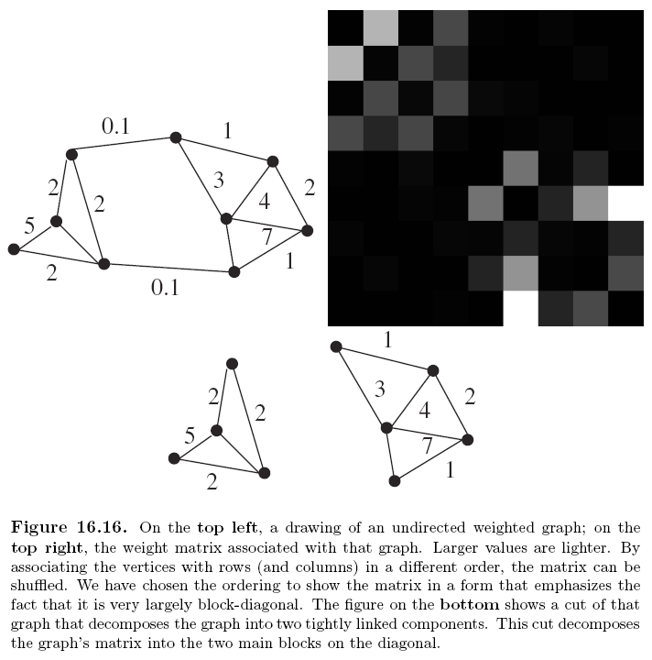

Slide 62
Graphs and Clustering
Associate each element to be clustered with a vertex on a graph
Construct an edge from every element to every other
Associate a weight with each edge based on a similarity measure
Cut the edges in the graph to form a good set of connected components

Slide 63
Weight Matrices
Typically look like block diagonal matrices
Why?
  Interclusters similarities are strong
  Intracluster similarities are weak
Split a matrix into smaller matrices, each of which is a block
Define Affinity Measures

Slide 64
More on this
Affinity measures
  Affinity by Distance
  Affinity by Intensity
  Affinity by Colour
  Affinity by Texture
Popular method: Normalized cuts
    Jianbo Shi and Jitendra Malik, “Normalized Cuts and Image Segmentation”, IEEE Transactions on Pattern Analysis And Machine Intelligence, Vol. 22, No. 8, August 2000
Want to know more?
Check out: Forsyth and Ponce, Section 14.5

Slide 65
Resources
Szeliski, “Computer Vision: Algorithms and Applications”, Springer, 2011
  Chapter 5 – “Segmentation”

