Slide 1
Computer Vision – TP14
Advanced Deep Learning Topics II
Miguel Coimbra, Hélder Oliveira

Slide 2
Outline
Generative models
Variational autoencoders (VAEs)
Generative adversarial networks (GANs)

Slide 3
Outline
Generative models
Variational autoencoders (VAEs)
Generative adversarial networks (GANs)

Slide 4
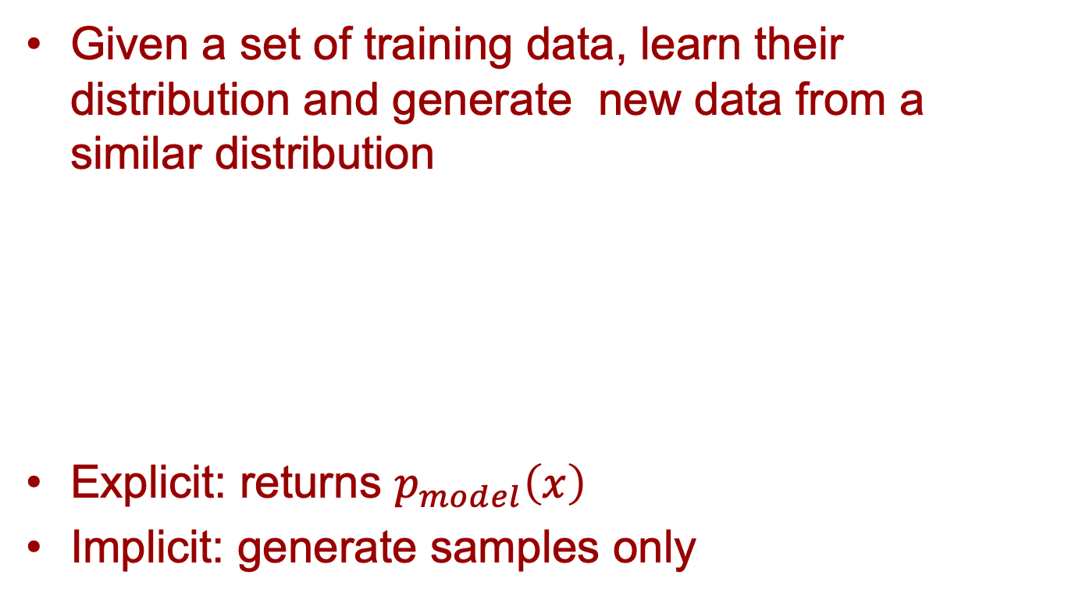
Generative models
Given a set of training data, learn their distribution and generate new data from a similar distribution
Explicit: returns $p_{model}\left(x\right)$
Implicit: generate samples only

Slide 5
Applications
Generate new data for simulations
  Reinforcement learning
Generate new data for model training
  Data augmentation
Fill in the gaps of measured data
  Super-resolution
  Colorization
Inference of latent representation

Slide 6
Outline
Generative models
Variational autoencoders (VAEs)
Generative adversarial networks (GANs)

Slide 7
Variational Autoencoders
Idea: we can use the autoencoder approach to generate data from a specific distribution
Training: data sampled from such distribution
Use autoencoder to generate the statistical description of the data

Slide 8
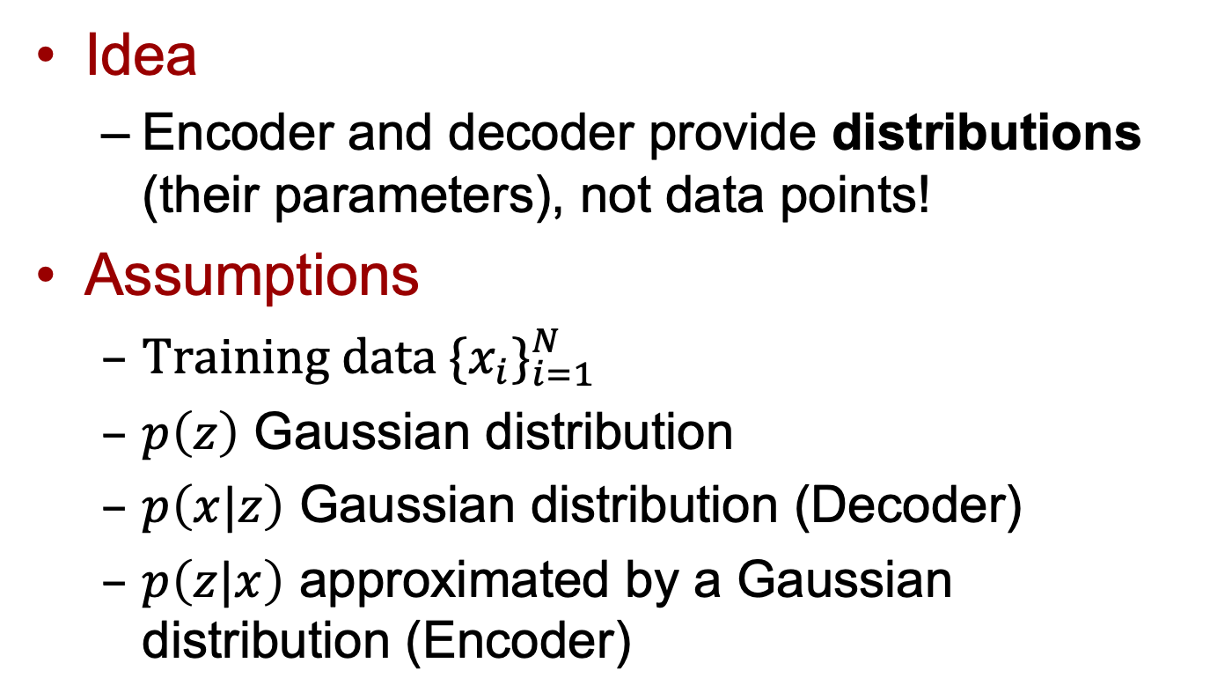
Variational Autoencoders
Idea
  Encoder and decoder provide distributions (their parameters), not data points!
Assumptions
  Training data ${\{x_{i}\}}_{i=1}^{N}$
  $p\left(z\right)$ Gaussian distribution
  $p\left(x|z\right)$ Gaussian distribution (Decoder)
  $p\left(z|x\right)$ approximated by a Gaussian distribution (Encoder)

Slide 9
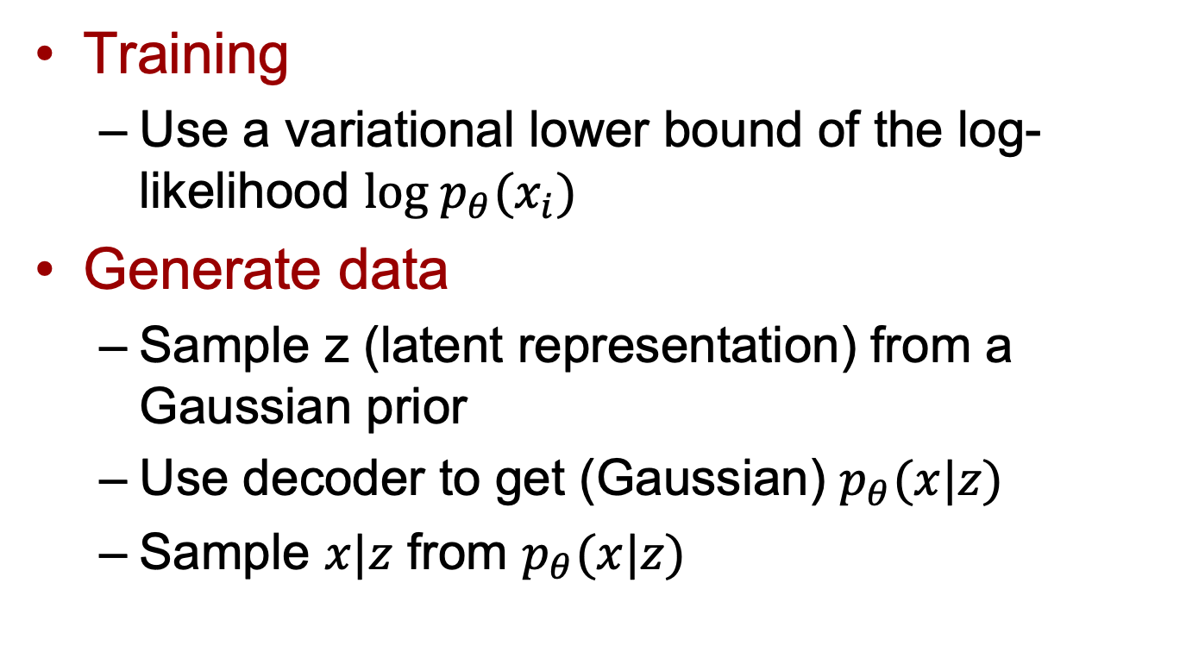
Variational Autoencoders
Training
  Use a variational lower bound of the log-likelihood $log p_{θ}(x_{i})$
Generate data
  Sample z (latent representation) from a Gaussian prior
  Use decoder to get (Gaussian) $p_{θ}(x|z)$
  Sample $x|z$ from $p_{θ}(x|z)$

Slide 10
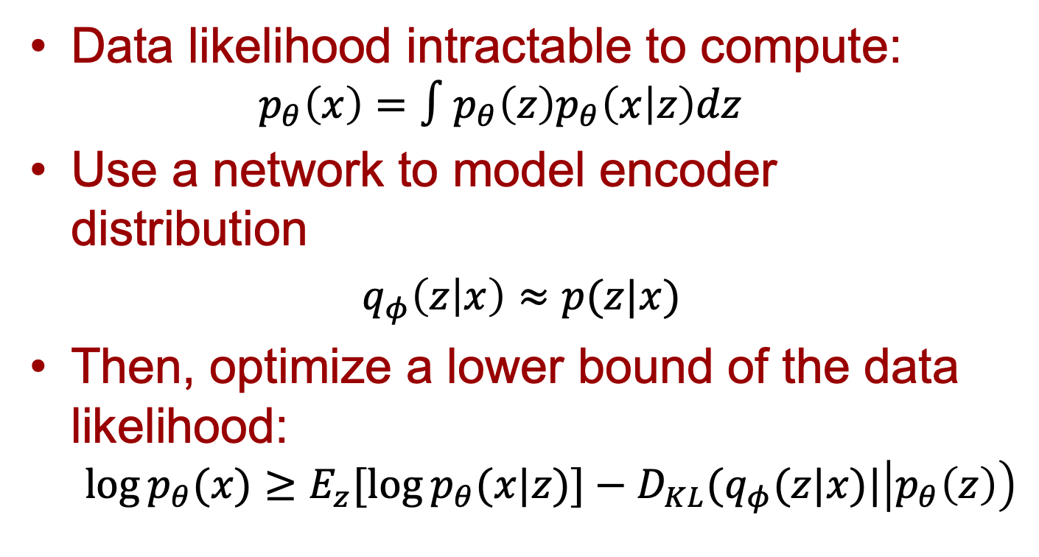
Training
Data likelihood intractable to compute:
  $$p_{θ}\left(x\right)=∫p_{θ}\left(z\right)p_{θ}\left(x | z\right)dz$$
Use a network to model encoder distribution
  $q_{φ}\left(z | x\right)≈p(z|x)$
Then, optimize a lower bound of the data likelihood:
  $$\log{p_{θ}(x)}≥E_{z}[\log{p_{θ}(x|z)]−D_{KL}(q_{φ}(z|x)|\left|p_{θ}\left(z\right)\right)}$$

Slide 11
Training
Encoder and decoder networks return distribution parameters

Slide 12
Training
Sample from these distributions to get latent z and image x

Slide 13
Training

Slide 14
Training

Slide 15
Training

Slide 16
Training

Slide 17
Training

Slide 18
Training

Slide 19
Training

Slide 20
Generating data
Sample z from prior
Use decoder network
Sample from Gaussian posterior

Slide 21
VAEs results

Slide 22
Latent representations
z contains independent factors!

Slide 23
Outline
Generative models
Variational autoencoders (VAEs)
Generative adversarial networks (GANs)

Slide 24
GANs taking over

Slide 25
Generative adversarial networks
Main idea
  In contrast with other models (e.g., VAEs), it does not provide explicit information about data distribution (i.e., density function)
  Generate samples only
How?
  Define an adversarial two-player game between a generator and a discriminator

Slide 26
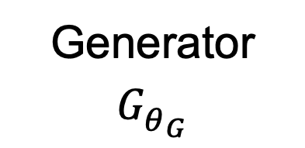
Generator
Learns a transformation from a simple noise distribution to training distribution (e.g., images)
Training samples
Generator
$$G_{θ_{G}}^{}$$
z
Input noise vector
Synthetic sample

Slide 27
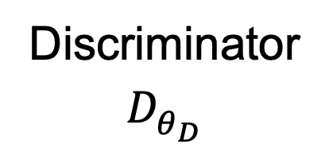
Discriminator
Distinguish between real and fake images
Real
Discriminator
$$D_{θ_{D}}^{}$$
REAL (1)
or
FAKE (0)?
Synthetic

Slide 28
Training GANs
Train jointly the generator and the discriminator in a minimax game
  Generator: try to fool the discriminator by generating real-looking images
  Discriminator: try to distinguish between real and generated images

Slide 29
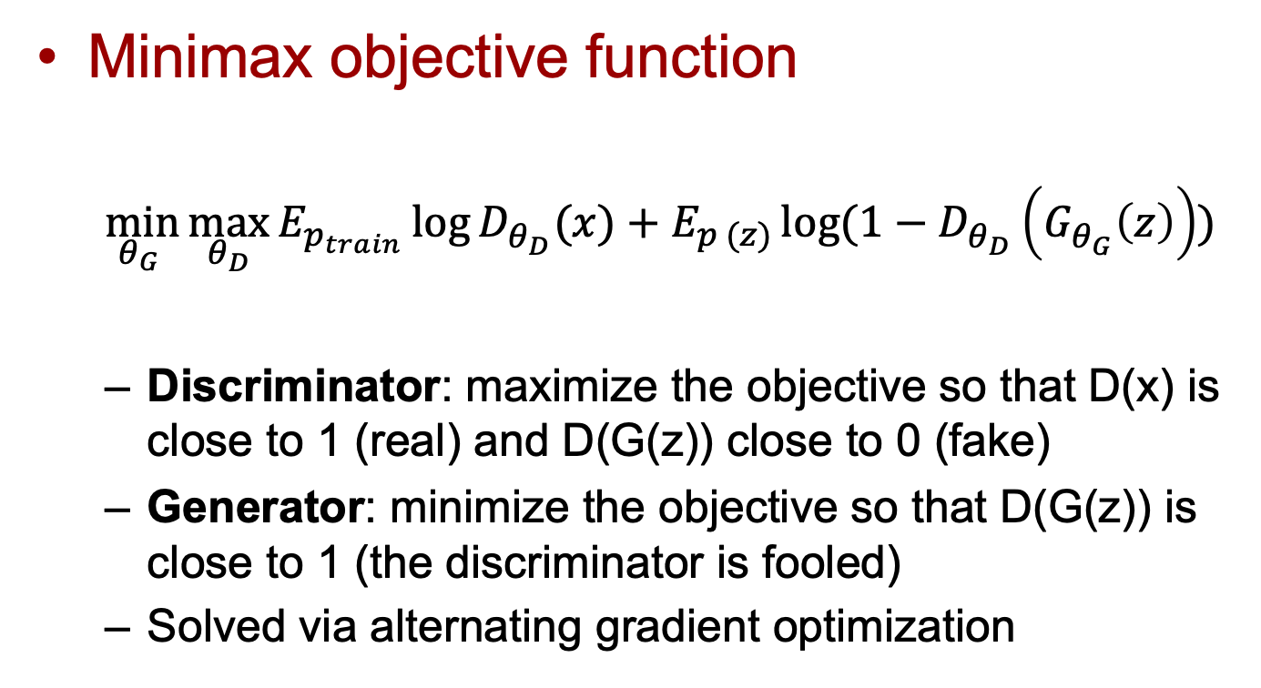
Training GANs
Minimax objective function
  $$\min_{θ_{G} }{\max_{θ_{D}}{E_{p_{train}}\log{D_{θ_{D}}^{}(x)}+E_{p (z)}\log{(1−D_{θ_{D}}^{}\left(G_{θ_{G}}^{}\left(z\right)\right))}}}$$
  Discriminator: maximize the objective so that D(x) is close to 1 (real) and D(G(z)) close to 0 (fake)
  Generator: minimize the objective so that D(G(z)) is close to 1 (the discriminator is fooled)
  Solved via alternating gradient optimization

Slide 30
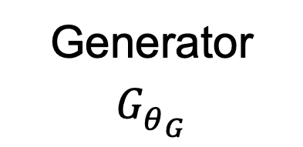
Generating data
After training, just use the generator to generate new samples
Useful side-effect:
  Discriminator can be used for transfer learning (why?)
Generator
$$G_{θ_{G}}^{}$$
z
Input noise vector
Synthetic sample

Slide 31
GANs architectures
Image GANs mainly use CNNs
Generator
  Upsampling + convolutional layers: similar to decoder in AEs
Discriminator
  Similar to classification CNN

Slide 32
GANs results
Karras T, Aila T, Laine S, Lehtinen J. Progressive growing of gans for improved quality, stability, and variation. arXiv preprint arXiv:1710.10196. 2017 Oct 27.

Slide 33
Latent representations
Interpretable vector math
Radford A, Metz L, Chintala S. Unsupervised representation learning with deep convolutional generative adversarial networks. arXiv preprint arXiv:1511.06434. 2015 Nov 19.

Slide 34
Generative models:
VAEs vs GANs
VAEs
  ☺ Principled (max likelihood) approach
  ☺ Provide explicit distributions
  ☹ Provide blurry samples
GANs
  ☺ Beautiful, state-of-the-art samples
  ☹ Trickier to train (unstable)
  ☹ Do not provide explicit distributions

Slide 35
Resources
F.F. Li, J. Johnson, S. Young. Convolutional Neural Networks for Visual Recognition, Stanford University, 2017
  Lecture 13- ”Generative models”
  http://cs231n.stanford.edu/slides/2017/cs231n_2017_lecture13.pdf
I. Goodfellow, Y. Bengio, and A. Courville. Deep learning. Cambridge: MIT press, 2016.
  Chapter 14 – “Autoencoders”
  Chapter 20 – “Deep Generative Models”

