Slide 1
Computer Vision – TP1
Image Formation
Miguel Coimbra, Hélder Oliveira

Slide 2
Outline
‘Computer Vision’?
The Human Visual System
Image Capturing Systems

Slide 3
Topic: Computer Vision?
‘Computer Vision’?
The Human Visual System
Image Capturing Systems

Slide 4
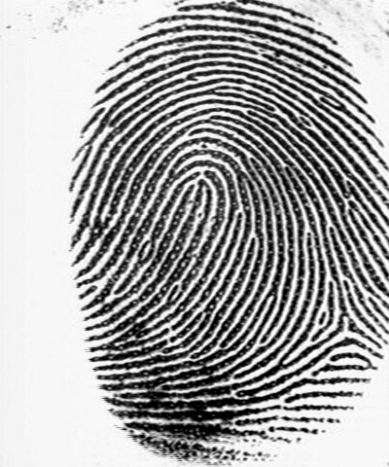
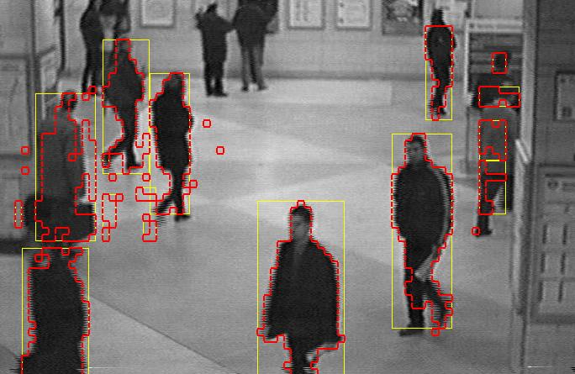
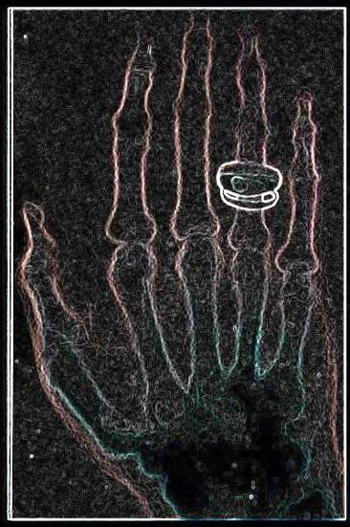
Computer Vision
“The goal of Computer Vision is to make useful decisions about real physical objects and scenes based on sensed images”,
Shapiro and Stockman, “Computer Vision”, 2001

Slide 5
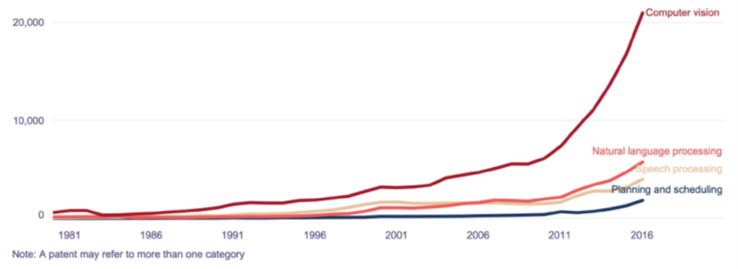
Fast Growing Field
Technological evolution
-> Deep neural networks
Growing relevance to business contexts
Consequences
  Niche area -> Area of general interest
  Change in programmatic content
  Continuous education contexts
Figure 1 - Patents per year in Artificial Intelligence (WIPO, 2019)

Slide 6
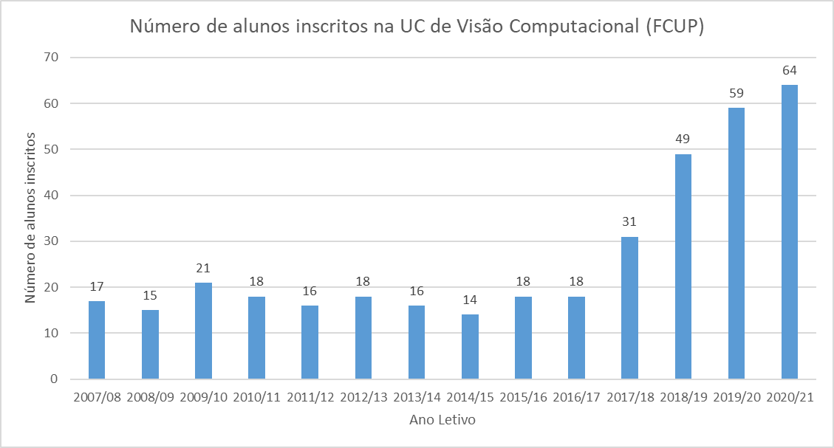
VC Students @ FCUP

Slide 7

Components of a Computer Vision System
Camera
Lighting
Computer
Scene
Scene Interpretation

Slide 8
Topic: The Human Visual System
‘Computer Vision’?
The Human Visual System
Image Capturing Systems

Slide 9
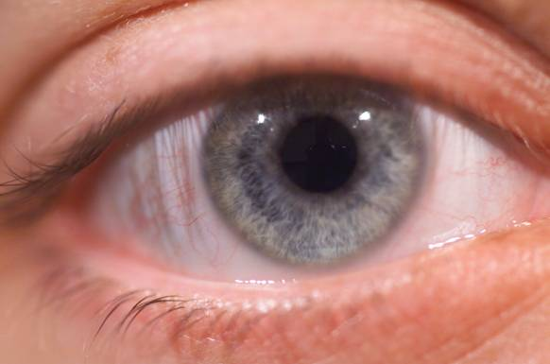
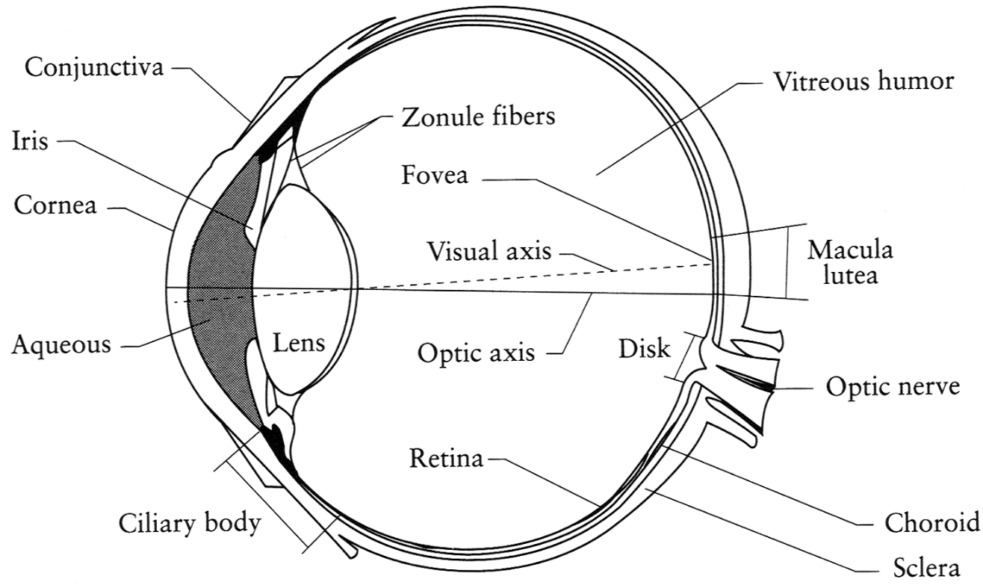
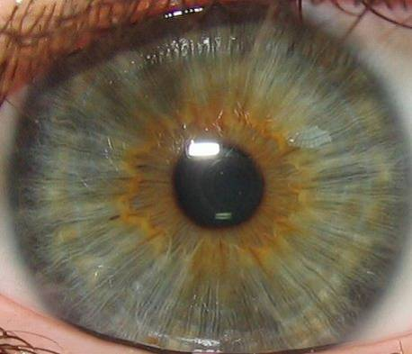
Our Eyes
Iris
Pupil
Sclera
Cornea
Iris is the diaphragm that changes the aperture (pupil)
Retina is the sensor where the fovea has the highest resolution

Slide 10
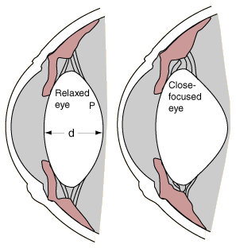
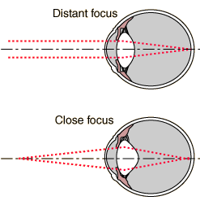
Focusing
shorter focal length
Changes the focal length of the lens

Slide 11
Myopia and Hyperopia

Slide 12
Blind Spot in the Eye
Close your right eye and look directly at the “+”

Slide 13
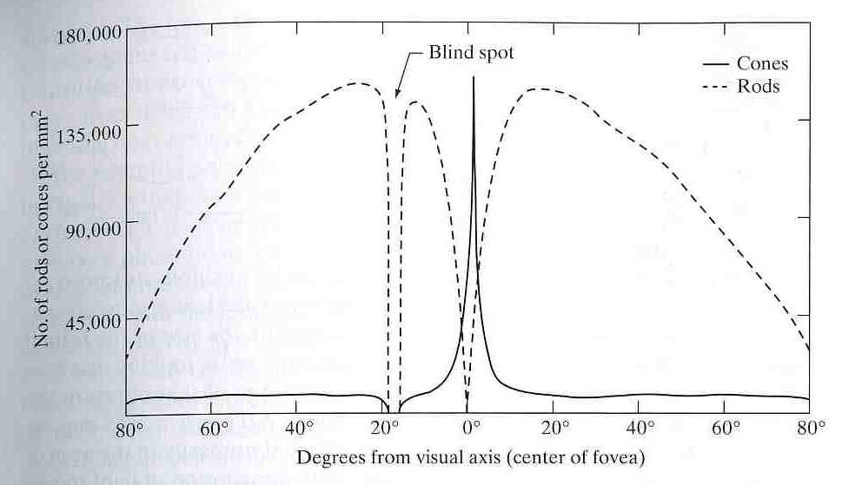
Colour
Our retina has:
  Cones – Measure the frequency of light (colour)
    6 to 7 millions
    High-definition
    Need high luminosity
  Rods – Measure the intensity of light (luminance)
    75 to 150 millions
    Low-definition
    Function with low luminosity
Gonzalez & Woods
We only see colour in the centre of our retina!

Slide 14
Topic: Image Capturing Systems
‘Computer Vision’?
The Human Visual System
Image Capturing Systems

Slide 15
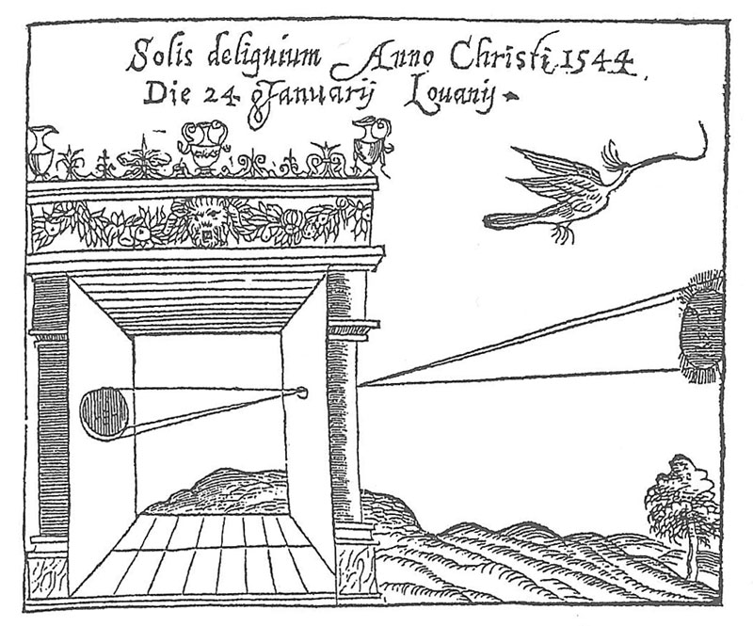
A Brief History of Images
1544
Camera Obscura, Gemma Frisius, 1544

Slide 16
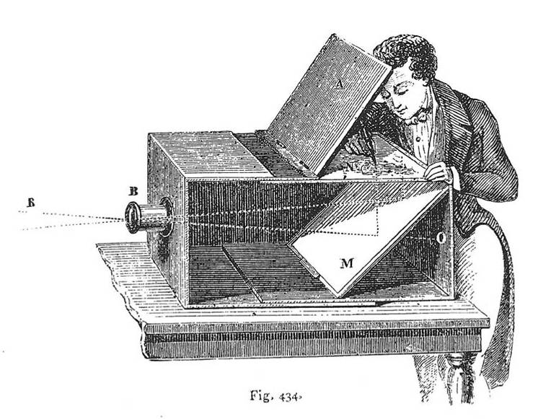
A Brief History of Images
1544
1568
Lens Based Camera Obscura, 1568

Slide 17
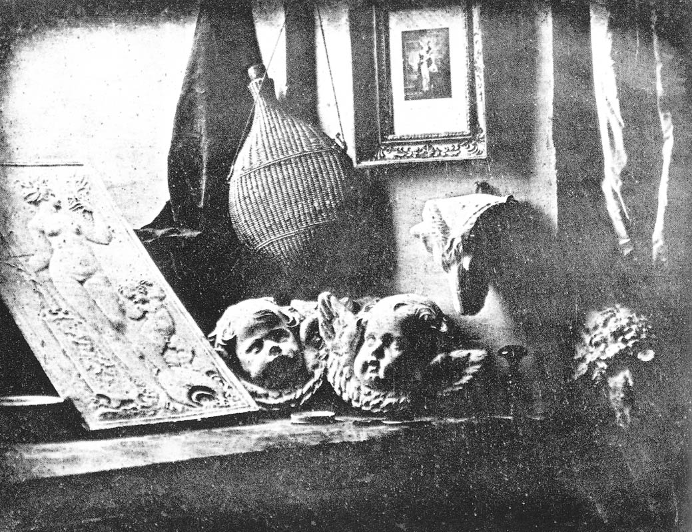
A Brief History of Images
1544
1568
1837
Still Life, Louis Jaques Mande Daguerre, 1837

Slide 18
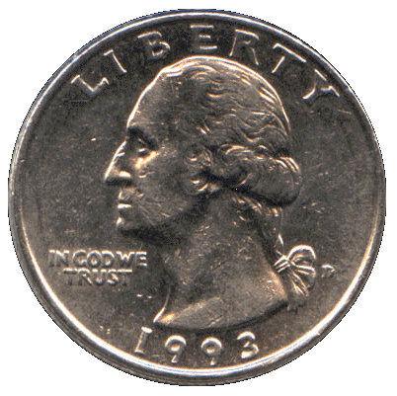
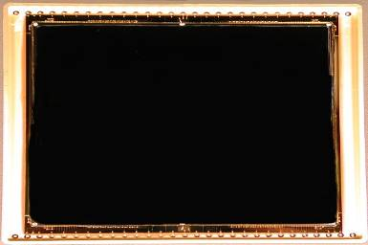
A Brief History of Images
1544
1568
1837
Silicon Image Detector, 1970
1970

Slide 19
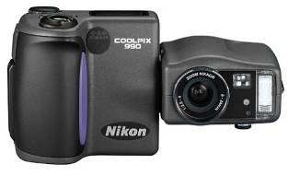
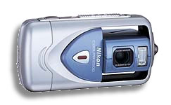
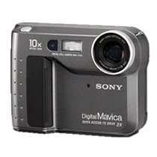
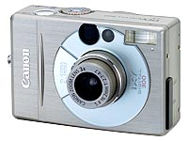
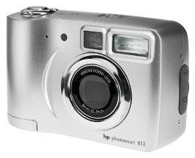
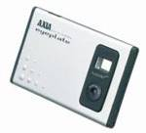
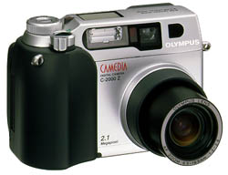
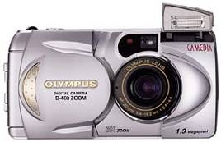
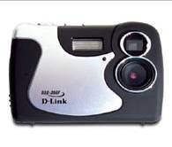
A Brief History of Images
1544
1568
1837
1970
Digital Cameras
1995

Slide 20
Components of a Computer Vision System
Camera
Lighting
Computer
Scene
Scene Interpretation

Slide 21
Pinhole and the Perspective Projection
Is an image being formed
on the screen?
YES! But, not a “clear” one.
(x,y)
screen
image plane
scene
y
optical
axis
effective focal length, f’
z
pinhole
x

Slide 22
Pinhole Camera
Basically a pinhole camera is a box,
with a tiny hole at one end and film
or photographic paper at the other.
Mathematically: out of all the light
rays in the world, choose the set of
light rays passing through a point
and projecting onto a plane.

Slide 23
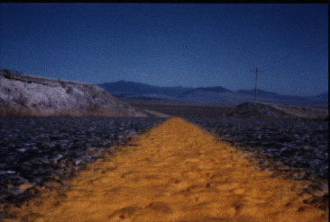
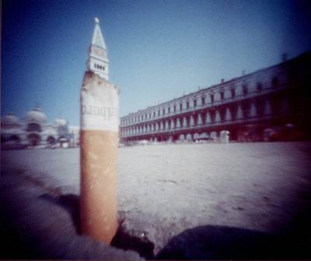
Pinhole Photography
©Charlotte Murray Untitled, 4" x 5" pinhole photograph, 1992
Image Size inversely proportional to Distance
Reading: http://www.pinholeresource.com/

Slide 24
Magnification
y
B
d
optical
axis
f’
z
A
Pinhole
d’
A’
x
planar scene
image plane
B’
From perspective projection:
Magnification:

Slide 25
Image Formation using Lenses
Lenses are used to avoid problems with pinholes.
Ideal Lens: Same projection as pinhole but gathers more light!
i
o
P
P’
f
Gaussian Thin Lens Formula:
f is the focal length of the lens – determines the lens’s ability to refract light

Slide 26
Focus and Defocus
aperture
aperture
diameter
Blur Circle, b
d
Gaussian Law:
In theory, only one scene plane is in focus

Slide 27
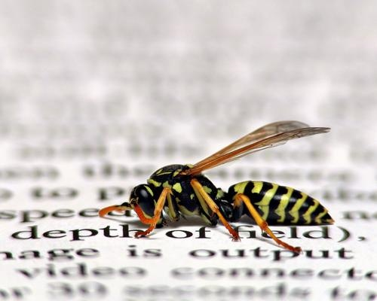
Depth of Field
Range of object distances
over which image is
sufficiently well focused
Range for which blur circle
is less than the resolution
of the sensor
http://images.dpchallenge.com/images_portfolio/27920/print_preview/116336.jpg

Slide 28
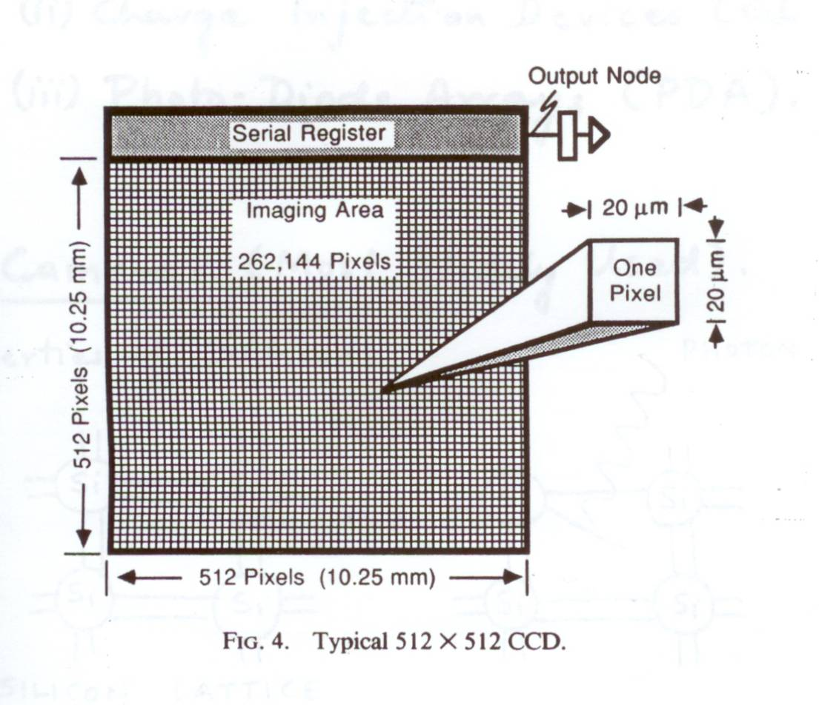
Image Sensors
Considerations
    Speed
    Resolution
    Signal / Noise Ratio
    Cost

Slide 29
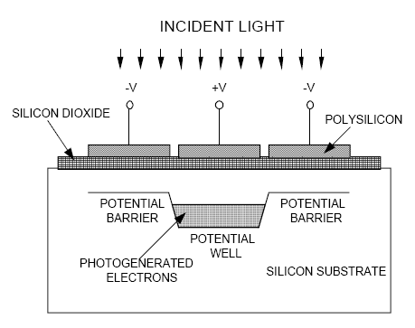
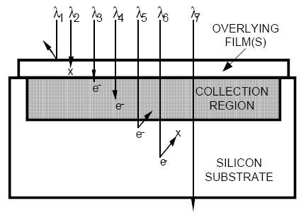
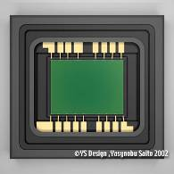
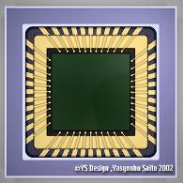
Image Sensors
Convert light into an electric charge
CCD (charge coupled device)
  Higher dynamic range
  High uniformity
  Lower noise
CMOS (complementary metal
Oxide semiconductor)
  Lower voltage
  Higher speed
  Lower system complexity

Slide 30
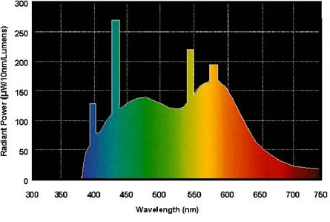
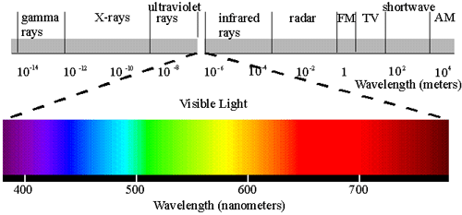
Sensing Brightness
Incoming light has a spectral distribution
So the pixel intensity becomes

Slide 31
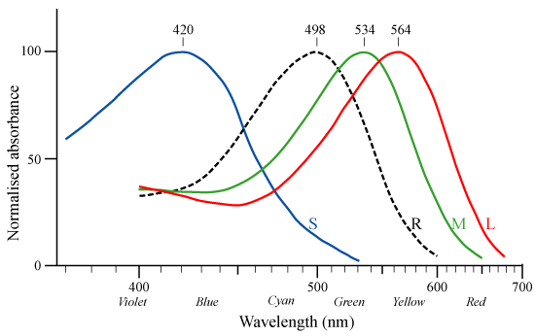
How do we sense colour?
Do we have infinite number of filters?
rod
cones
Three filters of different spectral responses

Slide 32
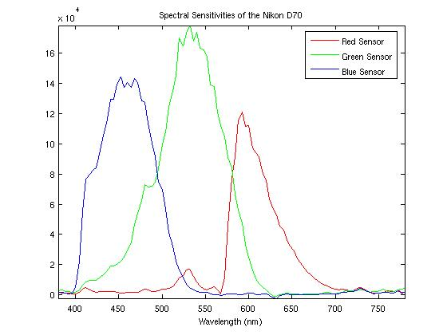
Sensing Colour
Tristimulus (trichromatic) values
Camera’s spectral response functions:

Slide 33
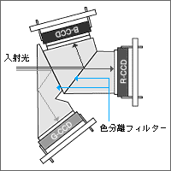
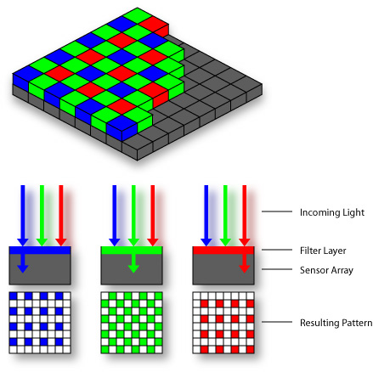

Sensing Colour
3 CCD
light
beam splitter
Bayer pattern
Foveon X3TM

Slide 34
Resources
Szeliski, “Computer Vision: Algorithms and Applications”, Springer, 2011
  Chapter 1 – “Introduction”
  Chapter 2 – “Image Formation”

