Slide 1
Computer Vision – TP4
Colour and Noise
Miguel Coimbra, Hélder Oliveira

Slide 2
Outline
Colour spaces
Colour processing
Noise

Slide 3
Topic: Colour spaces
Colour spaces
Colour processing
Noise

Slide 4
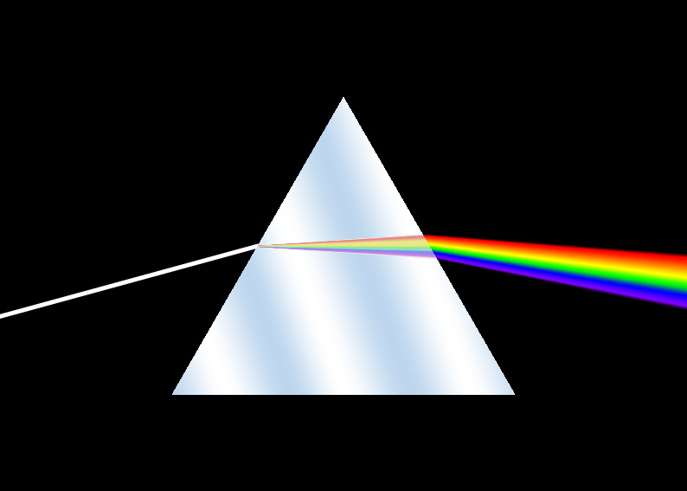

What is colour?
Optical Prism dispersing light
Visible colour spectrum

Slide 5
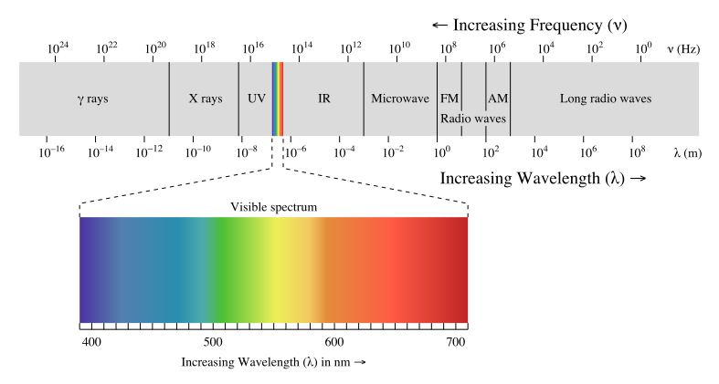
Visible Spectrum
Electromagnetic Radiation.
Same thing as FM Radiowaves!
http://science.howstuffworks.com/light.htm

Slide 6
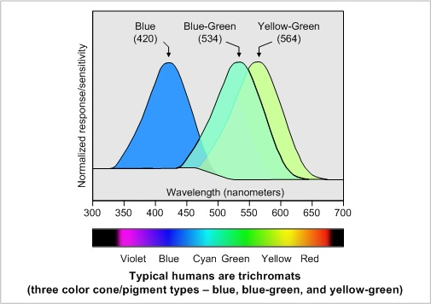
How do we see colour?
Human
Colour
Sensors:
Cones
65% ‘Red’ cones
33% ‘Green’ cones
2%’Blue’ cones

Slide 7
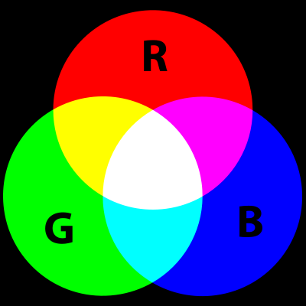
Primary Colours
Not a fundamental property of light.
Based on the physiological response of the human eye.
Form an additive colour system.

Slide 8
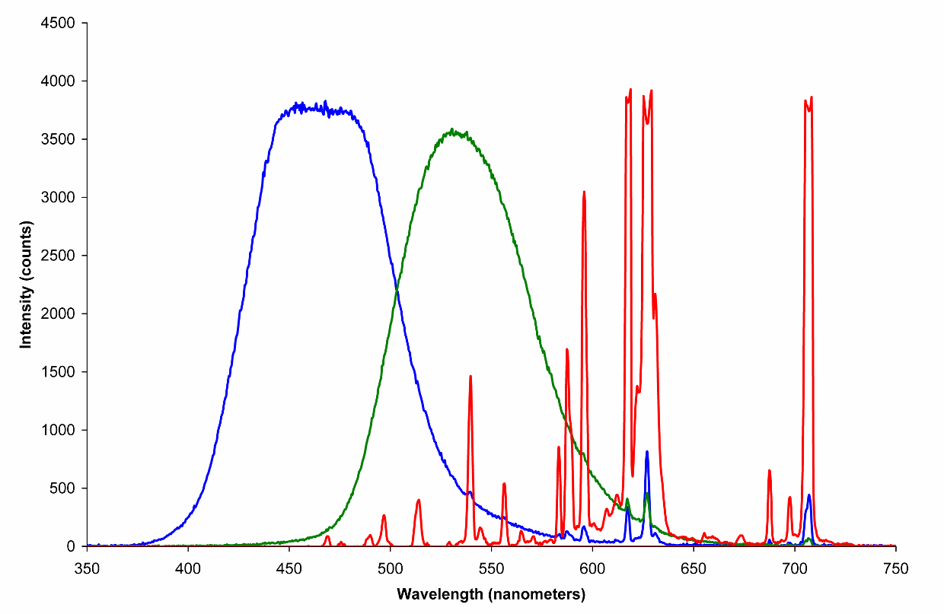
Example: Television
Three types of phosphors very close together
The components are added to create a final colour
http://www.howstuffworks.com/tv.htm

Slide 9
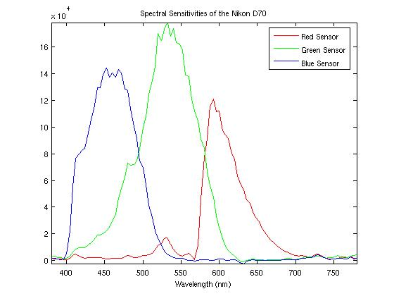
Sensing Colour
Tristimulus (trichromatic) values
Camera’s spectral response functions:

Slide 10
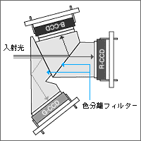
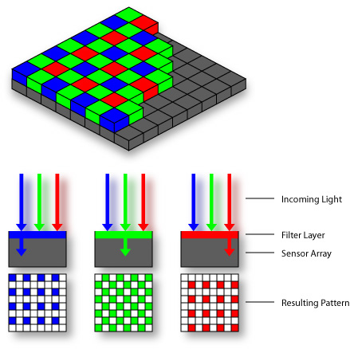

Sensing Colour
3 CCD
light
beam splitter
Bayer pattern
Foveon X3TM

Slide 11
Colour Space
“The purpose of a color model is to facilitate the specification of colours in some standard, generally accepted way”
    Gonzalez & Woods
Colour space
  Coordinate system
  Subspace: One colour -> One point

Slide 12
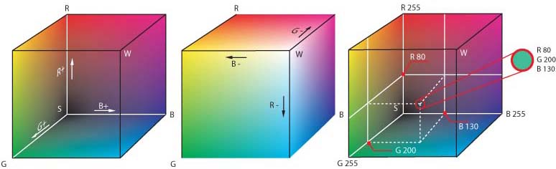
RGB
Red Green Blue
Defines a colour cube.
Additive components.
Great for image capture.
Great for image projection.
Poor colour description.

Slide 13
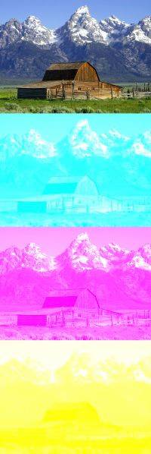
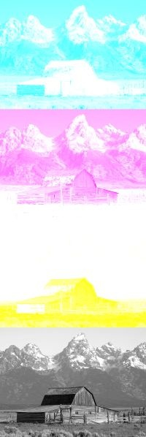
CMYK
Cyan Magenta Yellow Key.
Variation of RGB.
Technological reasons: great for printers.

Slide 14
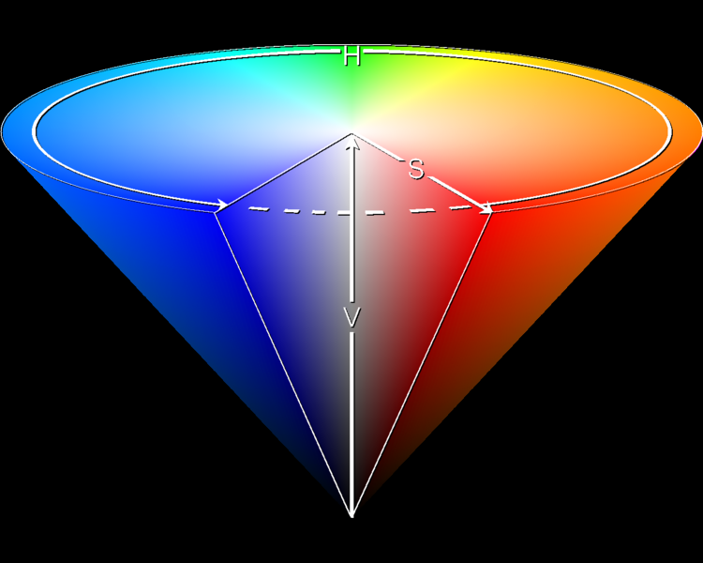
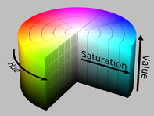
HSI
Hue Saturation Intensity
Defines a colour cone
Great for colour description.

Slide 15
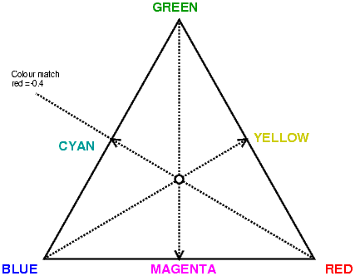
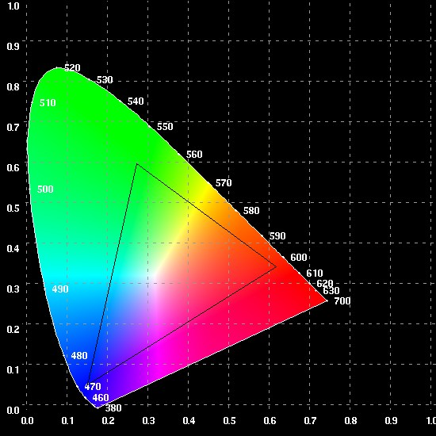
Chromaticity Diagram
Axis:
  Hue
  Saturation
Outer line represents our visible spectrum.
No three primaries can create all colours!

Slide 16
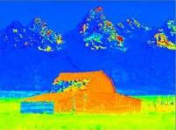
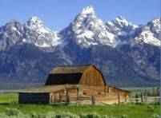
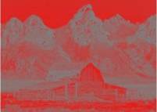
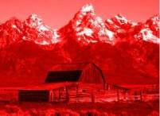
RGB to HSI
Hue:
Saturation
Intensity

Slide 17
HSI to RGB
Depends on the ‘sector’ of H
120 <= H < 240
0 <= H < 120
240 <= H < 360

Slide 18
Topic: Colour processing
Colour spaces
Colour processing
Noise

Slide 19
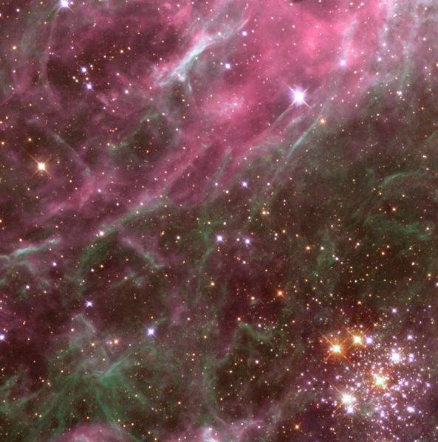
A WFPC2 image of a small region of the Tarantula Nebula in the Large Magellanic Cloud [NASA/ESA]

Slide 20
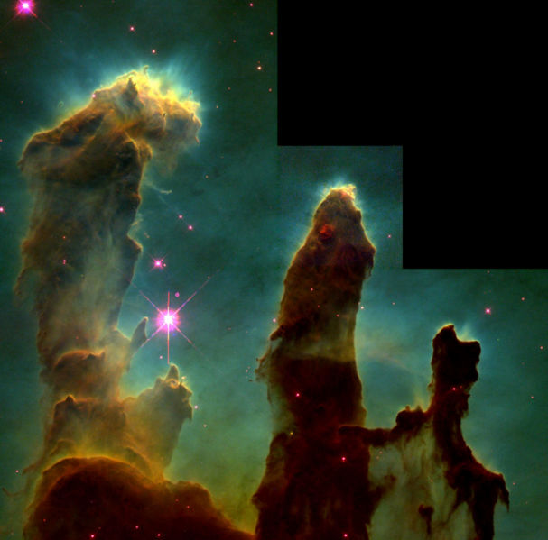
Pseudocolour
Also called False Colour.
Opposed to True Colour images.
The colours of a pseudocolour image do not attempt to approximate the real colours of the subject.
One of Hubble's most famous images: “pillars of creation” where stars are forming in the Eagle Nebula. [NASA/ESA]

Slide 21
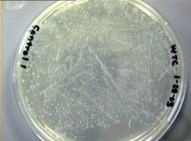
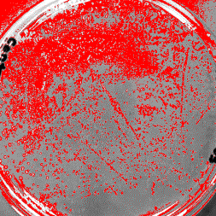
Intensity Slicing
Quantize pixel intensity to a specific number of values (slices).
Map one colour to each slice.
Loss of information.
Enhanced human visibility.

Slide 22
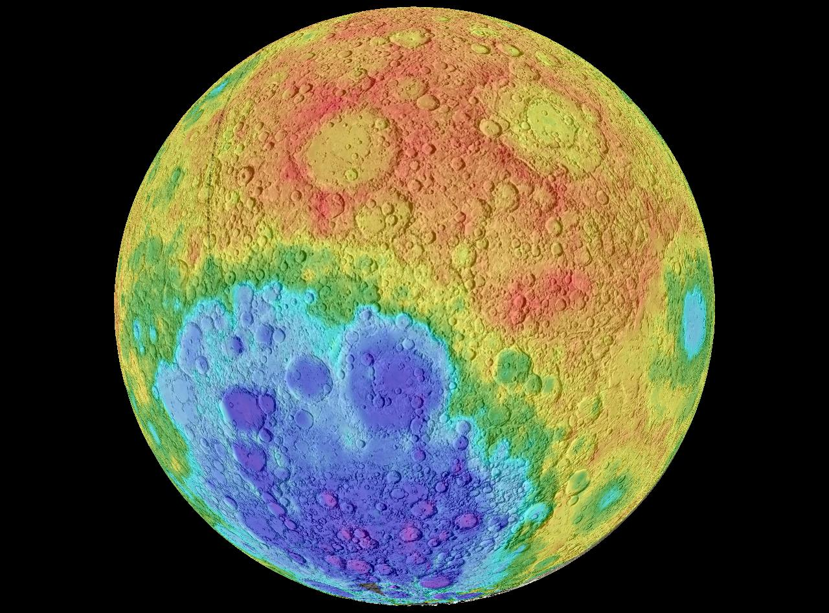
The Moon - The color of the map represents the elevation. The highest points are represented in red. The lowest points are represented in purple. In decending order the colors are red, orange, yellow, green, cyan, blue and purple.

Slide 23
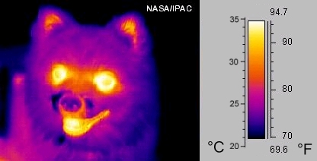
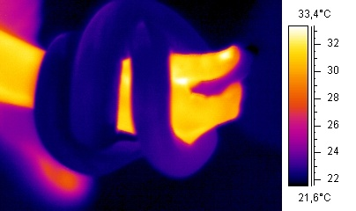
Intensity to Colour Transformation
Each colour component is calculated using a transformation function.
Viewed as an Intensity to Colour map.
Does not need to use RGB space!

Slide 24
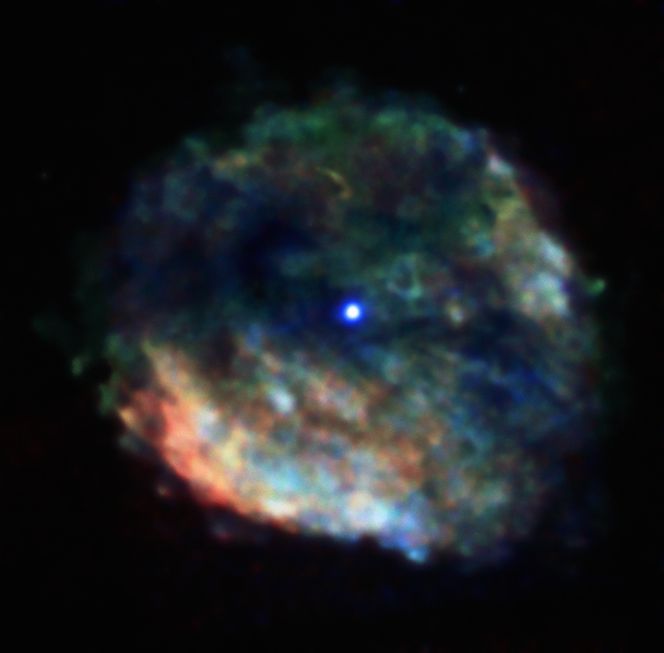
A supernova remnant created from the death of a massive star about 2,000 years ago.
http://chandra.harvard.edu/photo/false_color.html
http://landsat.gsfc.nasa.gov/education/compositor/

Slide 25
Colour Image Processing
Grey-scale image
  One value per position.
  f(x,y) = I
Colour image
  One vector per position.
  f(x,y) = [R G B]^{T}
(x,y)
Grey-scale image
(x,y)
RGB Colour image

Slide 26
Colour Transformations
Consider single-point operations:
  T_{i}: Transformation function for colour component i
  s_{i},r_{i}: Components of g and f
Simple example:
  Increase Brightness of an RGB image
What about an image negative?

Slide 27

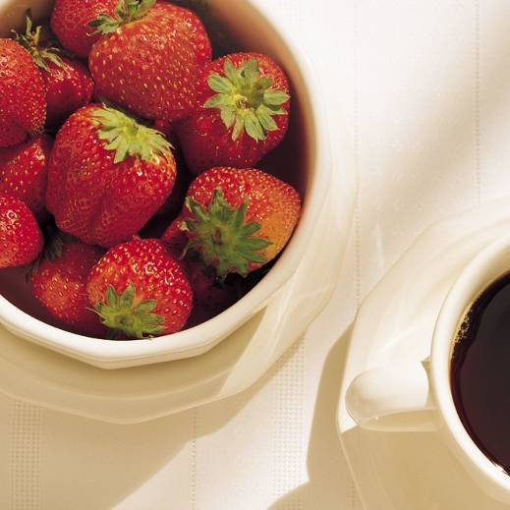
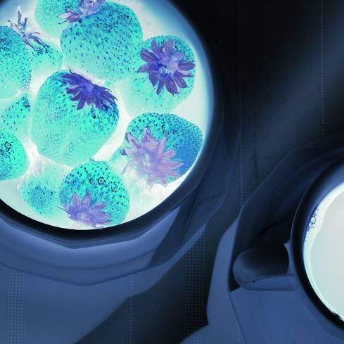
Colour Complements
Colour equivalent of an image negative.
Complementary Colours

Slide 28
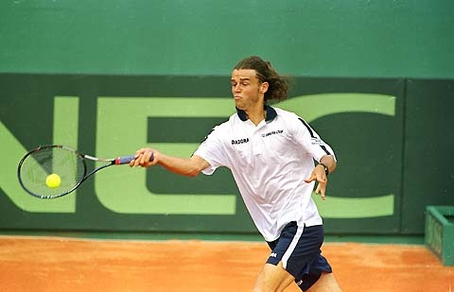

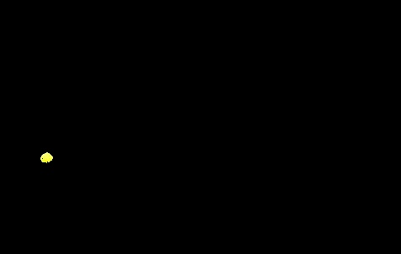
Colour Slicing
Define a hyper-volume of interest inside my colour space.
Keep colours if inside the hyper-volume.
Change the others to a neutral colour.

Slide 29
Topic: Noise
Colour spaces
Colour processing
Noise

Slide 30

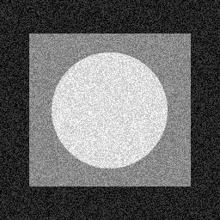
Bring the Noise
Noise is a distortion of the measured signal.
Every physical system has noise.
Images:
  The importance of noise is affected by our human visual perception
  Ex: Digital TV ‘block effect’ due to noise.

Slide 31
Where does it come from?
‘Universal’ noise sources:
  Thermal, sampling, quantization, measurement.
Specific for digital images:
  The number of photons hitting each images sensor is governed by quantum physics: Photon Noise.
  Noise generated by electronic components of image sensors:
    On-Chip Noise, KTC Noise, Amplifier Noise, etc.

Slide 32
Degradation / Restoration
Degradation
Function h
g(x,y)
Restoration
Filter(s)
f’(x,y)
f(x,y)
n(x,y)

Slide 33
Noise Models
Noise models
  We need to mathematically handle noise.
  Spatial and frequency properties.
  Probability theory helps!
Advantages:
  Easier to filter noise.
  Easier to measure its importance.
  More robust systems!

Slide 34
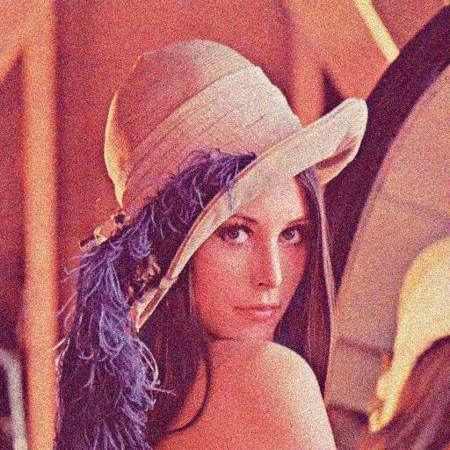
Model: Gaussian Noise
Gaussian PDF (Probability Density Function).
Great approximation of reality.
  Models noise as a sum of various small noise sources, which is indeed what happens in reality.

Slide 35
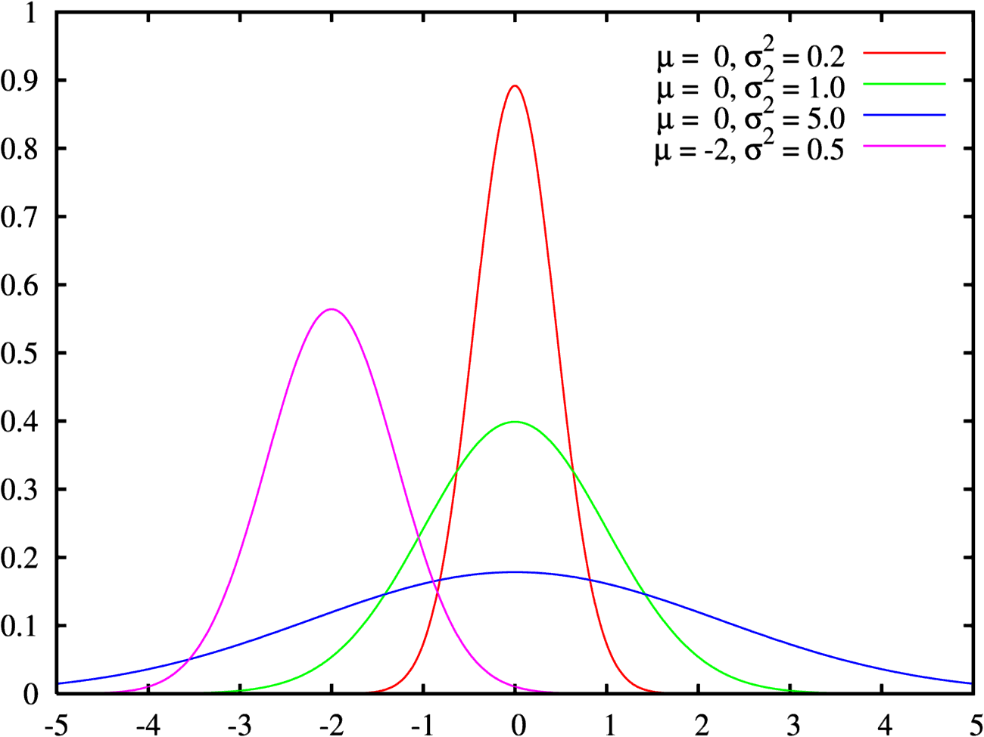
Model: Gaussian Noise

Slide 36

Model: Salt and Pepper Noise
Considers that a value can randomly assume the MAX or MIN value for that sensor.
  Happens in reality due to the malfunction of isolated image sensors.

Slide 37
How do we handle it?
Not always trivial!
  Frequency filters.
  Estimate the degradation function.
  Inverse filtering.
  ...
One of the greatest challenges of signal processing!

Slide 38
Resources
Szeliski, “Computer Vision: Algorithms and Applications”, Springer, 2011
  Chapter 2 – “Image Formation”

