Slide 1
Computer Vision – TP5
Single Pixel Manipulation
Miguel Coimbra, Hélder Oliveira

Slide 2
Outline
Dynamic Range Manipulation
Neighborhoods and Connectivity
Image Arithmetic
Example: Background Subtraction

Slide 3
Topic: Dynamic Range Manipulation
Dynamic Range Manipulation
Neighborhoods and Connectivity
Image Arithmetic
Example: Background Subtraction

Slide 4
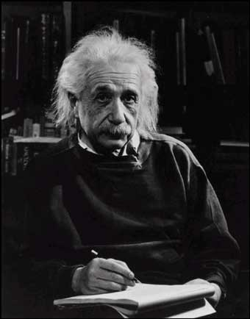
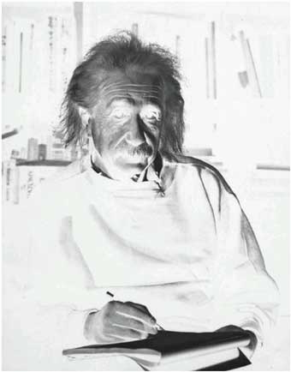
Manipulation
What I see
What I want to see

Slide 5
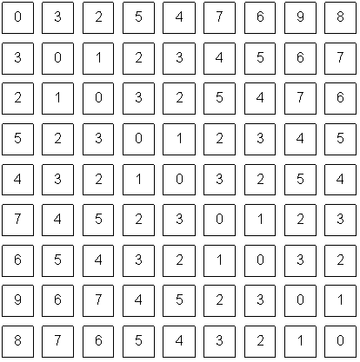
Digital Images
To change this...
I need to change this!
What we see
What a computer sees

Slide 6
Pixel Manipulation
Let’s start simple
I want to change a single Pixel.
Or, I can apply a transformation T to all pixels individually.

Slide 7
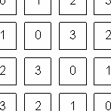
Image Domain
I am directly changing values of the image matrix.
Image Domain
So, what is the other possible ‘domain’?
3
3

Slide 8
Image Negative
What operation T allows me to obtain this result?
g=T(f)
What I see
What I want to see

Slide 9
Image Negative
Consider the maximum value allowed by quantization (max)
For 8 bits: 255
Then:
What I want to see

Slide 10
Dynamic Range Manipulation
What am I really doing?
  Changing the response of my image to the received brightness
Dynamic Range Manipulation
  Represented by a 2D Plot
g
f
Normal
Inverted

Slide 11
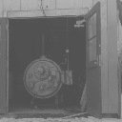
Example – Contrast Stretching

Slide 12
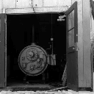
DRM Example – Contrast Stretching
Example – Contrast Stretching

Slide 13
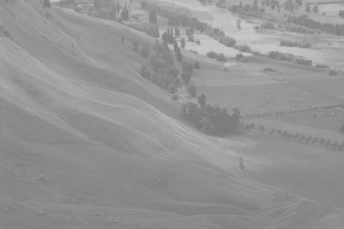
Example – Hist. Equalization

Slide 14
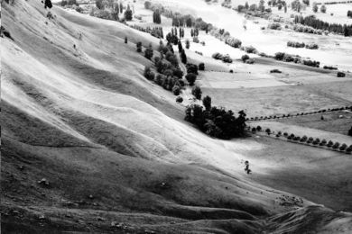
Example – Hist. Equalization

Slide 15
Other DRM functions
By manipulating our function we can:
  Enhance generic image visibility
  Enhance specific visual features
  Use quantization space a lot better

Slide 16
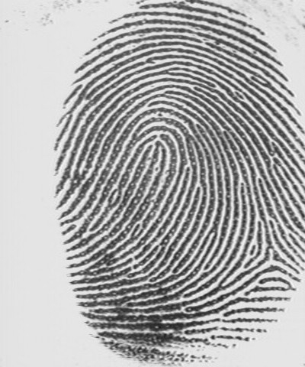
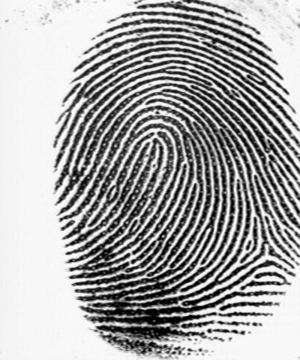
Contrast Stretching
‘Stretches’ the dynamic range of an image
Corrects some image capture problems
  Poor illumination, aperture, poor sensor performance, etc.
T(f)
g
f

Slide 17
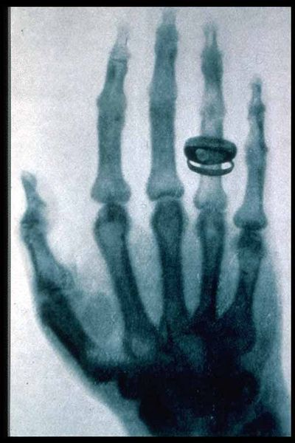
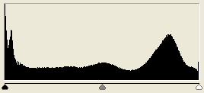
Histogram Processing
Histograms give us an idea of how we are using our dynamic range
What if I want a different histogram for my image?

Slide 18
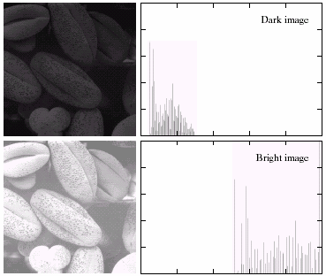
Types of Image Histograms
Images can be classified into types according to their histogram
  Dark
  Bright
  Low-contrast
  High-contrast

Slide 19
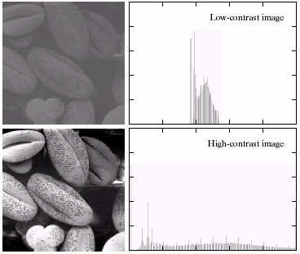
Types of Image Histograms
I can manipulate this using single Pixel operations!

Slide 20
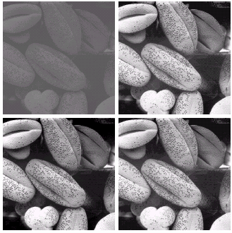
Histogram Equalization
Objective:
  Obtain a ‘flat’ histogram
  Enhance visual contrast
Digital histogram
  Result is a ‘flat-ish’ histogram
  Why?

Slide 21
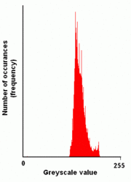
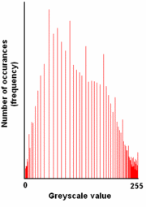
Histogram Equalization

Slide 22
Topic: Neighborhoods and Connectivity
Dynamic Range Manipulation
Neighborhoods and Connectivity
Image Arithmetic
Example: Background Subtraction

Slide 23
4-Neighbors
A pixel p at (x,y) has 2 horizontal and 2 vertical neighbors:
  (x+1,y), (x-1,y), (x,y+1), (x,y-1)
  N₄(p): Set of the 4-neighbors of p.
Limitations?
(x,y-1)
(x-1,y)
(x+1,y)
(x,y+1)

Slide 24
8-Neighbors
A pixel has 4 diagonal neighbors
  (x+1,y+1), (x+1,y-1), (x-1,y+1), (x-1,y-1)
  N_{D}(p): Diagonal set of neighbors
N₈(p) = N₄(p)+N_{D}(p)
Limitations?
(x-1,
y-1)
(x,y-1)
(x+1,
y-1)
(x-1,y)
(x+1,y)
(x-1,
y+1)
(x,y+1)
(x+1,
y+1)

Slide 25
Connectivity
Two pixels are connected if:
  They are neighbors (i.e. adjacent in some sense -- e.g. N₄(p), N₈(p), …)
  Their gray levels satisfy a specified criterion of similarity (e.g. equality, …)
(x-1,
y-1)
(x,y-1)
(x+1,
y-1)
(x-1,y)
(x,y-1)
(x+1,y)
(x-1,
y+1)
(x,y+1)
(x+1,
y+1)

Slide 26
4 and 8-Connectivity
(x-1,
y-1)
(x,y-1)
(x+1,
y-1)
(x-1,
y-1)
(x,y-1)
(x+1,
y-1)
(x-1,y)
(x,y-1)
(x+1,y)
(x-1,y)
(x,y-1)
(x+1,y)
(x-1,
y+1)
(x,y+1)
(x+1,
y+1)
(x-1,
y+1)
(x,y+1)
(x+1,
y+1)
4-Connectivity
8-Connectivity

Slide 27
Distances
How far is that point?
Distance

Slide 28
D4 Distance
D₄ distance (city-block distance):
  D₄(p,q) = |x-s| + |y-t|
  forms a diamond centered at (x,y)
  e.g. pixels with D₄≤2 from p
D₄ = 1 are the 4-neighbors of p

Slide 29
D8 Distance
D₈ distance (chessboard distance):
  D₈(p,q) = max(|x-s|,|y-t|)
  Forms a square centered at p
  e.g. pixels with D₈≤2 from p
D₈ = 1 are the 8-neighbors of p

Slide 30
Euclidean Distance
Euclidean distance:
  D_{e}(p,q) = [(x-s)² + (y-t)²]^{1/2}
  Points (pixels) having a distance less than or equal to r from (x,y) are contained in a disk of radius r centered at (x,y)

Slide 31
Topic: Image Arithmetic
Dynamic Range Manipulation
Neighborhoods and Connectivity
Image Arithmetic
Example: Background Subtraction

Slide 32
Arithmetic operations between images
Why do I want to add these images?

Slide 33
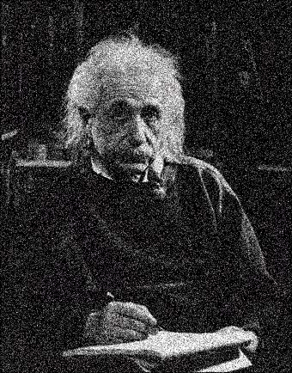
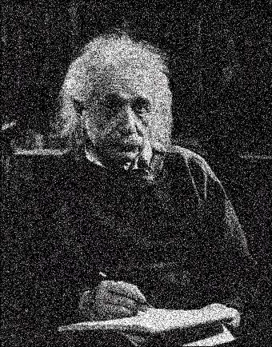
Arithmetic operations between images
Why do I want to add these images?

Slide 34
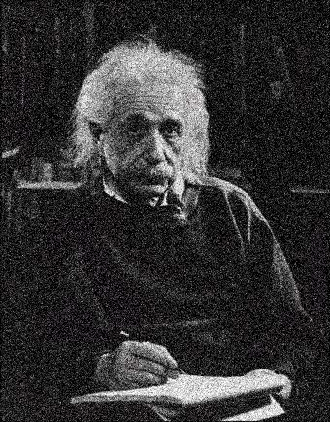
Arithmetic operations between images
Slightly better... What if I add a lot of similar noisy images together?

Slide 35
Image Arithmetic
Image 1: a(x,y)
Image 2: b(x,y)
Result: c(x,y) = a(x,y) OPERATION b(x,y)
Possibilities:
  Addition
  Subtraction
  Multiplication
  Division
  Etc..
Why is this useful?
What problems can happen?

Slide 36
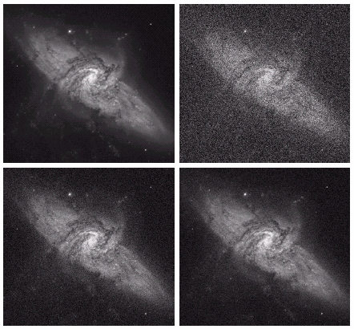
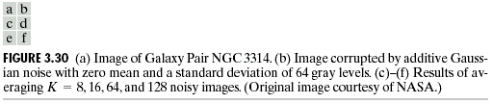

Slide 37
Logic Operations
Binary Images
We can use Boolean Logic
Operations:
  AND
  OR
  NOT
More on this when we study mathematical morphology

Slide 38
Topic: Example: Background Subtraction
Dynamic Range Manipulation
Neighborhoods and Connectivity
Image Arithmetic
Example: Background Subtraction

Slide 39
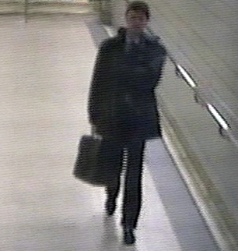
Example: Background Subtraction
Image arithmetic is simple and powerful
Is there a person here? Where?

Slide 40
Background Subtraction
Remember: We can only see numbers!
Is there a person here? Where?

Slide 41
Background Subtraction
What if I know this?

Slide 42
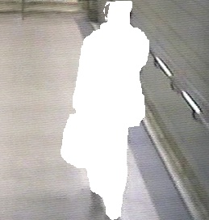

Background Subtraction
Subtract!
Limitations?

Slide 43
Background Subtraction
Objective:
  Separate the foreground objects from a static background
Large variety of methods:
  Mean & Threshold [CD04]
  Normalized Block Correlation [Mats00]
  Temporal Derivative [Hari98]
  Single Gaussian [Wren97]
  Mixture of Gaussians [Grim98]
Segmentation!!
More on this later.

Slide 44
Resources
Szeliski, “Computer Vision: Algorithms and Applications”, Springer, 2011
  Chapter 3 – “Image Processing”

