Slide 1
Computer Vision – TP7
Pattern Recognition
Miguel Coimbra, Hélder Oliveira

Slide 2
Outline
Introduction to Pattern Recognition
Statistical Pattern Recognition
Visual Features
Detection of interest points
Local invariant descriptors

Slide 3
Topic: Introduction to Pattern Recognition
Introduction to Pattern Recognition
Statistical Pattern Recognition
Visual Features
Detection of interest points
Local invariant descriptors

Slide 4
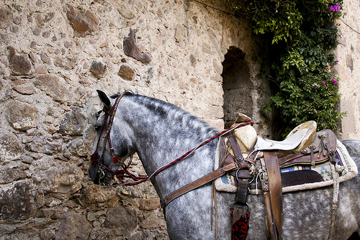
This is a horse
http://www.flickr.com/photos/kimbar/2027234083/

Slide 5
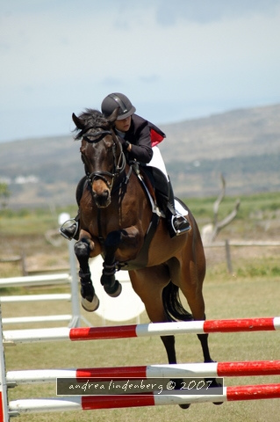
This is a horse
http://www.flickr.com/photos/genewolf/2031802050/

Slide 6
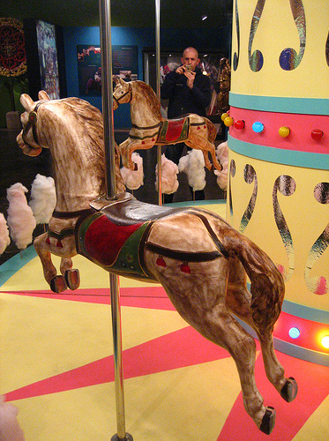
This is a... Horse?
http://www.flickr.com/photos/masheeebanshee/413465808/

Slide 7
One definition
Pattern recognition
  "the act of taking in raw data and taking an action based on the category of the data"
  Wikipedia
How do I do this so well?
How can I make machines do this?

Slide 8
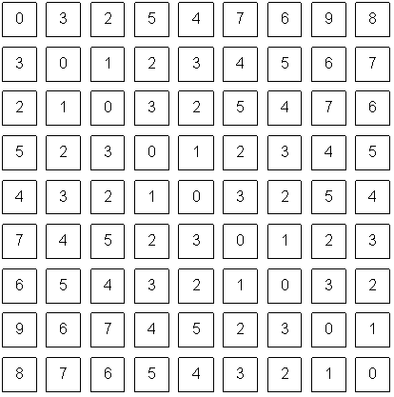
The problem
Do you ‘see’ a horse?
What a computer sees

Slide 9
Mathematics
We only deal with numbers.
  How do we represent knowledge?
  How do we represent visual features?
  How do we classify them?
Very complex problem!!
  Let’s break it into smaller ones...

Slide 10
Typical PR system
Sensor
Gathers the observations to be classified or described
Feature Extraction
Computes numeric or symbolic information from the observations;
Classifier
Does the actual job of classifying or describing observations, relying on the extracted features.

Slide 11
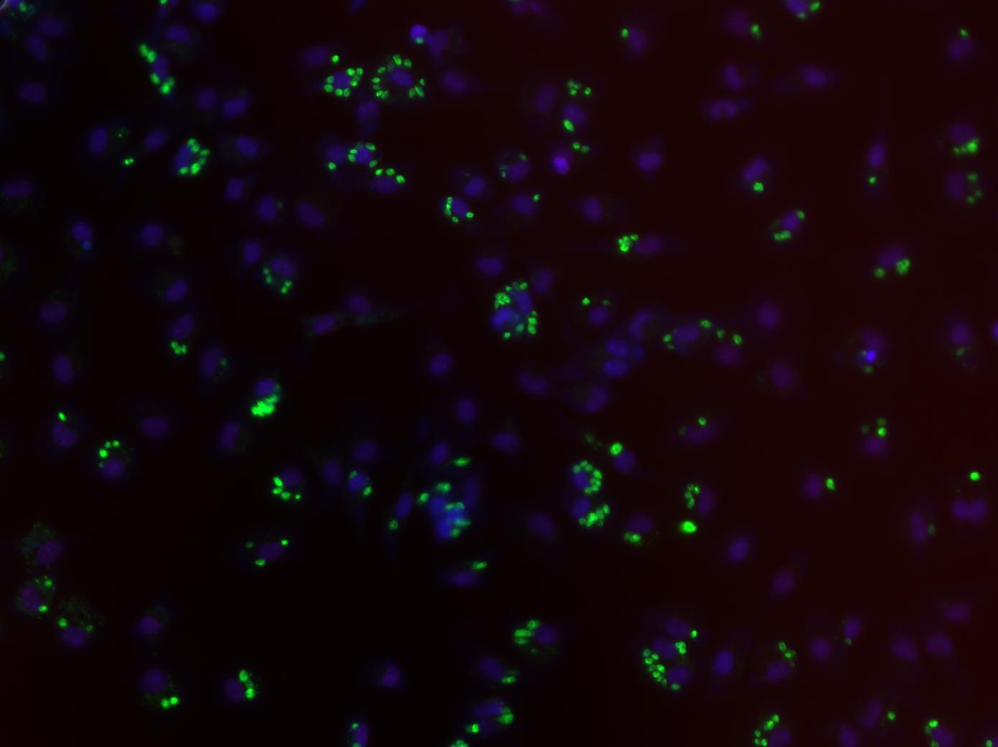
Sensor
In our specific case:
  Image acquiring mechanism
  Let’s assume we don’t control it
  One observation = One Image
  Video = Multiple Observations

Slide 12
Feature Extraction
What exactly are features?
  Colour, texture, shape, etc
  Animal with 4 legs
  Horse
  Horse jumping
These vary a lot!
Some imply some sort of ‘recognition’
    e.g. How do I know the horse is jumping?

Slide 13
Broad classification of features
Low-level
  Colour, texture
Middle-level
  Object with head and four legs
  Object moving up
  Horse
High-level
  Horse jumping
  Horse competition

Slide 14


Low-level features
Objective
Directly reflect specific image and video features
  Colour
  Texture
  Shape
  Motion
  Etc.

Slide 15
Middle-level features
Some degree of subjectivity
They are typically one solution of a problem with multiple solutions
Examples:
  Segmentation
  Optical Flow
  Identification
  Etc.

Slide 16

High-level features
Semantic Interpretation
Knowledge
Context
Examples:
  This person suffers from epilepsy
  The virus attacks the cell with some degree of intelligence
  This person is running from that one
How do humans do this so well?

Slide 17

The semantic gap
Fundamental problem of current research!
Low-level:
Colour
Texture
Shape
…
High-level:
Interpretation
Decision
-Understanding
…
Now what??
How do i cross this bridge?

Slide 18
Features & Decisions
Various
Possible
Solutions
Low-Level Features
Middle-Level Features
High-Level Features
How do I decide?
Decision
Decision
One
Solution

Slide 19
Classification
Middle-Level Features
High-Level Features
Horse
Classifier
Competition
Rider
Horse
Jumping
Upward
Motion
M inputs, N outputs

Slide 20
Layers of classification
First layer of classificaiton
Second layer of classificaiton
Brown
Horse
Competition
Head
Four legs
Rider
...
Horse
Jumping
...
Upward
Motion
...

Slide 21
Classifiers
How do I map my M inputs to my N outputs?
Mathematical tools:
  Distance-based classifiers
  Rule-based classifiers
  Support Vector Machines
  Neural Networks
  ...

Slide 22
Types of PR methods
Statistical pattern recognition
  based on statistical characterizations of patterns, assuming that the patterns are generated by a probabilistic system
Syntactical (or structural) pattern recognition
  based on the structural interrelationships of features

Slide 23
Topic: Statistical Pattern Recognition
Introduction to Pattern Recognition
Statistical Pattern Recognition
Visual Features
Detection of interest points
Local invariant descriptors

Slide 24
Is Porto in Portugal?

Slide 25
Porto is in Portugal
I want to make decisions
  Is Porto in Portugal?
I know certain things
  A world map including cities and countries
I can make this decision!
  Porto is in Portugal
I had enough a priori knowledge to make this decision

Slide 26
What if I don’t have a map?
I still want to make this decision
I observe:
  Amarante has coordinates x₁,y₁ and is in Portugal
  Viseu has coordinates x₂, y₂ and is in Portugal
  Vigo has coordinates x₃, y₃ and is in Spain
I classify:
  Porto is close to Amarante and Viseu so Porto is in Portugal
What if I try to classify Valença?

Slide 27
Statistical PR
I used statistics to make a decision
  I can make decisions even when I don’t have full a priori knowledge of the whole process
  I can make mistakes
How did I recognize this pattern?
  I learned from previous observations where I knew the classification result
  I classified a new observation
What pattern?

Slide 28
Back to the Features
Feature F_{i}
Feature F_{i} with N values.
Feature vector F with M features.
Naming conventions:
  Elements of a feature vector are called coefficients
  Features may have one or more coefficients
  Feature vectors may have one or more features

Slide 29
Back to our Porto example
I’ve classified that Porto is in Portugal
What feature did I use?
  Spatial location
Let’s get more formal
  I’ve defined a feature vector F with one feature F₁, which has two coefficients f_{1x}, f_{1y}

Slide 30
Feature Space
Feature Vector
  Two total coefficients
  Can be seen as a feature ‘space’ with two orthogonal axis
Feature Space
  Hyper-space with N dimensions where N is the total number of coefficients of my feature vector

Slide 31
A Priori Knowledge
I have a precise model of my feature space based on a priori knowledge
  City is in Spain if F_{1Y}>23
Great models = Great classifications
  F_{1Y}(London) = 100
  London is in Spain (??)
I know the border is here
Porto is in Portugal!

Slide 32
What if I don’t have a model?
I need to learn from observations.
  Derive a model
  Direct classification
Training stage
  Learn model parameters
Classification
‘Learned’
Model

Slide 33
Classes
In our example, cities can belong to:
  Portugal
  Spain
I have two classes of cities
A class represents a sub-space of my feature space
SPAIN
PORTUGAL

Slide 34
Classifiers
A Classifier C maps a class into the feature space
Various types of classifiers
  Nearest-Neighbours
  Bayesian
  Soft-computing machines
  Etc...

Slide 35
Topic: Visual Features
Introduction to Pattern Recognition
Statistical Pattern Recognition
Visual Features
Detection of interest points
Local invariant descriptors

Slide 36
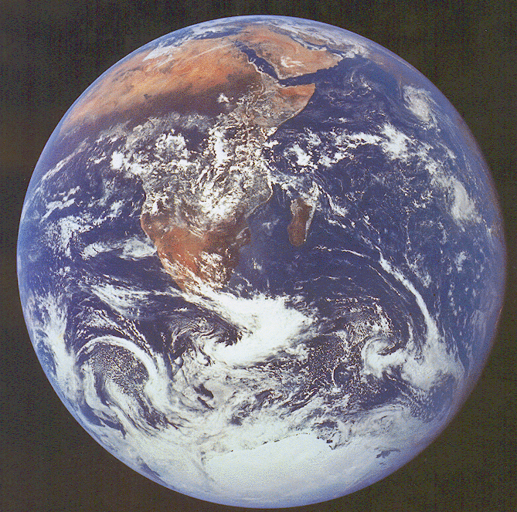
Visual Features
The earth is blue,
white and
brown
The earth is round
The south pole has
a smooth texture

Slide 37
Visual Features
Features
  Measure specific characteristics
  Numerical values
  May have multiple values
Visual Features
  Quantify visual characteristics of an image
  Popular features
    Colour, Texture, Shape

Slide 38
Feature vector
Feature F_{i}
Feature F_{i} with N values.
Feature vector F with M features.
Naming conventions for this module:
  Elements of a feature vector are called coefficients
  Features may have one or more coefficients
  Feature vectors may have one or more features

Slide 39
Features & Decisions
Various
Possible
Solutions
Low-Level Features
Starting point of most classification tasks!
Middle-Level Features
High-Level Features
How do I decide?
Decision
Decision
One
Solution

Slide 40
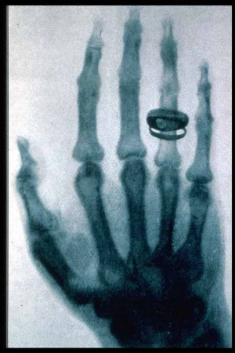
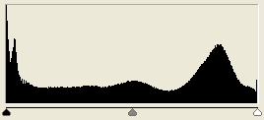
Gray-Level Histogram
Intensity distribution (HSI)
We can define the number of histogram bins
Histogram bins = Feature coefficients

Slide 41
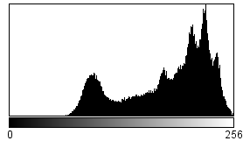
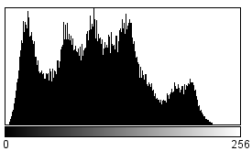
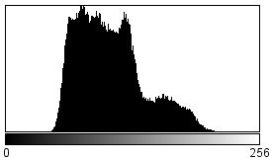
Colour Histogram
We typically have three histograms
  Ex: RGB Colour space
  - Red Histogram
  - Green Histogram
  - Blue Histogram
How do we build a feature vector?
  Concatenate vectors
  Multi-dimensional quantization of colour space
Red
Green
Blue

Slide 42
RGB Histogram
Simply concatenate vectors
Not very smart... (why?)

Slide 43
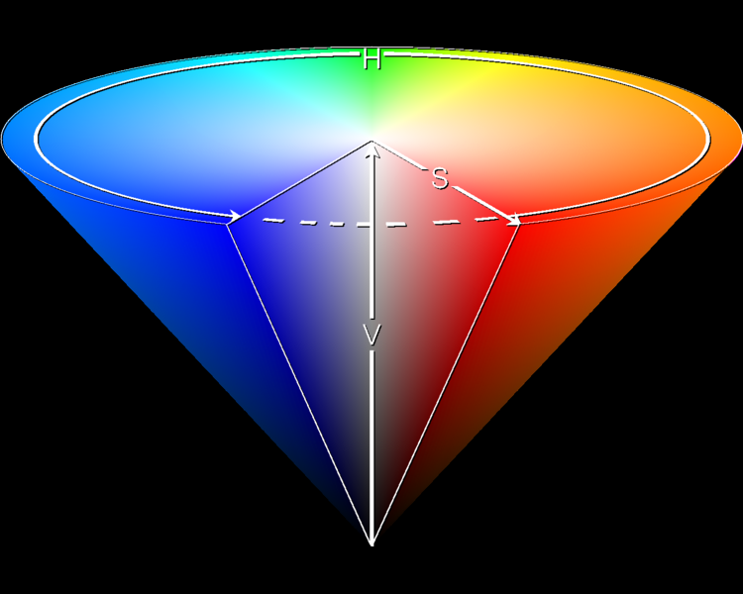
HSI Histogram
Quantize HSI space
  Define number of bins N.
  Feature vector
Typically better for object description

Slide 44
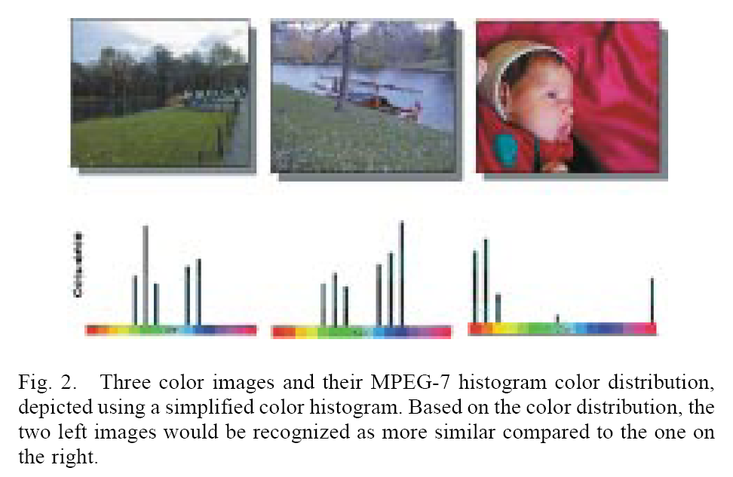
[Sikora 2001]

Slide 45
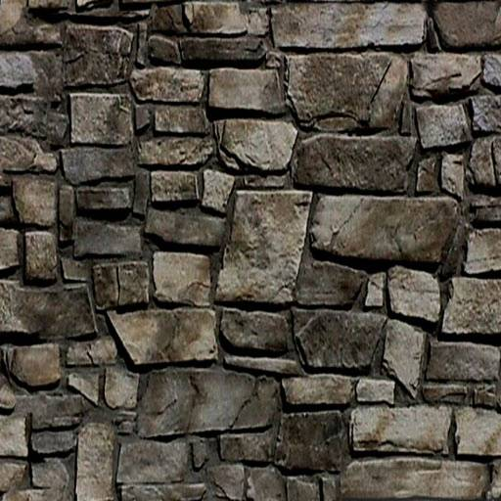
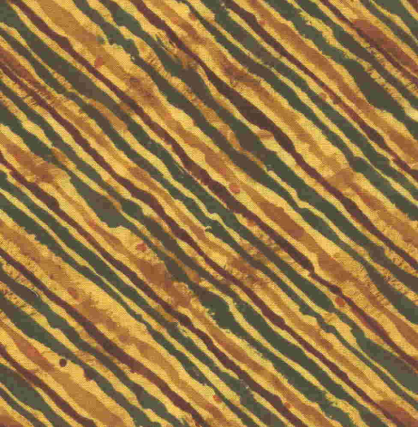
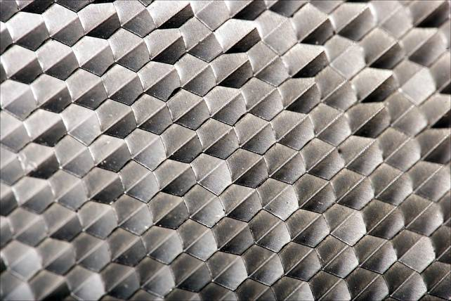
What is texture?
“Texture gives us information about the spatial arrangement of the colours or intensities in an image”
[L. Shapiro]

Slide 46
Two approaches to texture
Structural approach
  Texture is a set of primitive texels in some regular or repeated relationship
  Good for regular, ‘man-made’ textures
Statistical approach
  Texture is a quantitative measure of the arrangement of intensities in a region
  More general and easier to compute

Slide 47
Statistical approaches
Grey level of central pixels
Average of grey levels in window
Median
Standard deviation of grey levels
Difference of maximum and minimum grey levels
Difference between average grey level in small and large windows
Sobel feature
Kirsch feature
Derivative in x window
Derivative in y window
Diagonal derivatives
Combine features
How do I pick one??

Slide 48
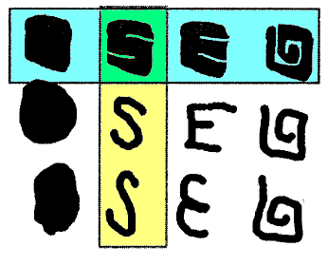
Shape Descriptors
Blue: Similar shapes by Region-Based
Yellow: Similar shapes by Contour-Based

Slide 49
Topic: Detection of interest points
Introduction to Pattern Recognition
Statistical Pattern Recognition
Visual Features
Detection of interest points
Local invariant descriptors

Slide 50
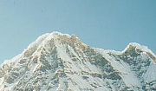

Motivation: Same interest points
We want to detect the same points in both images
No chance to find true matches!
Notes:
50

Slide 51
Motivation: ‘Unique’ descriptor per interest point
We want to match the same interest points
Need a descriptor invariant to geometric and photometric differences
?

Slide 52

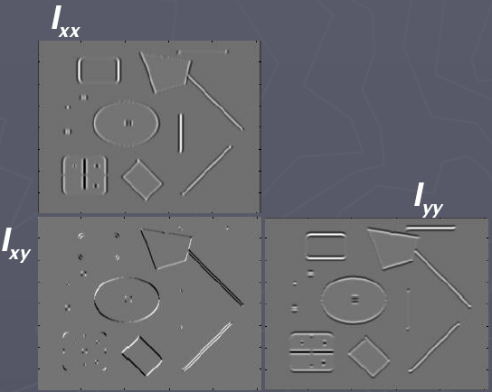
Corners are distinctive interest points
2 x 2 matrix of image derivatives (averaged in neighborhood of a point)
Notation:

Slide 53

Gradient strength
Since M is symmetric, we have
The eigenvalues of M reveal the amount of intensity change in the two principal orthogonal gradient directions in the window

Slide 54
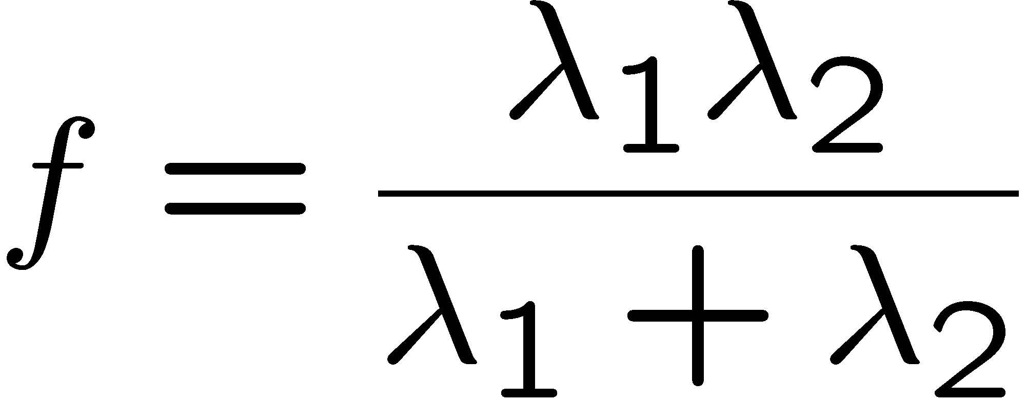
Scoring ‘cornerness’
“edge”:
“corner”:
“flat” region
λ₁ >> λ₂
λ₁ and λ₂ are large,
λ₁ ~ λ₂;
λ₁ and λ₂ are small;
λ₂ >> λ₁
One way to score the cornerness:

Slide 55
Harris corner detector
Compute M matrix for image window surrounding each pixel to get its cornerness score.
Find points with large corner response (f > threshold)
Take the points of local maxima, i.e., perform non-maximum suppression
Notes:
55

Slide 56
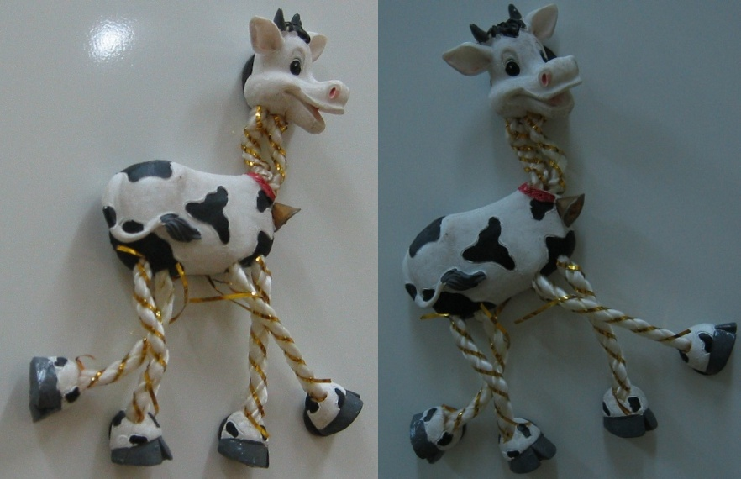

Slide 57
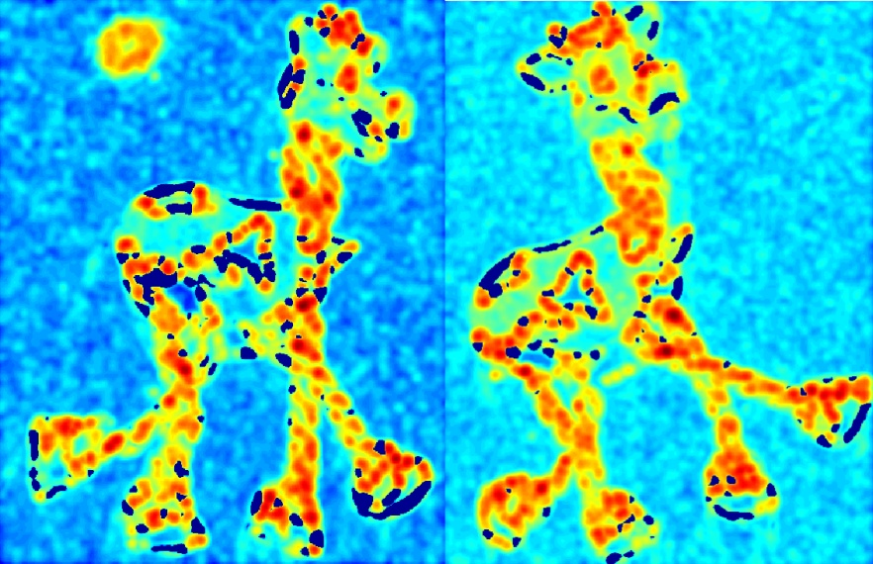

Slide 58


Slide 59


Slide 60


Slide 61
Properties of the Harris corner detector
Rotation invariant?
Scale invariant?
Yes

Slide 62
Properties of the Harris corner detector
Rotation invariant?
Scale invariant?
Yes
No
All points will be classified as edges
Corner !

Slide 63
Automatic scale selection
f
f
Image 1
Image 2
s₁
region size
s₂
region size

Slide 64
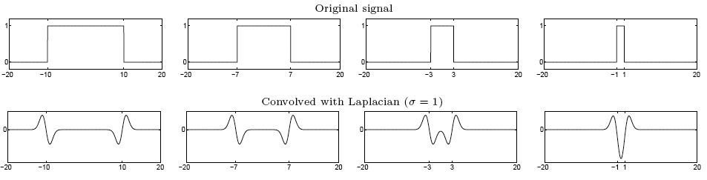
From edges to blobs
Edge = ripple
Blob = superposition of two ripples
Spatial selection: the magnitude of the Laplacian
response will achieve a maximum at the center of
the blob, provided the scale of the Laplacian is
“matched” to the scale of the blob
maximum

Slide 65
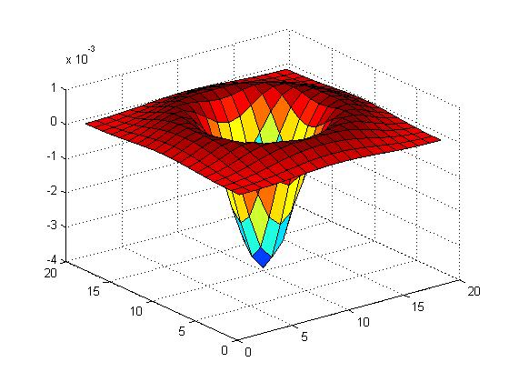

Blob detection in 2D
Laplacian of Gaussian: Circularly symmetric operator for blob detection in 2D

Slide 66
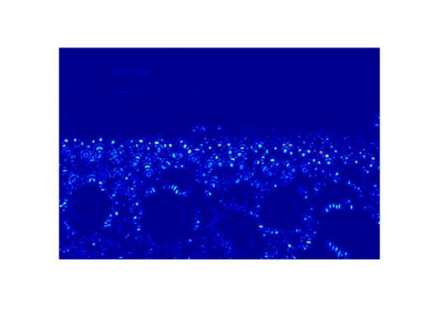
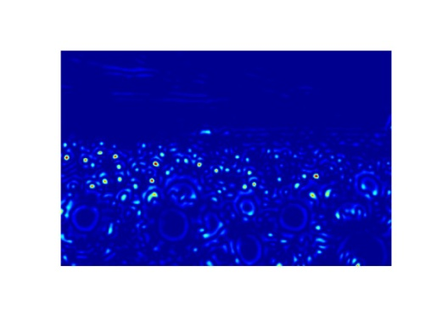
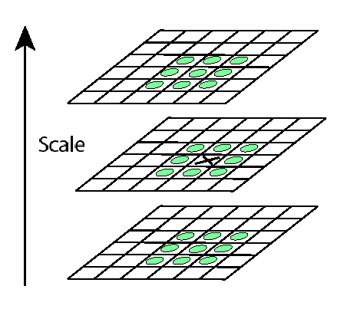
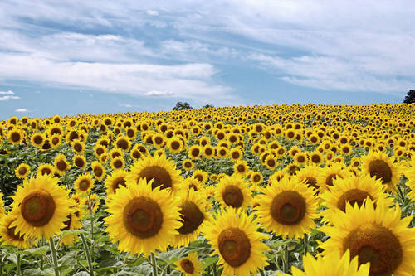
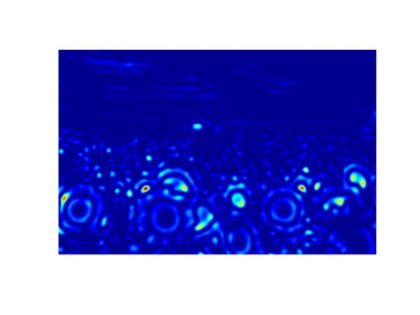
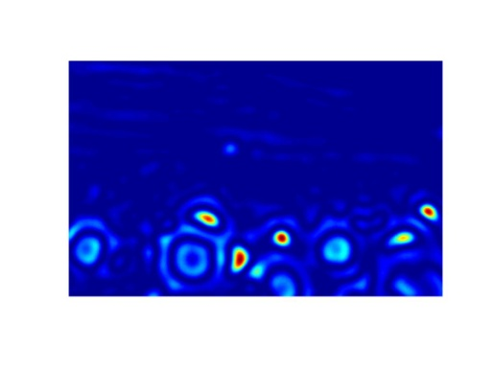
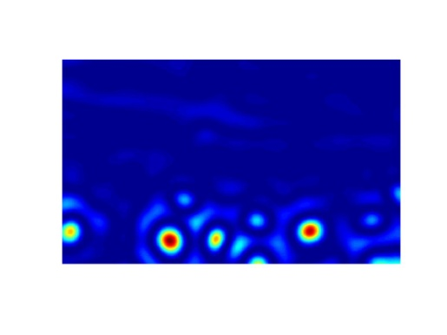
Scale invariant interest points
Interest points are local maxima in both position and scale
σ5
scale
σ4
σ3
σ2
⇒ List of
(x, y, σ)
Squared filter response maps
σ1

Slide 67
Topic: Local invariant descriptors
Introduction to Pattern Recognition
Statistical Pattern Recognition
Visual Features
Detection of interest points
Local invariant descriptors

Slide 68




Geometric transformations
e.g. scale, translation, rotation

Slide 69
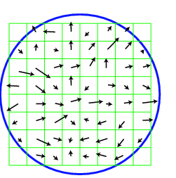
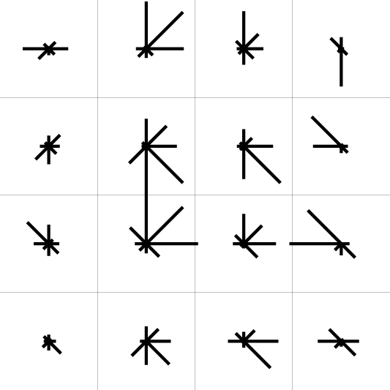
SIFT descriptor [Lowe 2004]
Use histograms to bin pixels within sub-patches according to their orientation
0
2
π
Why subpatches?
Why does SIFT have some illumination invariance?
Notes:
Scale invariant feature transform!

Slide 70
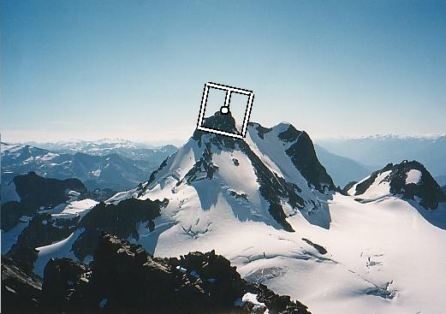
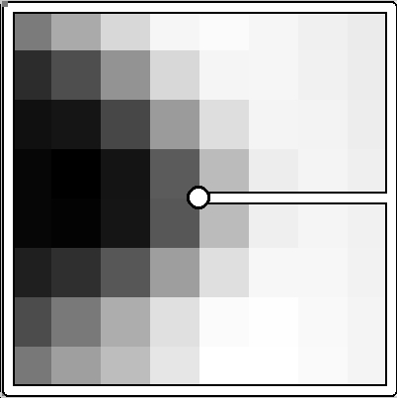
Making descriptor rotation invariant
Rotate patch according to its dominant gradient orientation
This puts the patches into a canonical orientation
CSE 576: Computer Vision

Slide 71

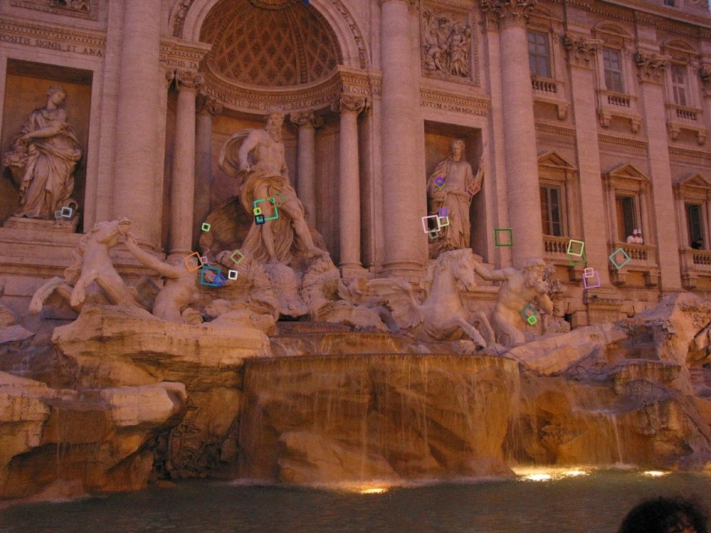
SIFT descriptor [Lowe 2004]
Extraordinarily robust matching technique
  Can handle changes in viewpoint
  Can handle significant changes in illumination
  Fast and efficient—can run in real time
  Lots of code available

Slide 72
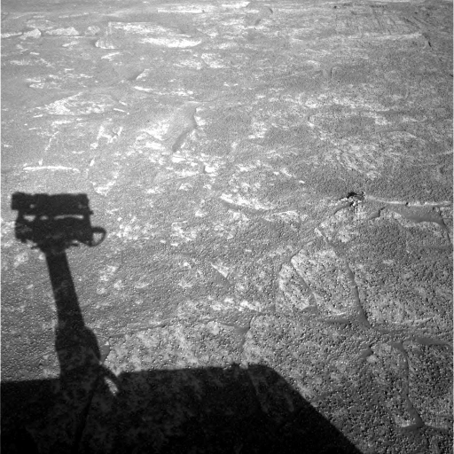
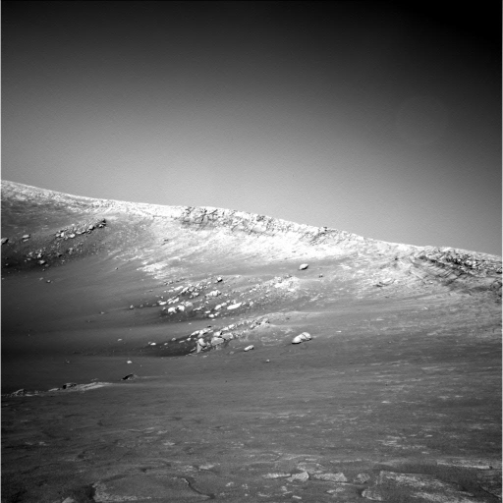
Example
NASA Mars Rover images

Slide 73
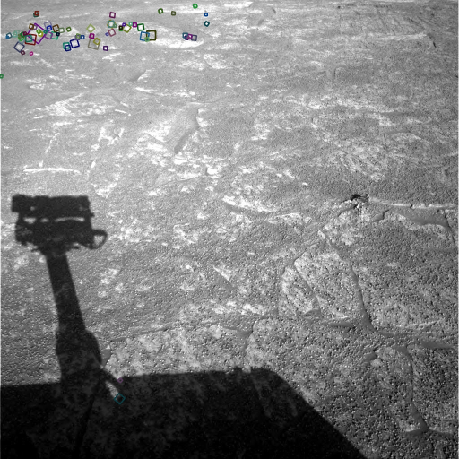
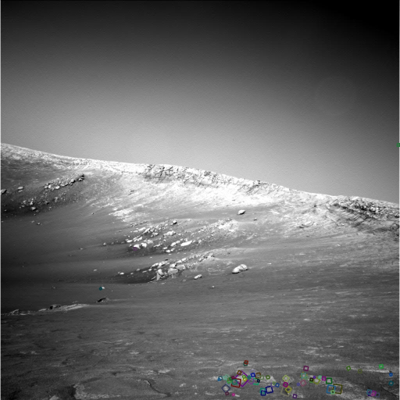
Example
NASA Mars Rover images

Slide 74
SIFT properties
Invariant to
  Scale
  Rotation
Partially invariant to
  Illumination changes
  Camera viewpoint
  Occlusion, clutter

Slide 75
Resources
Szeliski, “Computer Vision: Algorithms and Applications”, Springer, 2011
  Chapter 14 – “Recognition”
  Chapter 4 – “Feature Detection and Matching”

